Slide 1
A YANG Data Model for NTP
draft-ietf-ntp-yang-data-model-01
Wu Nan, Huawei
Anil Kumar S N, RTBrick
Yi Zhao, Ericsson
Dhruv Dhody, Huawei
Ankit Kumar Sinha, Huawei

Slide 2
Introduction
Yang Data Model
Configurations
NTP as per RFC 5905
Management of NTP demon – client and server
State
Most features of NTPv4 are covered
NTP WG, IETF 100 @ Singapore
2

Slide 3
Recent Changes
Modification in clock-state container
Separate Yang container is added
Container for configuring NTP unicast is separated from association node
Interface container name is updated
Yang example
Examples on Yang configuration and displays are added
A reference to association is added
NTP WG, IETF 100 @ Singapore
3

Slide 4
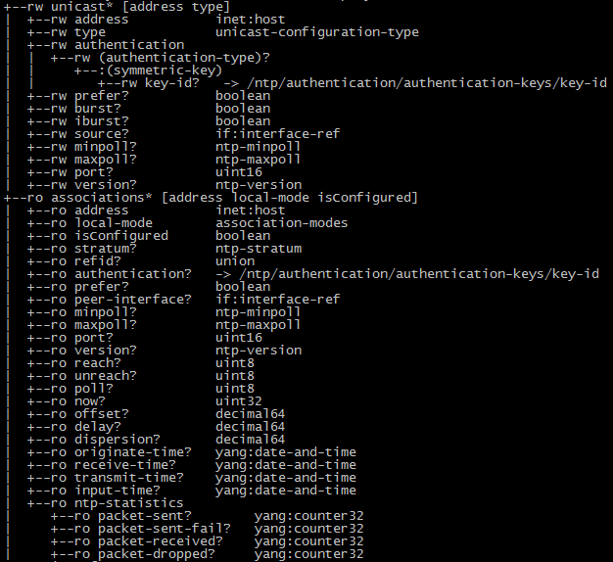
Separate Yang container is added
Earlier Unicast configuration was part of Associations container, now it’s a separate container.
Changes
New container is added
New leaf local-mode and isConfigured is added
NTP WG, IETF 100 @ Singapore
4

Slide 5
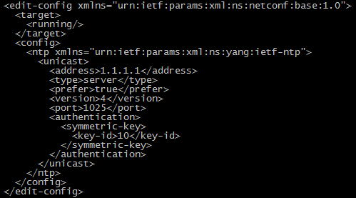
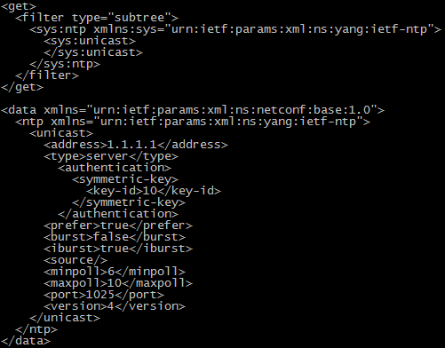
Yang Example
Unicast configuration example.
Unicast display example.
NTP WG, IETF 100 @ Singapore
5

Slide 6
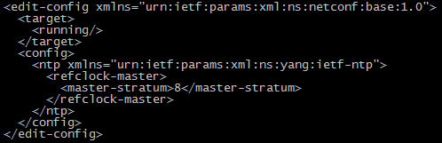
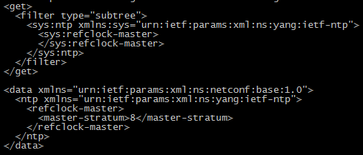
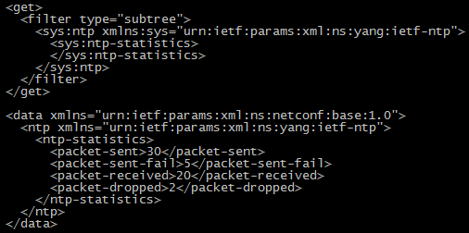
Yang Example
Reference clock configuration example.
Reference clock display example.
Global packet statistics display example.
NTP WG, IETF 100 @ Singapore
6

Slide 7
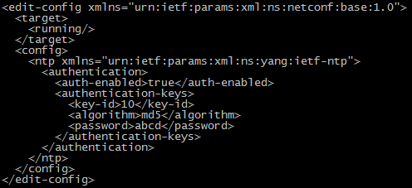
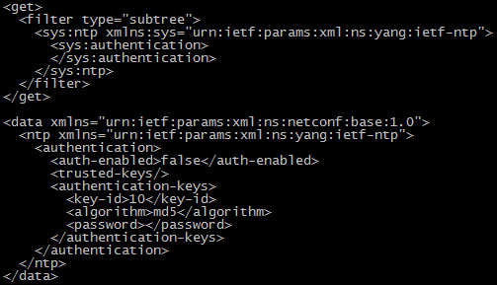
Yang Example
Authentication configuration example.
Authentication display example.
NTP WG, IETF 100 @ Singapore
7

Slide 8
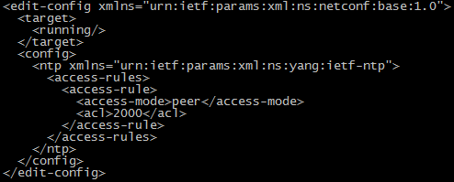
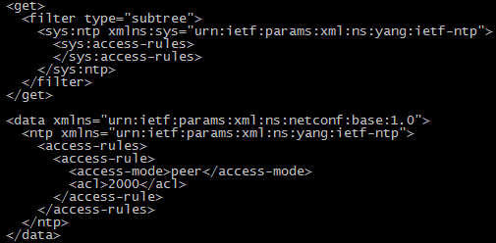
Yang Example
Access configuration example.
Access display example.
NTP WG, IETF 100 @ Singapore
8

Slide 9
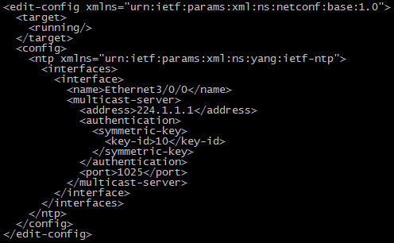
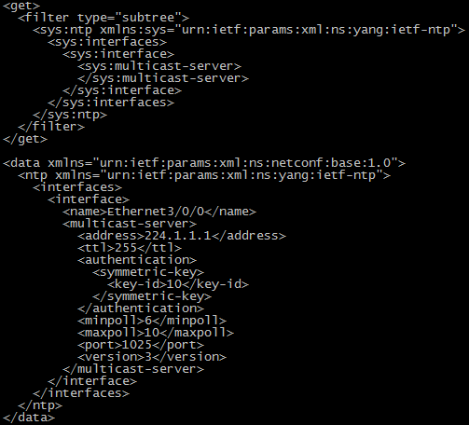
Yang Example
Multicast Server configuration example.
Multicast Server display example.
NTP WG, IETF 100 @ Singapore
9

Slide 10
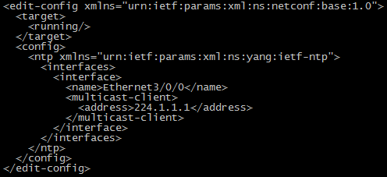
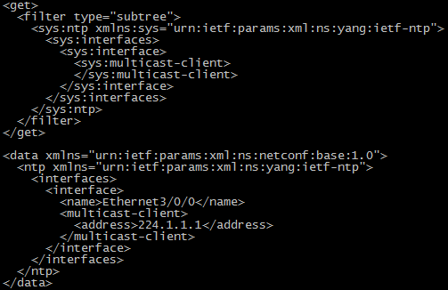
Yang Example
Multicast Client configuration example.
Multicast Client display example.
NTP WG, IETF 100 @ Singapore
10

Slide 11
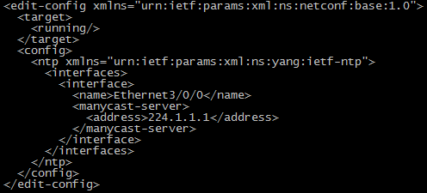
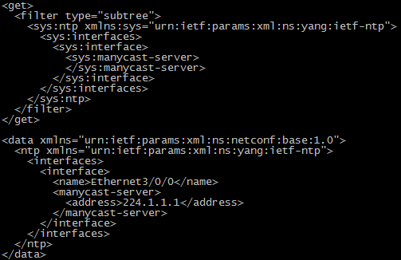
Yang Example
Manycast Server configuration example.
Manycast Server display example.
NTP WG, IETF 100 @ Singapore
11

Slide 12

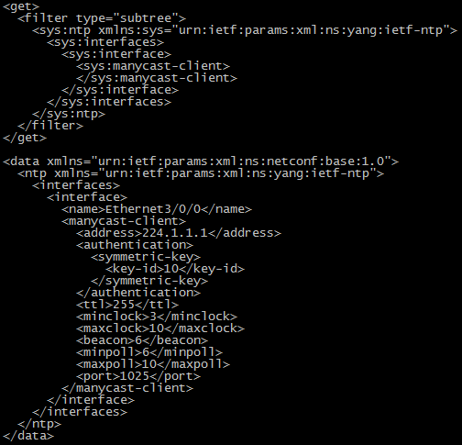
Yang Example
Manycast Client configuration example.
Manycast Client display example.
NTP WG, IETF 100 @ Singapore
12

Slide 13
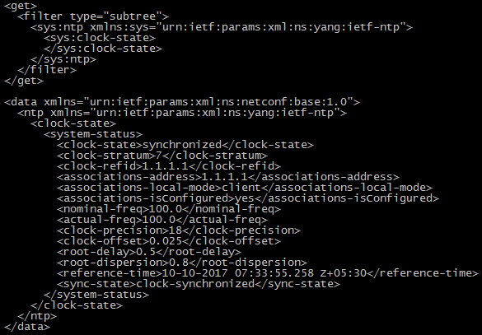
Yang Example
Display clock state example.
NTP WG, IETF 100 @ Singapore
13

Slide 14
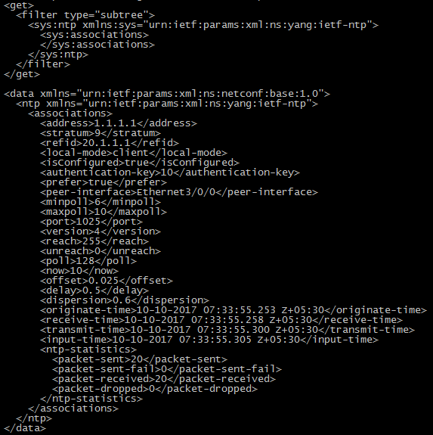
Yang Example
Display association example.
NTP WG, IETF 100 @ Singapore
14

Slide 15
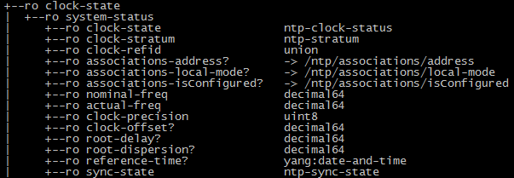
Modification in clock-state container
Leaf reference is added to store keys of ntp association.
NTP WG, IETF 100 @ Singapore
15

Slide 16
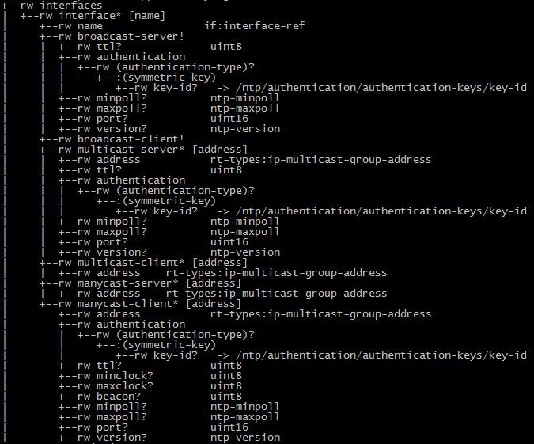
Interface container name is updated
Name used for Interface container was creating confusion, so we have updated and made same mentioned in ietf-interfaces.
NTP WG, IETF 100 @ Singapore
16

Slide 17
Next Step
More reviews
Review comments are always welcome!
NTP WG, IETF 100 @ Singapore
17

Slide 18
Thank You!
NTP WG, IETF 100 @ Singapore
18

Slide 19
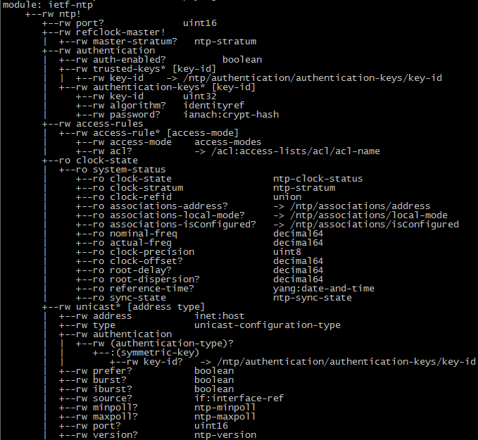
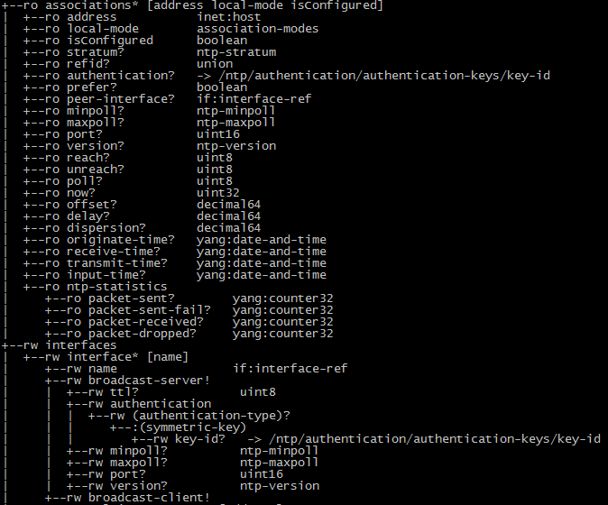
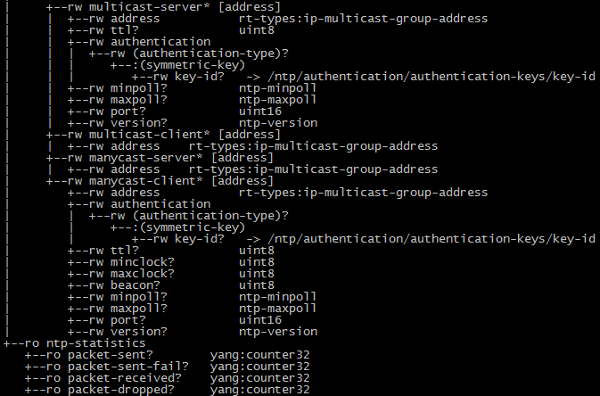
NTP Yang
NTP WG, IETF 100 @ Singapore
19

