Slide 1
A Yang Data Model for ACTN VN Operation draft-lee-teas-actn-vn-yang-12
Young Lee, Dhruv Dhody, Igor Bryskin | Huawei
Daniele Ceccarelli | Ericsson
Bin Yeong Yoon | ETRI
Haomian, Xian, Sergio, Qin, Takuya, Peter | Contributors

Slide 2
Introduction
A YANG data model for the ACTN Virtual Network Service (VNS) operation that is going to be implemented for CMI (between CNC and MDSC).
Aligned to Customer Service Model
VN Instantiation, VN Computation, VN Lifecycle
Access Points (AP) and Virtual Network Access Points (VNAP)
Virtual Network (VN)
List of VN members
Other VN Operations
Multi-src/Multi-dest
As per the ACTN Informational Model

Slide 3
Major Change
Coupling with the TE Topology Yang Model
Removed any duplicated information that can be found in TE Topology
Constraints
Explicit Path
Underlay path
Etc.
Simplification of model for both VN Type 1 & VN Type 2
JSON examples are added
ACTN VN
TE Topology
Access
AP/ VNAP
LTP
Customer’s Virtual Network
VN
Abstract Node
Customer Site to Site connection
VN-Member
Entry in the connectivity matrix of the abstract node

Slide 4
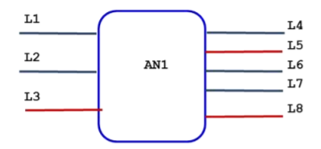

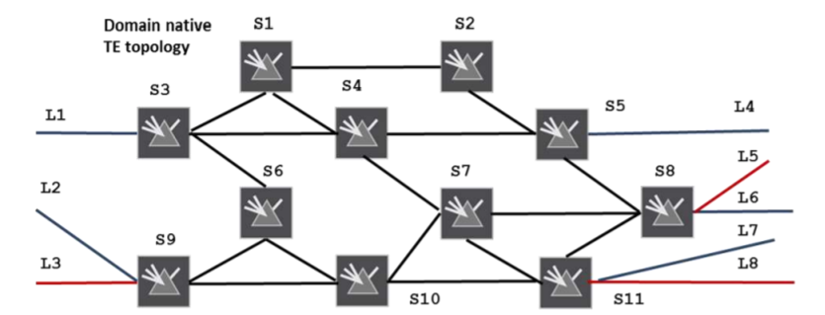
Overview
Abstract Topology with a
Single Node
ACTN VN Yang Model
AP/VNAP
VN
VN-Member
Connectivity
Matrix
For both VN Type 1 or Type 2 VN Yang model rely on a single node in the abstract TE Topology
The abstract node has
connectivity-matrices
connectivity-matrix [id]
The attributes directly under container connectivity-matrices are the default attributes for all connectivity-matrix entries when the per entry corresponding attribute is not specified. When a per entry attribute is specified, it overrides the corresponding attribute directly under the container connectivity-matrices.
Underlay

Slide 5
Node
connectivity-matrices
underlay
primary-path
path-constraints
Optimizations
computed-path-properties
connectivity-matrix [id]
From
underlay
Primary-path
path-constraints
Optimizations
To
tunnel-termination-points
tunnel
Overview
ACTN VN
AP
VNAP
VN
VN-Member
From
Constraints?
Policy?
To
/nw:networks/nw:network/nw:node/te-node-id
global
Per entry

Slide 6
How: Reference to TE Topology Yang Model
Access | AP/ VNAP -> LTP Ltp of type te-types:te-tp-id
Customer’s Virtual Network | VN -> Abstract Node vn-topology-id of type te-types:te-topology-id abstract-node -> /nw:networks/network/node/tet:te-node-id (reference)
Customer Site to Site connection | VN-Member -> Entry in the connectivity matrix of the abstract node connectivity-matrix-id -> /nw:networks/network/node/tet:te/te- node-attributes/connectivity-matrices/connectivity-matrix/id (reference)
All parameters which are can be set as global attributes to VN are set in the connectivity-matrices (such as bandwidth) and an attribute for a particular VN-member is set in the connectivity-matrix [id] (such as explicit path)!
Duplicate parameters in ACTN VN Yang model are removed!

Slide 7
VN Type 1
VN is seen as edge to edge links (VN-members) setup as tunnels across underlying networks!
Abstract Topology with a
Single Node
VN 1
VN-Member 1 L1-L4
VN-Member 2 L1-L7
VN-Member 3 L2-L4
VN-Member 4 L3-L8
This VN has following properties
Bandwidth 500
Optimize by delay
connectivity-matrices
Attributes
These properties
are set in TE Topo
14: L1-L4 | 17: L1-L7
24: L2-L4 | 38: L3-L8
Connectivity
Matrix

Slide 8
VN Type 2
Abstract Topology with a
Single Node
VN is seems as a topology of virtual nodes and links
To ease mapping between VN Yang Model and TE models, an abstract single node topology is created with VN topology as the underlay!
The same mapping as VN Type 1 is reused.
VN 2
VN-Member 1: L1-L8 via S3, S67110, S11
Set via the underlay path in connectivity-matrix[id]
Underlay
VN Topology
S3
S124
S5
S8
S9
S67110
S11
Underlay

Slide 9
Role of ACTN VN Model
Customer view of VN
Innovative Services
Service Mapping
AP / VNAP
VN Compute
Multi-Src / Multi-Dest
VN as a single entity (as per the ACTN info model)
~ Service Model

Slide 10
ACTN VN Yang Tree
module: ietf-actn-vn
+--rw actn
+--rw ap
| +--rw access-point-list* [access-point-id]
| +--rw access-point-id uint32
| +--rw access-point-name? string
| +--rw max-bandwidth? te-types:te-bandwidth
| +--rw avl-bandwidth? te-types:te-bandwidth
| +--rw vn-ap* [vn-ap-id]
| +--rw vn-ap-id uint32
| +--rw vn? -> /actn/vn/vn-list/vn-id
| +--rw abstract-node? -> /nw:networks/network/node/tet:te-node-id
| +--rw ltp? te-types:te-tp-id
+--rw vn
+--rw vn-list* [vn-id]
+--rw vn-id uint32
+--rw vn-name? string
+--rw vn-topology-id? te-types:te-topology-id
+--rw abstract-node? -> /nw:networks/network/node/tet:te-node-id
+--rw vn-member-list* [vn-member-id]
| +--rw vn-member-id uint32
| +--rw src
| | +--rw src? -> /actn/ap/access-point-list/access-point-id
| | +--rw src-vn-ap-id? -> /actn/ap/access-point-list/vn-ap/vn-ap-id
| | +--rw multi-src? boolean {multi-src-dest}?
| +--rw dest
| | +--rw dest? -> /actn/ap/access-point-list/access-point-id
| | +--rw dest-vn-ap-id? -> /actn/ap/access-point-list/vn-ap/vn-ap-id
| | +--rw multi-dest? boolean {multi-src-dest}?
| +--rw connetivity-matrix-id? -> /nw:networks/network/node/tet:te/te-node-attributes/connectivity-matrices/connectivity-matrix/id
| +--ro oper-status? identityref
+--ro if-selected? boolean {multi-src-dest}?
+--rw admin-status? identityref
+--ro oper-status? identityref
+--rw vn-level-diversity? vn-disjointness

Slide 11
Next Step
This update of draft is based on feedback received during the last IETF to reuse existing TE yang model as much as possible.
This update does just that and works well with abstract TE topology model
Request for WG Adoption!

Slide 12
Thank You!

Slide 13
Backup Slides

Slide 14
Typical Interactions: VN Type 1
CNC
Set Attributes, Connectivity Matrix, via Single Node Abstract TE Topology
POST /nw:networks/nw:network/nw:node/te-node-id/tet:connectivity-matrices/tet:connectivity-matrix
MDSC
200 OK
Create VN with VN members, VNAP and map it to the TE Topology model
POST /actn/vn/vn-list/vn-id
200 OK
Get VN Status, selected VN-members in case of multi-src/multi-dest
GET /actn/vn/vn-list/vn-id

Slide 15
Typical Interactions: VN Type 2
CNC
Set Attributes, Connectivity Matrix, via Single Node Abstract TE Topology
Explicitly creating a single node topology
POST /nw:networks/nw:network/nw:node/te-node-id/tet:connectivity-matrices/tet:connectivity-matrix
MDSC
200 OK
Create VN with VN members, VNAP and map it to the TE Topology model
POST /actn/vn/vn-list/vn-id
200 OK
Get VN Status, selected VN-members in case of multi-src/multi-dest
GET /actn/vn/vn-list/vn-id
The CNC creates a single node topology by itself, in this way VN Type 1 and VN Type 2 would have similar interactions

Slide 16
Typical Interactions: VN Type 2
CNC
MDSC
Create VN with VN members, VNAP first
POST /actn/vn/vn-list/vn-id
200 OK
MDSC populates a single node abstract node topology by itself
Get VN Status and information related to the single node abstract topology and mapping
GET /actn/vn/vn-list/vn-id
Set any changes in attributes, Connectivity Matrix, via Single Node Abstract TE Topology
POST /nw:networks/nw:network/nw:node/te-node-id/tet:connectivity-matrices/tet:connectivity-matrix
200 OK
The MDSC creates a single node topology by itself and maps it to the ACTN VN Yang model. Any attribute changes are done next via the te topology model

Slide 17
Multi-Src / Multi-Dest
VN-Member 1 | L1-L4(*)
VN-Member 2 (selected) | L1-L7(*)
VN-Member 3 | L2(*)-L4
VN-Member 4 (selected) | L3(*)-L4
(*) | Multi-src or Multi-destination enabled
Multiple VN members are configured and marked with multi-src or multi-dest option
The MDSC selects the VN member to actually setup and create a connectivity matrix entry in the single node abstract topology based on the selected.
MDSC is free to change the selected VN-member in coordination with CNC

