Slide 1
Extension For Stateful PCE to allow Optional Processing of PCEP Objects
draft-dhody-pce-stateful-pce-optional-00
Dhruv Dhody, Huawei
Stephane Litkowski, Orange

Slide 2
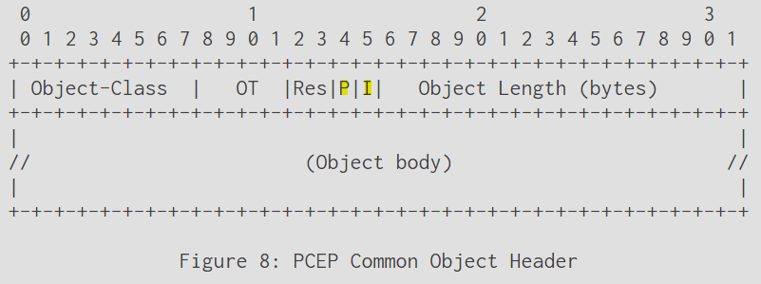
Introduction
RFC 5440
P Flag (Processing-Rule) in Common Object Header – the object must be taken into account by the PCE during path computation or is just optional.
I Flag (Ignore) in Common Object Header – indicate if the optional object was taken into account.
RFC 8231
The P and I flags of the PCEP objects defined in the current document MUST be set to 0 on transmission and SHOULD be ignored on receipt since they are exclusively related to path computation requests.
The behavior for P and I flag in other objects was not specified.
This document
Clarifies how the P and I flag could be used in the Stateful PCE model to identify optional objects in the PCRpt/PCUpd/PCInitiate messages.
Updates the handling of unknown objects based on these flags!

Slide 3
Usage Example
The requirement was discussed in the WG mailing list where the relaxing of constraints would be useful to indicate in the context of Stateful PCE.
Metric Object
Mark a Path delay variation bound metric as optional limiting constraint
Diversity
Mark the disjoint association as optional so that this constraint can be dropped by PCE if the disjoint path for the LSP cannot be found
Association Object
Indicate if the object was ignored or processed

Slide 4
Extension
Capability Advertisement
Handling of P flag
Handling of I flag
Unknown Objects
PCRpt
PCUpd
PCInitiate
PCUpd
PCRpt

Slide 5
capability
PCEP Speaker indicates its ability to support handling of P/I flag in Stateful PCEP messages.
A new flag in STATEFUL-PCE-CAPABILITY TLV
R (RELAX) bit – If set to 1, can send/receive PCEP objects with handling of P/I flags
Both peers needs to set the flag

Slide 6
P (Processing-Rule) flag
PCRpt
PCC to specify to PCE if the object must be taken into account by the PCE (during path computation or re-optimization) or is just optional.
When the P flag is set, the object MUST be taken into account by the PCE. Conversely, when the P flag is cleared, the object is optional and the PCE is free to ignore it.
PCUpd / PCInitiate
PCE to specify to PCC whether the object must be taken into account by the PCC (during path setup) or is just optional.
When the P flag is set, the object MUST be taken into account by the PCC. Conversely, when the P flag is cleared, the object is optional and the PCC is free to ignore it.
Mandatory Object always set P flag

Slide 7
I (Ignore) flag
PCUpd
PCE to indicate to PCC whether or not an optional object was processed.
PCRpt
PCC to indicate to PCE whether or not an optional object was processed in response to an PCUpd/PCInitiate.
PCInitiate
I flag has no meaning in this message.

Slide 8
Unknown Objects
Handling of unknown objects based on the setting of P flag (similar to RFC 5440)
If a PCEP speaker does not understand an object with the P flag set or understands the object but decides to ignore the object, the entire stateful PCEP message MUST be rejected and the PCE MUST send a PCErr message with Error-Type="Unknown Object" or "Not supported Object".
In case the P flag is not set, the PCEP speaker is free to ignore the object and continue with the message processing as defined.
RFC 8231 defined LSP Error Code TLV to be carried in PCRpt message in the LSP object to convey error information. This document does not change that procedure.

Slide 9
Summary & next steps
Useful Problem to Solve?
Is this the Right Approach?
Comments?

Slide 10
Thanks!

