Slide 1
Path Segment/ID in PCEP draft-li-pce-controlled-id-space-00 draft-li-pce-sr-path-segment-00 draft-li-pce-sr-bidir-path-00
____________________________________________________________
Cheng Li/Mach Chen/Dhruv/Lizhenbin
IETF#102
________

Slide 2
Motivation
Use cases like end-2-end 1+1 path protection, bidirectional path correlation or performance measurement (PM) require the ability to implement “path identification” in SR networks:
[draft-cheng-spring-mpls-path-segment] introduces a new segment to uniquely identify an SR path in a specific context that is referred to as Path Segment.
[draft-li-spring-passive-pm-for-srv6-np] defines a Path ID to identify an SRv6 path.
For configuring or allocating “path ID” to an SR path, extensions in PCEP are needed.
Path ID allocation and conveying it within PCEP
PCE controlled ID Space, where PCC informs the PCE the ID space range from which it should make allocations
Bidirectional path correlation is required in some scenarios such as mobile backhaul transport network for segment routing.
Bidirectional path correlation based on path Segment/ path ID.
Notes:
In SR-MPLS, no label or only the last label may be left in the MPLS label stack when the packet reaches the egress node.
Thus, the egress node cannot determine from which SR path the packet comes.

Slide 3
Drafts
draft-li-pce-controlled-id-space-00
specifies a mechanism for a PCC to inform the PCE of the identifier space under its control via PCEP.
draft-li-pce-sr-path-segment-00
specifies extensions to the PCEP to support path identifier allocation between PCEP speakers.
draft-li-pce-sr-bidir-path-00
defines PCEP extensions for grouping two reverse unidirectional SR Paths into an Associated Bidirectional SR path

Slide 4
draft-li-pce-controlled-id-space-00
[I-D.zhao-pce-pcep-extension-for-pce-controller] specifies the procedures and PCEP protocol extensions for using the PCE as a central controller, where label forwarding entries (Central Controller’s Instructions (CCI)) are downloaded through extending PCEP.
[I-D.zhao-pce-pcep-extension-for-pce-controller-sr] specifies the procedures and PCEP protocol extensions for using the PCE as the central controller in SR networks.
However, these documents assume that label range to be used by a PCE is known and set on both PCEP peers.
This document specify the extension to support advertisement of the various ID space (Label/ Path ID etc) to the PCE to control.

Slide 5
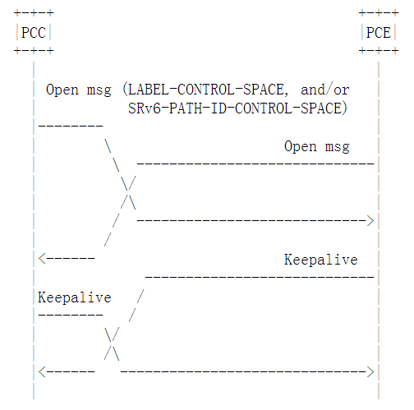
draft-li-pce-controlled-id-space-00
For informing the PCE controlled ID space, related ID Space TLV MUST be included in the Open message.
Each TLV (corresponding to each ID type) SHOULD be included only once in a Open Message.
The following ID-CONTROL-SPACE TLVs are defined in this document –
LABEL-CONTROL-SPACE - for MPLS Labels
SRv6-PATH-ID-CONTROL-SPACE - for SRv6 Path ID
The PCE can then allocate ID from within the controlled ID space.
Notes:
The following ID-CONTROL-SPACE TLVs are defined in this document - LABEL-CONTROL-SPACE - for MPLS Labels (including for SR-MPLS) SRv6-PATH-ID-CONTROL-SPACE - for SRv6 Path ID

Slide 6
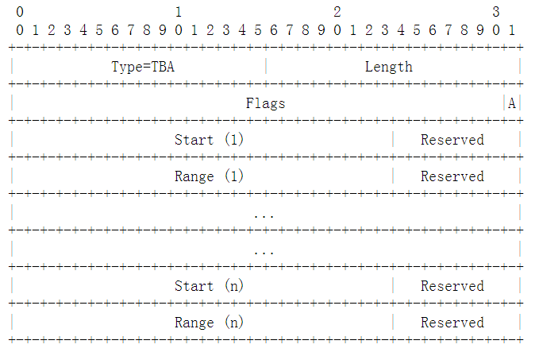
LABEL-CONTROL-SPACE TLV
Flags:
A: All space flag, set when all the label space is delegated to a PCE.
Blocks
Start(i) (24 bits): indicates the beginning of the label block i.
Range(i) (24 bits): indicates the range of the label block i.
Labels:
such as binding SID and path SID can be allocated directly from the PCE controlled space .
Notes:
The following ID-CONTROL-SPACE TLVs are defined in this document - LABEL-CONTROL-SPACE - for MPLS Labels (including for SR-MPLS) SRv6-PATH-ID-CONTROL-SPACE - for SRv6 Path ID
set when all the label space is delegated to a PCE.
Start(i) (24 bits): indicates the beginning of the label block i. Range(i) (24 bits): indicates the range of the label block i.

Slide 7
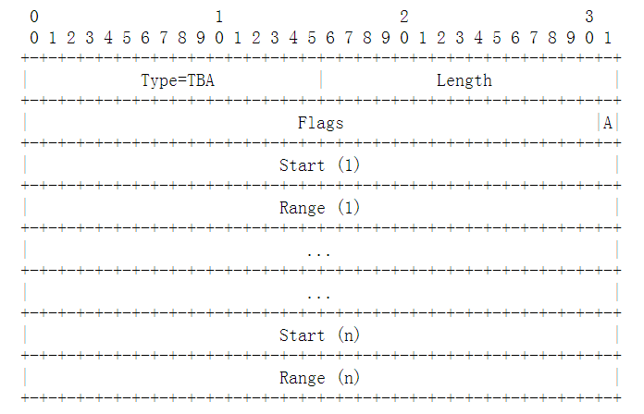
SRv6-PATH-ID-CONTROL-SPACE TLV
Flags:
A: All space flag, set when all the ID space is delegated to a PCE.
Blocks
Start(i) (32 bits): indicates the beginning of the SRv6 Path ID block i.
Range(i) (32 bits): indicates the range of the SRv6 Path ID block i.
Path IDs
can be allocated directly from the PCE controlled space .
Notes:
The following ID-CONTROL-SPACE TLVs are defined in this document - LABEL-CONTROL-SPACE - for MPLS Labels (including for SR-MPLS) SRv6-PATH-ID-CONTROL-SPACE - for SRv6 Path ID
set when all the label space is delegated to a PCE.
Start(i) (24 bits): indicates the beginning of the label block i. Range(i) (24 bits): indicates the range of the label block i.

Slide 8
draft-li-pce-sr-path-segment-00 PCEP Extension for Path Identification in SR

Slide 9
draft-li-pce-sr-path-segment-00
specifies a mechanism to carry the SR path identification information in PCEP
The path ID can be allocated by Ingress PCC itself and informed to the PCE. The PCE can then inform the egress PCC.
The PCC can also request PCE to allocate the path ID, in this case, the PCE would allocate and inform the assigned path ID to the ingress/egress PCC using PCEP messages.
Also, the PCE can allocate a path ID on its own accord and inform the ingress/egress PCC in case of PCE-initiated LSPs.
(Next Version) The path ID can be allocated by Egress PCC. The PCE should request the Egress PCC to allocate a Path ID and inform the PCE, which may further inform to the ingress PCC.

Slide 10
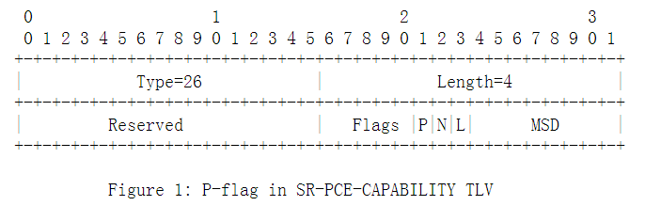
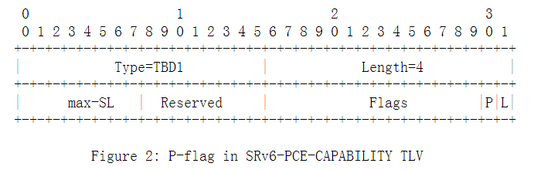
Capabilities Advertisement
For advertising the capability of Path ID allocation, new flags are required:
SR-PCE-CAPABILITY TLV [I-D.ietf-pce-segment-routing] in OPEN message:
P-flag: Path Identification bit, set to indicate that it has the capability to encode SR path identification.
SRv6-PCE-CAPABILITY TLV [I-D.negi-pce-segment-routing-ipv6]
P-flag: Path Identification bit, set to indicate that it has the capability to encode SRv6 path identification.

Slide 11
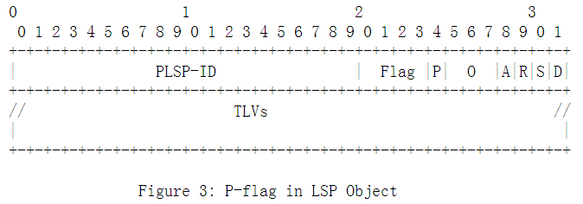
P-flag in LSP Object
P-flag: Indicating path ID needs to be allocated by PCE for this LSP
LSP.P-flag: MUST be set in PCReq/PCRpt msg, when PCC requires the path ID allocation.
LSP.P-flag: MUST be set in PCRep/PCUpd/PCInitiate, when PCE reply the path ID allocation requirement.

Slide 12
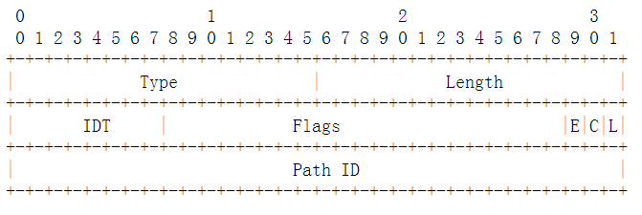
Path ID TLV in LSP Object
IDT（ID type）specifies the type of the Path ID field
0: MPLS Path segment, which is an MPLS label as defined in [I-D.cheng-spring-mpls-path-segment].
1: SRv6 Path ID, which is a 4-octet integer as defined in [I-D.li-spring-passive-pm-for-srv6-np].
Flags
L: Local/Global bit: set when the path ID has the local significance.
C: PCC/PCE bit: set when the Path ID is allocated by the PCC.
E: Egress/Ingress bit: set when the Path ID is allocated from the Egress PCC’s ID space.
Path ID:
32bit value of path ID.
The path ID type is indicated by the ID Type field.
Notes:
The path ID of an SR path. The path ID type is indicated by the ID Type field.

Slide 13
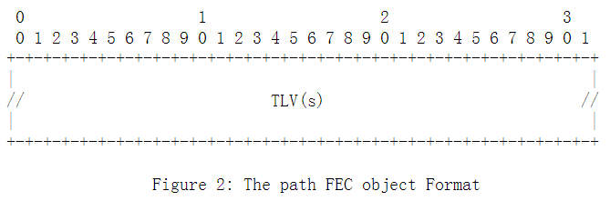
Inform the Egress PCC: Path FEC Object & CCI
This document extends the procedures of [I-D.zhao-pce-pcep-extension-pce-controller-sr] by defining a new Path FEC object to inform the Path Identification information to the Egress PCC.
One or more following TLV(s) are allowed in the Path FEC object:
SYMBOLIC-PATH-NAME TLV: a human readable string that identifies an LSP in the network [RFC8231].
LSP-IDENTIFIERS TLVs: optional for SR, but could be used to encode the source, destination and other identification information for the path [RFC8231].
SPEAKER-ENTITY-ID TLV: a unique identifier for the PCEP speaker, used to identify the Ingress PCC [RFC8232]. Can be used for two labels solution defined in [I-D.cheng-spring-mpls-path-segment].
The Path ID information is encoded directly in the Central Control Instructions(CCI) SR object. The Path ID TLV MAY also be included in the CCI SR object.
Notes:
Central Control Instructions

Slide 14
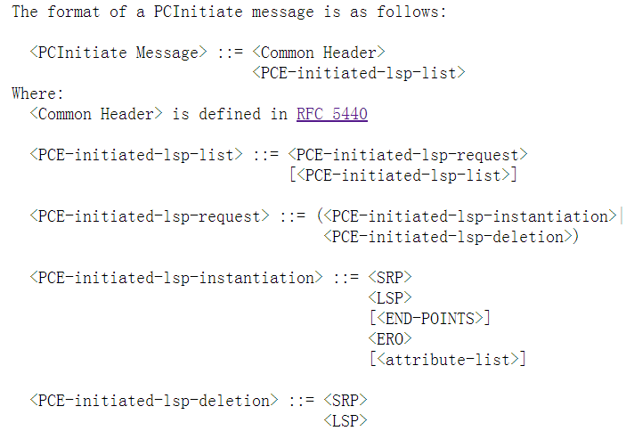
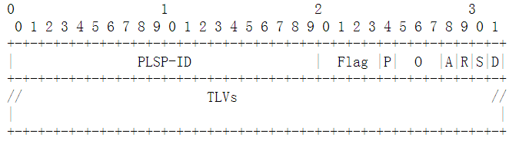
Message Example: PCInitiate
Notes:
The path ID of an SR path. The path ID type is indicated by the ID Type field.

Slide 15
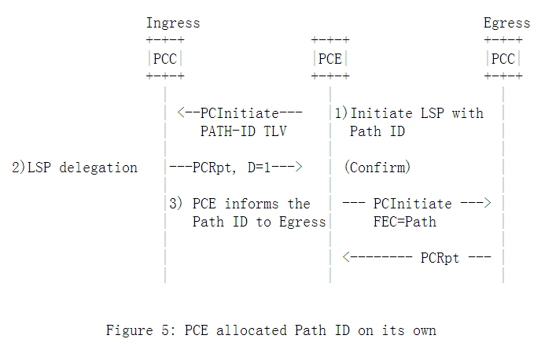
Example: PCE allocated Path ID on its own
Notes:
The path
Ingress PCC request Path ID to PCE
ID of an SR path. The path ID type is indicated by the ID Type field.

Slide 16
draft-li-pce-sr-bidir-path-00

Slide 17
draft-li-pce-sr-bidir-path-00
For associating two SR paths, this document defines a new association group called 'Double-sided Bidirectional SR Path Association Group'
The SR paths belonging to this association is conveyed via PCEP messages to the PCEP peer.
A member of the Double-sided Bi-directional SR Path Association Group can take the role of a forward or reverse SR path.
The TLVs, handling rules, error conditions are same as [I-D.ietf-pce-association-bidir].
B-flag in RP and SRP object MUST be set.
The PATH-ID TLV [I-D.li-pce-sr-path-segment] MUST also be included in the LSP object for these SR paths.
Notes:
Two uni-directional SR paths can be associated by the association group object as specified in [I-D.ietf-pce-association-group].
The PATH-ID TLV [I-D.li-pce-sr-path-segment] MUST also be included in the LSP object for these SR paths.
The error handling as described in [I-D.ietf-pce-association-bidir] continue to apply.

Slide 18
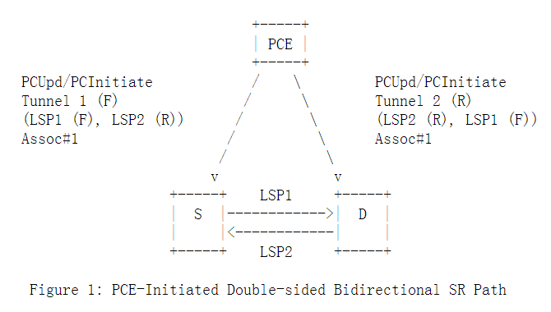
Example: PCE-Initiated Bidir Path
A stateful PCE:
Create/update the forward/reverse SR path independently
Establish/remove the association relationship on a per SR path basis.
Create/update the SR path and the association on a PCC via PCInitiate/PCUpd messages, respectively.
The Path-ID TLV MUST be included for each SR path in the LSP object.
The opposite direction SR SHOULD be informed via PCInitiate message with the matching association group.
Similarly PCC initiated SR Paths are delegated to the PCE which would update with the other direction SR path and the association group information!

Slide 19
Thank you
================

