Slide 1

PCECC for P2MP / SRv6
draft-dhody-pce-pcep-extension-pce-controller-p2mp-00
draft-dhody-pce-pcep-extension-pce-controller-srv6-00
Dhruv Dhody / Zhenbin Li

Slide 2
Introduction
RFC 8283 is published
An architecture for use of PCE/PCEP in a network with central control.
Introduces the architecture for PCE as a central controller and examines the motivations/applicability for PCEP as a control protocol in this environment.
A PCE-based central controller can simplify the processing of a distributed control plane by blending it with elements of SDN and without necessarily completely replacing it.
PCECC Extentions
Basic PCECC [I-D.zhao-pce-pcep-extension-for-pce-controller] WG adoption call
PCECC-SR [I-D.zhao-pce-pcep-extension-pce-controller-sr] WG adoption pending
Both were presented in IETF 102

Slide 3
Basic PCECC Mode
LSPs are provisioned as explicit label instructions at each hop on the end-to-end path.
Each router along the path must be told what label forwarding instructions to program and what resources to reserve.
The controller uses PCEP to communicate with each router along the path of the end-to-end LSP.
PCECC will take responsibility for managing some part of the MPLS label space for each of the routers that it controls
PCE-CC
Via PCEP: Central Controller Instructions (CCI) for each forwarding action along the path

Slide 4
PCECC-P2MP
[I-D.ietf-pce-stateful-pce-p2mp] specify the extensions that are necessary in order for the deployment of stateful PCEs to support P2MP TE LSPs
PCECC – P2MP additional requirement
A branch node is an LSR that replicates the incoming data on to one or more outgoing interfaces.
At the branch node N3 -
Incoming Label : B
Outgoing Label: (C, towards N4) and (D, towards N5)
3 instances of CCI object in PCInitiate message for each label
PCE-CC
A
B
N2
D
N1
N3
C
N5
N4

Slide 5
PCECC-P2MP
A new M-bit is added in PCECC-CAPABILITY
CCI Object Type = 1 for MPLS Label is already defined
For P2MP branch node, multiple CCI objects with outgoing flag is included.
No change in RBNF required; <cci-list> takes care of it!
<PCInitiate Message> ::= <Common Header>
<PCE-initiated-lsp-list>
Where:
<Common Header> is defined in [RFC5440]
<PCE-initiated-lsp-list> ::= <PCE-initiated-lsp-request>
[<PCE-initiated-lsp-list>]
<PCE-initiated-lsp-request> ::=
(<PCE-initiated-lsp-instantiation>|
<PCE-initiated-lsp-deletion>|
<PCE-initiated-lsp-central-control>)
<PCE-initiated-lsp-central-control> ::= <SRP>
(<LSP>
<cci-list>)|
(<FEC>
<CCI>)
<cci-list> ::= <CCI>
[<cci-list>]

Slide 6
SR PCECC Mode
PCECC can use PCEP for SR SID (Segment Identifier) distribution on the SR nodes.
SR SID is just another central controller instruction (CCI)
PCECC needs to be in control of label space to make SR SID allocation
Node/Prefix
Adjacency
A new CCI Object Type for SR is defined
PCE-CC
Via PCEP: CCI for each SR node/adj SID/label to all nodes!
1417
4106
payload
4106
payload

Slide 7
PCECC-SRv6
[I-D.negi-pce-segment-routing-ipv6] extends the PCEP-SR procedure to include support for SRv6 paths.
PCECC-SRv6 require support for SRv6 SID allocation and distribution via PCEP.
A new CCI object type for SRv6 is needed.
A new I-bit is added in PCECC-CAPABILITY for SR in IPv6 and a new PST is defined.
On receiving the SRv6 node/prefix SID allocation:
For the local SID, update SID with associated END function in "My Local SID Table“.
For the non-local SID, use the local routing information to determine the next-hop and download the forwarding instructions accordingly.
Similarly each adjacency is assigned a SRv6 adj SID

Slide 8
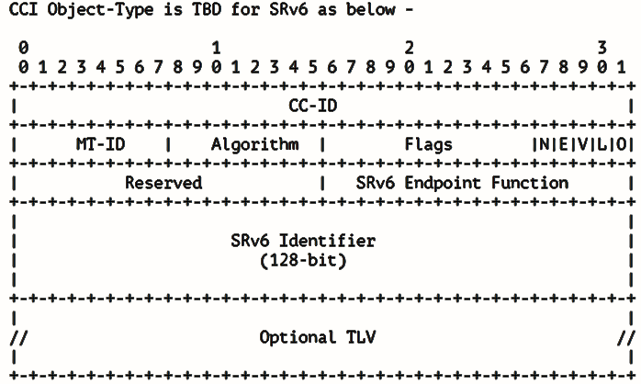
PCECC-SRv6
These fields are already defined for SR-MPLS!
Associated “function” of the SRv6 SID
128-bit SRv6 Segment
Question: is it worth encoding LOC:FUNC separately?

Slide 9
Question & Next Steps
Are these features useful?
They align to the use-cases in TEAS!
Are these extensions on the right track?
They seems to require minimal changes to PCECC!
Reviews?
Lets refine the work!

Slide 10
Thank You!

