Slide 1
A YANG Data Model for PCEP
draft-ietf-pce-pcep-yang-02
https://github.com/dhruvdhody-huawei/pcep-yang
Dhruv Dhody
Jonathan Hardwick
Vishnu Pavan Beeram
Jeff Tantsura

Slide 2
Introduction
Yang Data Model
Configurations
PCEP as per RFC 5440
Extensions
Management of PCEP speakers
State
Aligned to PCEP MIB
Stateful PCE, SR, SVEC, OF, GCO, P2MP…
Statistics
Moved as a separate model
Augments the base model

Slide 3
Recent Changes
A new “ietf-pcep-stats” module that augments “ietf-pcep”
Changes in other models
ietf-te
ietf-key-chain
Fixed various issues
x-path validation failures
Use of when statement v/s must statement
RPC for trigger re-sync
So that operator can have a mechanism to trigger session re-synchronization

Slide 4
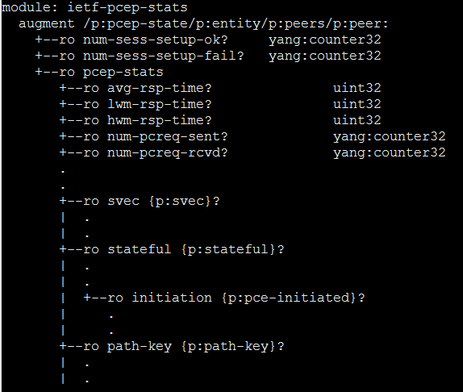
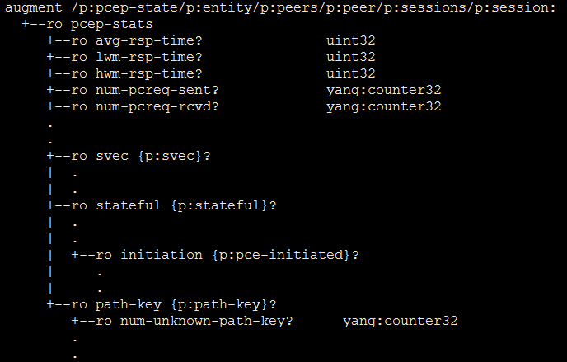
Statistics
A separate module that augments ietf-pcep’s state!

Slide 5
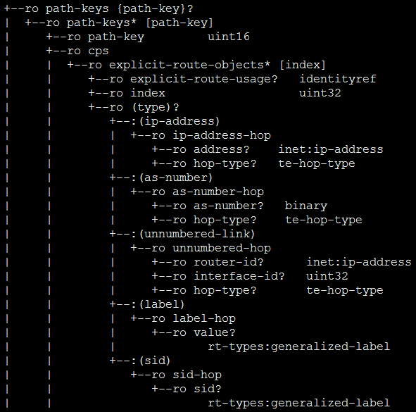
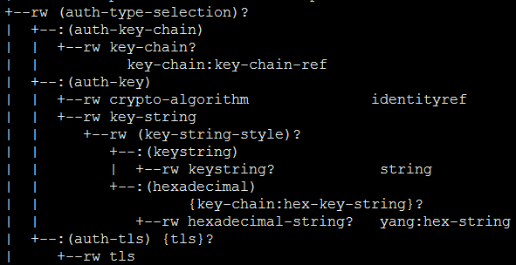
Grouping Changes in other models..

Slide 6
Questions..
Model
The pcep model has ‘config’ & ‘state’ constrainers separated from the inception.
We *prefer* to keep it that way!
Are there any motivations to change that?
What is the impact when revised-data-store is ready?
Notifications
Draft has some notifications related to PCEP session up/down or overload.
We prefer to keep them!
Are there motivations to remove even the most basic ‘notifications’ from the model?

Slide 7
To Do
Adding TLS support for PCEPS
Discussion is on-going with netconf authors of –
ietf-tls-client
ietf-tls-server
Which were updated recently!
We would be using the groupings defined in these model.
Plan to put an update out SOON.

Slide 8
Thank You!

