Slide 1
Traffic Engineering and Service Mapping Yang Model
draft-lee-teas-te-service-mapping-yang-00
Young Lee, Huawei
Dhruv Dhody, Huawei
Daniele Ceccarelli, Ericsson

Slide 2
Introduction
A YANG data model to map service model (e.g. L3SM) and Traffic Engineering model (e.g. TE Tunnel or ACTN VN model).
A TE service Mapping Model.
A seamless control and management of VPN with TE tunnel.
Dynamic TE tunnel creation for VPN service
Create and bind tunnels to VPN (network slicing)
Only when no suitable tunnel exist
Consistent with 2 core functions of ACTN-MDSC
Customer mapping/translation function
Virtual service coordination function

Slide 3
Mode of operations
VN/Tunnel Binding
Use VPN service model [L3SM-Yang] to deliver a L3VPN service.
Based on the sites, QoS, Isolation requirement, etc., the network operator could create a new VN via [ACTN-VN-YANG].
The mapping yang model is used to set the mapping between the L3VPN service and the TE tunnels/VN.
This could be done dynamically.
The VN (and TE tunnels) could be bound to the L3VPN and not used for any other VPN.
VN/Tunnel Selection
Customer could request an L3VPN service [L3SM-Yang],
The network elements (PE/ASBR) are configured to deliver the service.
Each of them would select a tunnel based on the configuration.
With this mode, new tunnels (or VN) are not created for each VPN.
Thus, the tunnels can be shared across multiple VPN.
The mapping yang model is used to get the mapping between the L3VPN and the tunnels in use.

Slide 4
Sample Flow
L3SM (+CMI) Customer Service Model
Create a L3VPN between CE1, CE2
with a new VN/TE-tunnel creation and binding
MDSC creates a new VN dynamically
MDSC coordinates with IP/MPLS PNC and Transport PNC
Create E2E PE-PE tunnels over the underlay transport
MDSC needs to pass VPN information to the IP/MPLS PNC
IP/MPLS PNC creates VRF instances on PE
Tunnel binding between VPN and TE-tunnel
MDSC
IP/MPLS PNC1
Transport PNC
IP/MPLS PNC2
CE1
CE2
Optical Transport

Slide 5
TE-Service Mapping Model
The role of TE-service Mapping model is to create a mapping relationship between -
Service – L3SM, L2SM etc
TE – TE Tunnel, ACTN VN
This TE-service mapping model is needed to bind L3VPN, L2VPN specific service model with TE-specific parameters.
This binding will facilitate a seamless service operation with underlay-TE network visibility.
L3SM
TE-Service Mapping Model
TE-Tunnel
L2SM
ACTN VN

Slide 6
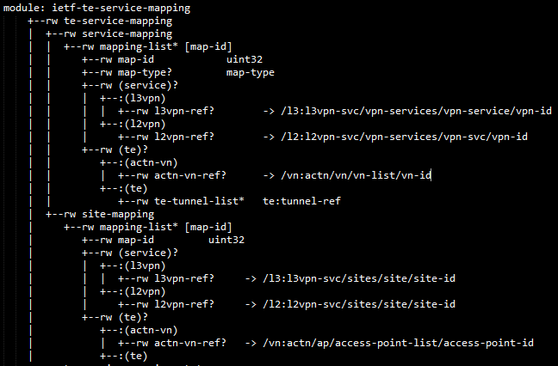
Yang Model
Service Mapping
L3SM or L2SM
ACTN VN or Tunnel List
Site Mapping
VPN Site
ACTN AP or TE Endpoints

Slide 7
Next Step
Is this ‘Mapping’ Model useful?
Continue to enhance the model…
Comments welcome!

Slide 8


