Slide 1
A YANG Data Model for NTP
draft-wu-ntp-ntp-cfg-02
Wu Nan (Eric), Huawei
Anil Kumar S N, RTBrick
Yi Zhao, Ericsson
Presenter – Dhruv Dhody, Huawei

Slide 2
Introduction
Yang Data Model
Configurations
NTP as per RFC 5905
Extensions
Management of NTP demon – client and server
State
Most features of NTPv4 are covered
Auto-key
New Author
Yi Zhao, Ericsson
Ankit, Dhruv (new recruits)
NTP WG, IETF 98 @ Chicago
2

Slide 3
Recent Changes
Authentication
Non Standard Port
Association
Interface
Port leaf added
A list of ‘trusted’ keys
Auto-key
Handling of association-type
Manycast etc
NTP WG, IETF 98 @ Chicago
3

Slide 4
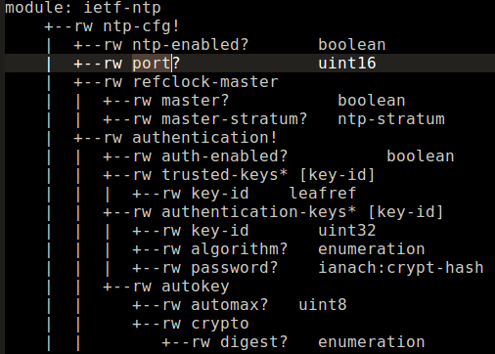
Non Standard Port
New leaf for non-standard Port configuration
This leaf will enhance NTP security
NTP WG, IETF 98 @ Chicago
4

Slide 5
Authentication
A list of trusted keys
as there can be many trusted keys
New container for Auto-key
NTP WG, IETF 98 @ Chicago
5

Slide 6
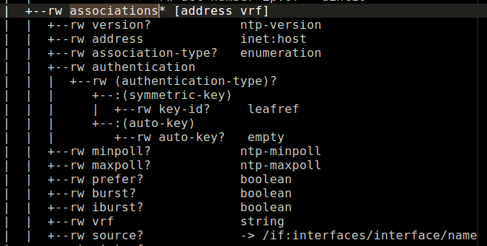
Association
Association-type
Server
Peer
Pool
Auto-Key Container
NTP WG, IETF 98 @ Chicago
6

Slide 7
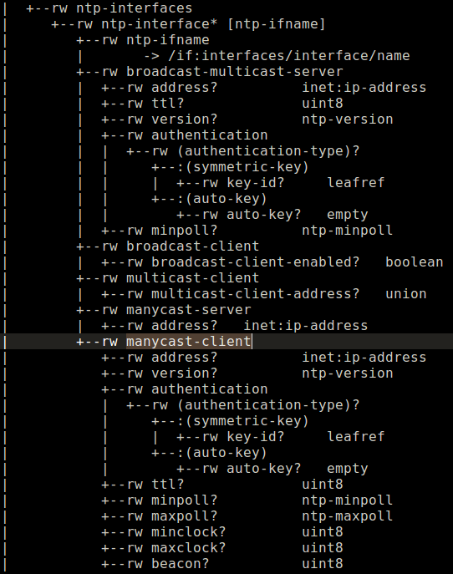
Interface
Interface
Broadcast and multicast server is added in same container
as mode of operation is same (mode 5)
Added with auto-key configuration option
New container for manycast server and client
NTP WG, IETF 98 @ Chicago
7

Slide 8
Next Step
Some Open Issues
Need for NTP state enhancement for manageability, statistics etc
Draft is ripe for WG Adoption.
More reviews
Review comments are always welcome!
NTP WG, IETF 98 @ Chicago
8

Slide 9
Thank You!
NTP WG, IETF 98 @ Chicago
9

