Slide 1

My Introduction

Slide 2
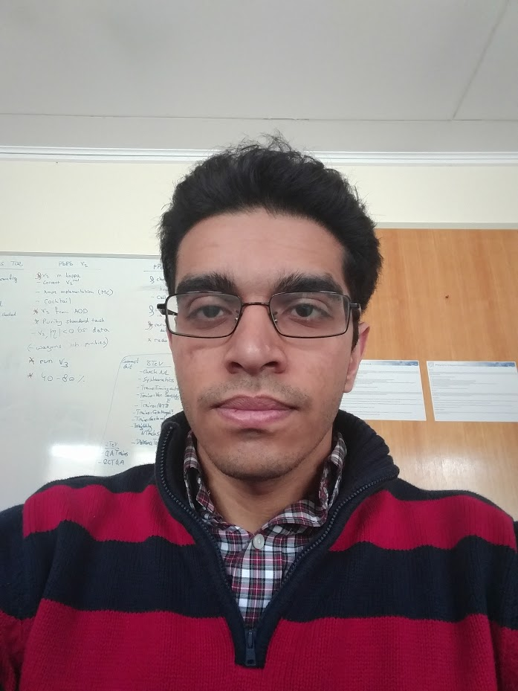
Hi, I am Dhruv
Past: Stony Brook University, graduated Dec 2015 with B.S. Physics and Math
Research: PHENIX MPCEX detector construction, commission, and calibration
Now: CERN semester student. In the UMichigan Research Semester at CERN program
Future: Hopefully UC, Berkeley starting Fall 2016

Slide 3
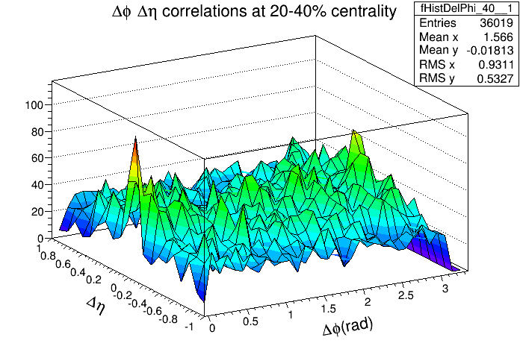
Familiarization with ALICE analysis framework
Wrote an Analysis task and a macro to execute to the task
φ-η correlations plots
895 events
P_{t}: 5 GeV for leading track and 2 GeV for associated tracks
Centrality cut: 20-40%
Basic HI phy concept
Centrality cuts
Correlation plots

Slide 4
What’s next?
Move to the 5 TeV pp and Pb-Pb
Including the DCal in the PCM based framework (QA and analysis)
Get the π⁰ spectrum at 5 TeV pp in both EMCal and Dcal
Di-Cluster and Merged cluster analysis
Would like to be involved in the Data taking this year
Extend to be discussed

