Slide 1


Welcome to PowerShell for Database Developers
Bryan Cafferky
Business Intelligence Consultant
BPC Global Solutions LLC
bryan256@msn.com
Notes:
This template can be used as a starter file for presenting training materials in a group setting.
Sections
Right-click on a slide to add sections. Sections can help to organize your slides or facilitate collaboration between multiple authors.
Notes
Use the Notes section for delivery notes or to provide additional details for the audience. View these notes in Presentation View during your presentation.
Keep in mind the font size (important for accessibility, visibility, videotaping, and online production)
Coordinated colors
Pay particular attention to the graphs, charts, and text boxes.
Consider that attendees will print in black and white or grayscale. Run a test print to make sure your colors work when printed in pure black and white and grayscale.
Graphics, tables, and graphs
Keep it simple: If possible, use consistent, non-distracting styles and colors.
Label all graphs and tables.

Slide 2
What is PowerShell?
Power Script is like Linux Scripting on Steroids!
Thank you to Pragmatic Works and Robert Cain whose
presentation inspired me to prepare this presentation.

Slide 3
Goals of this Presentation
Amaze you with the capabilities of PowerShell.
Convince you that you need PowerShell.
Provide a basic understanding of PowerShell programming.
Point you to where you can get support.

Slide 4
Connecting it All
SQL Server
Windows Server
File System
PowerShell
SharePoint
Exchange Server
Active Directory
IIS
Office

Slide 5
Remote Execution
Enable-PSRemoting -Force
Restart-Computer
Dev Server 1
Mary Smith’s Computer
DNS Server
Invoke-Command
Get-EventLog
Restart-Computer
PowerShell
Dev Server 2
Prod Server 1
Set-Service
Restart-Service
Show-EventLog
Enable-PSRemoting -Force
Dev Server 3
John Doe’s Computer
Prod Server 2
Test-Connection

Slide 6

Ok, But What is It?
Legacy of Unix and other Command Line Orientated Operating Systems.
A Shell is a Command Line interface to the OS that can work either interactively or as a script. An example is the Windows Command Prompt.
Historically Used to Perform Administrative Tasks like backups, moving files around or running batch job streams.
The question is not ‘What can you do with PowerShell?’ but ‘What can’t you do?’

Slide 7
PowerShell – Scripting on Steroids
Full Support of Traditional Shell features:
Piping
Indirection
Access to Hardware environment
Built In Integration with .NET
Support for Variables and Objects
Support for Lists, Arrays and Hash Tables
Secure Model
Notes:
Give a brief overview of the presentation. Describe the major focus of the presentation and why it is important.
Introduce each of the major topics.
To provide a road map for the audience, you can repeat this Overview slide throughout the presentation, highlighting the particular topic you will discuss next.

Slide 8
PowerShell – Recipes
Say it using SAPI. (scr_say_something)
Fun with SQL Server. (scr_SQL_Server, ufn_database_functions)
Wait for file polling. (ufn_wait_for_file)
Firing the file creation event. (ufn_register_file_create_event)
Combining files. (ufn_combine_files)
Fun with CSV Files. (scr_load_csv_file_to_table)
Calling C# code. (ufn_csharp_functions)
Import/Export Excel files. (ufn_Import_Excel)
Notes:
Give a brief overview of the presentation. Describe the major focus of the presentation and why it is important.
Introduce each of the major topics.
To provide a road map for the audience, you can repeat this Overview slide throughout the presentation, highlighting the particular topic you will discuss next.

Slide 9
PowerShell – Common Uses
Use by developers to do pre and post job processing.
Database Support (SQL Server Integration)
Backups
Security
Utilities like Stats
Special database processes like database copy (SMO)
Security Administration (Active Directory)
File System (.NET library and CMDLETS)
Network Administration
Working with MS Products; SharePoint, Office, etc.
Working with XML
Notes:
Give a brief overview of the presentation. Describe the major focus of the presentation and why it is important.
Introduce each of the major topics.
To provide a road map for the audience, you can repeat this Overview slide throughout the presentation, highlighting the particular topic you will discuss next.

Slide 10
PowerShell – Learning Challenges
Have to think differently than with other tools and CLIs due to object orientation, piping, and unusual syntax conventions.
Simple and powerful yet unintuitive.
Most examples are targeted towards system administrators.
Easy to do things the hard way when there is often a command-let for the task or a way to leverage piping.
Can find a work around such as a .bat file to avoid using PowerShell.
With great power comes many options which adds to the learning curve to master this tool.
Notes:
Give a brief overview of the presentation. Describe the major focus of the presentation and why it is important.
Introduce each of the major topics.
To provide a road map for the audience, you can repeat this Overview slide throughout the presentation, highlighting the particular topic you will discuss next.

Slide 11
PowerShell – Periods Matter
PowerShell will not default to the current folder.
.\my_function.ps1 # Refers to a script in the current folder.
C:\Scripts\Test.ps1 # Refers to a script not in the current folder.
Use Dot Sourcing to call the script and keep it in memory.
. c:\scripts\test.ps1 # Run the script and keep the functions and variables after it is done, i.e. available to the session.
. .\my_function.ps1 # Run script which is in the current folder and keep the functions and variables after it is done.
Space in the path?
& "C:\My Scripts\Test.ps1“ # Run script with space in the path.
Notes:
Give a brief overview of the presentation. Describe the major focus of the presentation and why it is important.
Introduce each of the major topics.
To provide a road map for the audience, you can repeat this Overview slide throughout the presentation, highlighting the particular topic you will discuss next.

Slide 12
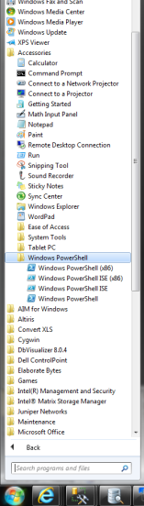
Starting PowerShell
Click Start→All Programs→Accessories→Windows PowerShell.
You may have several versions to choose from.
The ISE is suited to script development and testing.
Notes:
Give a brief overview of the presentation. Describe the major focus of the presentation and why it is important.
Introduce each of the major topics.
To provide a road map for the audience, you can repeat this Overview slide throughout the presentation, highlighting the particular topic you will discuss next.

Slide 13
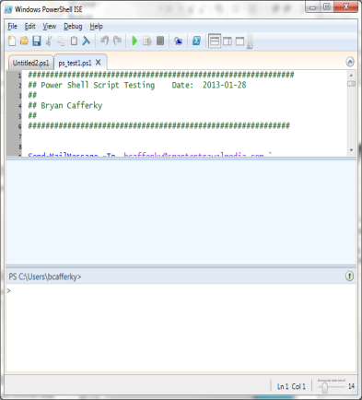
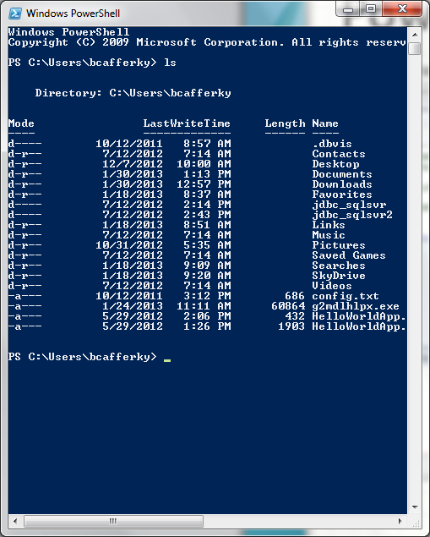
PowerShell Environments
The PowerShell ISE
… or …
The PowerShell CLI
Notes:
If there is relevant video content, such as a case study video, demo of a product, or other training materials, include it in the presentation as well.

Slide 14
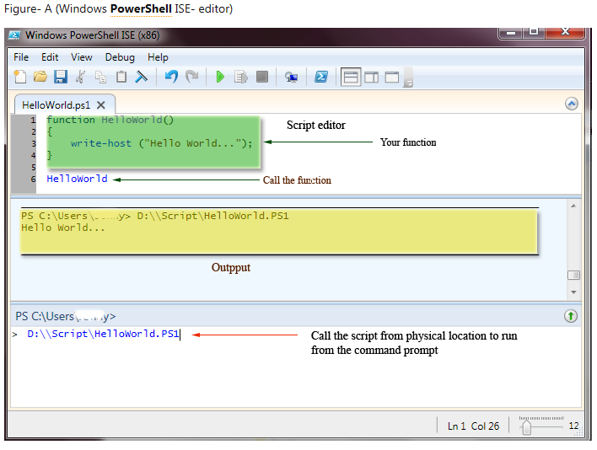
The PowerShell ISE
Notes:
If there is relevant video content, such as a case study video, demo of a product, or other training materials, include it in the presentation as well.

Slide 15
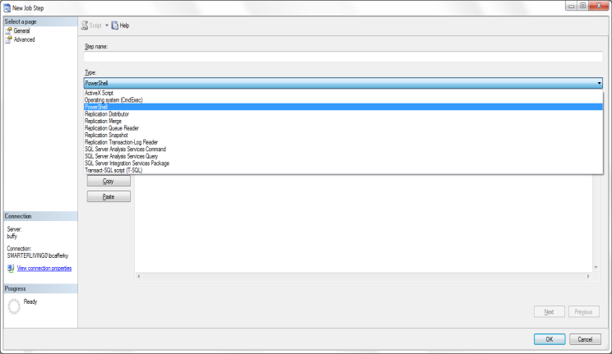
SQL Agent: Built In Support for PowerShell
Notes:
Give a brief overview of the presentation. Describe the major focus of the presentation and why it is important.
Introduce each of the major topics.
To provide a road map for the audience, you can repeat this Overview slide throughout the presentation, highlighting the particular topic you will discuss next.

Slide 16
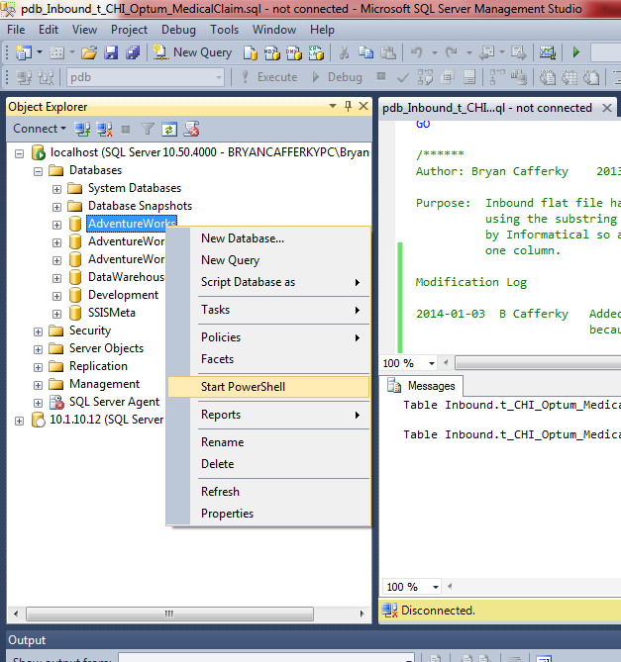
SSMS: Built In Support for PowerShell
Notes:
Give a brief overview of the presentation. Describe the major focus of the presentation and why it is important.
Introduce each of the major topics.
To provide a road map for the audience, you can repeat this Overview slide throughout the presentation, highlighting the particular topic you will discuss next.

Slide 17
PowerShell – A Very Well Supported Tool
Resources:
Downloads and Information
http://www.microsoft.com/windowsserver2003/technologies/management/
Training/Documentation
http://technet.microsoft.com/en-us/scriptcenter/powershell.aspx
Documentation
http://technet.microsoft.com/en-us/library/bb978526.aspx
Free Training
http://pragmaticworks.com/LearningCenter/FreeTrainingWebinars/FutureWebinars.aspx
Notes:
Add a case study or class simulation to encourage discussion and apply lessons.

Slide 18
PowerShell CMDLET
Pronounced "command-let“.
Is a single-feature command that manipulates objects in Windows PowerShell.
You can recognize cmdlets by their name format -- a verb and noun separated by a dash (-), such as Get-Help, Get-Process, and Start-Service
Are designed to be used in combination with other cmdlets
"get" cmdlets only retrieve data,
"set" cmdlets only establish or change data,
"format" cmdlets only format data,
"out" cmdlets only direct the output to a specified destination..
Each cmdlet has a help file that you can access by typing:
get-help <cmdlet-name> -detailed
Example: get_help write-host
Note: You can create your own cmdlet using PowerShell Software Developers Kit (SDK).
Notes:
Discuss outcomes of the case study or class simulation.
Cover best practices.

Slide 19
CMDLET Examples
Get-Help *
Get-Process
Get-Location
Set-Location C:\
Write-Host “Hello”
Get-WMIObject Win32_BIOS
Set-ExecutionPolicy RemoteSigned
Notes:
Summarize presentation content by restating the important points from the lessons.
What do you want the audience to remember when they leave your presentation?
Save your presentation to a video for easy distribution (To create a video, click the File tab, and then click Share. Under File Types, click Create a Video.)

Slide 20
PowerShell: Before You Can Run a Script…
Code Signing and Certificates
You need to set the security policy for PowerShell using the Set-ExecutionPolicy cmdlet
Set-ExecutionPolicy RemoteSigned
Restricts scripts to run from local machine only.

Slide 21
PowerShell: Set-ExecutionPolicy options
Set-Executionpolicy unrestricted
Set-ExecutionPolicy Restricted
invoke-command -computername Server01 -scriptblock {get-executionpolicy} | set-executionpolicy –force
set-executionpolicy -scope CurrentUser -executionPolicy AllSigned –force
set-executionpolicy -scope CurrentUser -executionPolicy Undefined
get-executionpolicy -list

Slide 22

PowerShell: Pipelining
Pipeline commands, - to pass the output of one command to another command as input
Examples:
PS> ipconfig | findstr "Address"
IP Address. . . . . . . . . . . . : 172.28.21.5 IP Address. . . . . . . . . . . . : 172.30.160.225
# Pipelining - combine CmdLets for power
Get-ChildItem | Where-Object { $_.Length -gt 10kb }
Notes:
This is another option for an Overview slides using transitions.

Slide 23
Running a Script
Set-Location \Users\bcafferky\Documents\Powershell\
.\Test_CLI.ps1
.\ tells PowerShell to find the script in the current folder.
To include the path to the script just add it before the script name.
\Users\bcafferky\Documents\Powershell\Test_CLI.ps1

Slide 24

Variables
User Created – These variables are the ones we create in the shell and in scripts. This variables are present only in the current process we are on and are lost when we close the session. We can create variables in scripts with global, script, or local scope.
Automatic – These variables keep the state of the PowerShell session and can not be modified directly. The values of this variables change as we execute and use the PowerShell session. This variables will save last run state of cmdlets, commands as well as other objects and information.
Preference – These variables store user preferences for PowerShell. These variables are created by PowerShell when a session is started and are populated with default values. We can change the values of these variables. For example, MaximumHistoryCount that sets the maximum number of entries in the session history.
Environment – These variables are the variables set by the system for Command and PowerShell environments.

Slide 25
Variables Are Objects
A variable is an object with methods and properties.
You can set the scope of a variable such as
Set-Variable -scope Global -name SqlServerMaximumChildItems -Value 0
By default a variable is created to be in the current scope and any child scopes.
A variable can hold different types of data unless it was type casted on creation.
$myvar = “test”
$myvar = 1
[string] $myvar = “test”
$myvar = 3 # will produce an error

Slide 26
Variables
User assigned variables start with a ‘$’ such as $MyVar = “Bryan”
PowerShell has predefined variables such as $Error that can be viewed in a script.
You can set the scope of a variable such as
Set-Variable -scope Global -name SqlServerMaximumChildItems -Value 0
By default a variable is created to be in the current scope and any child scopes.

Slide 27
Variables Types
Shortcut | Data Type
[datetime] | Date or time
[string] | String of characters
[char] | Single character
[double] | Double-precision floating number
[single] | Single-precision floating number
[int] | 32-bit integer
[wmi] | Windows Management Instrumentation (WMI) instance or collection
[adsi] | Active Directory Services object
[wmiclass] | WMI class
[Boolean] | True or False value

Slide 28
A Sample Script…
[int]$valA = 2;
[int]$valB = 3;
[int]$valC = 0;
$valC = $valA + $valB;
write-host ("The sum is: " + $valC);
write-host ("The sum is: $valC ");

Slide 29
Variables Methods
(123).equals(456) will return false (123).CompareTo(150)will return -1 (123).ToString()
($myStringVar1).ToLower() ($myStringVar1).equals($myStringVar2) ($myStringVar1).CompareTo($myStringVar2) ($myStringVar1).PadRight() + "**" ("a b c").split("b")
Note that CompareTo() differs from equals() in that it returns different values if the item is greater than or less than.
Finding methods for a string: "The world is everlasting" | get-member will return the methods: Clone, CompareTo, Contains, CopyTo, EndsWith, Equals,GetEnumerator, GetHashCode, GetType, GetTypeCode, GetChars, GetLength, IndexOf, IndexOfAny, Insert, IsNormalised, LastIndexOf, LastIndexOfAny, Normalize, PadLeft, PadRight, Remove, Replace,Split, StartsWith, Substring, ToCharArray, ToLower, ToLowerInvariant, ToString, ToUpper,ToUpperInvariant, T rim,TrimEnd,TrimStart, Chars, Length

Slide 30
Using Arrays…
## Create an array named $myArray that contains the ten numeric (int) values:1,2,3,4,5,6,7,8,9,10;
$myArray = 1,2,3,4,5,6,7,8,9,10;
[int] $sum = 0;
foreach ($val in $myArray)
{
write-host ("Index with value:$val");
$sum = $sum + $val;
}
write-host ("The sum is: $sum");

Slide 31
Using Associative Arrays…
A compact data structure for storing a collection of keys and values where each key is paired with a value.
PowerShell uses the hash table data type for storing the contents of an associative array because this data structure provides a fast lookup mechanism.
##Declaration syntax: $<array name> = @{<keyName = Value>;...}
$countries = @{'88' = 'Bangladesh'; '44' = 'United Kingdom'; '11' = 'United States';
'1' = 'Canada'};
$countries ;

Slide 32
For Loops…
for (<init>; <condition>; <repeat>) {<command_block>}
for ($i=0; $i<10;$i++) {Write-Host $i} $i = 1 for (;;){Write-Host $i}
foreach ($<item> in $<collection>){<command_block>}
$letterArray = "a","b","c","d"
foreach ($letter in $letterArray)
{
Write-Host $letter
}

Slide 33
While Loop…
while (<condition>){<command_block>}
while($val -ne 3)
{
$val++
Write-Host $val
}

Slide 34
IF Blocks…
if (<test1>)
{
<code_block1>
}
[elseif (<test2)
{
<code_block2>
}]
[else <code_block3>}]

Slide 35
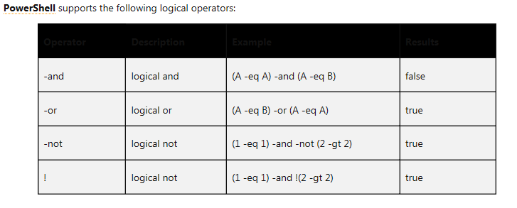
Logical Operators…

Slide 36
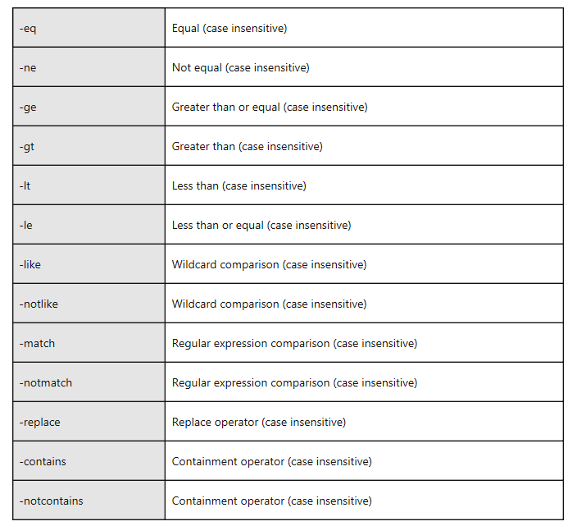
Comparison Operators…
Comparison Operators are NOT Case Sensitive By Default…

Slide 37
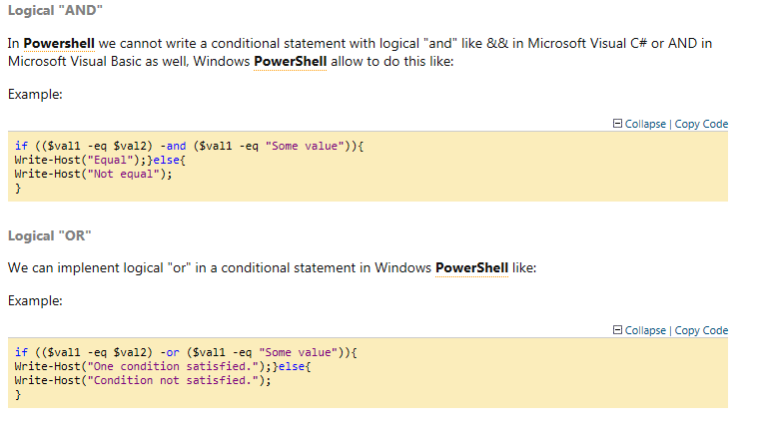
IF Examples (Logical AND/OR)…

Slide 38
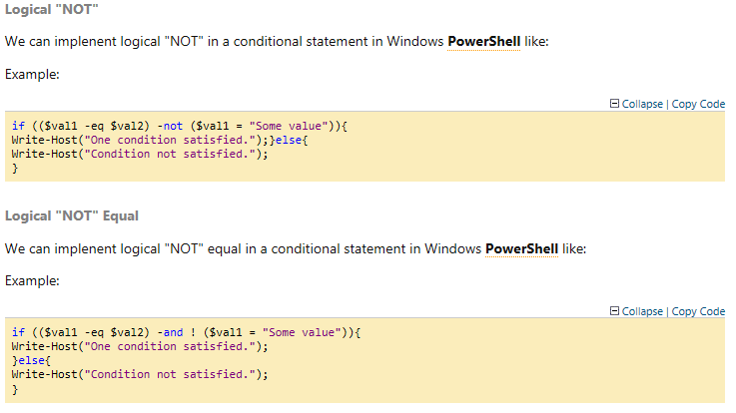
IF Examples (Logical Not/Not Equal)…

Slide 39
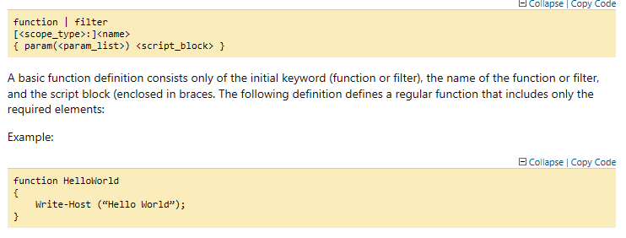
Functions…
As in other programming languages, you can define callable functions…

Slide 40
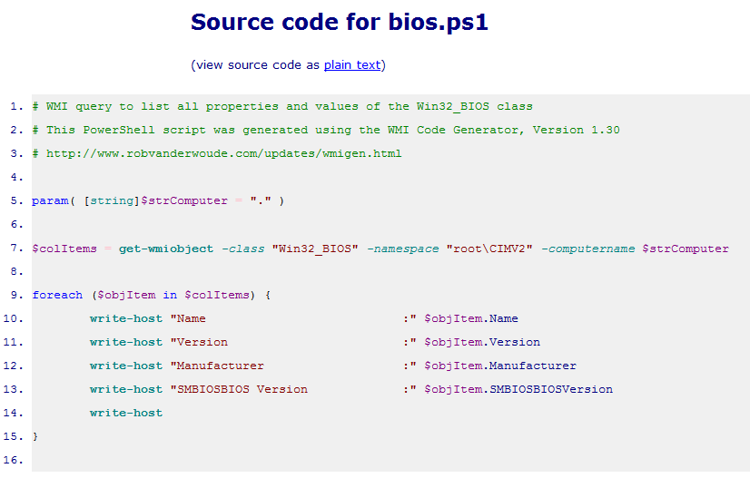
Sample Scripts 1 …

Slide 41
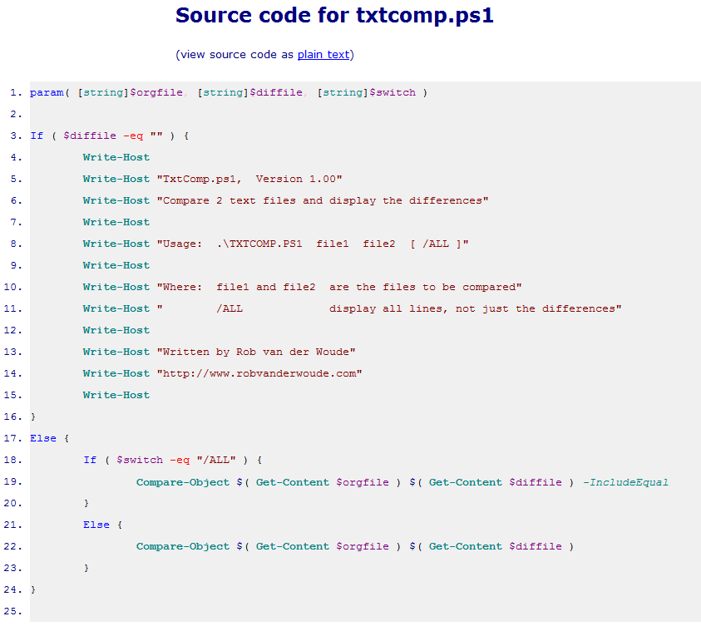
Sample Scripts 2 …

Slide 42
PowerShell Scripting Best Practices
Use naming conventions like ufn_do_something.ps1 where ufn means it’s a user defined function, scr prefix could signify a script, etc.
Have comment header at the tops of the file and consider using the built in reserved comment block tags.
Separate your programs by type like \Script and \Function.
Keep your code under source control.
Make your code modular and reusable, i.e. functions.
Resist the temptation to use the system delivered naming convention for your own scripts, i.e. don’t call a custom function Invoke-This . It is confusing for users of the code and it may run into a conflict in a later release of PowerShell. Note: Most examples out there do this.

Slide 43
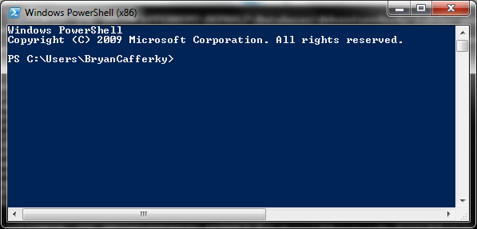
Don’t Forget the CLI…
The PowerShell CLI is the place to go when you need a command line.

Slide 44
notepad $profile
And Don’t Forget the Profile…
The profile lets you customize the PowerShell environment to your needs.
To see the profile path, enter “$profile”.
Test-Path $profile will tell you if the file exists.
New-Item -path $profile -type file –force
This will create a profile file for you.
Enter “notepad $profile” to edit your profile settings.
Taken from: http://technet.microsoft.com/en-us/library/ee692764.aspx

Slide 45
Revisiting the Goals of this Presentation
Amaze you with capabilities of PowerShell.
Convince you that you need PowerShell.
Provide a basic understanding of PowerShell programming.
Point you to where you can get support.

Slide 46
Wrapping Up: Why PowerShell?
Full Support by Microsoft.
Very Powerful.
Integrated into Windows and Windows Based Products.
Lot’s of Free Scripts Available.
Microsoft and Other Vendors Are Including Them More and More With Products.
Notes:
Is your presentation as crisp as possible? Consider moving extra content to the appendix.
Use appendix slides to store content that you might want to refer to during the Question slide or that may be useful for attendees to investigate deeper in the future.

Slide 47
What Can’t You Do With PowerShell?
Answer: Not Much!
Notes:
Is your presentation as crisp as possible? Consider moving extra content to the appendix.
Use appendix slides to store content that you might want to refer to during the Question slide or that may be useful for attendees to investigate deeper in the future.

Slide 48
Questions?
Notes:
Is your presentation as crisp as possible? Consider moving extra content to the appendix.
Use appendix slides to store content that you might want to refer to during the Question slide or that may be useful for attendees to investigate deeper in the future.

