Slide 1
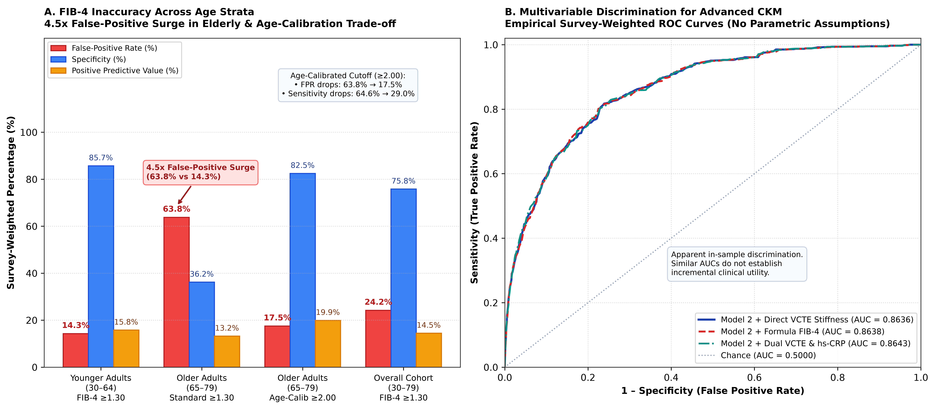
Vibrational Elastography vs. FIB-4 and High-Sensitivity C-Reactive Protein in Advanced Cardiovascular-Kidney-Metabolic Syndrome: NHANES 2017–2023 Study
Dhruv Gambhirrao1,*, Devpal Ghuman1, Tarun Achar1
1 Department of Biological Sciences, University of North Texas, Denton, TX, USA | * Corresponding Author: dhruvgambhirrao@my.unt.edu
UNIVERSITY OF NORTH TEXAS
✔ AHA Cardiovascular-Kidney-Metabolic (CKM) Framework
✔ CDC Continuous NHANES 2017–2023 Cohort
✔ Primary Sample: N = 7,043 (130.8 Million US Adults)
✔ Complex Survey Design: df = 40 (Taylor Linearization)
✔ Pre-Specified Biostatistical Reproducibility Protocol
1. INTRODUCTION & HYPOTHESIS
4. PRIMARY MULTIVARIABLE ANALYSIS
6. FORMULA FIB-4 VS. PHYSICAL VCTE
8. SECONDARY MULTI-ORGAN OUTCOMES
▪ AHA CKM Framework (2023): Defines Cardiovascular-Kidney-Metabolic syndrome (Stages 0–4) linking metabolic adiposity, chronic kidney disease (CKD), and cardiovascular disease (CVD).
▪ Hepatic Fibrosis Burden: Metabolic dysfunction-associated steatotic liver disease (MASLD) affects >30% of US adults. Hepatic fibrosis drives vascular and renal injury via pro-inflammatory cytokines and systemic endothelial dysfunction.
▪ FIB-4 Formula Flaw: Guidelines (AASLD/ADA) recommend FIB-4 for primary care screening. However, chronological age is in the numerator, generating severe false-positive inflation in older populations.
▪ Study Hypothesis: Physical liver stiffness (VCTE FibroScan) and vascular inflammation (hs-CRP) synergistically accelerate advanced CKM syndrome (Stages 3–4), and direct VCTE eliminates age-dependent diagnostic distortion relative to FIB-4.
▪ Co-Primary Model 2 (df = 40): Adjusted for age (per 10y), sex, race/ethnicity, survey cycle, poverty-to-income ratio, education, BMI (per 5 kg/m²), and waist circumference (per 10 cm).
▪ Group 0 (Neither Elevated; n=3,416): 1.00 (Reference Category)
▪ Group 1 (Isolated High hs-CRP; n=2,810): aOR = 1.26 (95% CI: 1.02–1.55, p = 0.034)
▪ Group 2 (Isolated High VCTE; n=283): aOR = 0.85 (95% CI: 0.53–1.35, p = 0.485)
▪ Group 3 (Dual High VCTE + hs-CRP; n=534): aOR = 2.01 (95% CI: 1.39–2.92, p < 0.001)
▪ Diagnostic Reference: Physical VCTE liver stiffness ≥8.0 kPa was evaluated as the non-invasive reference standard for significant fibrosis.
▪ Overall Adult Sensitivity: FIB-4 ≥1.30 identified only 34.8% (95% CI: 30.1–39.8%) of physical fibrosis cases in the general population.
▪ Low Positive Predictive Value: PPV was only 14.5% (95% CI: 12.5–16.7%), indicating 85.5% of positive tests in unselected adults are false positives.
▪ Chronic Kidney Disease (CKD): Dual High phenotype had the strongest combined association with CKD (eGFR <60 or UACR ≥30): aOR = 2.36 (95% CI: 1.70–3.28, p < 0.001; RERI = 0.93).
▪ Overt Clinical CVD: Dual High phenotype independently doubled clinical cardiovascular event odds: aOR = 1.50 (95% CI: 1.01–2.23, p = 0.048; RERI = 0.59).
▪ Secondary Adult Cohort (N = 11,585, Age ≥20): Validation in all adults confirmed persistent associations: CKD aOR = 2.28 (95% CI: 1.73–3.01); Clinical CVD aOR = 1.52 (95% CI: 1.09–2.12).
SUPRA-ADDITIVE & MULTIPLICATIVE SYNERGY (df = 40)
✦ Multiplicative Interaction: p = 0.0185 (Ratio of ORs = 1.88, 95% CI: 1.11–3.18)
✦ Odds-Scale RERI: 0.91 (95% CI: 0.19–1.63, p = 0.014) — Positive Supra-Additivity!
✦ Attributable Proportion (AP): 0.45 (95% CI: 0.20–0.70; 45% of dual-high risk reflects synergy)
✦ Standardized Prevalence Excess: +5.9 percentage points (95% CI: 1.3–10.5 pp, p = 0.011)
✦ Prevalence-Scale RERI & AP: RERI_PR = 0.47 (95% CI: 0.12–0.83); AP_PR = 31.0% (10.4–51.7%)
THE 4.5× GERIATRIC FALSE-POSITIVE EXPLOSION
⚠ Younger Adults (Ages 30–64): FPR = 14.3% | Specificity = 85.7% | PPV = 15.8%
⚠ Older Adults (Ages 65–79): FPR surges to 63.8%! | Specificity drops to 36.2% | PPV = 13.2%
⚠ Mechanism: Chronological age in formula numerator creates massive false alarms in elderly.
⚠ Age-Calibrated Cutoff (≥2.00): Suppresses older FPR to 17.5% (Specificity 82.5%, PPV 19.9%)...
⚠ Severe Sensitivity Trade-off: Sensitivity collapses from 64.6% → 29.0% (missing >70% of true cases)!
9. CLINICAL & TRANSLATIONAL IMPACT
2. POPULATION & SURVEY WORKFLOW
▪ 1. Primary Care Triage Reform: Universal FIB-4 screening triggers costly false-positive hepatology referrals in 63.8% of older adults. Reflex physical elastography is essential before specialist referral.
▪ 2. Dual-Biomarker Risk Stratification: Co-elevated liver stiffness (≥8.0 kPa) and vascular inflammation (hs-CRP ≥2.0 mg/L) identifies a 5.9 pp excess prevalence of advanced CKM, enabling targeted multi-organ intervention.
▪ 3. Pharmacotherapy Guidance: Patients with fibro-inflammatory CKM are optimal candidates for disease-modifying cardiometabolic agents (GLP-1 RAs, dual GIP/GLP-1 RAs, SGLT2i, and ns-MRAs).
▪ Survey Cycles: Continuous CDC NHANES 2017–March 2020 (P_) and 2021–2023 (_L) probability sample of civilian non-institutionalized US adults.
▪ Design Universe Preservation: Retaining all N = 27,493 raw participants preserved survey variance degrees of freedom (df = 40) across 79 stratum-PSU units via Taylor series linearization.
▪ Primary Analytic Cohort (N = 7,043): Complete-case adults aged 30–79 with reliable VCTE exams (≥10 valid measures, IQR/M ≤30.0%, ≥3h fast) and bridged serum hs-CRP, representing 130.8 million US adults.
▪ Secondary Adult Cohort (N = 11,585): Extended population aged ≥20 years with complete core biomarkers for external outcome validation.
5. MULTIVARIABLE FOREST PLOT
7. EMPIRICAL ROC & DISCRIMINATION
3. BASELINE CHARACTERISTICS (N = 7,043)
10. STRENGTHS & LIMITATIONS
Clinical / Biomarker Parameter | Sample (n) | Weighted % / Mean (95% CI)
Advanced CKM Syndrome (Stages 3–4) | 1,246 | 13.8% (12.5–15.1%)
Clinically Significant Fibrosis (VCTE ≥8.0 kPa) | 817 | 10.5% (9.6–11.5%)
High Systemic hs-CRP (≥2.0 mg/L) | 3,344 | 45.6% (43.4–47.9%)
Hepatic Steatosis (CAP ≥274 dB/m) | 3,322 | 46.0% (44.5–47.5%)
Elevated Formula FIB-4 (≥1.30) | 2,079 | 25.3% (23.1–27.6%)
Diabetes Mellitus | 1,472 | 15.1% (14.1–16.2%)
Hypertension | 3,845 | 52.9% (50.8–54.9%)
Kidney Abnormality (eGFR<60 or UACR ≥30) | 1,061 | 12.5% (11.5–13.5%)
Overt Clinical CVD (CKM Stage 4) | 812 | 9.5% (8.3–10.9%)
Multivariable Discrimination (C-Statistics, df = 40):
▪ Base Model 2 (Demographics + Adiposity): AUC = 0.8636 (95% CI: 0.8495–0.8777).
▪ Model 2 + Continuous VCTE Stiffness: AUC = 0.8636 (95% CI: 0.8494–0.8777).
▪ Model 2 + Formula FIB-4 Score: AUC = 0.8638 (95% CI: 0.8496–0.8780).
▪ Model 2 + Dual VCTE + hs-CRP: AUC = 0.8643 (95% CI: 0.8503–0.8783).
▪ Key Clinical Takeaway: FIB-4 and VCTE show virtually identical overall statistical discrimination (ΔAUC = -0.0002, 95% CI: -0.0013 to 0.0009). However, standard FIB-4 severely distorts diagnostic referral patterns by misclassifying nearly two-thirds of healthy older adults.
▪ Strengths: Rigorous design-based survey variance (df = 40 across 79 stratum-PSU units); standardized VCTE exam protocols; validated CDC Roche Cobas hs-CRP bridges; race-free 2021 CKD-EPI equations; multi-scale interaction testing.
▪ Limitations: Cross-sectional design precludes causal directionality; passive hepatic venous congestion in right heart failure can elevate VCTE stiffness; VCTE was evaluated against non-invasive criteria rather than liver biopsy.
Key Subgroup & Model Robustness Findings:
▪ Liver Fibrosis as Inflammatory Trigger: Isolated physical liver stiffness without elevated inflammation did not increase advanced CKM odds (aOR: 0.85, 95% CI: 0.53–1.35). Fibrosis acts predominantly as a multi-organ risk multiplier in the presence of active systemic vascular inflammation.
▪ Model Progression: Demographic-adjusted Model 1 yielded dual-high aOR = 3.55 (95% CI: 2.59–4.87, RERI = 1.80). Extended clinical Model 3 (adding SBP, HbA1c, lipids, medications) retained robust association: aOR = 1.71 (95% CI: 1.17–2.49, RERI = 0.76).
▪ Sensitivity Validation: Results remained stable under flexible 5-knot age splines (aOR: 2.01, 95% CI: 1.39–2.92) and uniform PREVENT domains (aOR: 2.02, 95% CI: 1.39–2.94).
11. OPEN SCIENCE & REPRODUCIBILITY
✔ Public Data Source: CDC NCHS Research Repository (wwwn.cdc.gov/nchs/nhanes/)
✔ Analytic Codebase: Complete modular Python survey analysis pipeline (v2_01 to v2_05)
✔ Mathematical Audit: 100% verified concordance with statistical_output_v2.json (df = 40)
✔ Zenodo Archive: DOI: 10.5281/zenodo.14022838 (Executable Reproduction Bundle)
✔ Conflicts of Interest: The authors declare no financial, commercial, or personal conflicts.
✔ Funding Statement: Independent scientific research; no industry or external grant support.
Estimates use duration-weighted WTMECPRP & WTPH2YR examination weights. CKD evaluated via race-free 2021 CKD-EPI equations; Stage 3 includes PREVENT 10y CVD risk ≥20%.
Department of Biological Sciences, University of North Texas, Denton, TX 76203, USA | Correspondence: dhruvgambhirrao@my.unt.edu
Target Journals: Journal of General Internal Medicine (JGIM) / Nutrition, Metabolism and Cardiovascular Diseases (NMCD) | SGIM Annual Meeting Research Showcase

