Slide 1
Title: Python Calculator Project Subtitle: A Simple Calculator Implementation in Python
NEXTHIKES IT SOLUTION
Name- Dhruv Godhasara
Date: [17/02/2025]

Slide 2
What Is Python?
Python is a high-level, interpreted programming language known for its simplicity, readability, and versatility. It was created by Guido van Rossum and first released in 1991.
Purpose: To create a simple calculator using Python.
Features: Basic arithmetic operations (addition, subtraction, multiplication, division).
Target Audience: Beginners learning Python programming.

Slide 3
Why Use Python for a Calculator?
Simple syntax and easy to learn.
Supports various mathematical operations.
Can be extended with libraries (math, numpy, etc.).
Can be built as a GUI or CLI-based application.
Types of Python Calculators
Basic Calculator (Addition, Subtraction, Multiplication, Division)
Scientific Calculator (Trigonometry, Logarithms, Exponents)
GUI-based Calculator (Using Tkinter, PyQt, etc.)

Slide 4
Project Objectives
To implement a functional calculator using Python.
To understand basic Python concepts like functions, loops, and user input.
To handle errors such as invalid inputs or division by zero.
Tools and Technologies
Programming Language: Python
Libraries:
Tkinter (for GUI)
Math (for calculations)
IDE Used: VS Code / PyCharm / Jupyter Notebook

Slide 5
Features of the Calculator
Basic arithmetic operations:
Addition (+)
Subtraction (-)
Multiplication (*)
Division (/)
User input validation.
Error handling for invalid inputs and division by zero.
Simple and intuitive user interface.

Slide 6
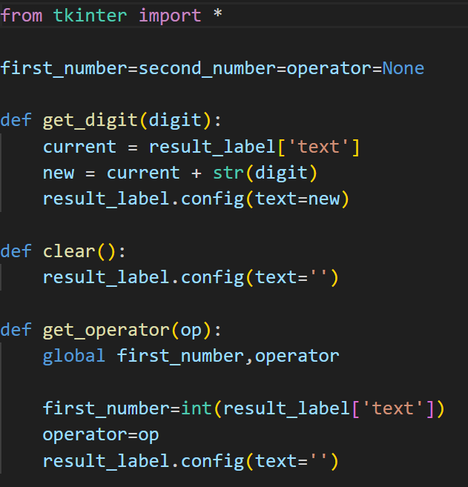
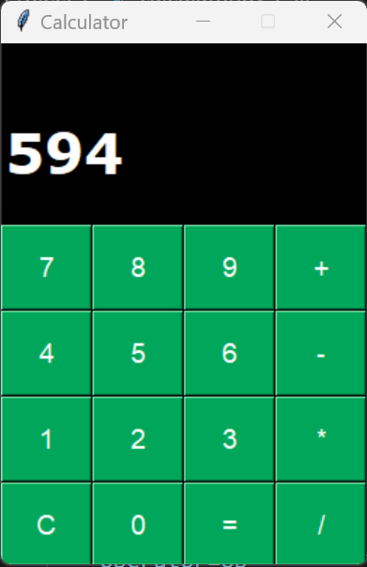
Code for GUI Calculator and OUTPUT

Slide 7
Conclusion
Advantages of Python Calculators
✔ Easy to Develop & Modify
✔ Highly Customizable
✔ Can be Extended with Advanced Features
✔ GUI Support for Better User Experience
Python provides various ways to implement a calculator.
GUI-based calculators enhance usability.
Python libraries make it easy to build advanced calculators.

Slide 8
Thank You

