Slide 1
Lab1
Integration of Merge Sort
& Insertion Sort
SC2001 Algorithm Design and Analysis
Gupta Dhruv · Gajulapalli Anish Reddy · Koh Jin En

Slide 2
Part (a): The Hybrid Algorithm
n
Merge sort recurses all the way down to subarrays of size 1 — at very small sizes, function-call and merge overhead dominates the actual sorting work.
Insertion sort has near-zero overhead per element, and is efficient exactly where merge sort is wasteful: small arrays.
Threshold S: once a subarray's size falls to S or below, switch from merge sort to insertion sort instead of recursing further.
n / 2
n / 4 (size ≤ S)
insertion_sort()
hybrid_sort(L, left, right, S):
if size ≤ S: insertion_sort(L)
else: split, hybrid_sort() on both halves, then merge()

Slide 3
Part (b): Generating Input Data
1,000 → 10,000,000
[ 1, 1,000,000 ]
42
Array sizes tested
Random integer range
Fixed random seed
Same array reused across every S value tested at a given n — isolates S as the only variable changing between runs.
Key comparisons are counted directly inside insertion_sort() and merge() as the algorithm runs.
Correctness is asserted against Python's sorted() on every single run — a wrong result fails loudly rather than silently producing bad data.

Slide 4
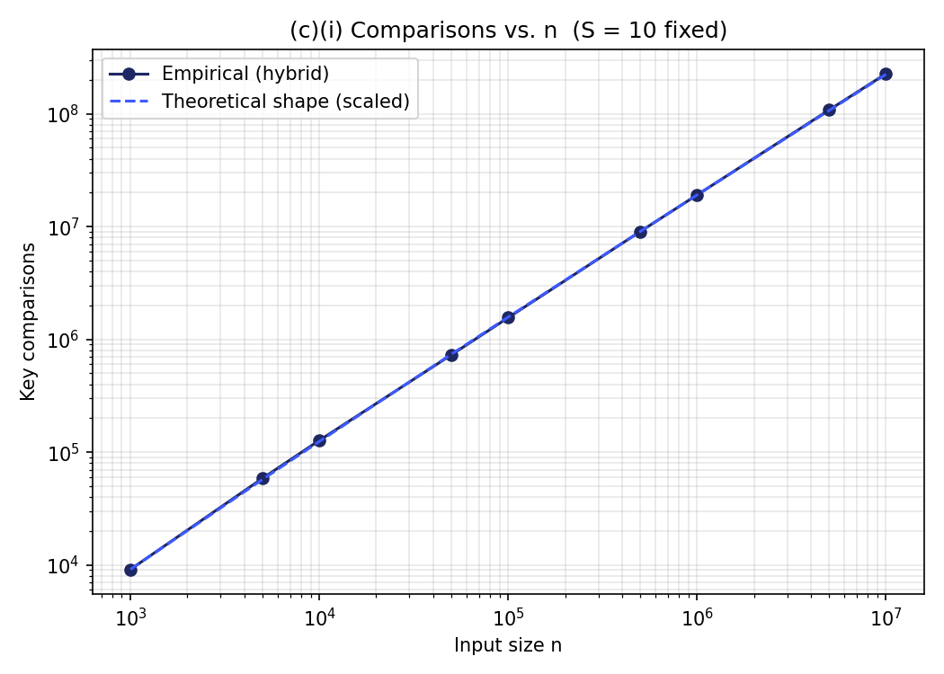
Part (c)(i): Comparisons vs. Input Size n
T(n,S) ≈ n · log₂(n / S) + n · S / 4
S fixed at 10 — n from 1,000 to 10,000,000
Merge cost ≈ n·log₂(n/S): log₂(n/S) halving levels, each costing ~n comparisons total across all merges at that level.
Insertion cost ≈ n·S/4: ~S²/4 average comparisons per block of size S, times n/S blocks.
With S fixed, the nS/4 term is just a constant multiple of n — so growth is still O(n log n), same as plain merge sort.
Empirically confirmed: measured comparisons track the theoretical curve almost exactly across all 4 orders of magnitude tested.

Slide 5
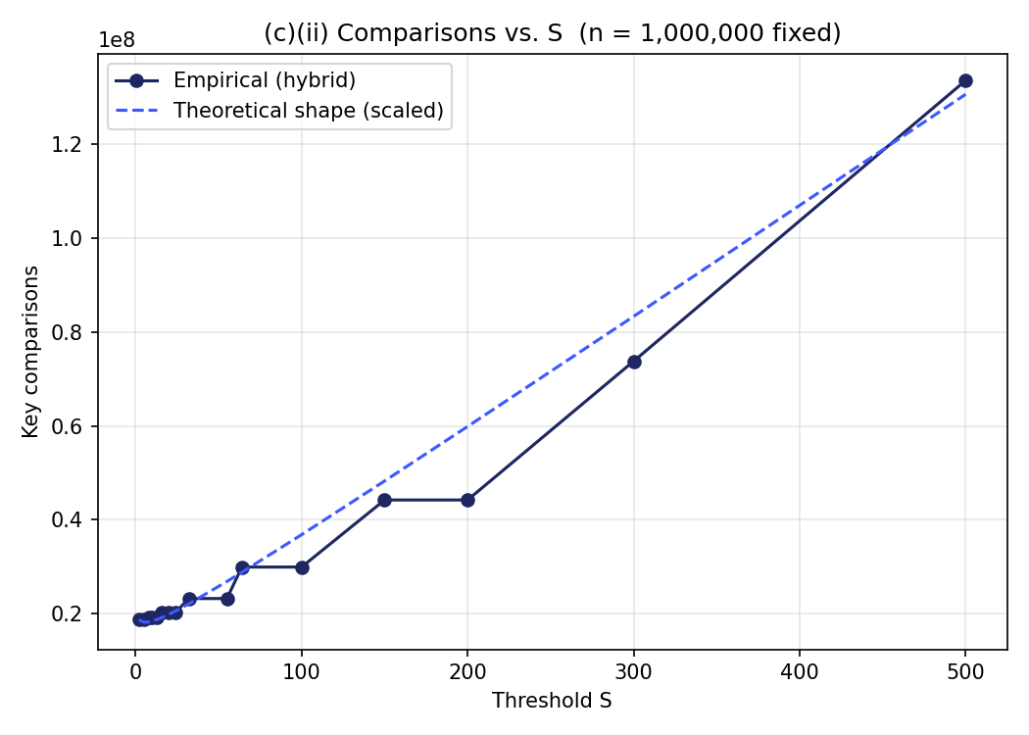
Part (c)(ii): Comparisons vs. Threshold S
n fixed at 1,000,000 — S from 2 to 500
Same formula, n fixed: the log term shrinks very slowly as S grows, while nS/4 grows linearly — so nS/4 dominates once S is large enough.
Matches theory: comparisons rise close to linearly with S past roughly S = 20–50.
Real finding beyond the formula: several neighbouring S values give IDENTICAL comparison counts — S = 8, 10, and 13 all tie; likewise S = 16/20/24, S = 32/55, S = 64/100, and S = 150/200.
Not noise — hybrid_sort's recursive halving fixes actual subarray sizes in advance. S only changes behavior when it crosses one of those halving boundaries, making the true curve a step function.

Slide 6
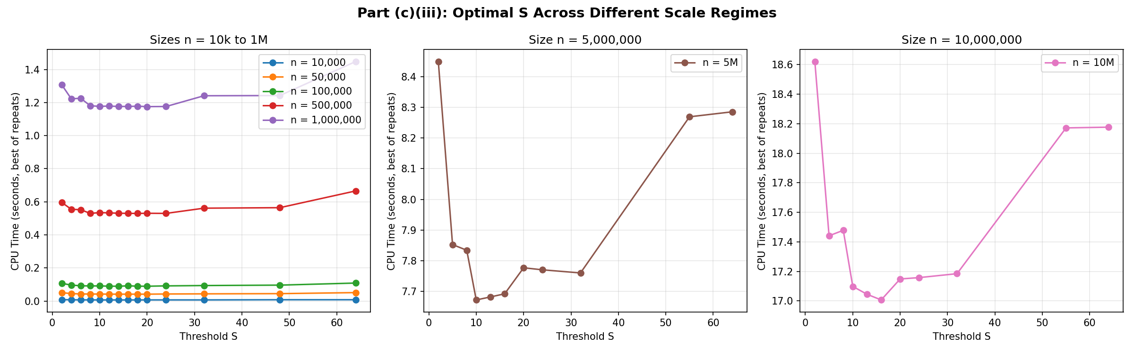
Part (c)(iii): Finding the Optimal S
Grid search across 7 sizes (10k – 10M) × up to 14 values of S, repeated 2–5 times for noise reduction
By fewest comparisons
By fastest CPU time
S = 2
S = 16
220,099,259 comparisons at n = 10,000,000
17.01s (best of repeats) at n = 10,000,000

Slide 7
Part (d): Hybrid vs. Original Merge Sort
n = 10,000,000 — Hybrid uses S = 16, the time-optimal value from part (c)(iii)
226,422,209
220,099,110
16.96s
19.03s
Hybrid — Comparisons
Merge Sort — Comparisons
Hybrid — CPU Time
Merge Sort — CPU Time
The counterintuitive result:
Hybrid sort makes 6,323,099 MORE comparisons than plain merge sort — yet finishes 2.07s faster (10.9% less CPU time).
Why: comparisons are not the only cost. Plain merge sort recurses all the way to size-1 subarrays, paying function-call and array-slicing overhead at every level. Insertion sort's extra comparisons at S=16 are individually cheaper operations — no recursive calls, no slicing — so more of them still finishes faster in wall-clock/CPU time.

Slide 8
Key Takeaways
Hybrid sort's comparison count matches its theoretical model, n·log₂(n/S) + n·S/4, almost exactly across 4 orders of magnitude.
"Optimal S" is metric-dependent: S=2 minimizes comparisons, but S=16 minimizes actual CPU time on our machine (S=10, 13, and 16 are a near-exact tie) — fewer comparisons doesn't automatically mean faster.
At n=10,000,000, hybrid sort beats plain merge sort on time (10.9% faster) despite doing more comparisons — recursion and function-call overhead are real costs that comparison-counting alone misses.
Practical implication: when picking a threshold S, measure wall-clock/CPU time, not just comparisons — they can disagree.
Questions?

