Slide 1




Join us at Flo 2026!
Your SDLC, Now Agentic - with Spring AI
Build, Review & Ship with AI Agents
10 Oct, 2026 | 3pm – 3:45pm
Harsh Vishwakarma
Sr. Staff Engineer
Bubble Coral Stage - Level 8 - North
Dhruv Gupta
Principal Engineer
Workshop

Slide 2
Enterprise Copilot
AI proposes. Humans dispose
AI accelerates delivery; humans own accountability.
Flo 2026 — Spring AI Workshop
Notes:
Meet four AI teammates and the human who holds the deploy button. This deck covers how the system is built, how to add the Confluence Agent exercise, and how to present the demo.

Slide 3
What if Jira had a team of AI engineers?
AUDIENCE
TRADITIONAL
ENTERPRISE COPILOT
Developer
Jira
🔍 Requirements
Jira
💻 Code
Code
🛡 Review
Review
🚀 Release
Human
Deploy
One assistant helps a developer.
An agent team can participate across the SDLC.
Notes:
AUDIENCE
Ask: “How many of you already use AI every day while developing software?”
Then contrast the two workflows.
Say: “The shift is not from human to AI. It is from one assistant to a coordinated AI engineering team.”
Transition: “So what does that look like as a product?”

Slide 4
Your Sprint Has Agents Now
Building a Multi-Agent SDLC Pipeline with Spring AI
Flo 2026
JIRA
🔍 Rhea
💻 Nova
🛡 Sentinel
🚀 Atlas
HUMAN
PRODUCTION
ISSUE
REQUIREMENTS
CODE
REVIEW
RELEASE
APPROVAL
OUTCOME
“
A Jira ticket becomes a team of AI engineers.
Notes:
OPENING HOOK
Say: “What if your Jira ticket didn't just create work for you — it created a team of AI engineers?”
Pause. Let the pipeline sit visually for a moment.
Transition: “Let me show you what that means.”
No demo yet.

Slide 5
1 · ARCHITECTURE
Four agents, like new teammates
🔍 Rhea
💻 Nova
🛡 Sentinel
🚀 Atlas
Requirements Analyst
Senior Java Engineer
Security & Compliance
Release Manager
LLM
LLM
LLM
Deterministic Java
Refuses to guess. Raises clarification questions that PAUSE the pipeline.
Proposes code as a PR diff + tests. Never touches the filesystem.
Severity-tagged findings. Any CRITICAL blocks deploy. The hero moment.
Rule-based gates. Allowed only when every gate passes AND a human approves.
Notes:
Name them like people. Rhea clarifies, Nova proposes, Sentinel catches the flaw, Atlas holds the gate. Atlas is deterministic Java in every mode — the release decision is never a probability.

Slide 6
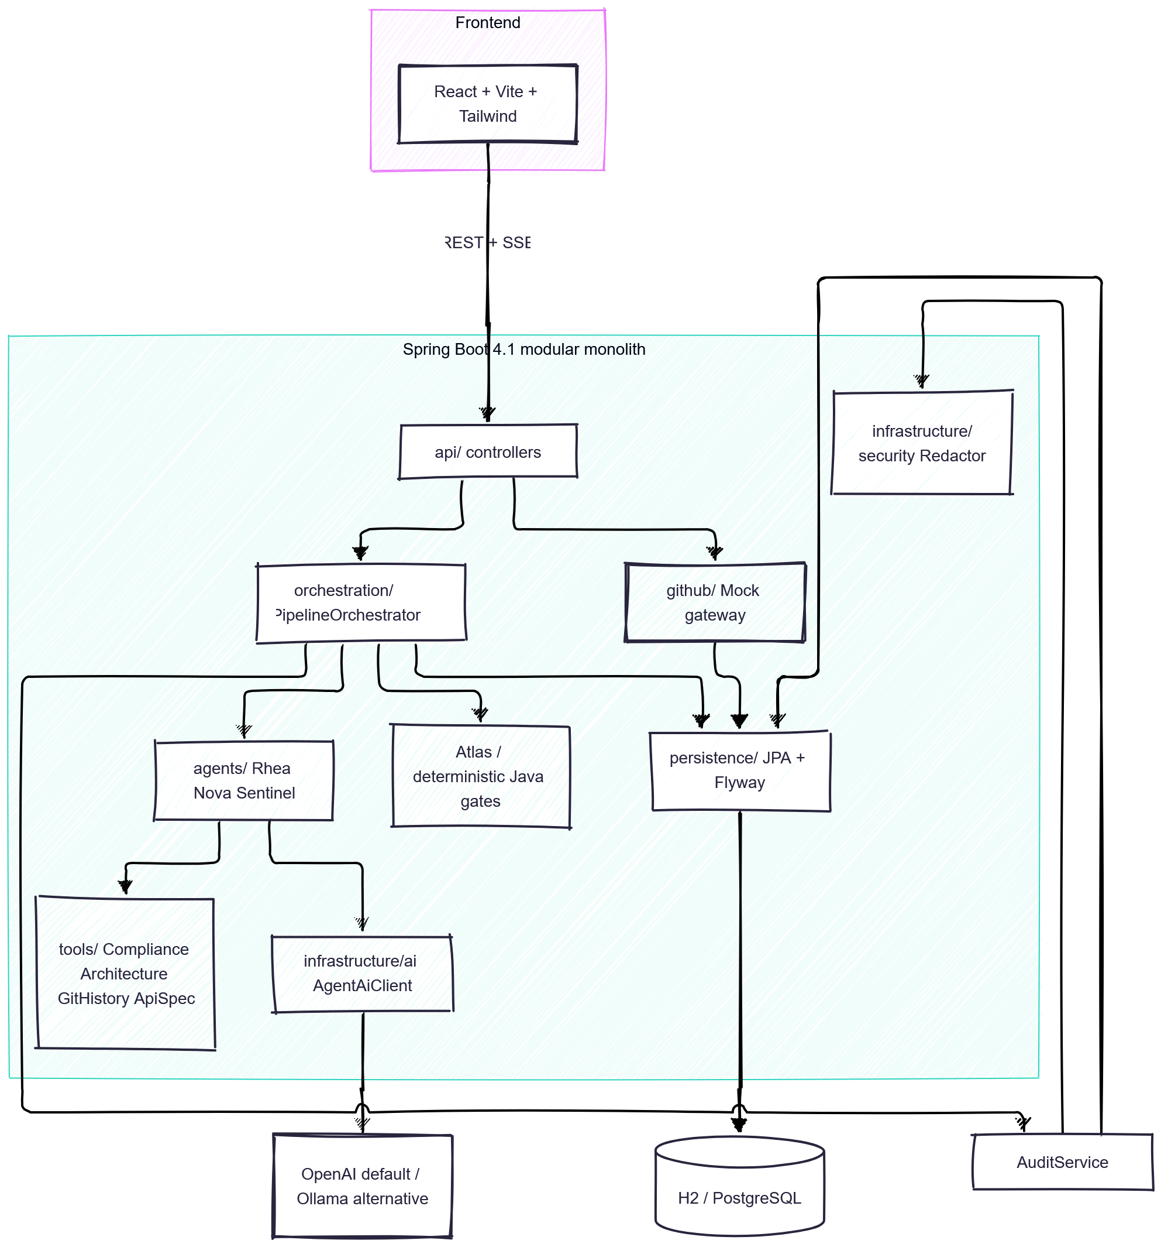
System Architecture

Slide 7
1 · ARCHITECTURE
Modular monolith + React dashboard
• Spring Boot modular monolith — one process, clear boundaries
  – api/ controllers expose REST + SSE
  – orchestration/ PipelineOrchestrator drives the flow
  – agents/ Rhea, Nova, Sentinel (LLM)
  – Atlas — deterministic Java gates
  – tools/ Compliance, Architecture, GitHistory, ApiSpec, Confluence
• React + Vite + Tailwind dashboard
  – REST + SSE; UI auto-detects optional stages from events
• Persistence
  – pipelines snapshot (JSON) + append-only redacted audit_events
  – Flyway owns schema; Hibernate validate-only
Flow
• UI → API → Orchestrator
• Orchestrator → Agents → Tools
• Agents → AgentAiClient → OpenAI / Ollama
• Orchestrator → Atlas (deterministic gates)
• Orchestrator → AuditService → Redactor
• Orchestrator → Persistence → H2 / PostgreSQL
Notes:
One process, no premature microservices. The orchestrator coordinates three model-backed agents and one deterministic release manager. Everything is auditable and redacted.

Slide 8
1 · ARCHITECTURE
Pipeline & execution modes
ISSUE → REQUIREMENTS → CODE → REVIEW → DEPLOY (human approval before DEPLOYED)
• LIVE — OpenAI default
  – Rhea, Nova, Sentinel make real model calls; results vary
  – Ollama is the explicit local LIVE alternative
• DEMO — deterministic preview/fallback
  – Scripted outcomes for 100% reproducible reveals
  – Credential-free self-checks
• Atlas is deterministic Java in EVERY mode
  – Gates: artifacts, clarification, review APPROVE,
  – no CRITICAL findings, valid test signal, human approval
• Never promise a deterministic LIVE security finding
  – Tests & deployment are simulated — nothing ships for real
Notes:
The reveal must be reproducible, so the hero moment is shown in DEMO. LIVE uses the real provider. Atlas never changes: a human always owns the last click.

Slide 9
2 · EXERCISE
Add the Confluence Agent
Goal: give Rhea internal business context so she resolves an ambiguity without asking a human.
• Deterministic — NO LLM. Not every agent needs a model.
  – Reads one supplied local decision document and passes the text to Rhea transiently
  – No new AI kind, result model, prompt, state, persistent field or feature flag
• Already provided (do NOT build):
  – ConfluenceTool — reads resources/demo-data/confluence.md (no search)
  – RequirementsAgent.analyze(ctx, businessContext) — Rhea's string overload
  – withConfluenceActivity(...) wrapper emits the activity events
  – DEMO plumbing + React UI that auto-detects the optional Confluence stage
• Participant work: ~15–20 lines + supplied wiring (5 min expected, 8 max)
Notes:
Teaching point: not every agent needs an LLM. Rhea already reasons; she just needed the missing business context. The tool, overload and plumbing are supplied.

Slide 10
2 · EXERCISE
Step 1 — Create the agent
backend/.../agents/confluence/ConfluenceAgent.java
@Component
public class ConfluenceAgent {
private final ConfluenceTool confluenceTool;
public ConfluenceAgent(ConfluenceTool confluenceTool) {
this.confluenceTool = confluenceTool;
}
public String gatherContext(Ticket ticket) {
return confluenceTool.lookup(ticket.description());
}
}
Notes:
About 15-20 lines including imports. Constructor injection of the supplied ConfluenceTool; gatherContext just calls lookup with the ticket description.

Slide 11
2 · EXERCISE
Step 2 — Wire it into the orchestrator
• Fill the five CONFLUENCE_EXERCISE markers:
  – Import the agent
  – Field: private final ConfluenceAgent confluenceAgent;
  – Constructor parameter: ConfluenceAgent confluenceAgent,
  – Assignment: this.confluenceAgent = confluenceAgent;
  – Replace the initial Rhea call (right)
String businessContext =
withConfluenceActivity(ctx,
() -> confluenceAgent
.gatherContext(ctx.ticket()));
RequirementAnalysis analysis =
requirementsAgent
.analyze(ctx, businessContext);
Notes:
Markers keep the exercise scoped. The supplied withConfluenceActivity wrapper records the activity events that make the Confluence stage appear in the UI.

Slide 12
2 · EXERCISE
Step 3 — Before / After (UB-4823)
BEFORE (starter)
AFTER (with agent)
• Rhea pauses and asks:
  – “Which notification channel should we use?”
• Flow: Rhea → Human clarification
• Confluence supplies the approved SMS decision
  – No human input needed
• Confluence → Rhea → Nova → Sentinel → Atlas → Approval
Negative control — UB-4825 still BLOCKS: the policy supplies no fraud contract, so Sentinel blocks the unsupported proposal even with Confluence context.
Notes:
Reset for the starter, apply for the reference. ./workshop/scripts/confluence-exercise.sh reset | apply. Both idempotent; apply --force only replaces exercise-owned files.

