Slide 1

EV CHARGING
SOLUTION
Presented by:
Dhruvi Bavaria
Sweta Mandani
Guided By:
Saumil Trivedi

Slide 2
CONTENT
Project Definition
Project Description
Flow Chart
Implementation
Future Scope
Conclusion

Slide 3
PROJECT DEFINITION
To develop a system for easy access to all the charging points that are planted in different areas for users

Slide 4
PROJECT DESCRIPTION
Use of electric vehicles is increasing and the chargers for them don’t occupy large spaces as petroleum pumps due to which it is hard to locate charging pumps when you travel to new cities.
To solve this problem of Users we have developed a solution named EVCharging Solution in which user will be able to login and will be able to see nearby locations in google map.
Also, we have implemented an easy access for Admin to Manage Locations,services,chargers,static page data etc.

Slide 5
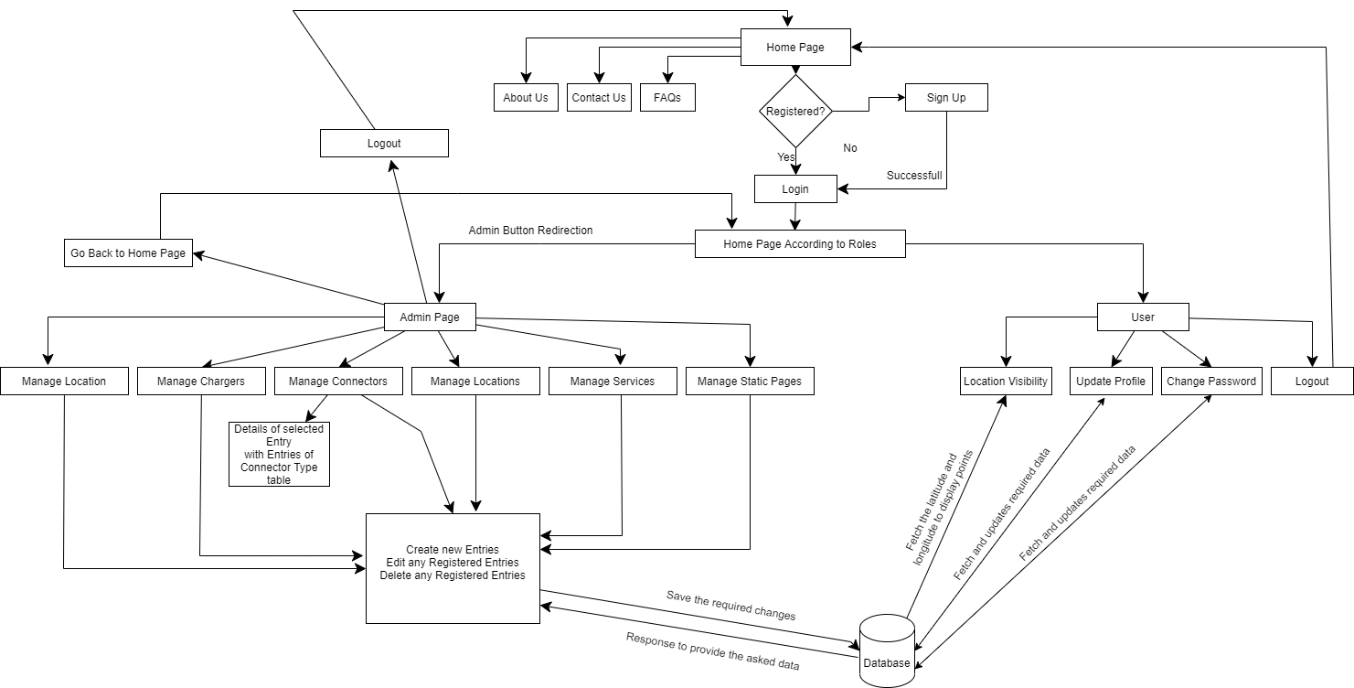
FLOW CHART

Slide 6
FUTURE SCOPE
Can add an history page to maintain the users history of searches.
User can interact with map by writing down the location name.
User can see all the details about the entered location with the photos of street and charger.
User can be able to see if charger is available or busy.

Slide 7
CONCLUSION
The system is available for users to know the locations of charging points in the area of their choice.
Admin is able to manage data easily, which makes it more interactive for him to perform tasks.

Slide 8
THANK YOU!

