Slide 1

A PRODUCT STORY, TOLD BY ME
REWARDS & LOYALTY
ON THE SAATHI APP
How I found the problem, confirmed it was real, built the fix, and proved it worked
By Sibin | Loyalty, Retention & Growth | PayNearby

Slide 2

01 — PROBLEM STATEMENT
The Problem, As I Saw It
Our Saathi retailers were doing real volume — 30, sometimes 40 transactions a day across Recharge, AePS and Mutual Funds. But when I asked a few of them a simple question, “do you know how much you earned this week?” — almost none of them could answer.
The reward was real, it just wasn’t felt. It landed once a month, as one lump sum, with no link back to the transaction that earned it. So the thing that was supposed to make a retailer come back and transact again wasn’t doing its job.
In one line: retailers were earning, but they couldn’t see it, feel it, or connect it to their own effort — and that was quietly capping how often they came back.
Rewards & Loyalty — Saathi App
2

Slide 3




02 — DISCOVERY
How I Landed On This Problem
I didn’t start with a solution in mind — I started by reading and listening.
Read the tickets
Checked the data
I pulled three months of CRM tickets tagged ‘rewards’ / ‘incentive’. The same question kept showing up: “Where is my incentive for last week’s recharge?”
I looked at DAU/MAU for our top-tier retailers and saw a dip in the two weeks after each month-end payout — the engagement bump from the reward wore off fast.
Sat with retailers
Talked to CRM & Growth
I visited a handful of retail counters and just watched — how they checked their earnings, what confused them, what they wished the app told them.
I sat with the CRM and Growth teams to understand exactly how the existing month-end mechanism worked, and where it was already stretched thin.
Rewards & Loyalty — Saathi App
3

Slide 4

03 — VALIDATION OF THE PROBLEM
Confirming This Was Worth Solving
Three signals, pointing the same way — that’s when I knew this wasn’t a one-off complaint.
Behaviour dipped, predictably
Tickets kept repeating
Retailers said it themselves
Every month, the same DAU/MAU dip in the two weeks after payout, across cohorts — not a coincidence.
The ‘where’s my reward’ question wasn’t rare — it was one of the most repeated themes in CRM logs across regions.
Unprompted, more than one retailer told me they’d rather get paid “a little, right away” than “a lot, but late.”
With that evidence in hand, I took it to the CRM and Growth leads — and we agreed this was worth prioritising ahead of other asks that quarter.
Rewards & Loyalty — Saathi App
4

Slide 5

04 — THE SOLUTION
So instead of one more monthly-payout tweak, I proposed a rewards & loyalty layer that sits on top of Saathi — one that pays retailers the moment they’ve earned it, shows them exactly why, and makes checking your earnings something you actually want to do.
Instant, not monthly
Fully transparent
A little bit of delight
Built to scale
Here’s what that looked like, feature by feature →
Rewards & Loyalty — Saathi App
5

Slide 6
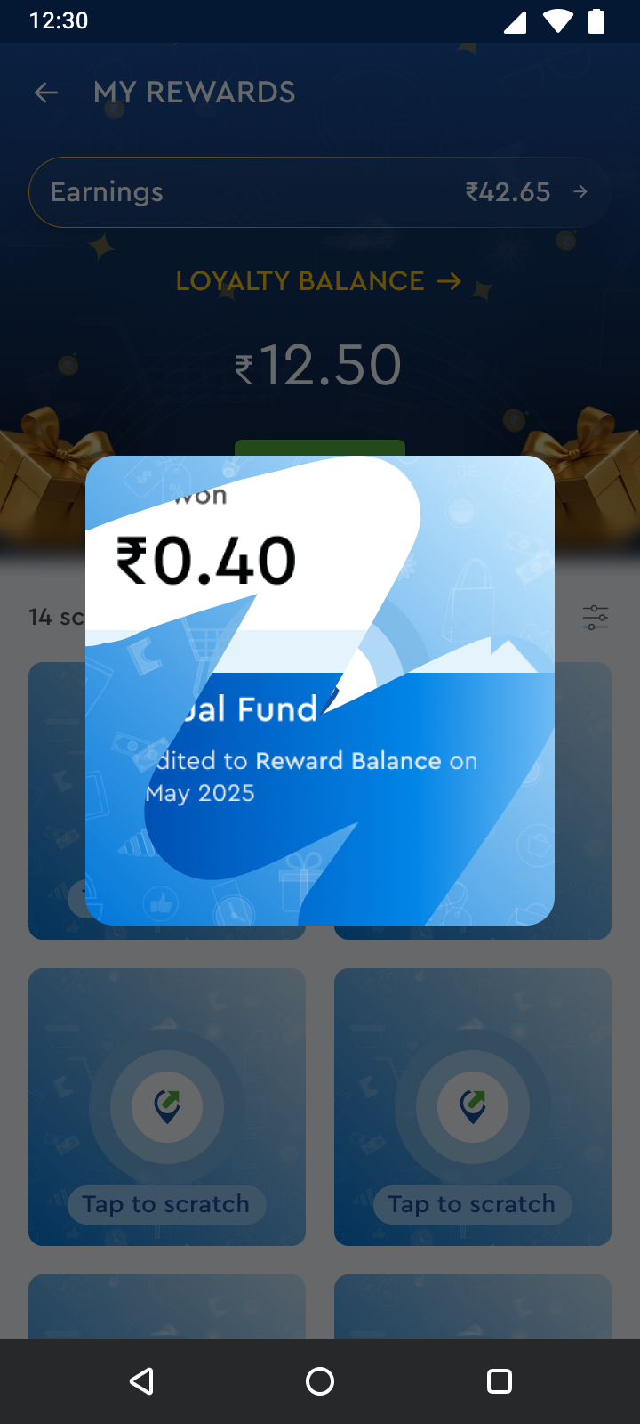

05 — SOLUTION DESCRIPTION
Real-Time Instant Credit
This is the heart of it. Instead of waiting for month-end, a qualifying Recharge or Mutual Fund transaction credits the retailer’s main ledger the same instant — via the GDC API — and they see it confirmed right there on screen.
WHY IT MATTERS
It puts the reward back next to the action that earned it.
It’s the single biggest lever on repeat-transaction frequency.
It runs quietly alongside the existing monthly system — nothing legacy breaks.
Rewards & Loyalty — Saathi App
6

Slide 7
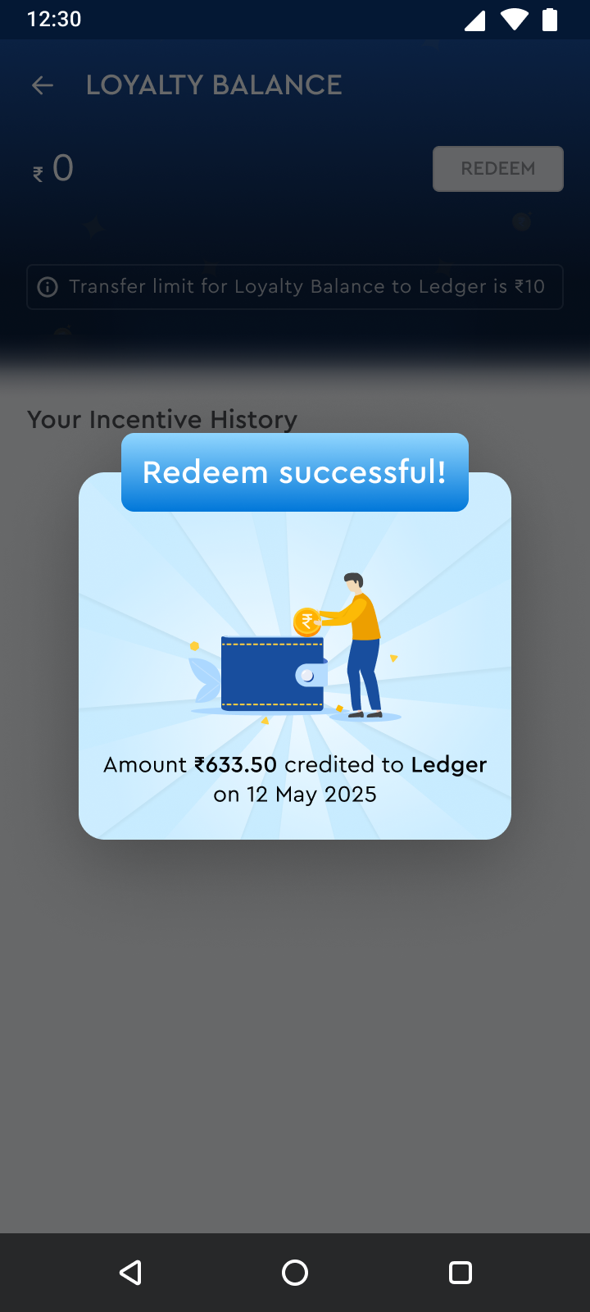

05 — SOLUTION DESCRIPTION
Gamified Scratch-Card Coupons
After a transaction, a scratch card reveals a randomised reward — Cash, a GrabOn Coupon, or Better Luck Next Time — based on payout ratios I could tune per campaign.
WHY IT MATTERS
The unpredictability is the point — it’s a small moment of delight, not just a payout.
It gives retailers a reason to open the app the same day, not just at month-end.
I could dial the ratio up or down per service without touching the core engine.
Rewards & Loyalty — Saathi App
7

Slide 8
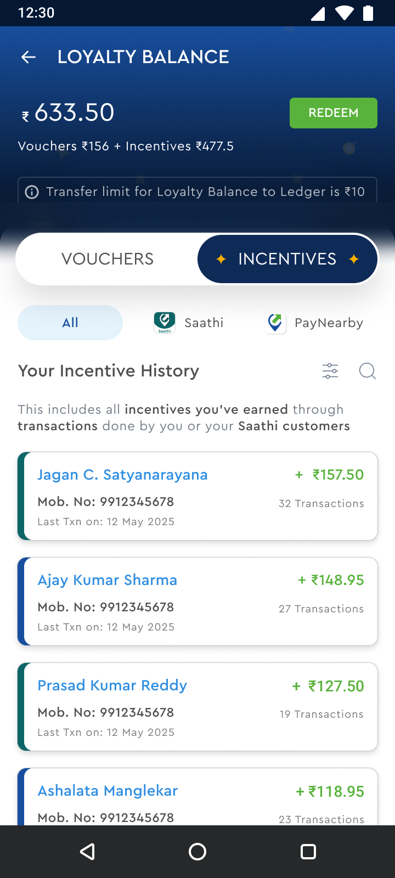
05 — SOLUTION DESCRIPTION
Loyalty Balance & Redeem
One screen, one number. Vouchers + Incentives combine into a single Loyalty Balance, and one tap redeems it straight to the Main Ledger.
WHY IT MATTERS
No more guessing — a retailer always knows exactly what they’ve earned.
One-tap redemption meant fewer ‘how do I get my money’ support calls.
A small ₹10 minimum-transfer rule kept settlement costs sane at scale.
Rewards & Loyalty — Saathi App
8

Slide 9
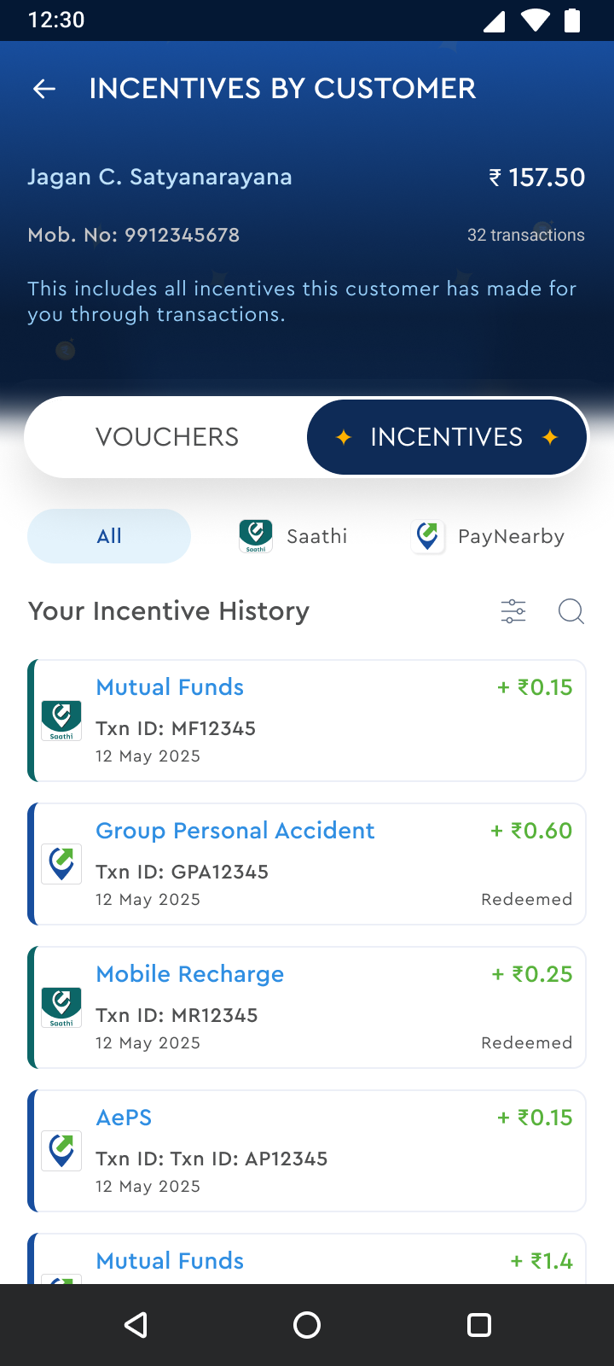

05 — SOLUTION DESCRIPTION
Incentive History by Customer
Every rupee is traceable back to the exact customer and transaction that earned it — mobile number, transaction count, per-service split, all in one view.
WHY IT MATTERS
Retailers could finally see which of their customers were worth nurturing.
That visibility nudged them to cross-sell AePS, Mutual Funds and GPA to the right people.
No reward ever showed up without a reason attached — that’s what built trust.
Rewards & Loyalty — Saathi App
9

Slide 10
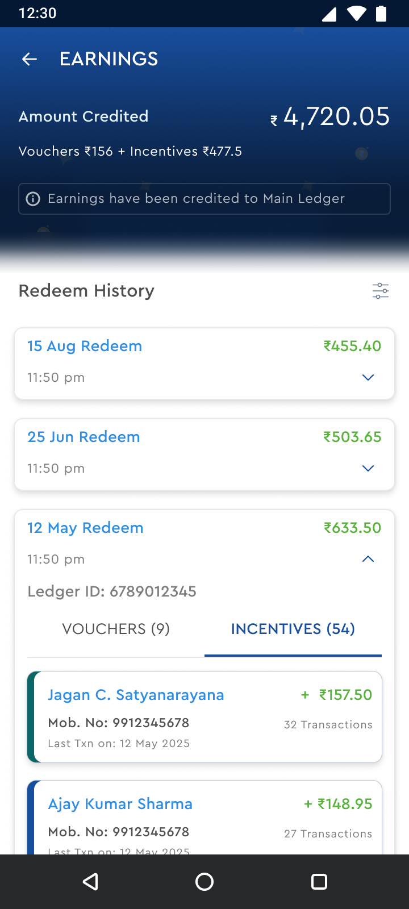
05 — SOLUTION DESCRIPTION
Earnings & Redeem History
A running record of every past redemption — date, amount, Ledger ID, and a Vouchers vs. Incentives split — always sitting there for the retailer to refer back to.
WHY IT MATTERS
This is what turned a one-time fix into something retailers actually trusted long-term.
It let retailers self-serve reconciliation instead of raising a ticket.
Ledger IDs gave CRM a clean trail whenever an escalation did come in.
Rewards & Loyalty — Saathi App
10

Slide 11
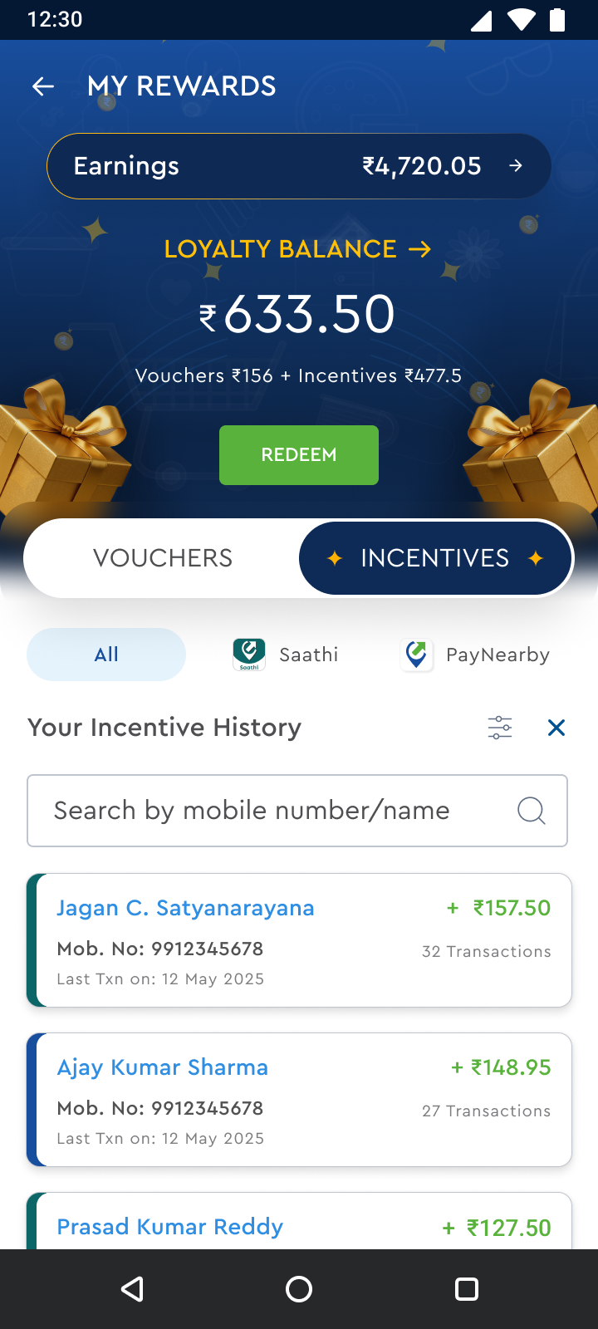

05 — SOLUTION DESCRIPTION
Search & Filter Incentives
For the busiest retailers, I added a simple search by mobile number or name, plus a filter by service — Saathi or PayNearby.
WHY IT MATTERS
It kept the experience usable once a retailer had hundreds of entries in their history.
A faster lookup meant a faster path from ‘I have a question’ to ‘okay, I trust this.’
It also gave us a cleaner data model to build service-level analytics on, later.
Rewards & Loyalty — Saathi App
11

Slide 12


06 — PROVING IT WORKED
How I Validated the Solution
I didn’t roll this out to all 20,000+ retailers on day one — I wanted proof first.
Started with a pilot
Compared against a control
Ran the instant-credit and scratch-card flow with a smaller retailer cohort across two regions, for four weeks, before touching the full base.
Tracked repeat-transaction rate and DAU/MAU for the pilot group against a matched control group still on the old monthly cycle.
Iterated on the reward mix
Closed the loop with retailers
The first scratch-card payout ratio was too conservative — retailers noticed. I re-tuned it with Growth before the wider rollout.
Went back to the same retailers I’d spoken to during discovery, to check whether the fix actually matched what they’d asked for.
Rewards & Loyalty — Saathi App
12

Slide 13

07 — IMPACT OF THE SOLUTION
What changed once it shipped
30%
60%
64%
52%
Acquisition growth across 20K+ retailers, from owning the referral & loyalty roadmap
Retention uplift via experimentation, A/B testing and CRM lifecycle personalization
Increase in repeat transactions across the retailer base
DAU/MAU growth through behavioral analytics and funnel optimization
None of this was the plan on day one — it’s what came from following the problem all the way from a CRM ticket to a shipped, validated fix.
Rewards & Loyalty — Saathi App
13

Slide 14
THANKS!
Rewards & Loyalty on the Saathi App | Sibin
14

