Slide 1

PRODUCT MANAGEMENT PORTFOLIO
Rewards & Engagement
Engine
Migrating Banking Correspondent customers from assisted, in-store transactions to self-service on the Saathi App — without losing the retailer.
COMPANY
ROLE
TIMELINE
PayNearby
Product Owner — Loyalty, Retention & Growth
Q3 2025 – Q1 2026
TEAM
DOMAIN
OBJECTIVE
Growth, CRM, Engineering & Design (cross-functional)
Fintech — Banking Correspondent (BC) Network
Shift assisted BC transactions to self-service, without losing retailer engagement
Rewards & Engagement Engine — PM Portfolio
01

Slide 2


CONTEXT — WHAT CHANGED
From assisted transactions to self-service
OLD MODULE — PAYNEARBY APP
NEW MODULE — SAATHI APP
Retailer facilitates the transaction in-store, on the customer’s behalf
Customer walks in; the retailer operates the app or device
Retailer earns a commission for doing the transaction himself
Customer transacts directly, on their own, on the Saathi App
Retailer’s role shifts to promoting and activating the customer
Retailer still earns commission — passively, for enabling it
WHY THIS SHIFT
Customers become self-sufficient instead of queuing at the counter. The retailer’s job becomes promotion and activation — not manual operation — which cuts his store setup and operating cost, and frees him to activate many customers instead of serving one at a time.
Rewards & Engagement Engine — PM Portfolio
02

Slide 3


PROBLEM STATEMENT
Two problems hiding behind one launch
1. The customer wasn’t changing habit
2. The retailer was flying blind
No repeat self-service transactions — customers tried it once and stopped
New activations kept growing, but DAU/MAU kept dropping underneath
The same customers were still transacting in-store, through the retailer, on PayNearby
Confirmed directly — retailer interviews and a survey both backed the pattern
No visibility into incentives earned from Saathi customer transactions vs. his own
No way to see which of his customers were active, and which had gone quiet
No consolidated view of total commission earned, broken down by customer
WHY IT MATTERED
The launch was succeeding at acquisition and quietly failing at retention on both sides — the customer wasn’t sticking, and the retailer had no way to even see it happening, let alone act on it.
Rewards & Engagement Engine — PM Portfolio
03

Slide 4


USER RESEARCH — PERSONAS
Two sides of the same habit
SUPPLY SIDE
DEMAND SIDE
The Retailer — BC Agent
The Customer — BC Services User
Jagan C. Satyanarayana — Age 35 — runs a Banking Correspondent counter (cash withdrawal, deposit, AePS, mini-KYC)
Ashalata Manglekar — regularly does cash withdrawal, AePS and mini-statements at her local BC counter
GOAL Grow his commission income while spending less time per transaction.
GOAL Get her banking transaction done reliably, without extra effort or risk.
PAIN POINTS
PAIN POINTS
Doesn’t know which customers are actually using Saathi vs. gone quiet
Can’t separate in-store commission from Saathi-driven commission
No clear incentive to actively push customers toward self-service
Worried self-service means losing the footfall and the relationship
Comfortable with the retailer doing it for her — trusts the person, not an app
Sees no real reason to switch to doing it herself on an unfamiliar app
Tried Saathi once, likely at the retailer’s prompting, but saw no reason to return
Feels no different reward doing it herself vs. simply asking the retailer
Rewards & Engagement Engine — PM Portfolio
04

Slide 5


INSIGHTS
What the evidence actually said
Adoption without retention
Reversion to the old habit
New self-service activations kept growing, but DAU/MAU for the Saathi App kept dropping underneath — a classic leaky bucket.
The very same customers who’d tried Saathi were still going back to transact in-store, through the retailer, on PayNearby.
Confirmed on the ground
The retailer had no visibility
Retailer interviews and a structured survey both backed the same pattern — this wasn’t a data artifact, it was real behaviour.
No way to see which incentives came from Saathi vs. his own transactions, who was active, who’d gone quiet, or total commission by customer.
Rewards & Engagement Engine — PM Portfolio
05

Slide 6



OPTIONS CONSIDERED
Three ways to close the gap
A. Force self-service
B. Flat cashback for self-service
C. Retailer-led nudges only
Limit or disable retailer-assisted transactions on PayNearby to push customers onto Saathi.
Give every customer a fixed discount for transacting on their own.
WhatsApp reminders and in-store posters encouraging customers to try the app.
TRADEOFF
TRADEOFF
TRADEOFF
Fast forcing function — but risks losing the customer and the retailer relationship entirely, rather than converting the habit. Too aggressive for a trust-first customer base.
Simple to build — but a flat, guaranteed reward is pure cost with no compounding engagement effect. Customers habituate fast; it becomes an entitlement, not a habit driver.
Low cost — but passive. It educates without creating any real incentive to change, and does nothing for the retailer’s own motivation to promote it.
Rewards & Engagement Engine — PM Portfolio
06

Slide 7


FINAL SOLUTION
The Rewards System — built for both sides
CUSTOMER SIDE
RETAILER SIDE
Gets a randomised reward for every self-service transaction — the unpredictability is what makes her want to come back and try again, not just a one-time discount.
Gets full visibility into every Saathi-driven rupee earned, by customer — plus milestone-based bonus incentives when his customers hit usage milestones, giving him a real reason to promote it.
LONG-TERM VISION
Make the customer self-sufficient on the Saathi App — reducing load on the retailer’s in-store counter and on the PayNearby app, one habit at a time.
Rewards & Engagement Engine — PM Portfolio
07

Slide 8
SOLUTION DEEP DIVE — CUSTOMER SIDE
A reason for the customer to come back
Every time a customer completes a transaction on the Saathi App by herself, she gets a randomised reward — a small credit, a coupon, or sometimes a friendly miss. It’s the same unpredictability that makes a scratch card exciting, applied to something as routine as an AePS withdrawal.
WHY IT MATTERS
Turns a neutral, habitual action into something with a small emotional payoff
Variable rewards build a stronger habit loop than a flat, predictable discount
Works even if the retailer never actively mentions it
CONCEPT
Illustrative — customer-facing reward reveal on the Saathi App
Rewards & Engagement Engine — PM Portfolio
08

Slide 9
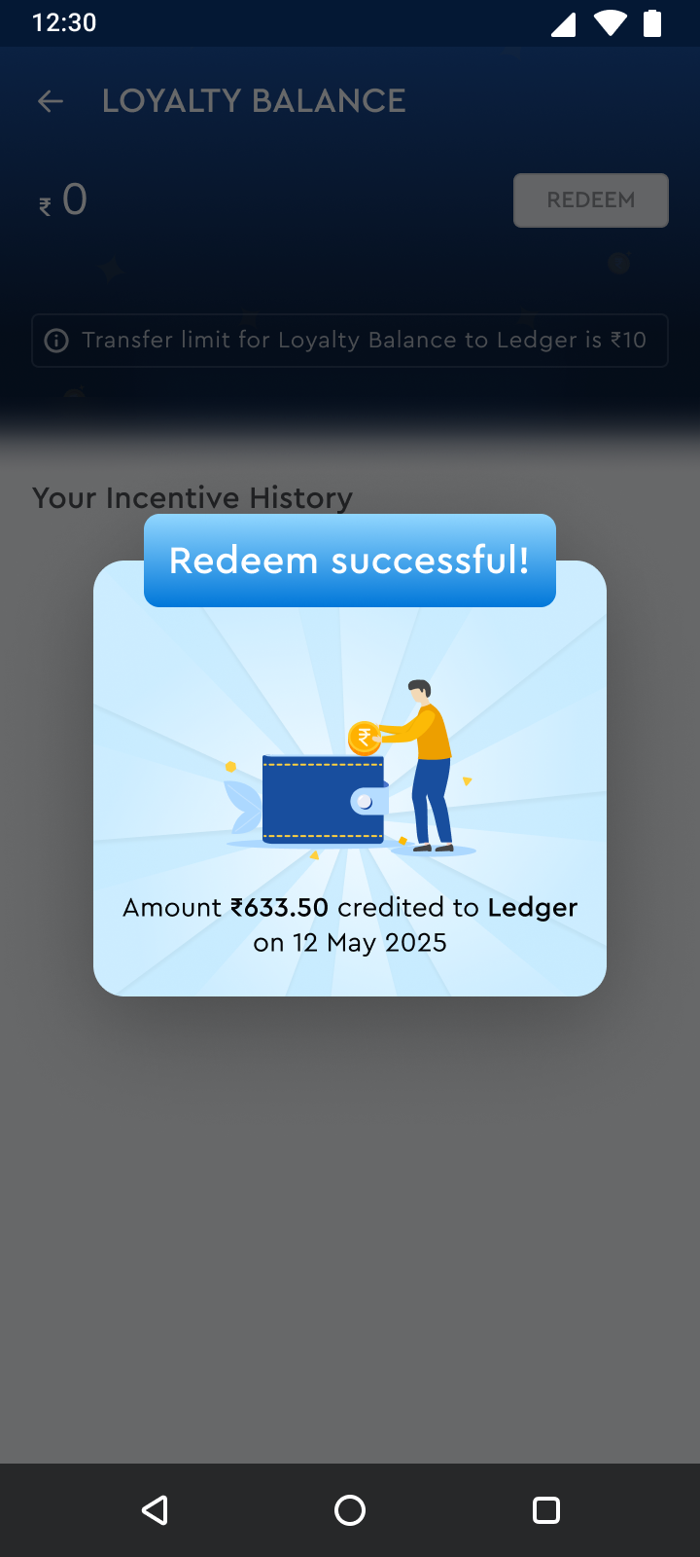
SOLUTION DEEP DIVE — RETAILER SIDE
A reason for the retailer to promote it
When a customer hits a usage milestone on Saathi — say, her 5th self-service transaction — the retailer unlocks a bonus incentive of his own, revealed the same way: a small, delightful moment, not a buried line item.
WHY IT MATTERS
Turns ‘promote the app’ from an abstract ask into a concrete, earnable outcome
Aligns the retailer’s incentive with the exact behaviour we need — customers coming back
Makes the retailer an active partner in the habit change, not a bystander losing footfall
Rewards & Engagement Engine — PM Portfolio
09

Slide 10
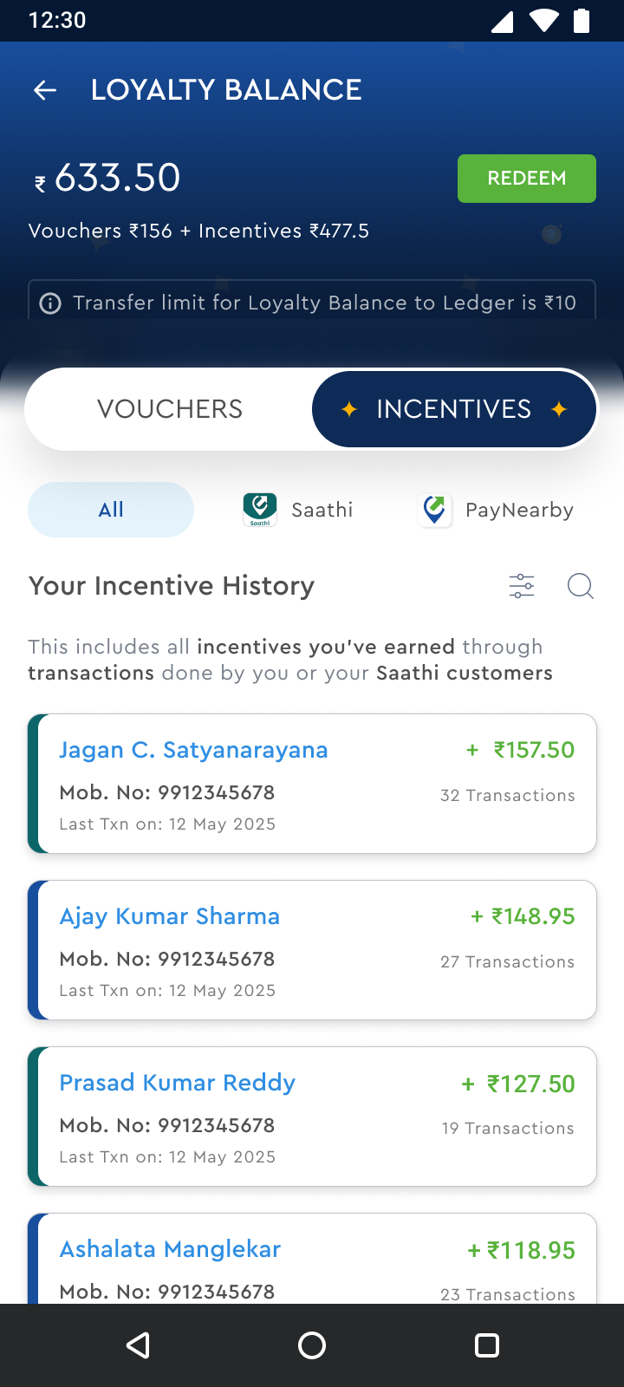
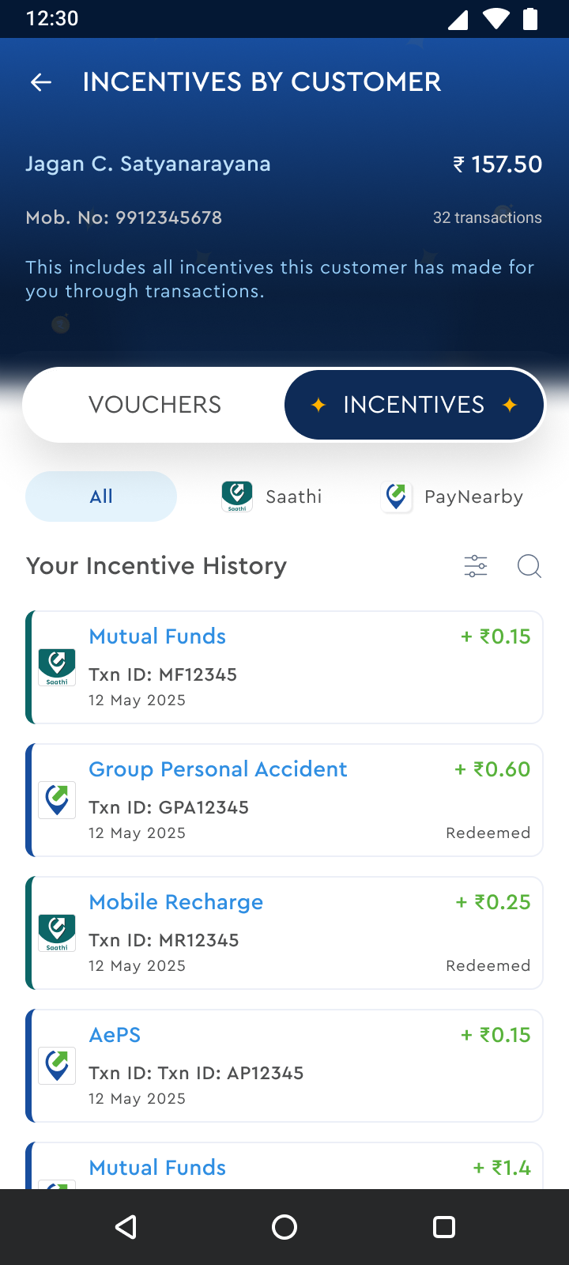
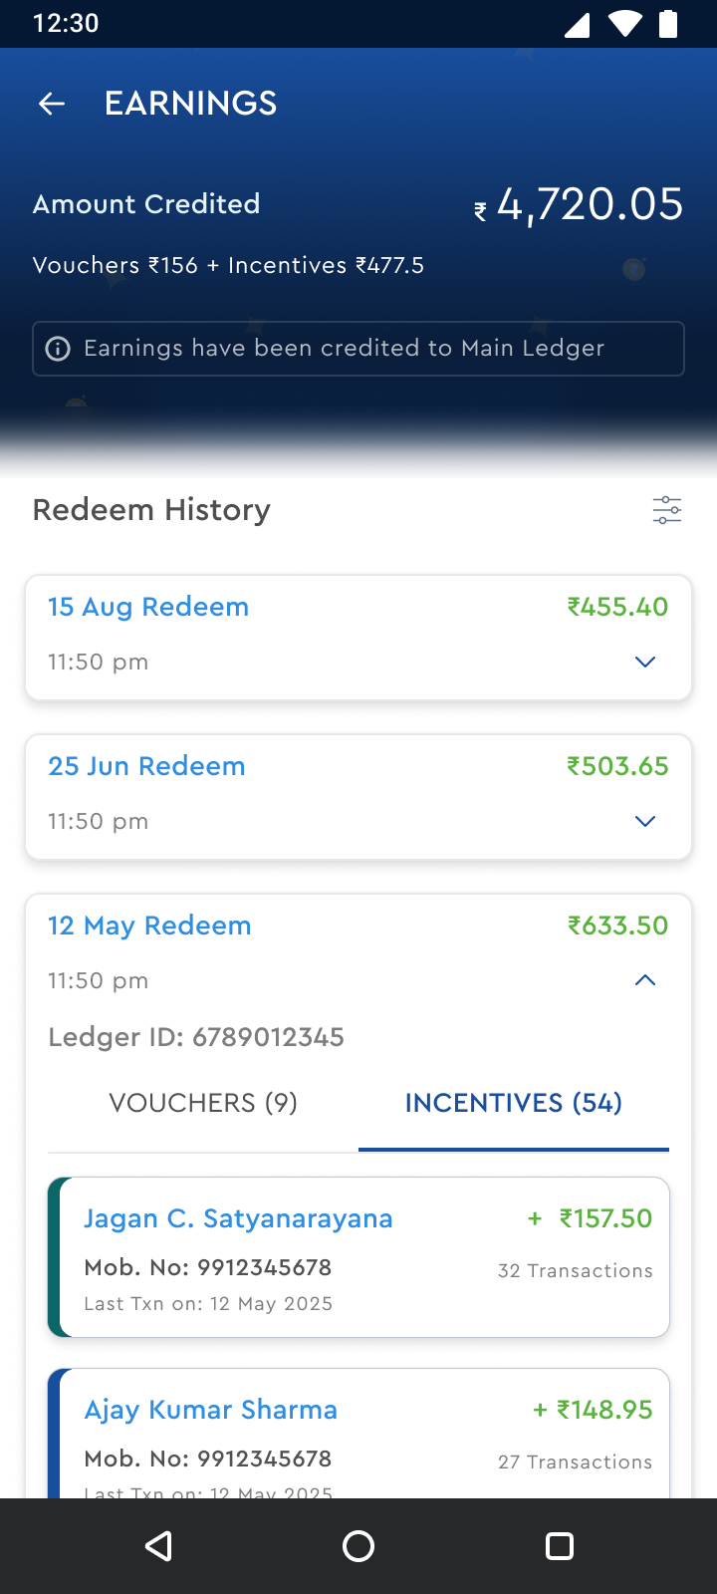
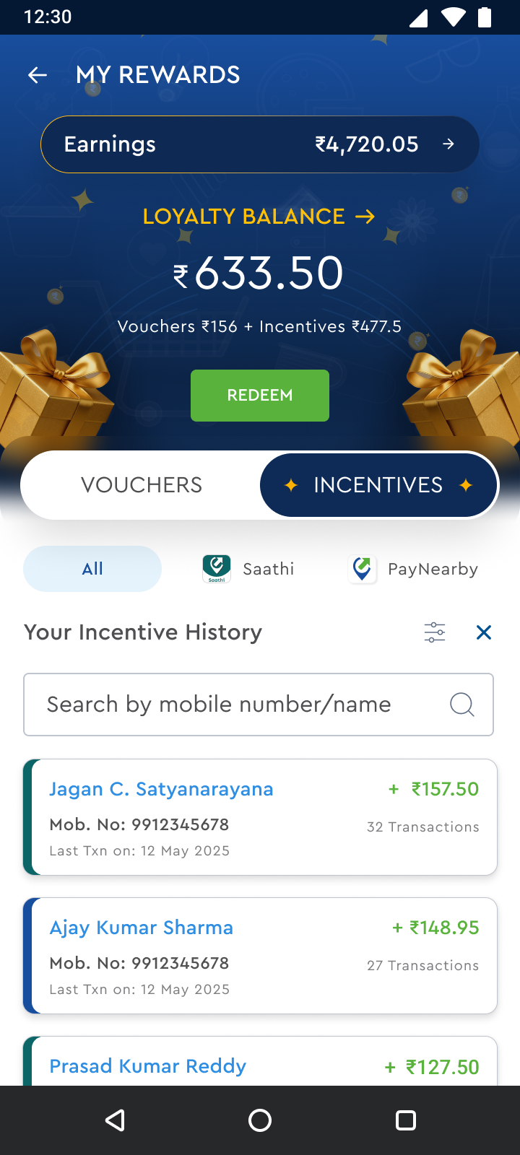
SOLUTION DEEP DIVE — RETAILER SIDE
Everything he couldn’t see, now in one place
Loyalty Balance & Redeem
Incentive History by Customer
Earnings & Redeem History
Search & Filter
One number — Saathi + in-store combined, one tap to redeem
Exactly who transacted, how often, and what it earned him
A running, trustworthy record of every past payout
Fast lookup once a retailer has hundreds of customers
Rewards & Engagement Engine — PM Portfolio
10

Slide 11


PRODUCT STRATEGY
Vision & North Star
VISION
Every Banking Correspondent customer feels confident transacting on their own — and every retailer can see exactly how that pays him.
NORTH STAR METRIC
30-Day Customer Self-Service Repeat Rate
The % of Saathi customers who transact on their own again within 30 days of their first self-service transaction — the one number that separates a real habit from a one-time trial.
Rewards & Engagement Engine — PM Portfolio
11

Slide 12
PRODUCT STRATEGY
OKRs & product principles
OBJECTIVE Turn a one-time trial into a lasting self-service habit for the customer, and a lasting promotion habit for the retailer.
+64%
−38%
+52%
KR1
KR2
KR3
Increase 30-day customer self-service repeat rate
Reduce reversion to in-store PayNearby transactions
Grow retailer engagement with the visibility dashboard
PRODUCT PRINCIPLES
Reward the behaviour, not the transaction
Make the invisible visible
Two-sided incentives, not one-sided asks
Self-service should feel easier, not just cheaper
Rewards & Engagement Engine — PM Portfolio
12

Slide 13
PRIORITIZATION
Sequencing the roadmap with RICE
Feature | Reach | Impact | Confidence | Effort | Score | Priority
Customer Randomised Rewards | 95 | 95 | 80 | 45 | 16,044 | 1
Retailer Visibility Dashboard | 90 | 90 | 90 | 50 | 14,580 | 2
Retailer Milestone Incentives | 80 | 85 | 75 | 45 | 11,333 | 3
Real-Time Commission Credit | 70 | 60 | 90 | 35 | 10,800 | 4
Search & Filter (Retailer) | 40 | 45 | 90 | 20 | 8,100 | 5
Score = (Reach × Impact × Confidence) ÷ Effort. Customer rewards and retailer visibility rank highest — they directly attack the two confirmed problems; milestone incentives and infra follow once the core loop is proven.
Rewards & Engagement Engine — PM Portfolio
13

Slide 14
METRICS
The KPI dashboard behind the launch
REVERSION TO IN-STORE TXNS
RETAILER WKLY USE OF DASHBOARD
MILESTONE COMPLETION RATE
DAYS TO 2ND SELF-SERVICE TXN
22%
3.4x
58%
4.2
−38%
per week
of active retailers
down from ~19 days
Rewards & Engagement Engine — PM Portfolio
14

Slide 15

BUSINESS IMPACT
What changed once it shipped
30%
60%
64%
52%
Growth in self-service customer acquisition, expanding the base the rewards system now retains
Retention uplift among self-service customers — keeping them off the in-store fallback
Increase in repeat self-service transactions — directly reversing the ‘no repeat txn’ pattern
Recovery in DAU/MAU, turning the early decline into sustained growth
Rewards & Engagement Engine — PM Portfolio
15

Slide 16
CHALLENGES
Constraints, tradeoffs & how I resolved them
Retailer had a soft disincentive to promote self-service
Tied milestone bonuses directly to customer self-service activity, making promotion directly profitable for him
→
Hard to attribute a Saathi-origin commission inside a shared ledger
Built the Saathi vs. PayNearby split directly into the incentive history view
→
Randomised rewards risked feeling like ‘found money’, not habit reinforcement
Tuned reward timing to land immediately after the self-service action, never batched later
→
Risk of retailers gaming milestones with fake activity
Added milestone verification tied only to genuine, unique completed transactions
→
Rewards & Engagement Engine — PM Portfolio
16

Slide 17
KEY LEARNINGS
What this project taught me
Behaviour change needs incentives on both sides
Retention problems hide behind acquisition metrics
Rewarding only the customer, or only the retailer, wouldn’t have worked — the habit had to be profitable for both.
New customer growth looked healthy while DAU/MAU and repeat rate were quietly declining underneath it.
Visibility is itself a retention lever
Validate the human story, not just the dashboard
Just letting the retailer see what was happening changed his behaviour, before any incentive was even added.
The DAU/MAU dip only became a confirmed problem once retailer interviews backed up what the data was hinting at.
Rewards & Engagement Engine — PM Portfolio
17

Slide 18
Thank you
REWARDS & ENGAGEMENT ENGINE — BC SELF-SERVICE MIGRATION | SIBIN | PRODUCT OWNER, LOYALTY, RETENTION & GROWTH
18

