Slide 1
PLATFORM ARCHITECTURE CASE STUDY · AGRI-FINTECH SAAS
Subsidex
A multi-tenant SaaS platform I architected to automate India's fertilizer subsidy claims chain — replacing manual government-portal reconciliation with RPA-driven data capture, real-time stakeholder nudges, and role-based analytics.
Solution Architect & Product Owner · Architecture note v1.0 → v1.2 · Mar – Jul 2020
2
120+
5
3
Govt. portals automated — iFMS & MFMS
Days — legacy claims cycle after DBT
Stakeholder tiers in the ack. chain
Reviewed architecture revisions
SUBSIDEX · PLATFORM ARCHITECTURE CASE STUDY
01

Slide 2
THE PROBLEM
Every handover needs a government-portal acknowledgement
India's fertilizer subsidy is paid by the government directly to manufacturers, but only once every handover in the plant → rake point → wholesaler → retailer → farmer chain is acknowledged on a government portal. DBT stretched that reconciliation cycle from under 30 days to 120+, and the entire process was still being run by hand.
1
2
3
Data moves faster than people can read it
Manual consolidation, manual errors
Field officers act on stale data
The government portal updates constantly, but companies were only pulling it weekly or fortnightly.
MIS teams hand-downloaded reports and rebuilt pending-acknowledgement lists in Excel — every step open to error.
By the time a nudge reached a wholesaler or retailer, the numbers behind it were already out of date.
SUBSIDEX · PLATFORM ARCHITECTURE CASE STUDY
02

Slide 3
OBJECTIVES
What the platform had to be true to
I framed the business case around three outcomes, then translated each into architectural commitments before writing a line of the design.
01
02
03
Working capital
Field efficiency
Market intelligence
Cut the subsidy claims cycle by driving faster stock-receipt acknowledgements and surfacing long-standing inventory for liquidation.
Automate the repetitive admin work field officers were doing so their time goes back into direct selling.
Turn the same portal data into production planning, sales strategy, and competitive insight for the manufacturer.
SUBSIDEX · PLATFORM ARCHITECTURE CASE STUDY
03

Slide 4
OBJECTIVES
The architectural goals I set to get there
01
Pull data from iFMS & MFMS on a regular, automated cadence via web automation.
06
Scale horizontally as subsidy volumes grow.
02
Clean, parse, and persist that data against real business requirements.
07
Give stakeholders visibility into job execution, with alerts on failure.
03
Process it against defined business KPIs, not raw dumps.
08
Surface automated, intelligent KPI dashboards for the sales-and-stock lifecycle.
04
Notify every stakeholder per predefined workflows and rules.
09
Let business users manually trigger and pull reports on demand.
05
Build for portal downtime — a fault-resilient platform, not a fragile one.
10
Keep every tenant's data secure and logically isolated.
SUBSIDEX · PLATFORM ARCHITECTURE CASE STUDY
04

Slide 5
BASELINE — BEFORE SUBSIDEX
There was no system to displace. Just a habit.
Most companies had no software here at all — MIS teams manually pulled government data weekly or fortnightly and curated it in spreadsheets to decide what the field force should chase next.
EXTRACT
CURATE
PUSH
REPEAT
Manual download from the Govt. portal, weekly or fortnightly.
→
Consolidated by hand or in XL sheets into a pending-action list.
→
Actionables emailed out to the field force.
→
Errors and staleness compounding at every cycle.
SUBSIDEX · PLATFORM ARCHITECTURE CASE STUDY
05

Slide 6
SCOPE OF THE PROPOSED SOLUTION
Twelve capabilities I scoped into v1
01
02
03
RPA-driven report downloads from the Govt. portal
Configurable download frequency & timing
Automated captcha resolution on login
04
05
06
Consolidation & merge of same-report files into the DB
Retry mechanisms for portal flakiness
Master data management
07
08
09
Business logic implementation
Isolated, secure tenant-specific data
Historical consolidation with per-tenant archival policy
10
11
12
Role-based access per authorisation
UI for monitoring processing status
SMS & email integrations
SUBSIDEX · PLATFORM ARCHITECTURE CASE STUDY
06

Slide 7
DESIGN INPUTS
Assumptions & constraints I designed against
Assumptions
Constraints
Data is available on the Govt. portals in the first place.
iFMS & MFMS refresh before 8 AM daily.
Notifications route via SMS, email, or the Khaad Dealer App.
Analytics access sits behind a separate re-login for that platform.
Extraction is entirely dependent on portal uptime.
Data accuracy is capped by the accuracy of the source portal.
Any Govt. UI change means redevelopment of the scraping layer.
SMS & email delivery both depend on third-party providers.
SUBSIDEX · PLATFORM ARCHITECTURE CASE STUDY
07

Slide 8
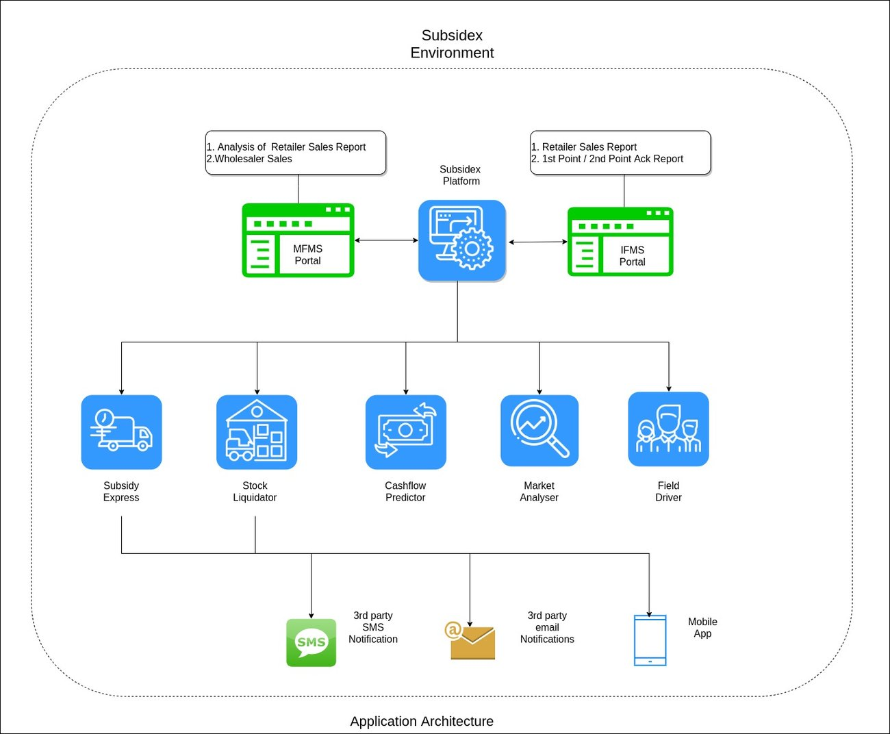
PROPOSED SOLUTION
Application architecture
The full module map — from RPA capture at the edge through to the analytics layer the business teams actually live in.
SUBSIDEX · PLATFORM ARCHITECTURE CASE STUDY
08

Slide 9
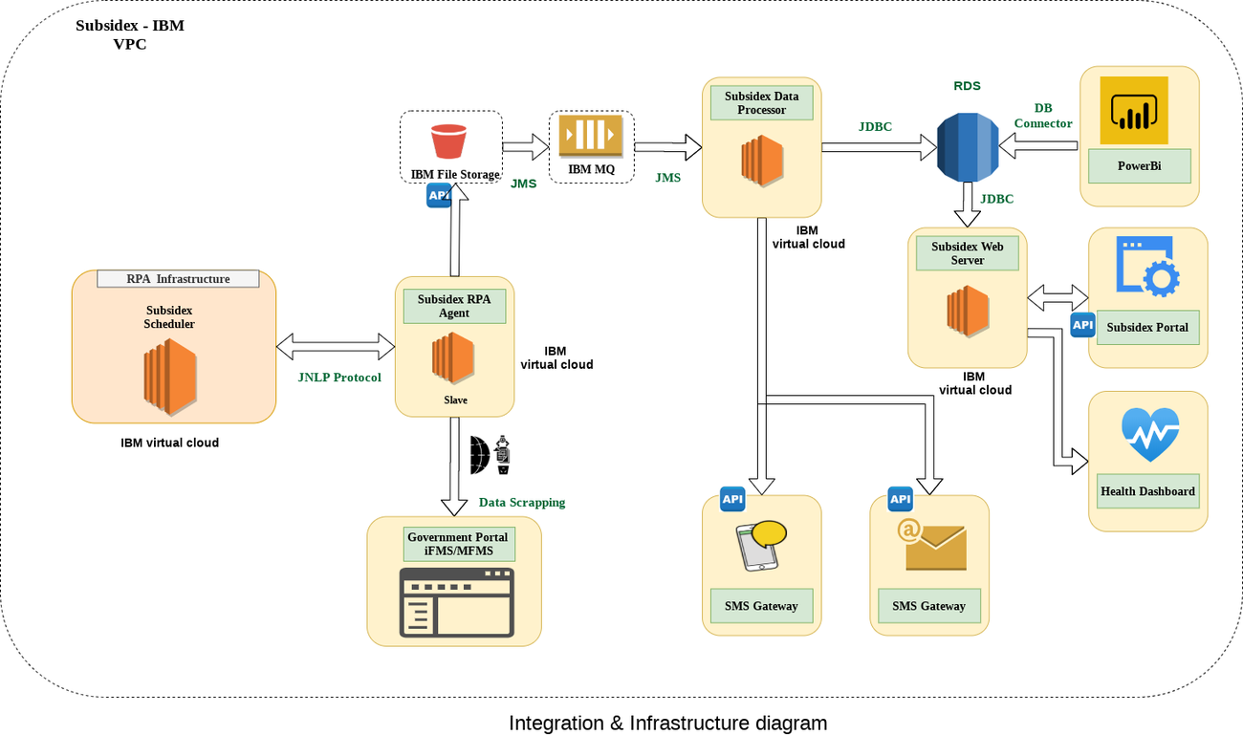
PROPOSED SOLUTION
Integration & infrastructure architecture
Hosted end-to-end on IBM Cloud infrastructure.
SUBSIDEX · PLATFORM ARCHITECTURE CASE STUDY
09

Slide 10
PROPOSED SOLUTION
The path a single scraped file takes
1
Subsidex is hosted and managed on IBM infrastructure as a cloud service.
6
The processor validates, maps, and cleans the data, persisting it into Postgres via JDBC, per-tenant schema.
2
The Scheduler stays connected to the RPA agent over JNLP; scraping jobs run on independent slave servers.
7
The same processor pushes the relevant data out over SMS and email via third-party APIs.
3
Files the RPA agent extracts are pushed to IBM file storage via the IBM SDK's REST API.
8
The portal client calls the web server for anything a user needs on screen.
4
That upload fires an event that publishes a message onto IBM MQ via JMS.
9
The analytics dashboard reads straight from the relevant DB schemas through DB connectors.
5
The Data Processor is subscribed to that queue and pulls the matching file back down on arrival.
10
Dashboards themselves are built on Microsoft Power BI.
SUBSIDEX · PLATFORM ARCHITECTURE CASE STUDY
10

Slide 11
PROPOSED SOLUTION
RPA engine & external integrations
RPA ENGINE
EXTERNAL INTEGRATIONS
A custom Selenium-based framework, config-driven rather than script-per-portal.
SMS
Email
Config-driven scraping
Third-party API integration to publish alerts to stakeholders.
Third-party provider for stakeholder email delivery.
Every download job is defined via configuration, not custom code per source.
Built-in retries
Failure detection and auto-retry are first-class, not bolted on.
Captcha resolver
Email tracker
Automated third-party captcha solving on portal login.
Read receipts, bounces, and delivery status tracking.
NFR-aware
Designed to absorb the Govt. portal's downtime and change velocity.
SUBSIDEX · PLATFORM ARCHITECTURE CASE STUDY
11

Slide 12
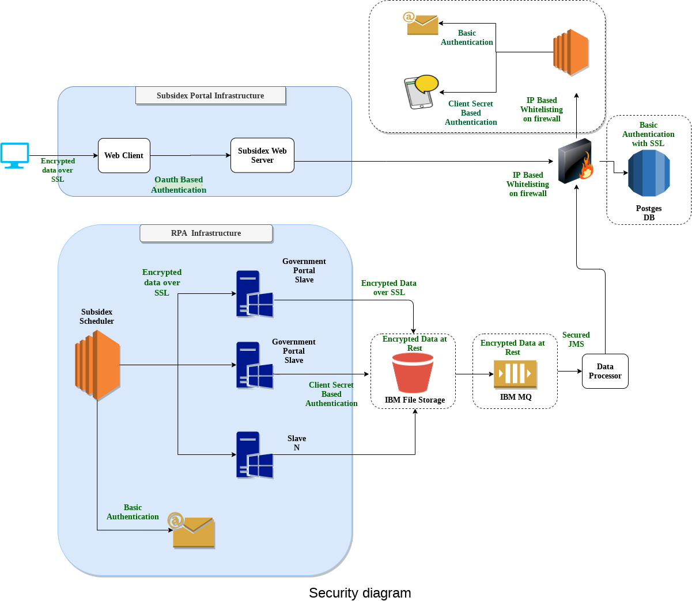
SECURITY & COMPLIANCE
Data security
SSL encryption on all data in transit; encryption at rest with periodic key rotation.
Portal credentials encrypted at storage — entered directly by the client, never visible to any person.
AES-256 for critical data such as company iFMS credentials.
OAuth-based access to the Subsidex portal, tokens valid for 30 minutes to bound any leak.
A secure VPC around the entire platform, with client-managed role-based access via an admin portal.
SUBSIDEX · PLATFORM ARCHITECTURE CASE STUDY
12

Slide 13
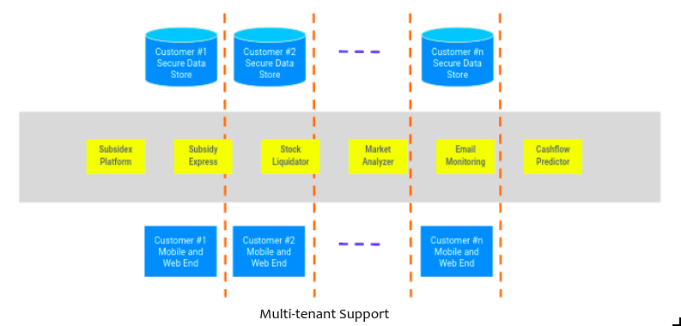
SECURITY & COMPLIANCE
Multi-tenancy
Each client gets a separate schema — logical, not physical, isolation.
Platform-level data lives in one shared schema that never carries client-specific data.
All tenants share the same underlying infrastructure, scaled horizontally or vertically as needed.
SUBSIDEX · PLATFORM ARCHITECTURE CASE STUDY
13

Slide 14
SECURITY & COMPLIANCE
Archival, account lifecycle & access control
Archival & purging
Onboarding / offboarding
Role-based access
Govt.-portal data persisted for a predefined period per data-set policy.
On contract termination, client data is retained 90 days, then purged.
Onboarding provisions a dedicated schema and admin accounts for the client.
Offboarding revokes all user access immediately; data persists 90 days before purge.
Client admins create roles with varied access levels.
Roles are assigned per employee to control what each person can reach.
SUBSIDEX · PLATFORM ARCHITECTURE CASE STUDY
14

Slide 15
BUSINESS VALUE
What this was designed to be worth
01
Lower working capital pressure from a shorter subsidy claims cycle.
02
Field staff spend less time on admin — stock acks and PoS liquidation drive themselves.
03
Automation of critical steps for near-100% accuracy and consistency.
04
Big-data consolidation from the Govt. portal for supply-chain and competitor visibility.
05
A real communication channel across every stakeholder in the value chain.
06
Better process and data management across previously disconnected systems.
07
Reporting that used to take days, available on demand.
SUBSIDEX · PLATFORM ARCHITECTURE CASE STUDY
15

Slide 16
DOCUMENT CREDENTIALS
Three revisions, four months, two reviewers
This architecture note wasn't written once — it was pressure-tested and revised as the design matured, each version reviewed by a peer engineer before it shipped.
v1.0
v1.1
v1.2
24 Mar 2020
15 May 2020
10 Jul 2020
Initial draft
Added multi-tenancy architecture
Improved data security architecture
Baseline architecture — reviewed by Irshad Chohan.
Introduced schema-level tenant isolation — reviewed by Onkar Pradhan.
Hardened encryption, OAuth token scoping, and VPC design — reviewed by Onkar Pradhan.
SUBSIDEX · PLATFORM ARCHITECTURE CASE STUDY
16

Slide 17
SUBSIDEX
Thank you
Dhruvi Chauhan
Business Analyst, Neebal Technologies
SUBSIDEX · PLATFORM ARCHITECTURE CASE STUDY
SUBSIDEX · PLATFORM ARCHITECTURE CASE STUDY
17
17

