Slide 1
Aste
RISK
AI-Powered Financial Contagion Risk Simulator
DTCC Industry-Powered AI Hackathon · 2026
Track - Generative AI for Finance
Arunava Roy · Atif Hussain · Sibananda Patnaik · Dhruvi Pandya · Femi Javia · Harshit Sharma · Pulkit Rajpal · Thorfinn Manison
AsteRISK | DTCC Gen AI Hackathon 2026 | Confidential

Slide 2
Problem & Solution
If a sector or set of counterparties enters distress today, where does the cascade go, how far does it reach, and how fast?
Approach
01
02
03
LLM Interpretation
Contagion Engine
Interactive Dashboard
AWS Bedrock translates analyst natural-language queries into structured simulation parameters.
▶
Deterministic SIR-based model with correlation-weighted S&P 500 financial network mirrors real market structure.
▶
React + D3.js visualization renders contagion cascades in real time with multi-factor risk scoring.
AsteRISK | DTCC Gen AI Hackathon 2026 | Confidential

Slide 3
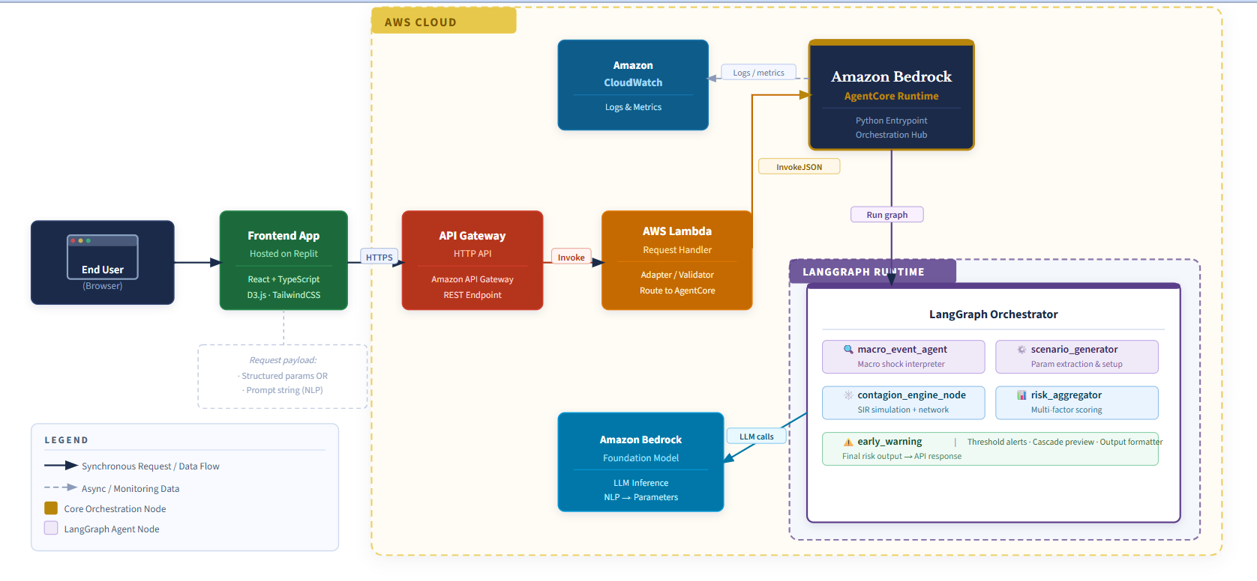
Architecture & Tech Stack
AsteRISK | DTCC Gen AI Hackathon 2026 | Confidential

Slide 4
Data & Model Performance
Real market structure, validated simulation mechanics
DATA INPUTS
PERFORMANCE RESULTS
📈
25 S&P 500 Tickers
Multi-Step
1-year historical prices
Contagion Snapshots
🔗
Correlation Matrix
High Intra-Sector
Daily returns, |corr| ≥ 0.6 threshold
Correlations → Rapid Cluster Spread
📊
Multi-Factor Scoring
Firewall Effect
Price · volume · sentiment signals
Correlation threshold blocks propagation
🤖
LLM-Only for NLU
30+ Test Cases
AI used only for natural language parsing
Pytest validates all simulation mechanics
AsteRISK | DTCC Gen AI Hackathon 2026 | Confidential

Slide 5
Challenges & Limitations
Known constraints and paths to resolution
Correlation ≠ Causation
Next milestone
Exposure data would significantly improve accuracy. Correlation is a proxy — direct clearing exposure integration is the next step.
SIR Simplification
Roadmap
The SIR model simplifies real financial contagion dynamics. Advanced epidemiological models (SEIR, agent-based) can be layered in.
Dataset Scope
Scalable
Current dataset limited to 25 S&P 500 tickers. Architecture is designed to scale to the full index with minimal refactoring.
AsteRISK | DTCC Gen AI Hackathon 2026 | Confidential

Slide 6
INDUSTRY IMPACT
From Reactive
to Predictive Risk
AI-driven scenario interpretation + deterministic contagion modeling
Real market data + interactive visualization
Helps risk managers see systemic risk before it spreads
Complete web-app deployed on Replit
Pipeline design with stateless LangGraph enables horizontal auto-scaling with zero re-architecture
AsteRISK | DTCC Gen AI Hackathon 2026 | Confidential

Slide 7
AsteRISK
Questions & Discussion
DTCC Industry-Powered AI Hackathon 2026
Arunava Roy · Atif Hussain · Sibananda Patnaik · Dhruvi Pandya · Femi Javia · Harshit Sharma · Pulkit Rajpal · Thorfinn Manison
Transforming stress testing from manual craft to AI-powered, real-time intelligence.
AsteRISK | DTCC Gen AI Hackathon 2026 | Confidential

Slide 8
Path to Production & Scalability
Enterprise-grade architecture designed to grow
PATH TO PRODUCTION
SCALABILITY
☁️
Deploy to AWS Bedrock AgentCore
⟷
Stateless LangGraph
Pipeline design enables horizontal auto-scaling with zero re-architecture
🔗
Integrate DTCC clearing exposure data
∑
Extendable Correlation Matrix
SIR simulation and correlation matrix are O(n²) – manageable growth to 500 tickers
🕸️
Activate full 6-node LangGraph pipeline
⚡
Independent Scaling
📡
Enable WebSocket streaming for real-time dashboards
LLM and deterministic engine scale independently — cost-efficient growth
AsteRISK | DTCC Gen AI Hackathon 2026 | Confidential

