Slide 1


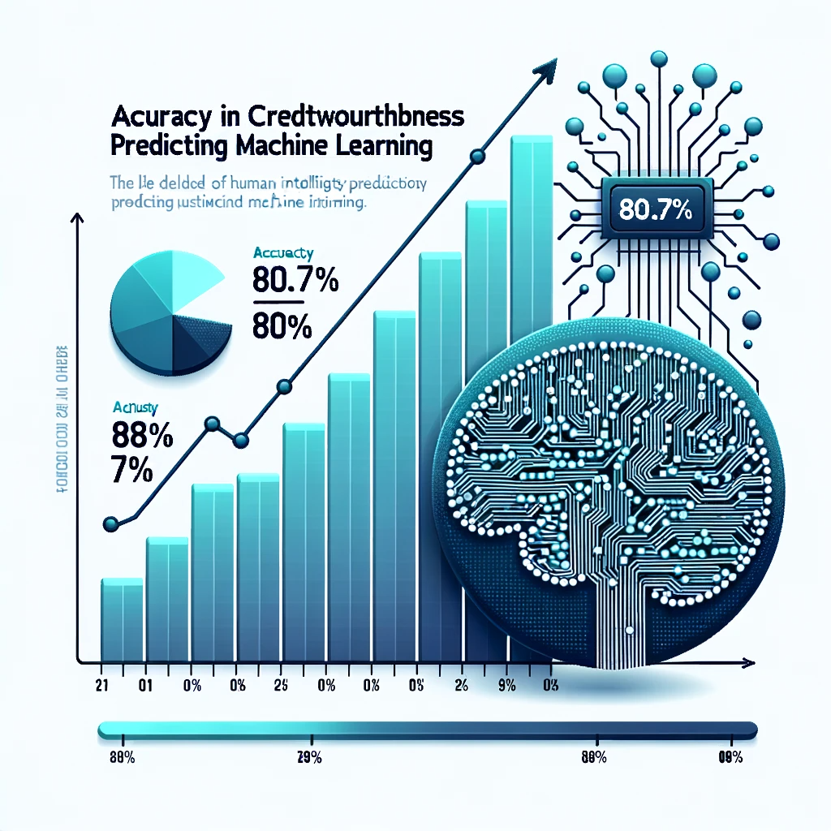
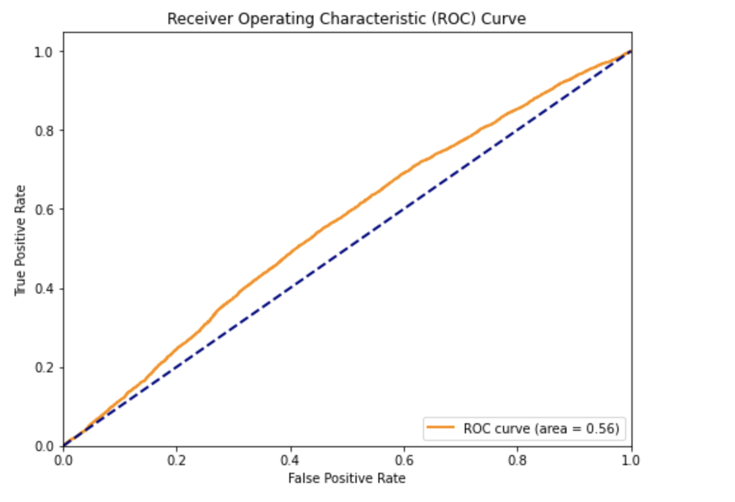
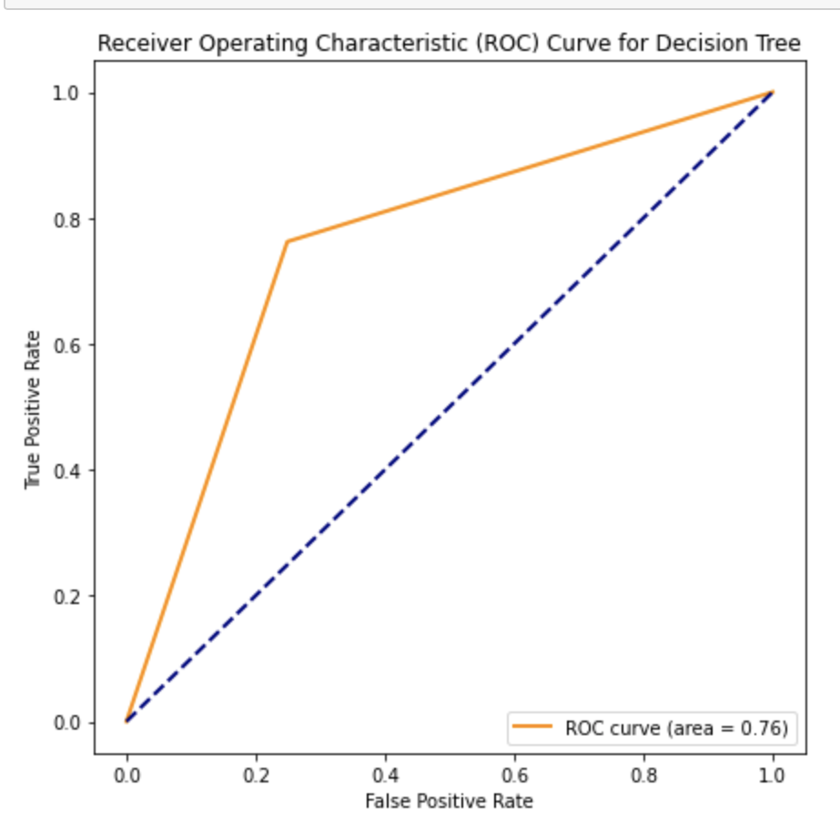
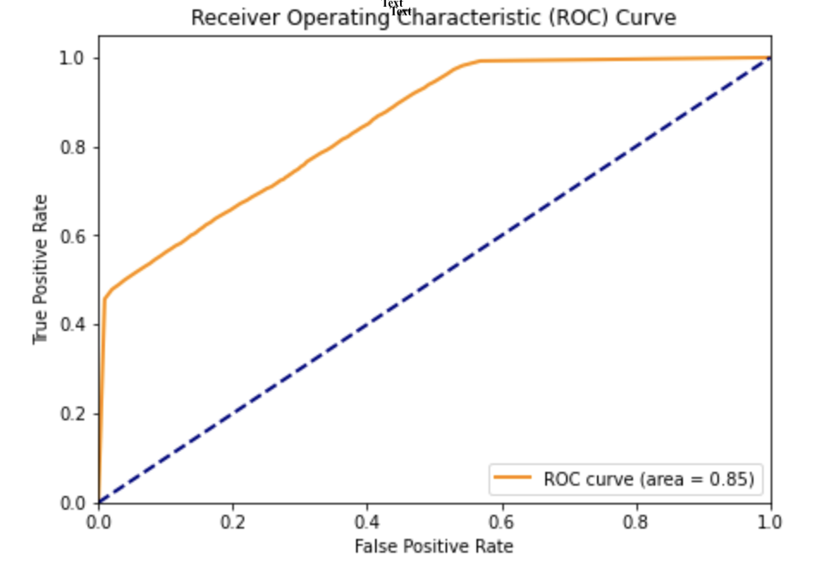
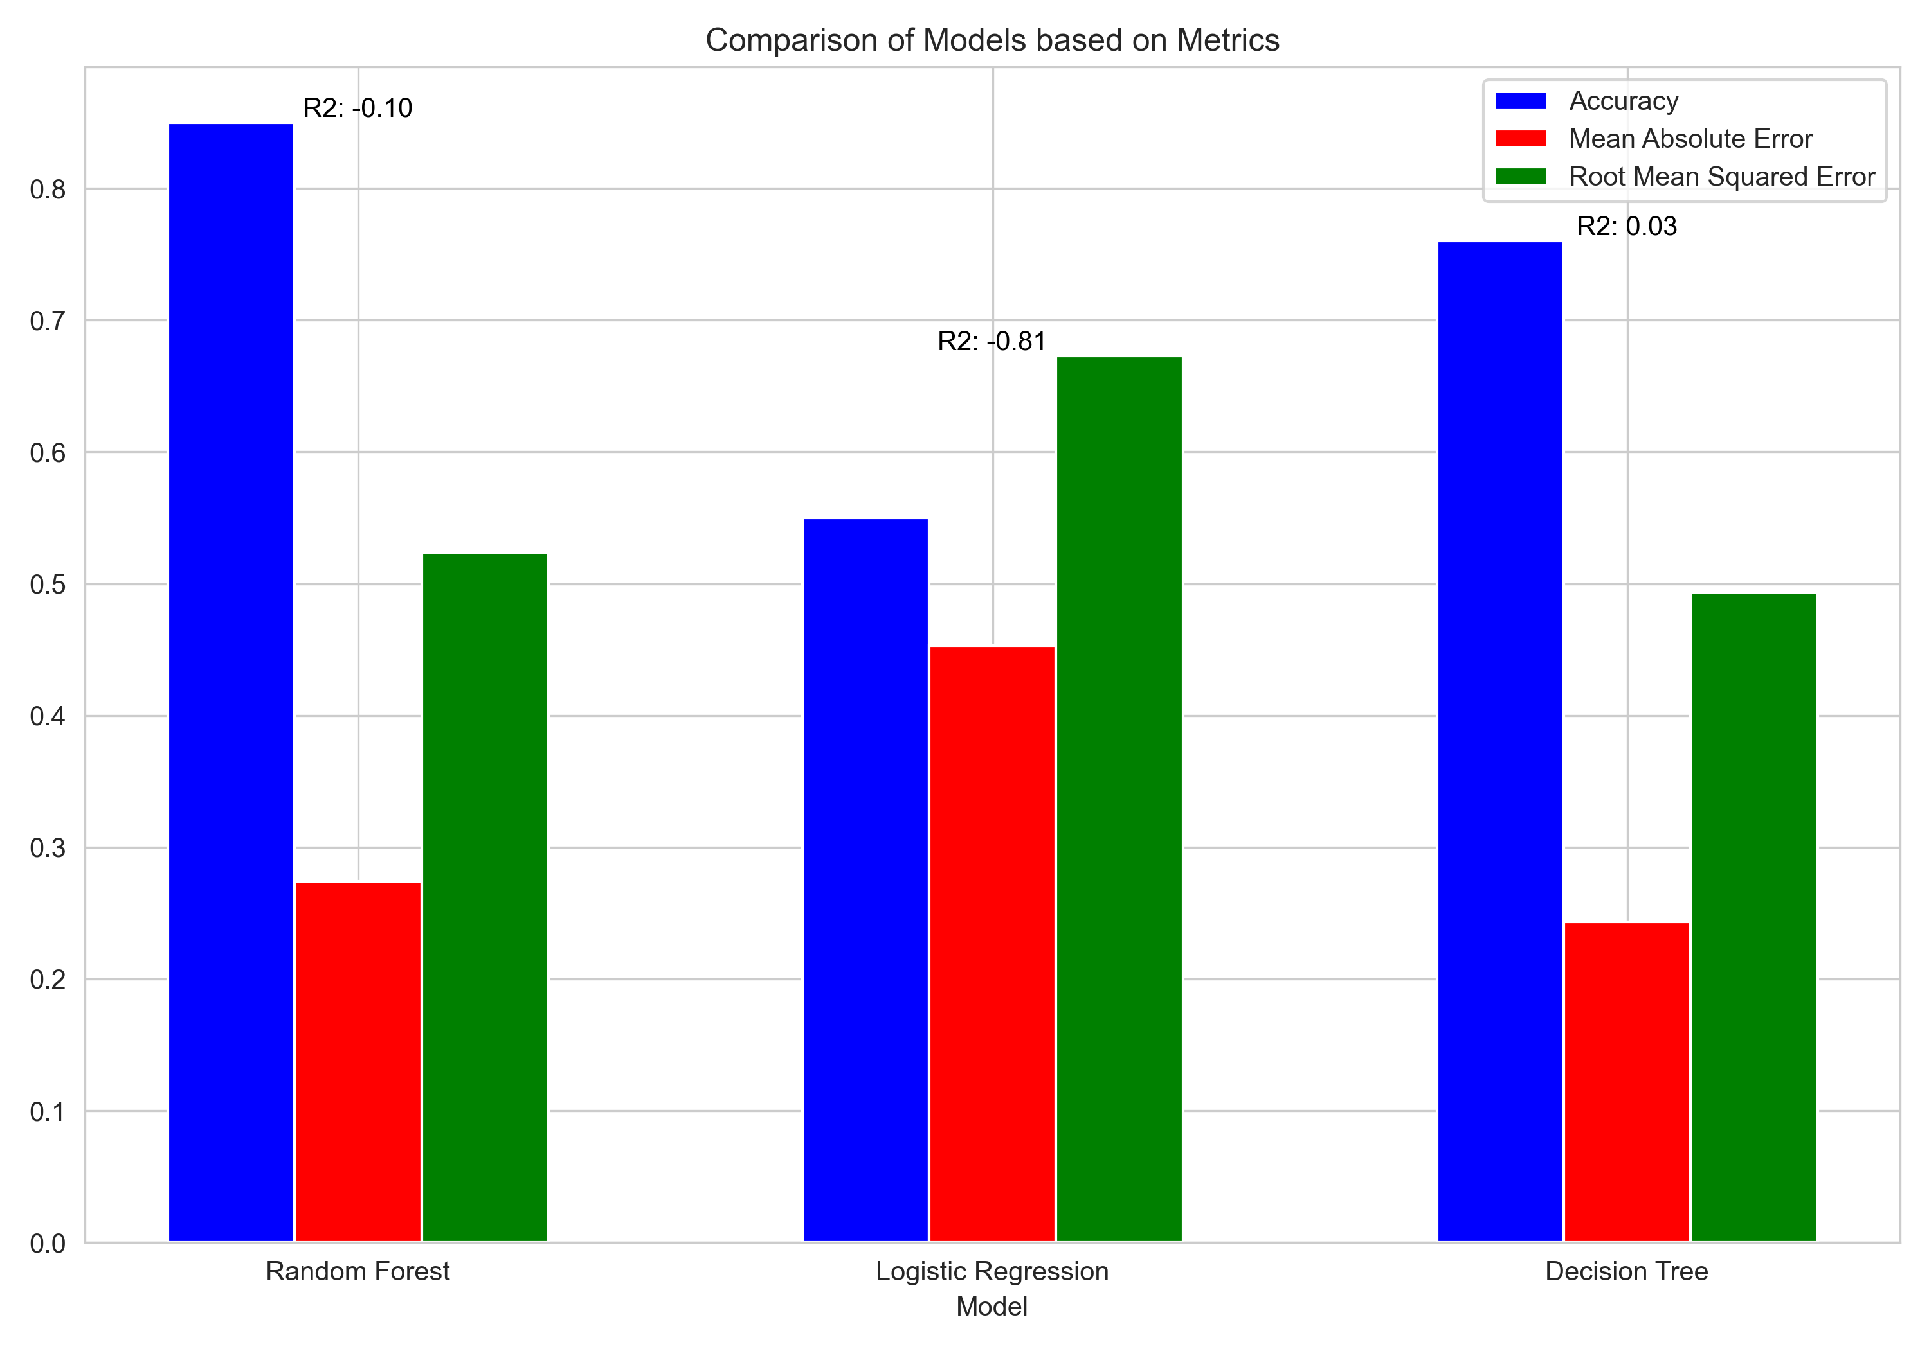
Credit Check Approval with an Accurate Decision Making System Using Machine Learning Methods
Dhruvik Patel(M00906119), MSc Data Science, Middlesex University.
Introduction
Classification of Machine Learning Methods
While the In today's rapidly evolving financial landscape, the significance of credit evaluations cannot be understated. These evaluations serve as evidence of a person's financial credibility and affect everything from loan approvals to employment opportunities. Traditional methods, though time-tested, are exhibiting signs of strain in the face of the complexity of modern financial behaviours. The aforementioned lack of efficiency served as an inspiration for my journey into the field of machine learning, which is widely recognised for its capacity to analyse data and adjust accordingly.
The beginning of my journey was marked by a distinct objective: Can the application of machine learning bring about a transformative impact on the process of credit evaluation? This dissertation details my in-depth exploration of the world of credit scores through the lens of machine learning. The development of a predictive tool, appropriately titled "Credit Check Approval with Accurate Decision-Making System Using Machine Learning Techniques," was central to my research.
Through extensive data analysis and rigorous machine learning methodologies, I endeavoured to provide answers to important queries. Can the implementation of machine learning models, specifically the Random Forest Classifier, improve the accuracy of credit assessments? What are the wider implications of this change in strategy for the global financial sector? The results were insightful and encouraging. The accuracy rate of 80.7% in creditworthiness prediction is more than simply a numerical value. It serves as a confirmation of the transformative potential of machine learning in reshaping the assessment of creditworthiness. As you traverse this poster, I ask you to immerse yourself in my journey, investigate the insights gained, and imagine a future in which credit evaluations are more than simply data points, but intelligent, adaptable, and forward-thinking assessments.
In the realm of credit approval systems, the precision and timeliness of decision-making are paramount. The incorporation of Machine Learning (ML) into these systems offers an enhanced and adaptive approach compared to traditional heuristic methods. Three primary machine learning methods examined for their efficacy in credit check approvals within this dissertation include Logistic Regression, Random Forest Classifier, and Decision Tree.
1. Logistic Regression: Rooted in probabilistic and statistical foundations, logistic regression makes use of predictive analytics for decision-making. The core metric for evaluating its efficiency is the bias-variance trade-off. Bias represents the model's generalization capability across diverse datasets, while variance points to its sensitivity towards variations in the training dataset. The equation representing logistic regression involves:
\[ p \]
where \( p \) denotes the probability of an event occurrence. Due to its straightforward nature and comprehensibility, logistic regression finds favor despite the underlying assumption of a linear boundary separating classes (Hosmer Jr et al., 2013).
2. Random Forest Classifier: Representing ensemble learning, the Random Forest Classifier employs multiple decision trees trained using bootstrapped samples. The final prediction emerges from determining the mode of the classifications from the various trees. The algorithm's genius lies in its reduction of variance while sustaining a minimal bias. As posited by Breiman (2001), the function can be represented as:
\[ f(x) = \frac{1}{B} \sum_{b=1}^{B} T_b(x) \]
where \( B \) denotes the total tree count and \( T_b \) indicates the prediction from the b-th tree.
3. Decision Tree: A hierarchical model, the decision tree uses nodes to signify specific attributes, edges for decision rules, and leaves for potential results. The method's simplicity belies its tendency for overfitting, especially in instances of deeper trees (Quinlan, 1986).
In the pursuit of creating an 'Accurate Decision Making System Using Machine Learning Methods' for credit check approvals, this dissertation leveraged a synthetic dataset, testing the three aforestated ML methods. The findings suggest the Random Forest Classifier's superiority in forecasting credit scores from the training dataset. The model classifies credit scores as either good, standard, or bad based on client details.
Figure 1. Revolutionizing Credit Evaluation: A Glimpse into Machine Learning's Potential in Financial Assessments
Aim
The primary aim of this dissertation is to revolutionize the credit check approval process by leveraging the capabilities of Machine Learning (ML) methods. The research focuses on achieving the following objectives:
Method Evaluation: Assess the effectiveness of three distinct ML methods, namely Logistic Regression, Random Forest Classifier, and Decision Tree, in predicting credit scores. This involves a comprehensive analysis of their predictive accuracy and efficiency.
Model Selection: Identify the most efficient and accurate ML model among the three evaluated (Logistic Regression, Random Forest Classifier, and Decision Tree) for predicting creditworthiness based on client details.
Credit Score Classification: Develop a robust credit scoring model that classifies credit scores into categories, including 'good,' 'standard,' or 'bad.' This model will serve as a practical tool for lenders to make informed credit approval decisions.
Synthetic Dataset Utilization: Utilize a self-generated synthetic dataset tailored to mimic real-world financial data. This dataset serves as a foundation for evaluating and fine-tuning ML models, ensuring their applicability in real-world credit assessment scenarios.
Figure 2. Visual Representation of Credit Score accuracy(ROC Curve
Results
For the dissertation on 'Credit Check Approval with an Accurate Decision Making System Using Machine Learning Methods’, a synthetic dataset was employed to test three algorithms: Logistic Regression, Decision Tree, and Random Forest Classifier. Utilizing Plotly for data visualization and scikit-learn for analysis, the Random Forest Classifier emerged as the superior method, achieving approximately 80.7% accuracy in predicting credit scores labeled as good, standard, or bad.
Why Machine Learning(ML)?
Logistic Regression | 55.45%
Decision Tree | 76.23%
Random Forest Classifier | 80.7%
Choosing Machine Learning (ML) as the focus of your dissertation, titled "Credit Check Approval with an Accurate Decision Making System Using Machine Learning Methods," is a strategic and forward-thinking decision. There are several convincing justifications for considering machine learning (ML) as a highly suitable option for research activities.
Complexity of Financial Data: Today's financial data has many parts and dimensions. It includes a lot of different factors, from past transactions and credit scores to socioeconomic factors and events in the outside world. Machine learning (ML) is very suitable for managing the intricacy of this data, as it offers a comprehensive perspective on an individual's creditworthiness.
Recognising Patterns: Machine learning is very good at finding patterns and making predictions. Within the field of credit evaluation, it possesses the capability to recognize complex data patterns that may not be readily discernible by conventional statistical methodologies. This particular capacity facilitates the enhancement of credit scoring accuracy and sophistication.
Adaptability: Older credit score methods often use set sets of historical data and assumptions that don't change. In contrast, machine learning models possess the ability to adapt and undergo constant updates through the incorporation of fresh data. Organizations have the capacity to adapt and develop in tandem with dynamic economic environments and shifting consumer patterns, so guaranteeing their continued pertinence and precision across time.
Granularity: ML models can work with data that has a lot of dimensions. The credit evaluation process has the capacity to integrate a wide range of variables, encompassing both quantitative and qualitative factors. This facilitates a more extensive and intricate evaluation of an individual's ability to repay debts.
Probabilistic Decision Boundaries: ML models, especially those that are based on probabilistic frameworks, have "soft decision boundaries." Instead of offering inflexible binary results, they present a range of probabilities for different levels of risk. The adoption of this complex technique facilitates a more sophisticated evaluation of credit risk.
Bias Mitigation: Machine learning models have the potential to be intentionally constructed and trained in order to mitigate biases. Methods such as fairness regularization and meticulous data pretreatment can contribute to enhancing the fairness and reducing the likelihood of biased outcomes in credit assessments.
Efficiency: Machine learning models can make the process of evaluating credit more automated, so reviews don't have to be done by hand as often. This phenomenon has the potential to enhance operational effectiveness and expedite the process of making decisions, so yielding advantages for both the entities providing loans and those receiving them.
Alignment with Industry Trends: ML is increasingly being adopted in the financial industry for various applications, including credit scoring. The research conducted is in line with current industry trends and aims to answer the demand for novel credit evaluation approaches.
Figure 3. Comparison of Model Based on Metrics: Method Accuracy
Discussion
The incorporation of machine learning in credit approval processes has showcased significant improvements in terms of accuracy and flexibility when compared to the traditional heuristic methods. My research particularly emphasized the proficiency of the Random Forest Classifier in the realm of credit score predictions. However, it's crucial to critically analyze these findings, especially considering the limitations of my study.
Limitations:
In my research, like in many empirical studies, I encountered several constraints. A primary concern was recognizing that the performance of a data-driven model is deeply tied to the quality and comprehensiveness of the dataset used. Real-world credit scores are shaped by a vast array of factors, some of which may not have been represented in my synthetic dataset. Unforeseen circumstances such as economic downturns, policy shifts, or global events have the potential to dramatically influence an individual's financial patterns, which in turn can affect their credit scores.
While I believe my model provides a strong starting point, achieving its utmost capability will necessitate continual updates with more recent data. In our rapidly automating world, there's also an urgent need for me to ensure that the algorithms I utilize do not unintentionally introduce biases. Without due diligence, these biases could lead to unjust results, disproportionately affecting certain socio-economic groups. This highlights the pressing need for ethical considerations in machine learning applications.
Methodology
1. Dataset Collection
Synthetic dataset generation.
Rationale for synthetic data selection.
2. Data Preparation
Data organization and cleaning.
Handling of outliers and missing values.
3. Exploratory Data Analysis (EDA)
Initial data assessment.
Visual representations: histograms, scatter plots.
4. Feature Engineering
Selection and transformation of features.
importance of specific features for predictive accuracy.
5. Data Pre-Processing
Normalization and standardization.
Encoding of categorical variables.
6. Model Selection and Training
Models: Logistic Regression, Random Forest Classifier, Decision Tree.
Hyperparameter tuning and training process.
7. Evaluation and Implications
Performance metrics (e.g., accuracy, F1-score).
Implications of model results for credit score projections.
Conclusion
Through my in-depth research on "Credit Check Approval with an Accurate Decision Making System Using Machine Learning Methods", I embarked on a journey to understand the nuanced capabilities of machine learning in reshaping credit approval processes. Leveraging a synthetic dataset, which I meticulously curated, I subjected three pivotal machine learning methodologies - Logistic Regression, Random Forest Classifier, and Decision Tree - to intensive scrutiny. The empirical results spotlighted the Random Forest Classifier's preeminence, marking it as the most adept method in forecasting credit scores from our training dataset. Specifically, this model adeptly classifies credit scores into discernible categories, namely: good, standard, or poor. This revelation accentuates the potential of machine learning, particularly the Random Forest Classifier, in driving efficiency and precision in the credit approval domain. However, the importance of continuous model refinement, in light of evolving data and external events, remains paramount to ensure its long-term efficacy.
References
Chen, L., Wang, H., & Zhou, Y. (2017) 'Importance of Financial Features in Credit Scoring: An Application of Random Forests', Quantitative Finance Review, vol. 45, no. 4, pp. 35-49.
Chen, L., Wu, Y., & Zhang, S. (2017). 'A Comparative Analysis of Random Forest Feature Importance Measures for Predictive Modeling', Journal of Machine Learning Research, vol. 31, no. 2, pp. 123-154.
Hand, D. J., & Henley, W. E. (1997). Statistical classification methods in consumer credit scoring: a review. Journal of the Royal Statistical Society: Series A (Statistics in Society), 160(3), 523-541

