Slide 1
ZOMBIENEXUS
CryptoZombies, fixed and upgraded
Solidity 0.4.25 + React + MetaMask on a local Ganache chain
CSUF Advanced Blockchain midterm
COMMON
RARE
HERO
2521625881949400
9343918324261100
6212148620395099
DNA defines the character
DNA defines the character
DNA defines the character
Dhruvi Kothari Het Siddhapura
ZOMBIENEXUS
01
Notes:
TIME: 0:10
We’re presenting ZOMBIENEXUS, our upgraded CryptoZombies application. I’ll explain the changes, demonstrate the features live, and finish with testing and limitations.
DEMO CUE: Title, then the prepared browser tabs
BUILD: none
SOURCES: README.md Overview, Technology stack; SPEC.md §2.3
SLOT: 0:00–2:00 before demo

Slide 2
Starter bugs
The starter works, until you look closely
Transfer accounting
Stale approval
Attack readiness
Count follows the caller
Approval survives ownership change
Loss succeeds during cooldown
ownerZombieCount[msg.sender]
Approvals never cleared
No readiness check
Also: unchecked _from and a hard-coded legacy address
ZOMBIENEXUS
02
Notes:
TIME: 0:20
The starter had several correctness problems. Transfer accounting used the caller instead of the previous owner, approvals survived transfers, and attacks lacked a consistent cooldown check. We fixed these contract behaviors before building the new interface.
DEMO CUE: none
BUILD: Read cards left to right
SOURCES: CHANGES.md Starter bugs fixed; PROJECT.md §9
SLOT: 0:00–2:00 before demo

Slide 3
What we built
1
2
3
React frontend
Wallet and network
Factory and Army
Responsive pages and DNA art
Connect, detect and switch
Preview DNA, sort and filter
4
5
6
Ownership transfer
Avenger feeding
Battle arena
Transfer and verify the recipient
Create a hero with ...99 DNA
Avenger odds and zombie PvP
ZOMBIENEXUS
03
Notes:
TIME: 0:15
We added six main improvements: a React frontend, wallet and network handling, Factory and Army, ownership transfer, hero feeding, and a battle arena. I’ll show each during the demo.
DEMO CUE: Use these six items as the live demonstration checklist
BUILD: Read tiles one through six
SOURCES: README.md Implemented improvements; CHANGES.md Improvements
SLOT: 0:00–2:00 before demo

Slide 4
Architecture
Reads via RPC, no wallet needed
Ganache / chain 1337
Browser
React + ethers v6
Vite
MetaMask
Signs writes
127.0.0.1:7545
ZombieOwnership
scripts/
demo, seed, check, serve
deployment.json
No hard-coded app addresses
AvengerContract
App on :8080 /legacy/ serves the original trio
ZOMBIENEXUS
04
Notes:
TIME: 0:25
The app runs on a local Ganache chain. React reads directly through RPC, while MetaMask signs transactions. ZombieOwnership contains the inherited zombie functionality and connects to our separate AvengerContract. The frontend loads addresses and ABIs from deployment.json instead of embedding addresses in its source.
DEMO CUE: none
BUILD: Follow browser, wallet, chain, then configuration
SOURCES: SPEC.md §§1, 3.3–3.5, 4.3; README.md Architecture
SLOT: 0:00–2:00 before demo

Slide 5
Contract fixes: before and after
AREA
BEFORE
AFTER
Transfer count
ownerZombieCount[msg.sender]
ownerZombieCount[_from]
Approval
Approval remains after transfer
delete zombieApprovals[_tokenId]
Transfer sender
No ownership check on _from
zombieToOwner[_tokenId] == _from
Battle cooldown
No readiness guard
require(_isReady(myZombie), ...)
Level up
Private fee, no id check/event
public levelUpFee; emit LevelUp
ZOMBIENEXUS
05
Notes:
TIME: 0:25
The important transfer changes are correct owner counts, cleared approvals, and validation that the supplied sender owns the zombie. Battles check readiness before resolving either outcome. Level up now exposes its fee, validates the zombie ID, and emits an event. These changes make behavior easier to verify.
DEMO CUE: none
BUILD: Compare each row before moving to the next
SOURCES: CHANGES.md Starter bugs fixed; SPEC.md §§1.1, 1.3–1.5
SLOT: 0:00–2:00 before demo

Slide 6
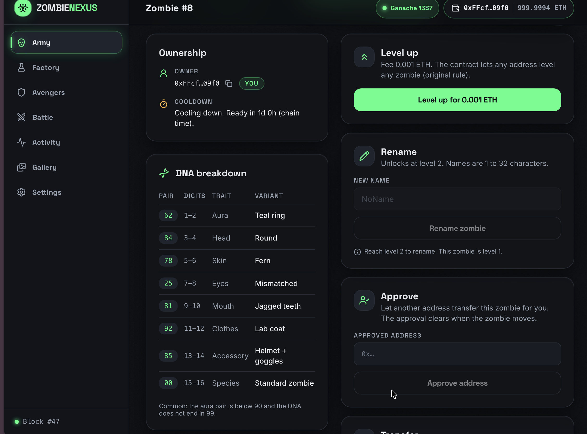
AvengerContract: a local NPC
power = genes % 10 + 1
chance = clamp(50 + 5*level
- 5*power, 10, 90)
win = roll < chance
L8 / P4
70%
L8 / P9
45%
L1 / P10
10%
L20 / P1
90%
Anyone can createAvenger(genes)
Feeding creates hero DNA ending in 99
Replaces CryptoKitties locally
Now the live demo
DNA traits /zombie/:id
ZOMBIENEXUS
06
Notes:
TIME: 0:25
Our local AvengerContract replaces the external CryptoKitties dependency. Feeding creates a hero zombie whose DNA ends in ninety-nine. Battle odds depend on zombie level and Avenger power, bounded between ten and ninety percent. For example, level eight has seventy percent against power four. Let’s demonstrate the application.
DEMO CUE: Run the compressed browser walkthrough for six minutes, from 2:00 to 8:00
BUILD: Formula first, then four examples
SOURCES: SPEC.md §§1.5–1.6, 8.5; README.md Demo walk-through
SLOT: 0:00–2:00 before demo
LIVE DEMO: 2:00–8:00 (6:00, included in total presentation time).
2:00–2:45 Legacy trio
DO: Use account C at /legacy/. Click Create Zombie, Show Zombies and Level Up, confirming the two writes in MetaMask. Show the listed zombie and updated level. Account C must start empty and end owning exactly one zombie.
SAY: I’m starting with the original page. Using our legacy account, I’ll create a zombie, list it, and level it up. This demonstrates that the starter trio still works on Ganache. We kept this page and changed its contract address to match the deployment.
2:45–3:10 React interface, wallet and diagnostics
DO: Open /settings in the React app. Switch to account B if needed and connect. Point to Ganache 1337, the connected wallet and live diagnostics. Briefly narrow the browser to show the navigation adapting, then restore its width. Do not switch networks live.
SAY: Here is the React interface. The wallet and Ganache status are visible, and Settings checks the chain and contract wiring. The navigation also adapts when I narrow the window. Writes use MetaMask, while reads use the direct RPC connection.
3:10–3:55 Factory: preview and live creation
DO: As account B, open /create and type a name. Point to the preview and DNA before clicking Create. Confirm in MetaMask, wait for the receipt, then compare the created zombie DNA to the preview. Do this before B receives a transfer.
SAY: As our fresh account, I’ll type a name and show the DNA preview before signing. Now I’ll create the zombie. After confirmation, I’ll compare the stored DNA with the preview. This connects the frontend calculation to the contract result.
3:55–4:30 Army, filter and level up
DO: Switch to account A. Open /, apply a rarity filter, then clear it. Open /zombie/0 and point to the DNA breakdown. Level up Rotfang once and confirm. Point to the updated level. Leave Rotfang ready for feeding.
SAY: Switching to our main account shows its army. I can filter the collection and inspect the DNA traits. I’ll also level up Rotfang and verify the new level after confirmation. The fee is exposed by the contract, and level up emits an event.
4:30–5:35 Avengers: summon, Infect and hero result
DO: Open /avengers and summon one Avenger, confirming the transaction. Then open /create?tab=infect. Select Rotfang and Thor, show the before/after DNA, click Infect and confirm. Show the new child and DNA ending in 99. Do not claim the child is created until its receipt confirms.
SAY: Avengers live in our own local contract. I’ll summon one, then select Rotfang and Thor in the Infect tab. Before signing, the interface previews the resulting DNA. After confirmation, I’ll show the newly created hero zombie and verify that its DNA ends in ninety-nine. Feeding also puts the parent on cooldown.
5:35–6:35 Avenger battle and PvP
DO: Open /battle. Select Duskwalker against Hawkeye, show 70%, then Thor to show 45%. Choose one and fight, confirming once. Show the event-based result. Next switch to vs Zombies and use Mossbelly against The Warden. Confirm and show the result. Do not reuse Rotfang or Duskwalker for the second fight.
SAY: Duskwalker has seventy percent against Hawkeye and forty-five percent against Thor. I’ll fight one and show the confirmed event result. Next, Mossbelly fights The Warden in PvP, which retains the starter’s seventy-one percent chance. A PvP win creates a child zombie. Either outcome starts a cooldown.
6:35–7:25 Ownership transfer and receiving wallet
DO: As A, open Grimjaw, /zombie/1. Transfer it to account B using B’s prepared public address. Confirm the transfer. Switch to B, open Army and show Grimjaw. This proves receipt by the new owner. Do not use account C as the recipient.
SAY: Finally, I’ll transfer Grimjaw to our second account. After the receipt confirms, I’ll switch wallets and show Grimjaw in the receiving army. This demonstrates the ownership change across both accounts, rather than only showing a success notification.
7:25–7:45 Activity evidence
DO: Open /activity and point to the newly generated Transfer, AvengerFed and battle events. If test output was captured beforehand, briefly show the prepared terminal summary. Do not launch a new test run during the slot.
SAY: Activity now shows the events generated by our actions, including transfer, feeding and battles. These entries let us verify what the contracts recorded. Our test results are prepared separately so we do not spend presentation time running the suite.
7:45–8:00 Transaction and navigation buffer
DO: Use this reserved time for a delayed confirmation or navigation. If everything is complete, return to slide 7 early and preserve the remaining time as finishing margin.
SAY:

Slide 7
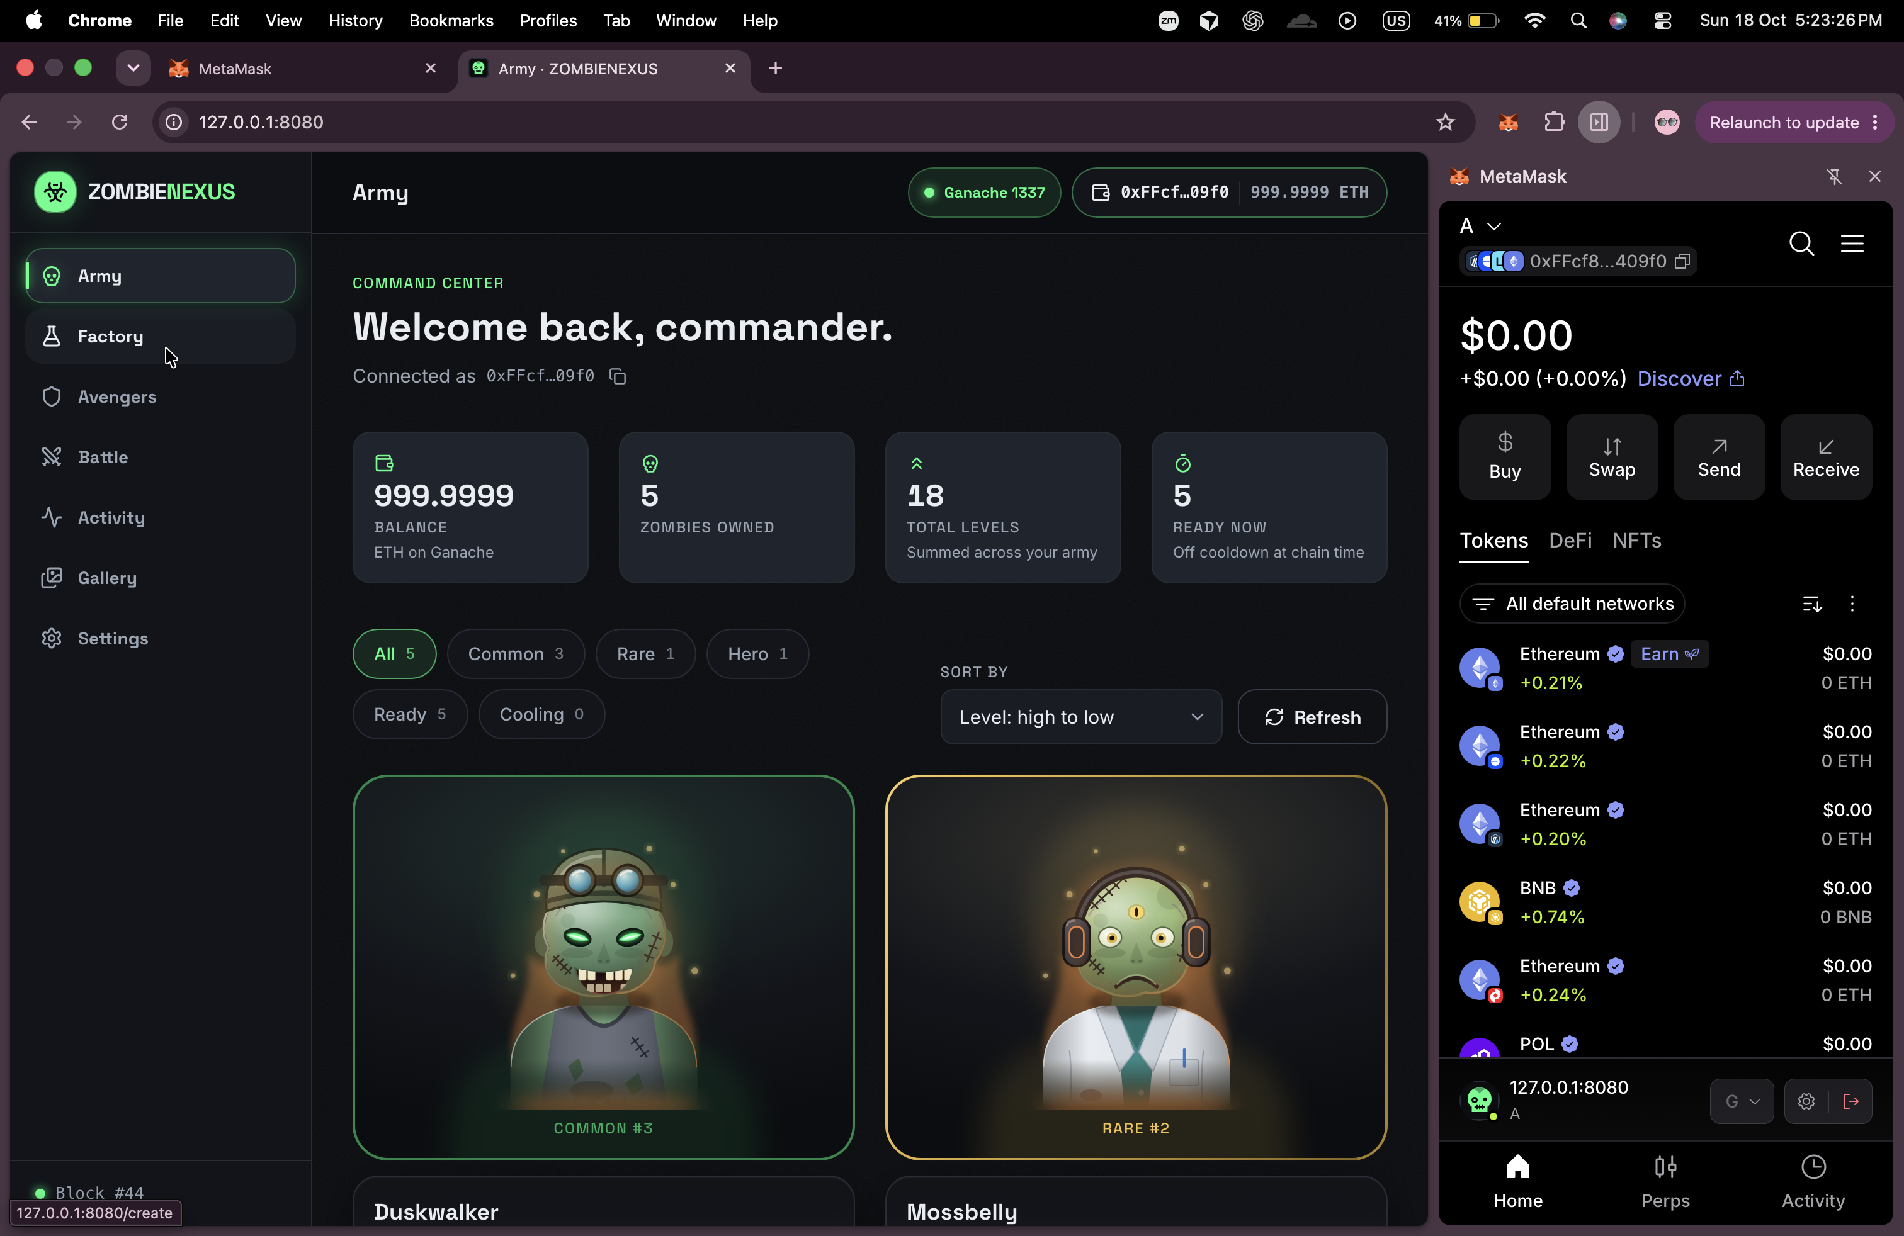
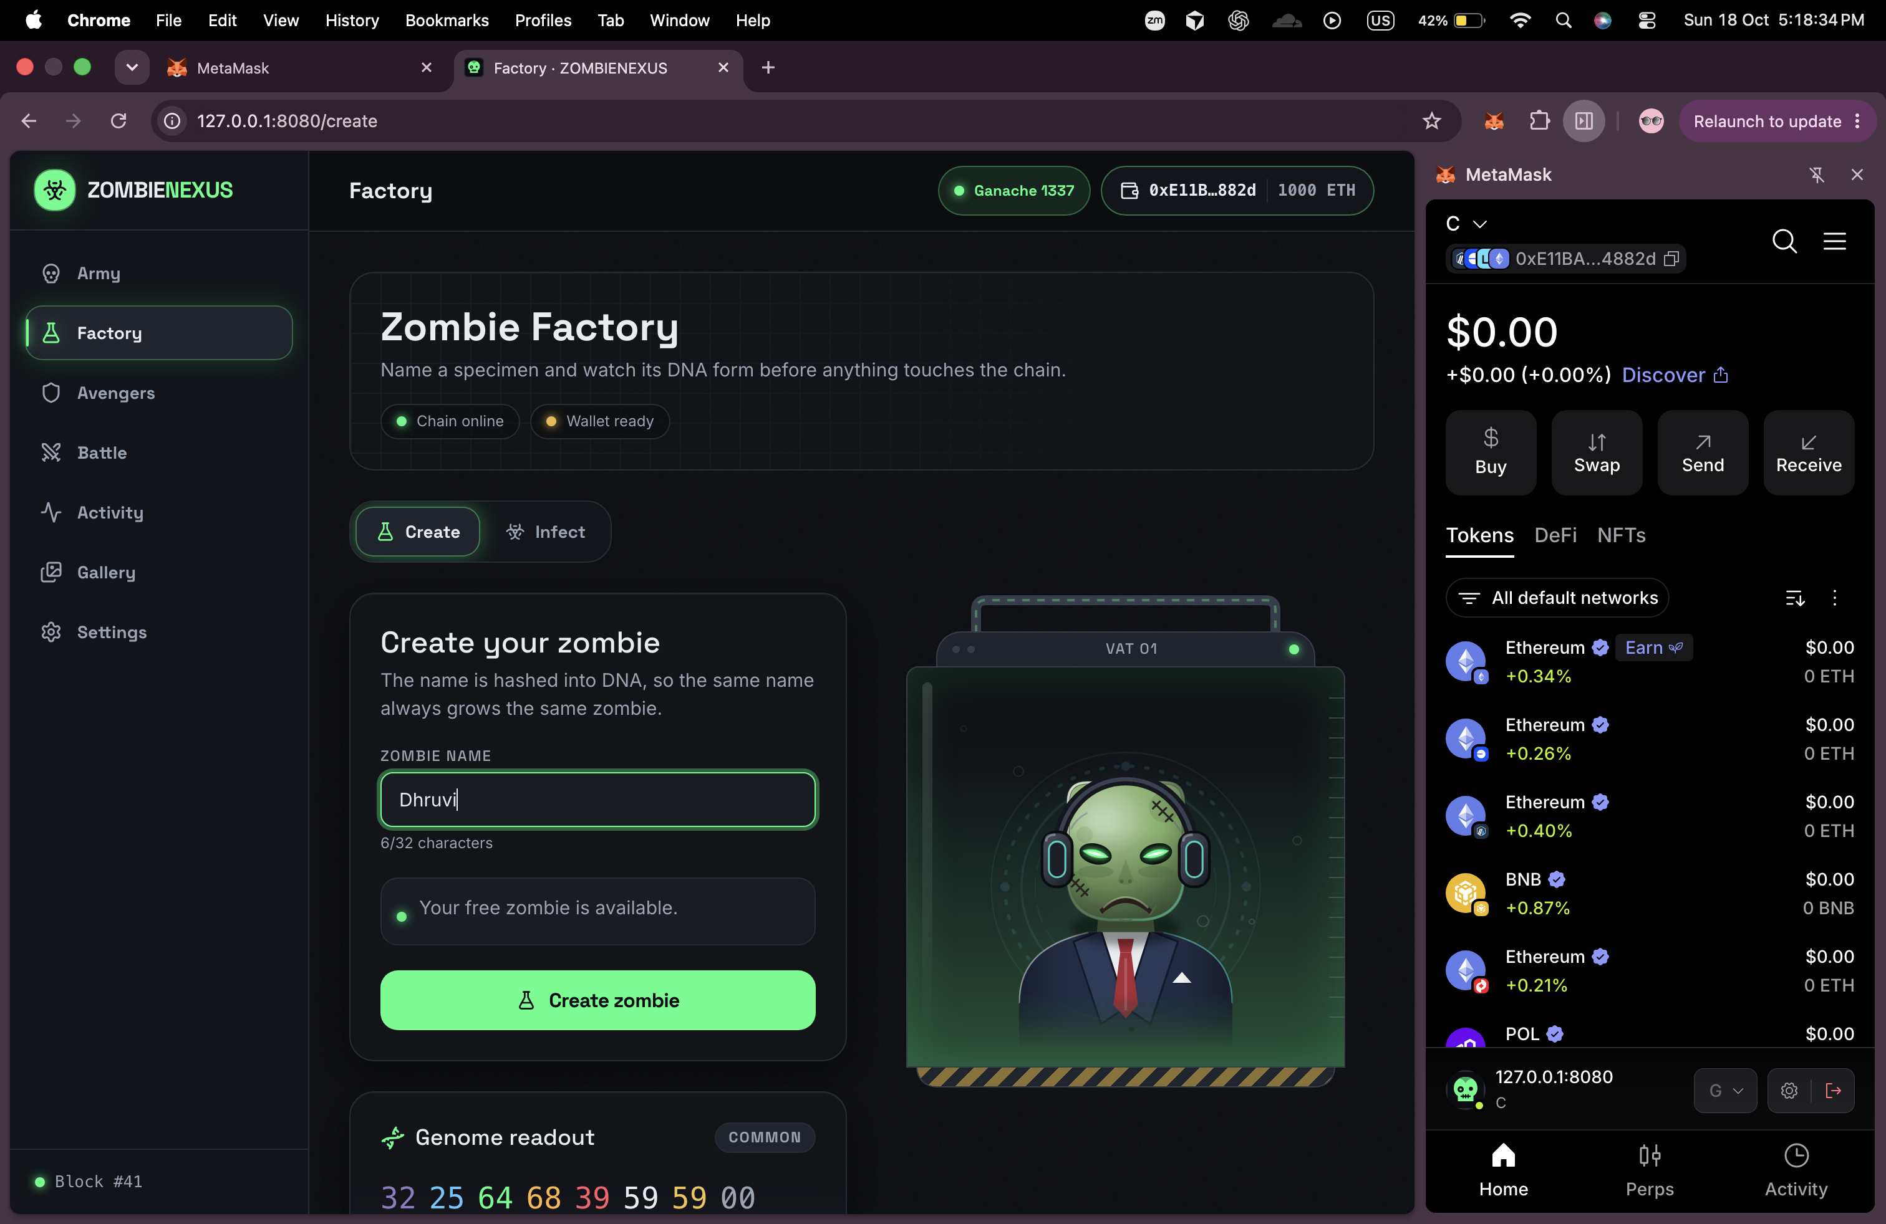
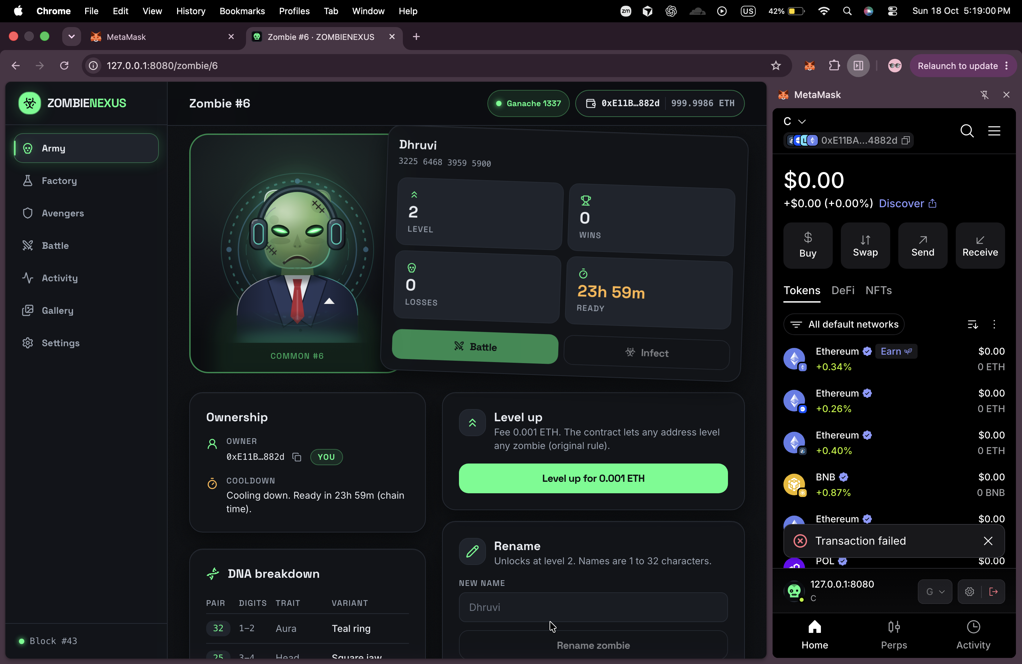
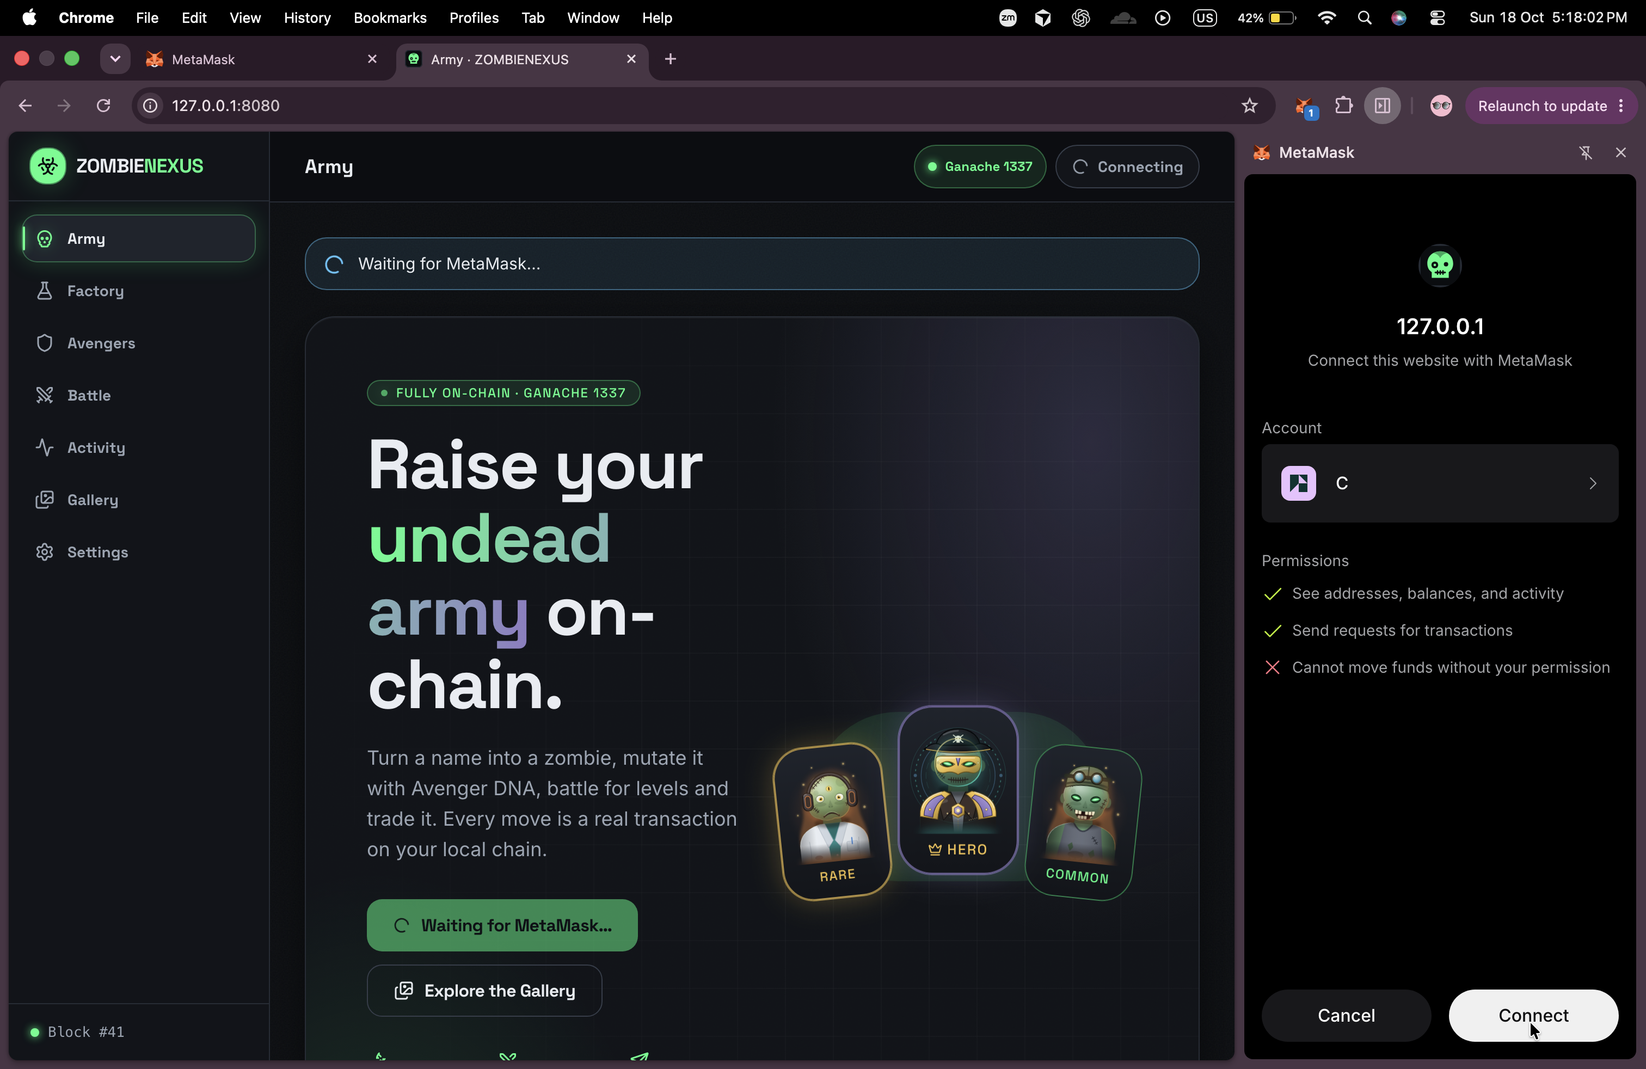
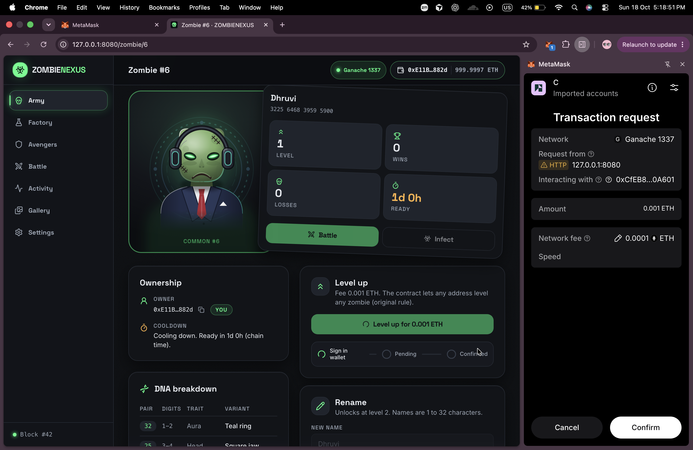
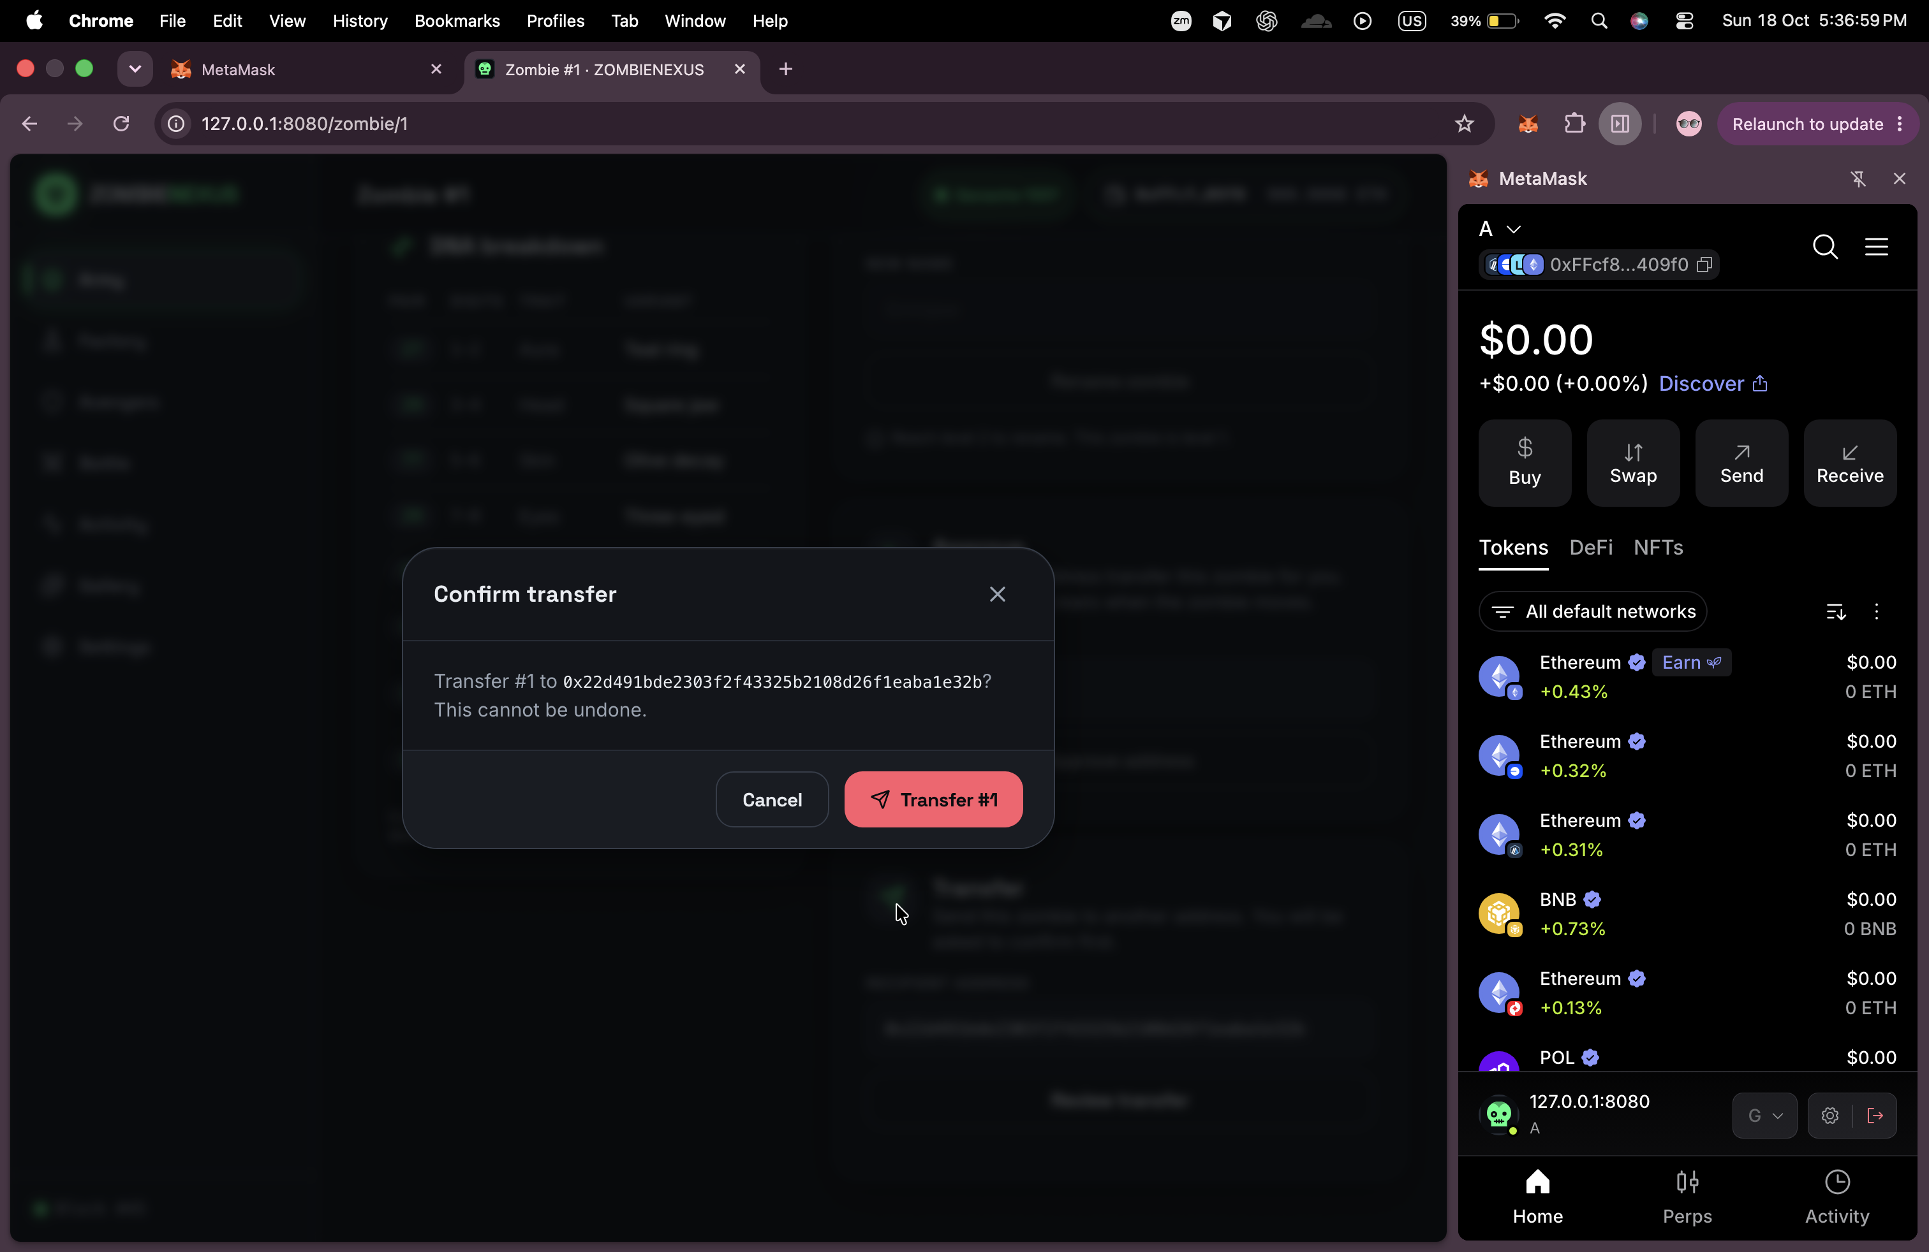
Frontend tour
Army /
Factory /create
Detail /zombie/:id
Connect MetaMask
Level up MetaMask
Transfer /zombie/:id
ZOMBIENEXUS
07
Notes:
TIME: 0:10
These captures show Army, Factory, zombie details, wallet connection, level-up approval and transfer confirmation. They summarize the interface demonstrated live.
DEMO CUE: Return from the live demonstration to this interface recap
BUILD: none
SOURCES: README.md Main front end features; user Screenshots folder
SLOT: 8:00–10:00 after demo

Slide 8
Wallet and tx handling
WALLET STATES
TRANSACTION STATES
rpc-down
no-contract
idle
awaiting-signature
pending
confirmed
Top-priority banners
reverted
rejected
failed
no-metamask
disconnected
rejected
You rejected the request in MetaMask.
ready
connecting
funds
Not enough test ETH for gas and fees.
network
Switch MetaMask to Ganache.
reverted
You do not own this zombie.
wrong-network
switch / refresh
unknown
Is npm run demo running?
Success: receipt.status is 1 No reload on chain change Readable errors
ZOMBIENEXUS
08
Notes:
TIME: 0:15
Wallet state and transaction state are separate. We distinguish missing wallets, network problems and unavailable contracts. A transaction succeeds only when its receipt status is one, and errors produce readable guidance.
DEMO CUE: Recall the wallet status, transaction stepper and diagnostics seen live
BUILD: Wallet path first, then transaction path and errors
SOURCES: SPEC.md §§4.2–4.3
SLOT: 8:00–10:00 after demo

Slide 9
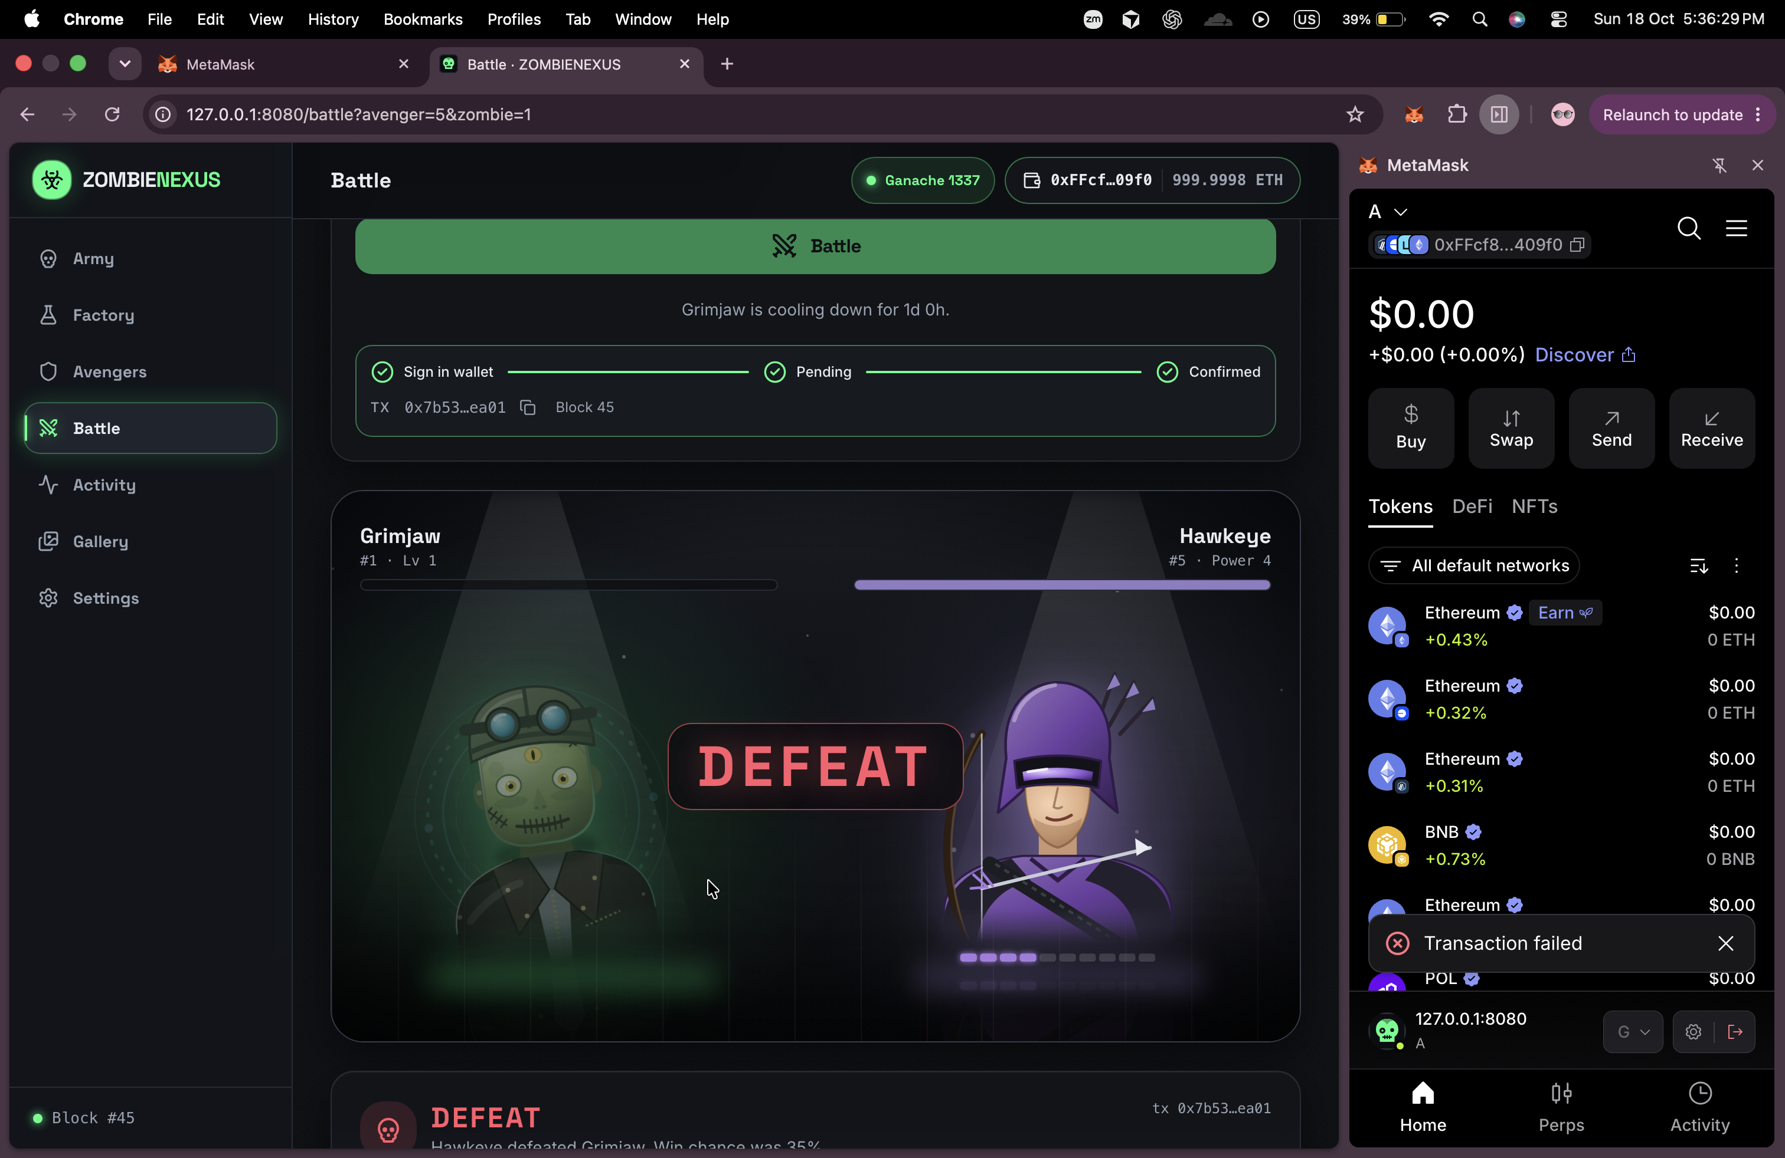
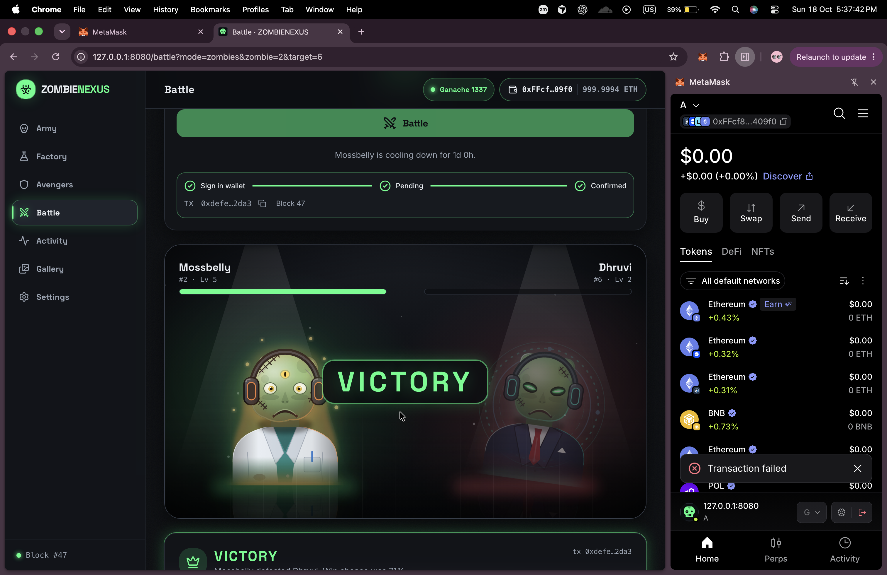
Battle arena
Avenger battle / DEFEAT
Zombie PvP / VICTORY
Fight Avengers or other owners’ zombies
Read odds before signing
Result comes from the on-chain event
ZOMBIENEXUS
09
Notes:
TIME: 0:10
Both battle modes use on-chain results. The animation presents the event outcome, and the interface shows the odds before signing.
DEMO CUE: Duskwalker versus an Avenger, then Mossbelly versus The Warden
BUILD: none
SOURCES: SPEC.md §§1.5, 6; README.md Demo walk-through
SLOT: 8:00–10:00 after demo

Slide 10
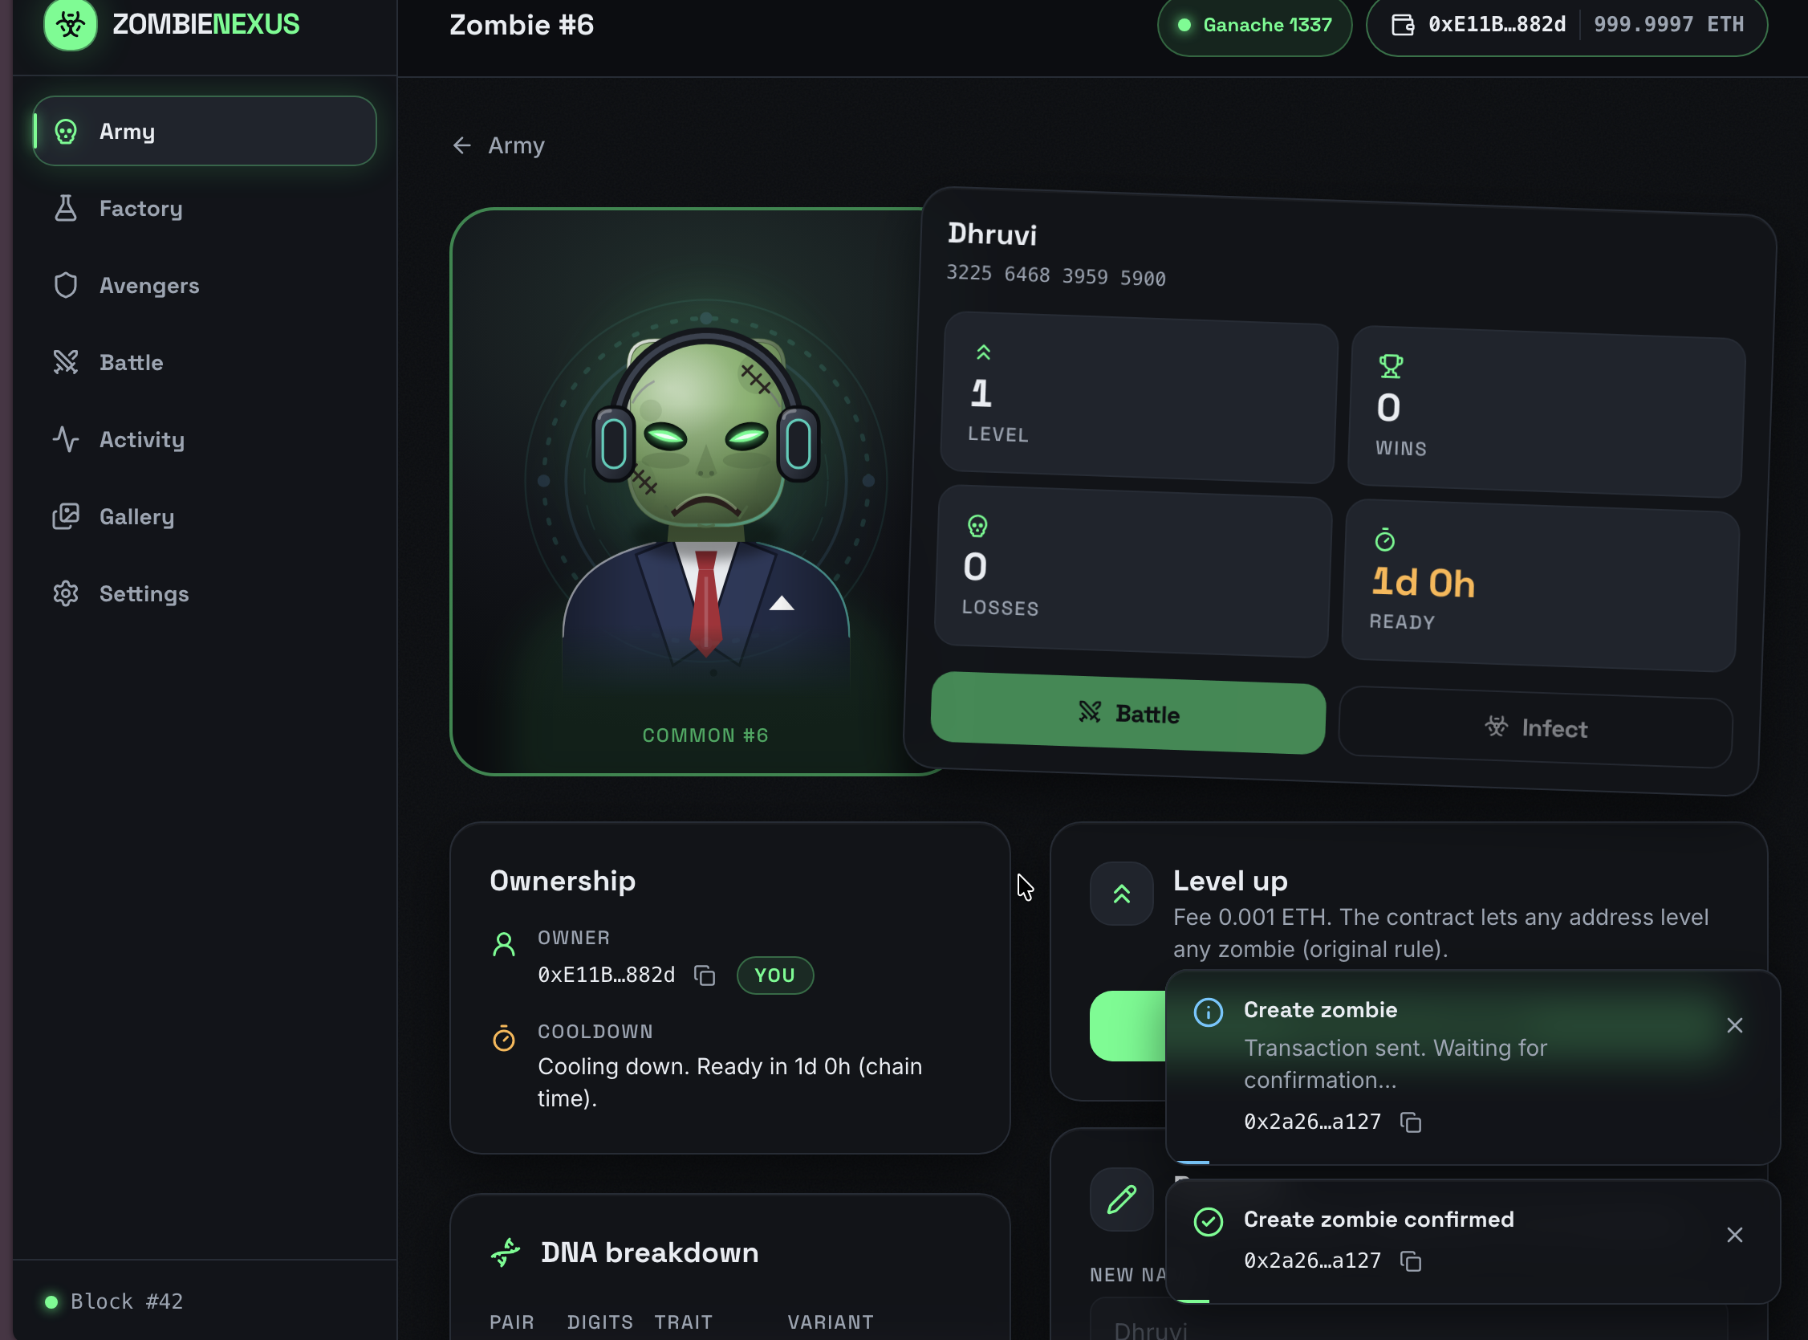
Tested, not trusted
30
47
Truffle scenarios
Vitest unit tests
UI capture / creation confirmed
6 starter + 20 master + 4 Avenger
6 files
Battle tests recompute the roll
Revert reasons have assertions
DNA preview matches on-chain DNA
UI capture / level updated
Counts from project docs. Images show UI outcomes.
ZOMBIENEXUS
10
Notes:
TIME: 0:15
The documented suite contains thirty Truffle scenarios and forty-seven frontend tests. Battle tests recompute the random roll, and DNA tests check that preview calculations match the expected contract values.
DEMO CUE: Explain the documented counts. The user images show UI outcomes, not test-run output.
BUILD: Read counts, then the properties they check
SOURCES: CHANGES.md Improvements; README.md Testing; SPEC.md §8
SLOT: 8:00–10:00 after demo

Slide 11
One command
npm run setup
Install and compile
Repeatable demo state
npm run demo
Start, deploy, seed, check, serve
npm run reset
Fresh chain state
Golden snapshot restores
the saved chain.
npm run snapshot
Save golden state
npm run restore
Return to saved state
npm run check
Verify chain and wiring
Stop the chain before
reset, snapshot or restore.
npm test
Run contract tests
ZOMBIENEXUS
11
Notes:
TIME: 0:10
The demo command prepares and serves the application. Snapshot and restore return the chain to a saved state for repeatable demonstrations.
DEMO CUE: Show npm run check output and the prepared startup terminal
BUILD: none
SOURCES: README.md Run on a new Mac, Other commands, MetaMask setup
SLOT: 8:00–10:00 after demo

Slide 12
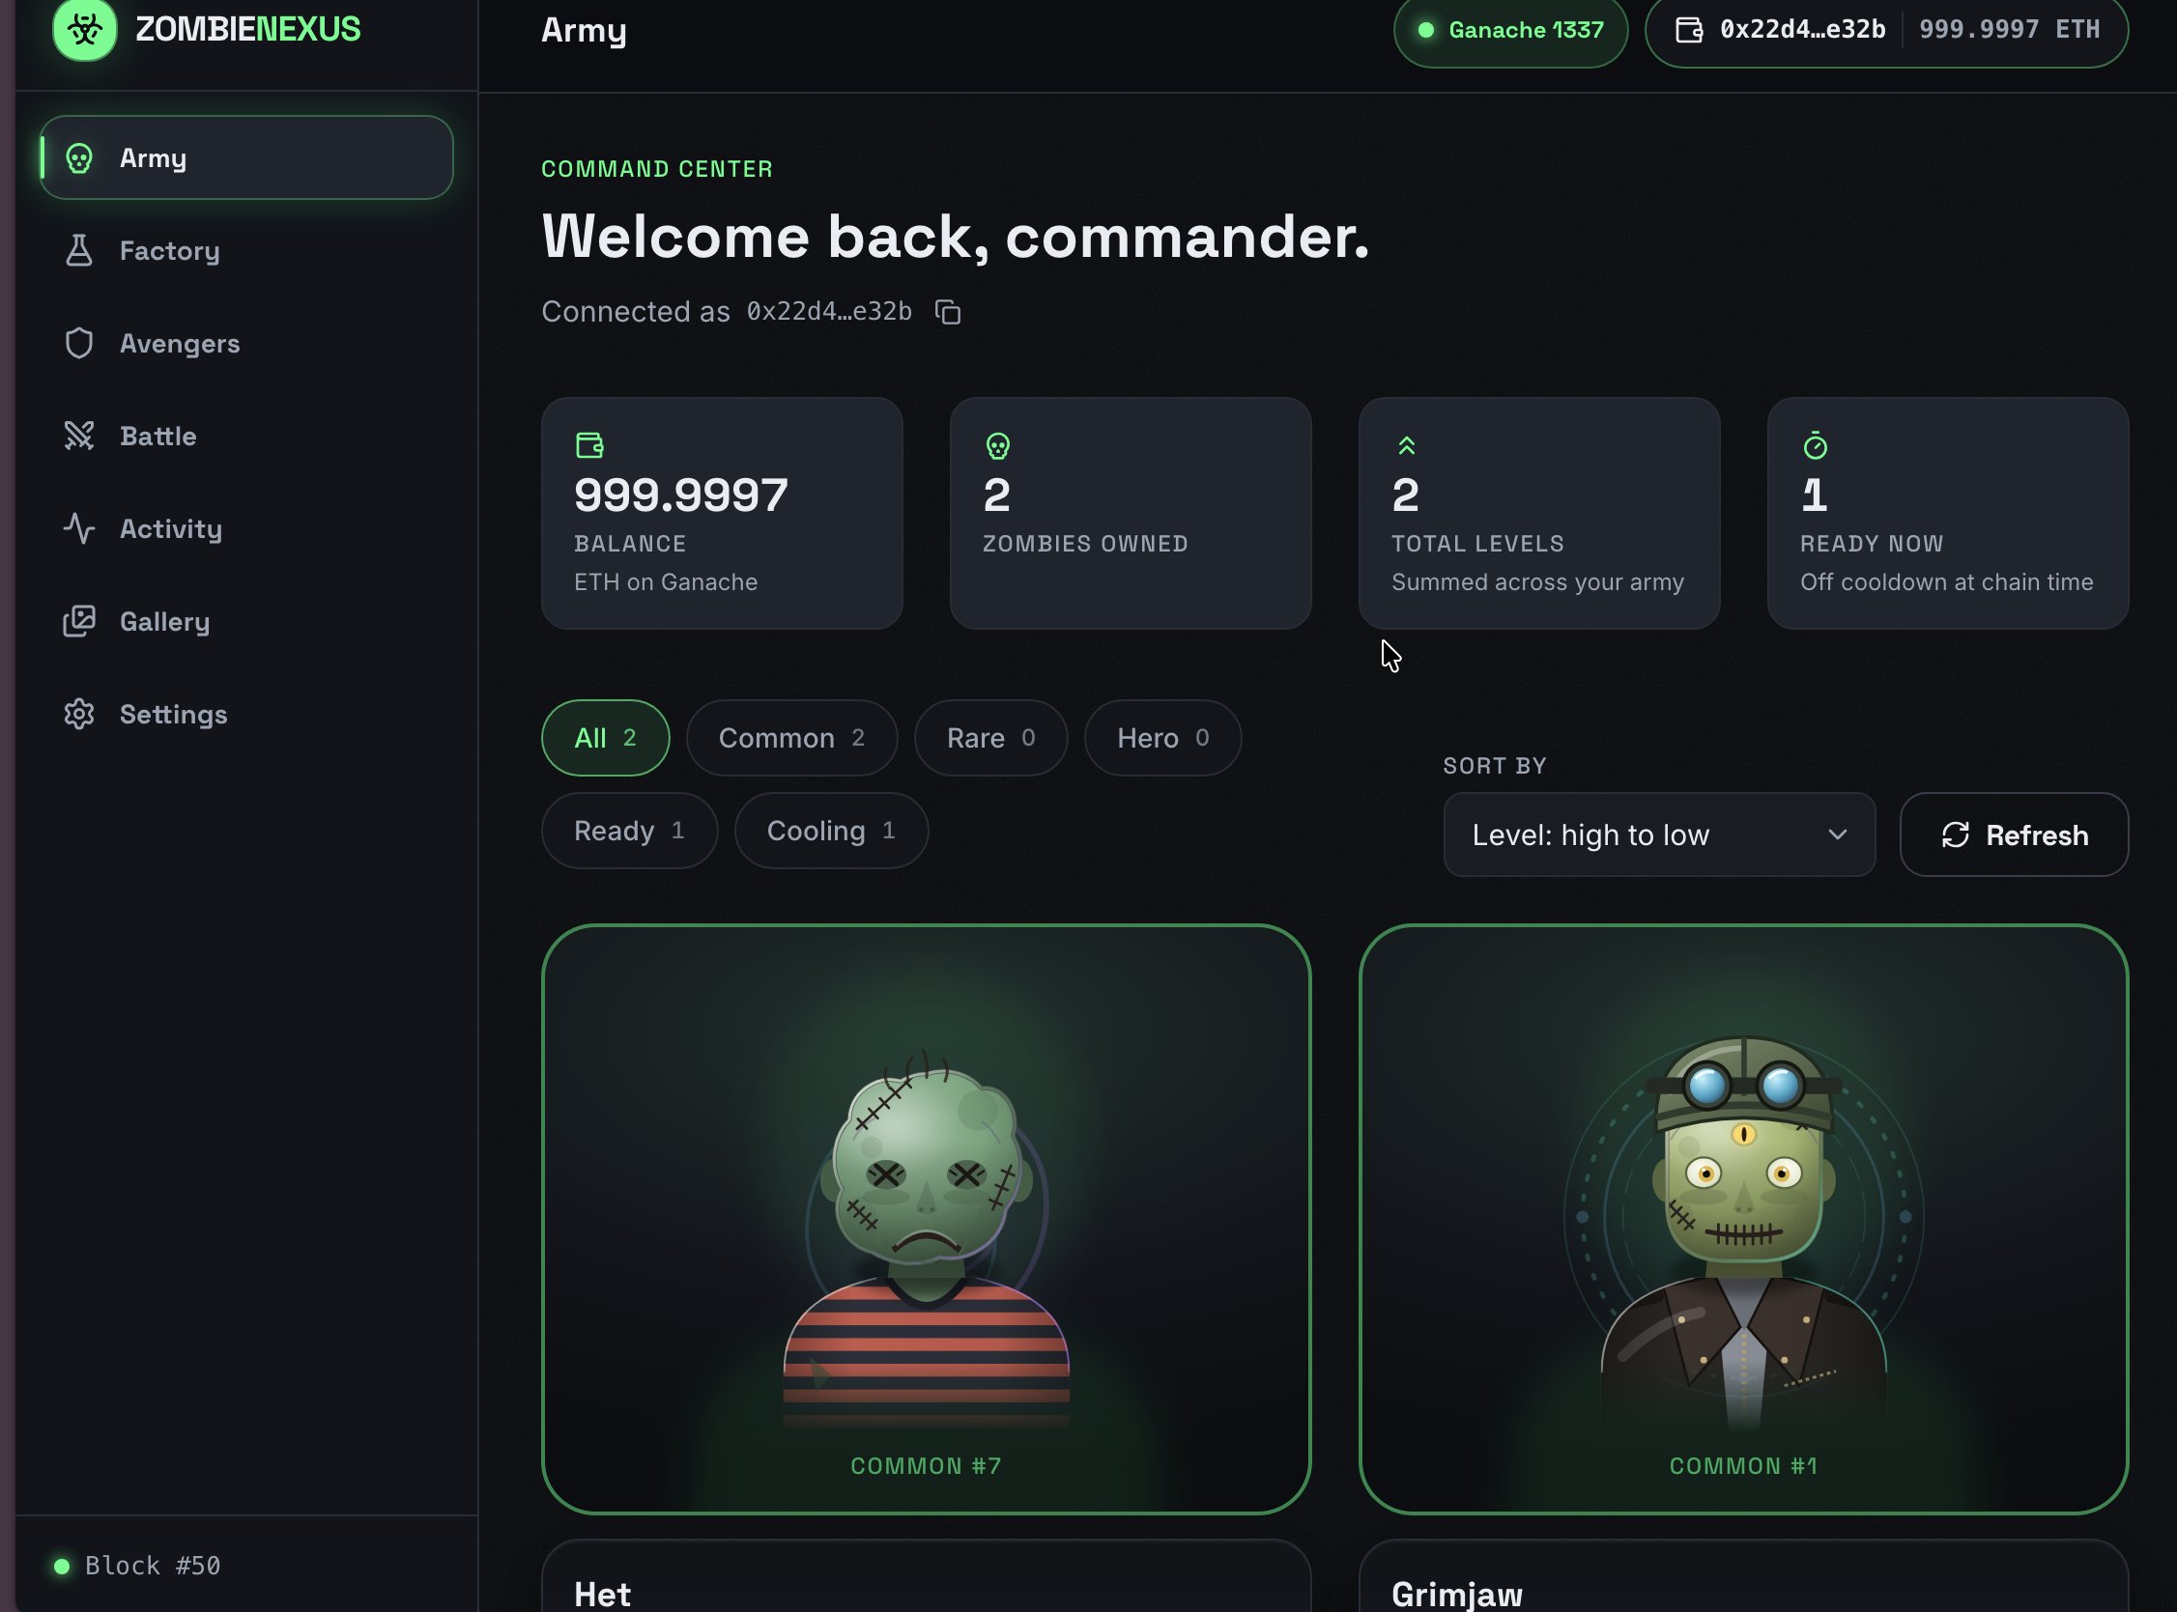
Rubric map
Credit depends on demonstrating each improvement live
IMPROVEMENT (+1 PT EACH)
LIVE PROOF
React frontend
Tour pages and responsive Gallery
Wallet + network
Connect, status and diagnostics
Factory + Army
Create, compare DNA, filter Army
Ownership transfer
Transfer, switch wallet, verify owner
Feeding / mutation
Infect, compare DNA, hero ends 99
Receiving wallet / Army
Battle arena
Odds, fight, receipt event result
Starter on Ganache
24 pts baseline
Backups: Activity, diagnostics, bug fixes + 30 tests, demo/reset
Subjective team performance, compared with peers. No score claimed.
ZOMBIENEXUS
12
Notes:
TIME: 0:25
This map connects each improvement to what we demonstrated: the interface, wallet status, creation and Army, transfer, hero feeding, and battles. We understand that credit requires showing the features working, and that grading considers overall team performance compared with peers. We are not claiming a guaranteed score.
DEMO CUE: Verify all six improvements were shown, including transfer and hero creation
BUILD: Baseline first, then each improvement and its live proof
SOURCES: SPEC.md §7; PROJECT.md §11; README.md Demo walk-through; user grading clarification
SLOT: 8:00–10:00 after demo

Slide 13
Honest limits, real lessons
KNOWN LIMITATIONS
LESSONS FROM THE FIXES
Anyone can pay to level up
Ownership invariants
Check both balances and clear approvals.
PvP wins on 71% of rolls
Consistent preconditions
Randomness is predictable
Validate readiness before either outcome.
Open genes allow easy opponents
Observable outcomes
Self-attack remains possible on-chain
Use receipts and events to explain state.
ZOMBIENEXUS
13
Notes:
TIME: 0:20
This is a local educational demo. Randomness is predictable, anyone can pay to level up, and open Avenger genes allow easy opponents. PvP retains the starter’s seventy-one percent probability. The fixes illustrate why ownership checks and consistent preconditions matter.
DEMO CUE: Mention these limitations while wrapping up the live walkthrough
BUILD: Limits first, then lessons
SOURCES: CHANGES.md Known limitations; PROJECT.md §9
TODO: confirm lessons with the team
SLOT: 8:00–10:00 after demo

Slide 14
Questions?
Q&A
Dhruvi Kothari
CWID: 874294333
Het Siddhapura
CWID: 826929101
[GITHUB_REPO_URL]
Run it: npm run setup, npm run demo
ZOMBIENEXUS
14
Notes:
TIME: 0:15
Our repository includes setup instructions and a repeatable demo workflow. We’re ready for questions about the contracts, implementation choices, or limitations. Thank you.
DEMO CUE: none
BUILD: none
SOURCES: CHANGES.md Known limitations; README.md Requirements, Other commands
SLOT: 8:00–10:00 after demo
PRESENTER BACKUP: I am ready to answer questions about the boundaries of the implementation. Why predictable randomness? We retained the starter approach for this local demo. Who can level up? Any address that pays the fee. Can anyone create an Avenger? Yes, with any genes. Why are approve and transfer payable? Those signatures came from the starter, and sent ETH stays until withdrawal. Is the Avenger contract trusted? Yes, the owner sets it. Deployment here is Ganache only.

