Slide 1
Document Scanner And
Perspective Correction

Slide 2
Group 01 - Digital Image Processing
Name | Enrolment No.
Ayush Makwana | AU2340138
Dhruvik Shah | AU2340113
Divyam Thakkar | AU2340227
Jainik Patel | AU2340042

Slide 3
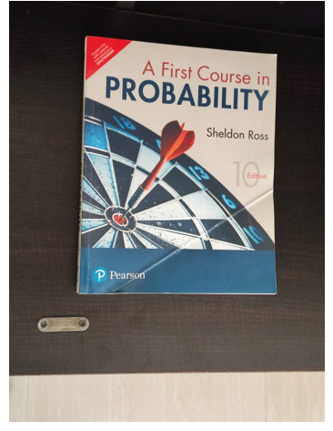
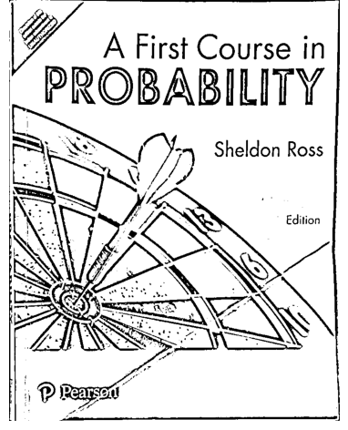
Introduction
Document Scanning
  Problems
    Perspective Distortion
    Shadow
    Noise
Goal:
Our project transforms a photographed document into a clean, flat, scanned copy.

Slide 4
Methodology Overview
Roadmap Of Technical Approach
Preprocessing and Edge Detection
Perspective Correction
Document Contour Detection
Final Enhancement & Binarization

Slide 5
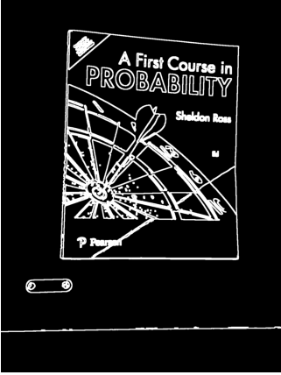
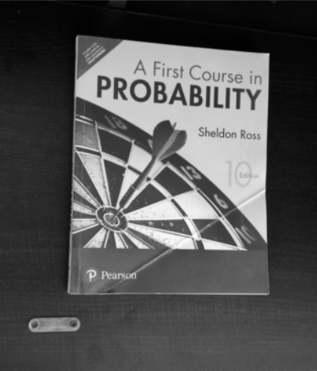
Step 1: Preprocessing & Edge Detection
Goal: To find the outline of the paper.
Read the input image.
Convert to Grayscale
(simplifies processing).
Apply Gaussian Blur
(reduces high-frequency noise).
Use Canny Edge Detector to find edges.

Slide 6
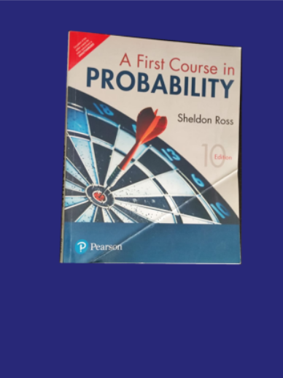

Step 2: Document Contour Detection
Goal: To isolate the 4 corners of the document from all other edges.
Use cv2.findContours to get a list of all detected outlines.
Sort contours by area and select the largest one, assuming it's the document.
Use cv2.approxPolyDP to simplify the contour into a polygon. (We expect 4 corners for a doc)

Slide 7
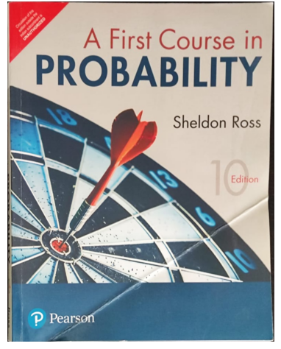
Step 3: Perspective Transformation
Goal: To "unwarp" the document and make it flat.
Order the 4 detected corner points
Define the dimensions of the target output image
Calculate the transformation Matrix using cv2.getPerspectiveTransform.
Apply the transformation using cv2.warpPerspective to get the "bird's-eye view."

Slide 8
Step 4: Final Enhancement
Goal: To make the flat image look like a high-contrast scanned document.
Apply Adaptive Thresholding cv2.ADAPTIVE_THRESH_GAUSSIAN_C to turn the image into pure black-and-white, handling lighting variations.
This step achieves Improved Contrast and Reduced Background Noise.

Slide 9
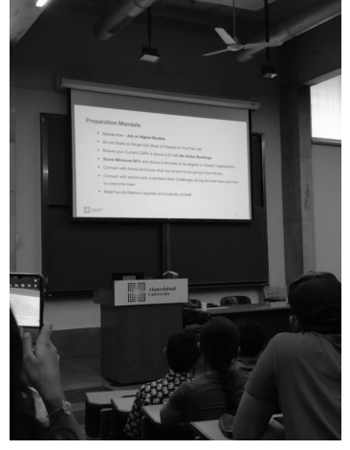
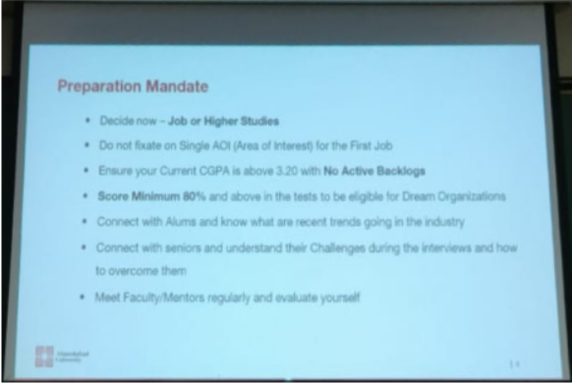
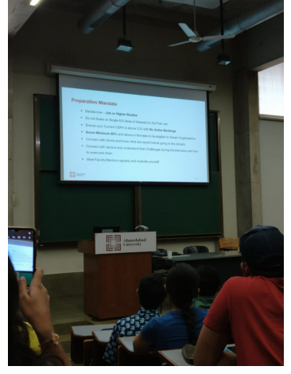
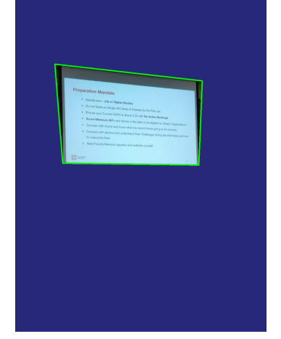
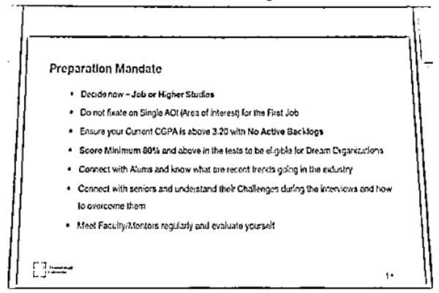
Result Gallery

Slide 10
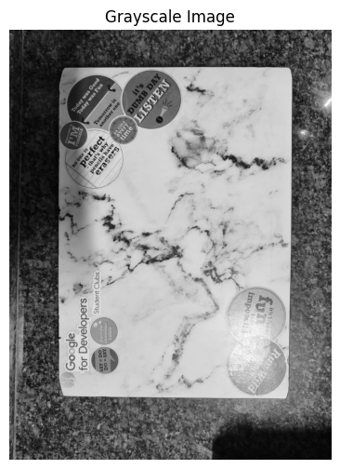
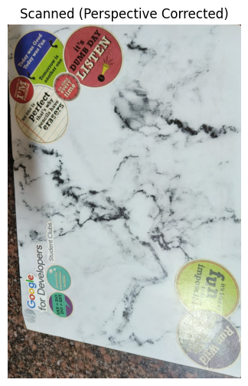
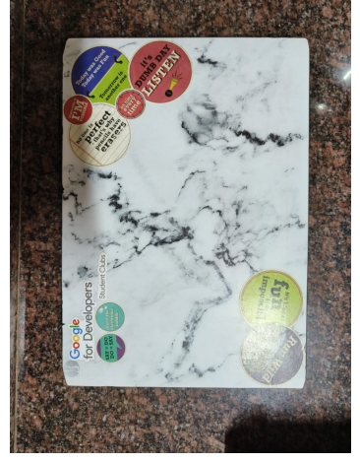
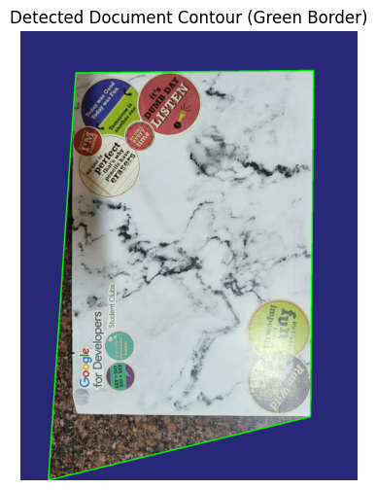
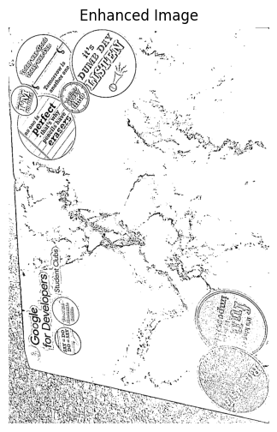
Result Gallery

Slide 11
Conclusion
Summary
Our methodology successfully combines classical computer vision techniques like Canny, Contours, Perspective Transforms and some others to convert photographed documents into clean, usable scans. We avoided the use of ML or LLM models in this project.
Challenges
Fails if the background is too noisy.
Small text relative to the Image may appear as a cluster.
Handwritten documents might be difficult for contour detection.
Requires the document to be the largest object (around 70 - 80%).

Slide 12
References
Canny (1986) – A Computational Approach to Edge Detection
Introduced the Canny edge detector — still the most used edge detection technique.
  https://www.researchgate.net/publication/224377985_A_Computational_Approach_To_Edge_Detection
Suzuki & Abe (1985) – Topological Structural Analysis of Digitized Binary Images by Border Following
Basis for cv2.findContours() algorithm used in OpenCV.
  https://www.sciencedirect.com/science/article/pii/0734189X85900167

Slide 13
Thank You
Questions?

