Slide 1
Document Scanner And
Perspective Correction

Slide 2
Group 01 - Digital Image Processing
Name | Enrolment No.
Ayush Makwana | AU2340138
Dhruvik Shah | AU2340113
Divyam Thakkar | AU2340227
Jainik Patel | AU2340042

Slide 3
Introduction
Document Scanning
  Problems
    Edge Detection
    Perspective Correction
Goal:
Through this project we expect to transform a photographed document into a clean scanned copy.

Slide 4
Literature Review
https://www.sciencedirect.com/science/article/pii/0734189X85900167
From the articles and information available on the web we managed to find different ways of achieving the goal set forward for us. The article given below used a combination of edge localization techniques with geometric transformation to correct the perspective angles. This technique was used by Wormbs et al. that applied Canny edge detection followed by homography estimation for perspective distortion. More recently these tasks are pushed to finer details due to the use of deep learning models like DesigNed for exceptional results. This literature involves the transformation of tech from classical gradient edge detection and geometric wrapping to learned boundary inference and spatial rectification.

Slide 5
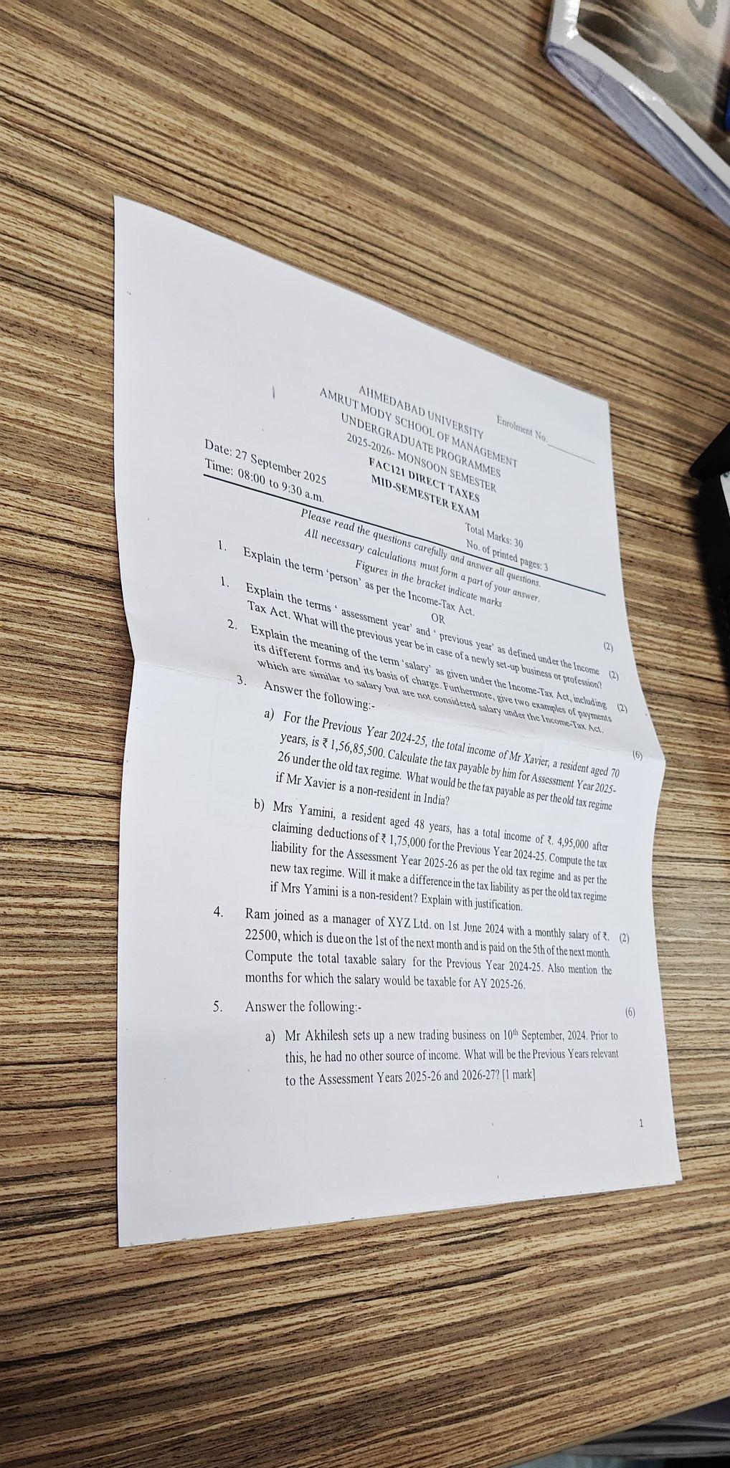
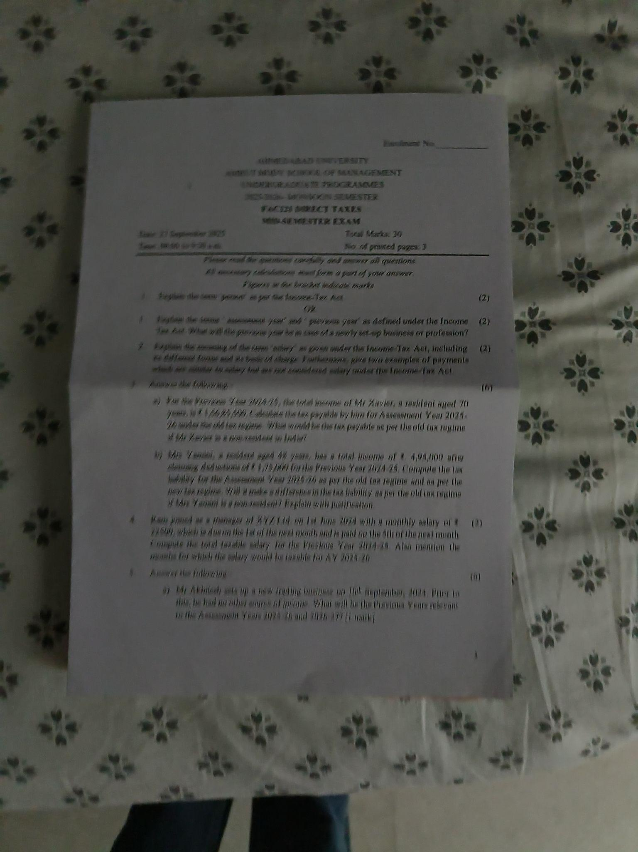
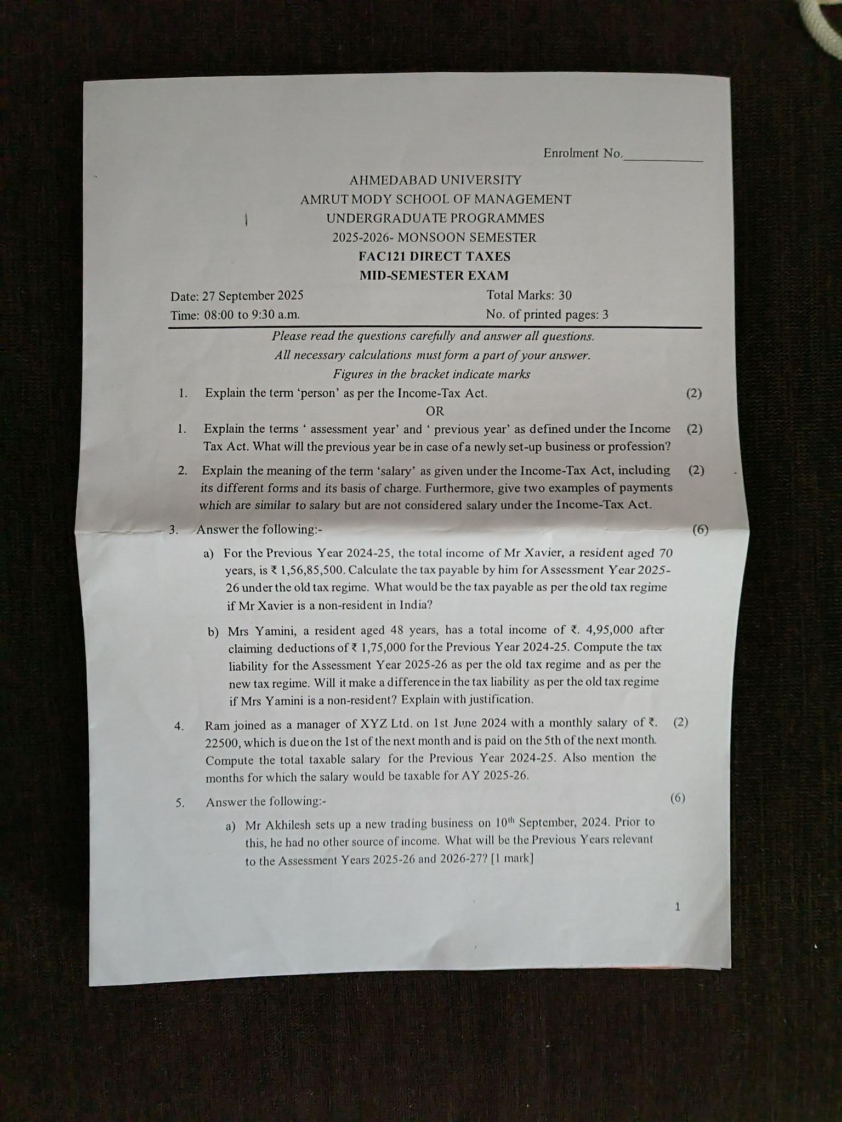
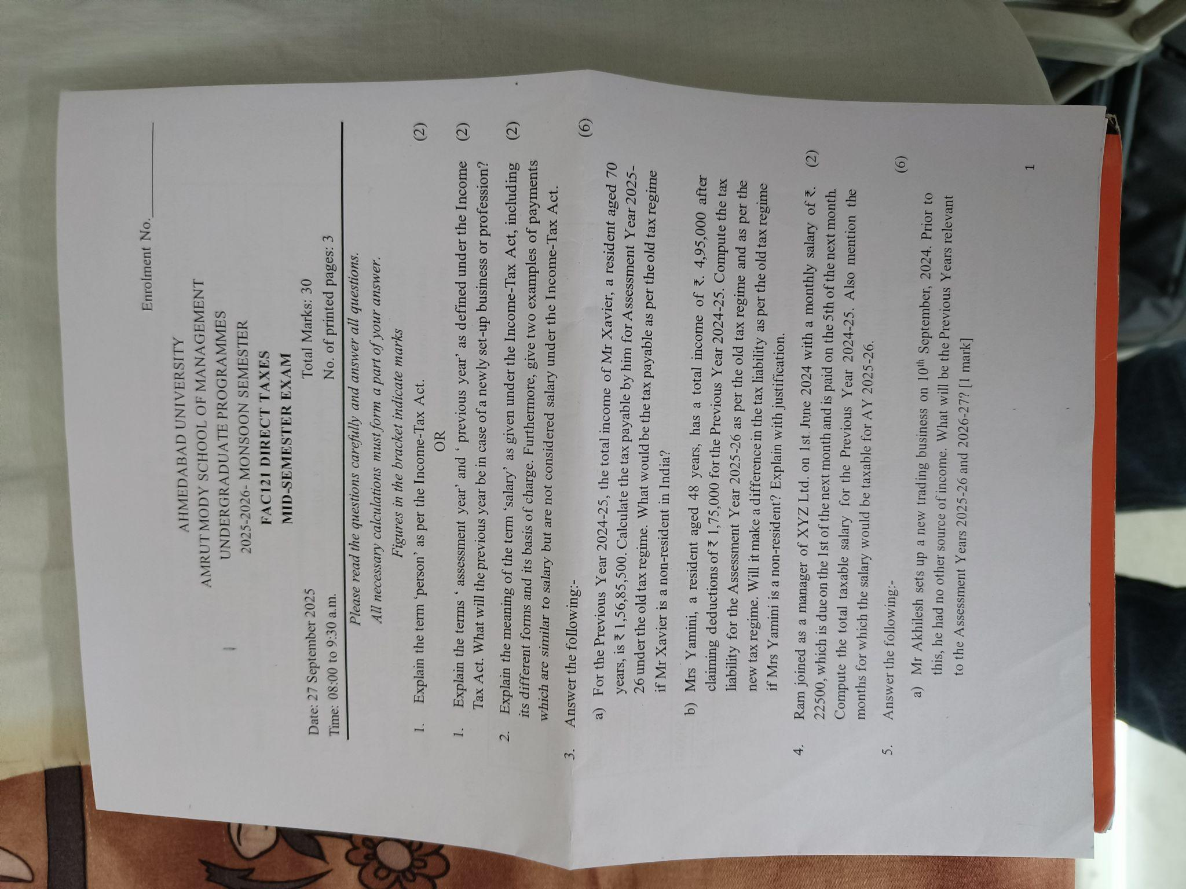
Data Set
Images captured under different lighting conditions and angles.

Slide 6
Methodology
Image Acquisition
Preprocessing
Contour Detection
Perspective Transformation
Enhancement and Integration

Slide 7
Results
Expected Outcome:
Improved Contrast
Clean Edges
Perspective Corrected Images
Reduced Background Noise
Output resembles Scanned Docs

Slide 8

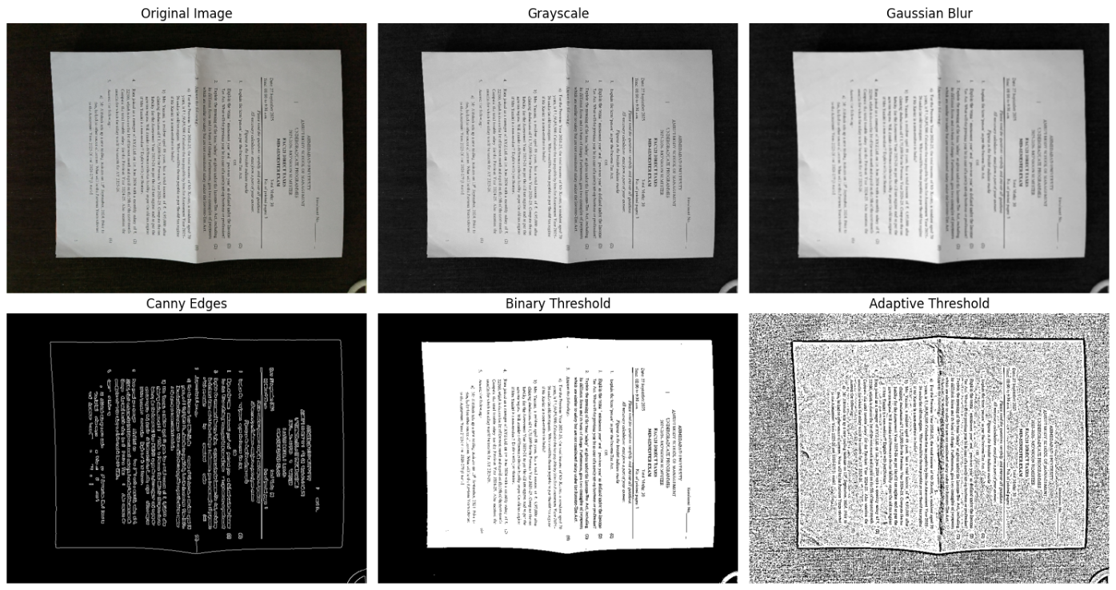
Expectations and Results

Slide 9
Conclusion
Our methodology would effectively convert angled photos into scanned photos. It has to be consistent under different circumstances.

Slide 10
Next Set Of Work
Contour Detection
Perspective Correction
Post Processing

Slide 11
References
Canny (1986) – A Computational Approach to Edge Detection
Introduced the Canny edge detector — still the most used edge detection technique.
  https://www.researchgate.net/publication/224377985_A_Computational_Approach_To_Edge_Detection
Suzuki & Abe (1985) – Topological Structural Analysis of Digitized Binary Images by Border Following
Basis for cv2.findContours() algorithm used in OpenCV.
  https://www.sciencedirect.com/science/article/pii/0734189X85900167

