Slide 1
Computer Programming
-
By, Mosam Patel

Slide 2
COURSE CODE BTCS104 | COURSE NAME COMPUTER PROGRAMMING-I
 |  |  | L | T | P | C
 |  |  | 3 | 0 | 0 | 4
Total Credits: 4 | Total Hours in semester : 45 | Total Marks:100
 | Course Objectives :
To provide the basics of programming components.
To develop logics for array and string which will help them to create applications in C
To familiar students about functions and pointers.
To give brief idea about structures in c programming
To gain knowledge about file handling using c language.

Slide 3
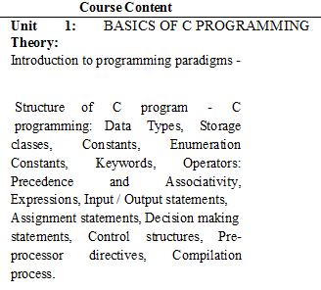

Slide 4
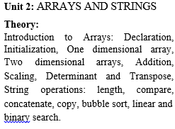

Slide 5
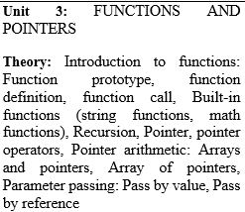

Slide 6
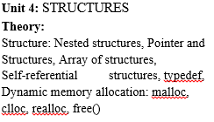

Slide 7
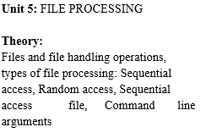

Slide 8
Textbooks:
1. Programming in ANSI C, 7th Edition by Balaguruswamy
2. C Programming: Test Your Skills, 1/e by Ashok Kamthane
3. Let Us C,16th Edition, by Yashwant Kanetkar
4. Programming with C, 2nd Edition by Gottfried, McGraw-Hill.
5. Understanding Pointers in C, 5th edition by Yashwant Kanetkar

Slide 9
Evaluation Scheme | Total Marks 100
Mid semester Marks | 30
End Semester Marks | 50
Continuous Evaluation Marks

Slide 10
Attendance | 5 marks
Quiz | 5 marks
Skill enhancement activities / case study | 5 marks
Presentation/ miscellaneous activities | 5 marks

Slide 11
Course Outcomes | 1. Gain basic understanding of basic components of programming language
 | 2. Understand any other programming language with the knowledge of array and string.
 | 3. Apply function concepts in real time applications.
 | 4. Analyze working of structure in c or other programming language programs.
 | 5. Students will be able to develop applications using C programming

Slide 12
General Discussion
What you mean by Hardware and Software ?
What is programming language? What is the need of a programming language?
Different types of programming languages
Machine Language/ Low Level Language
Assembly Language
High Level language

Slide 13
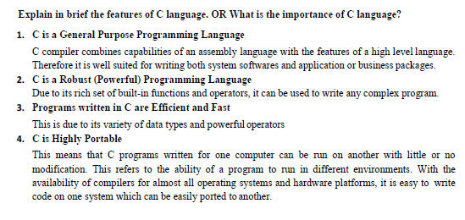

Slide 14
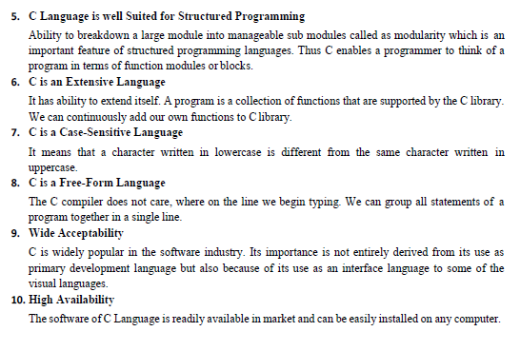

Slide 15
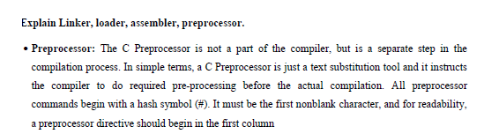

Slide 16
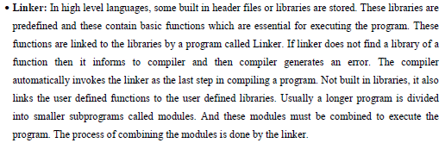

Slide 17
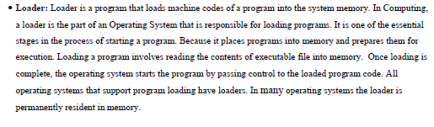

Slide 18
General Discussion
Compiler and Interpreter
Flowcharts and Algorithms

Slide 19
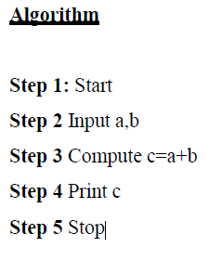

Slide 20
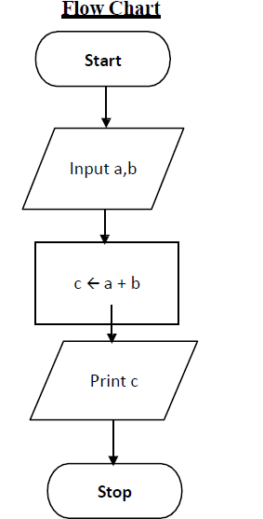

Slide 21
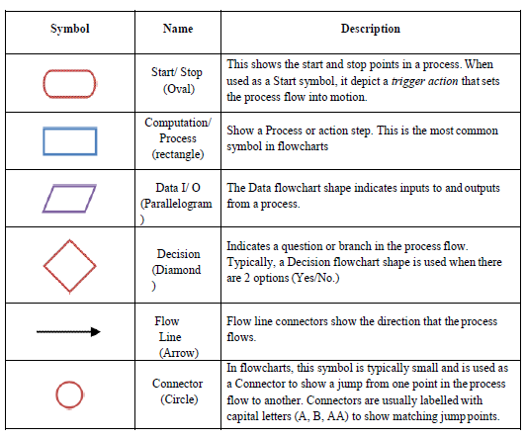

Slide 22
Executing a program written in C involves following series of steps:
1. Creating the program
2. Compiling the program
3. Linking the program with functions that are needed from the C-library
4. Executing the program

Slide 23
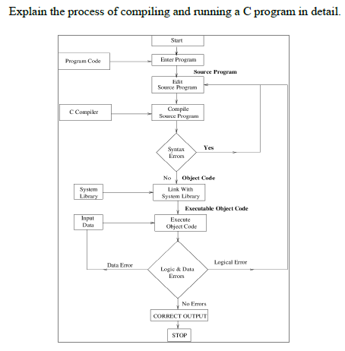

Slide 24
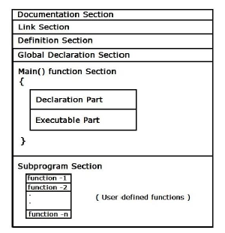
Basic Structure of C Program

