Slide 1
Model Evaluation and Selection

Slide 2
Definitions
Training Dataset: The sample of data used to fit the model. The actual dataset that we use to train the model (weights and biases in the case of a Neural Network). The model sees and learns from this data.
Validation Dataset: The sample of data used to provide an unbiased evaluation of a model fit on the training dataset while tuning model hyper parameters. The evaluation becomes more biased as skill on the validation dataset is incorporated into the model configuration.
The validation set is used to evaluate a given model, but this is for frequent evaluation. We, as machine learning engineers, use this data to fine-tune the model hyper parameters. Hence the model occasionally sees this data, but never does it Learn” from this. We use the validation set results, and update higher level hyper parameters.
Test Dataset: The sample of data used to provide an unbiased evaluation of a final model fit on the training dataset.

Slide 3
Model Evaluation and Selection
Evaluation metrics: How can we measure accuracy? Other metrics to consider?
Use validation test set of class-labeled tuples instead of training set when assessing accuracy
Methods for estimating a classifier’s accuracy:
Holdout method, random subsampling
Cross-validation
Bootstrap
3

Slide 4
Validation Techniques
Resubstituting:
If all the data is used for training the model and the error rate is evaluated based on outcome vs. actual value from the same training data set, this error is called the resubstituting error. This technique is called the resubstituting validation technique.
Hold-out
To avoid the resubstituting error, the data is split into two different datasets labeled as a training and a testing dataset. This can be a 60/40 or 70/30 or 80/20 split. This technique is called the hold-out validation technique. In this case, there is a likelihood that uneven distribution of different classes of data is found in training and test dataset. To fix this, the training and test dataset is created with equal distribution of different classes of data. This process is called stratification.
LOOCV
Random subsampling
Bootstrapping

Slide 5
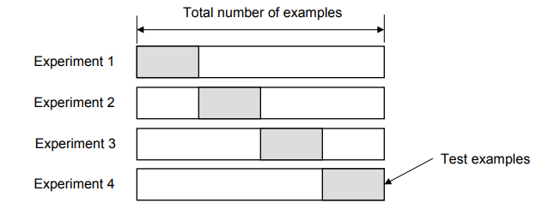
K-fold cross-validation
In this technique, k-1 folds are used for training and the remaining one is used for testing as shown in the picture given below. The advantage is that entire data is used for training and testing. The error rate of the model is average of the error rate of each iteration. This technique can also be called a form the repeated hold-out method. The error rate could be improved by using stratification technique.

Slide 6
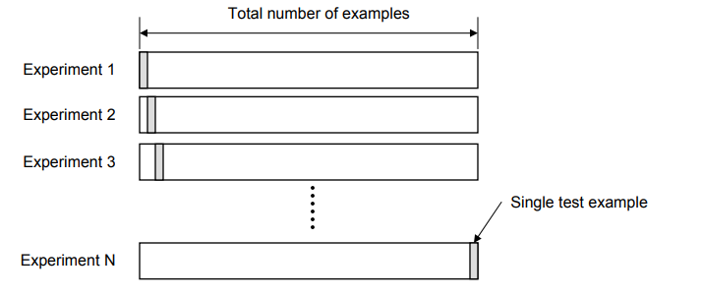
Leave-One-Out Cross-Validation (LOOCV)
In this technique, all of the data except one record is used for training and one record is used for testing. This process is repeated for N times if there are N records. The advantage is that entire data is used for training and testing. The error rate of the model is average of the error rate of each iteration. The following diagram represents the LOOCV validation technique.

Slide 7
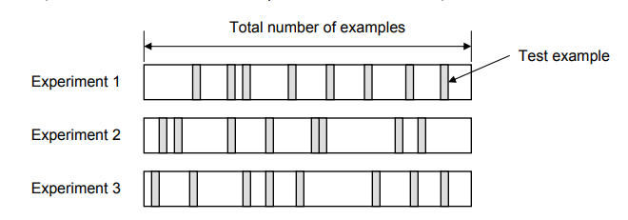
Random Subsampling
In this technique, multiple sets of data are randomly chosen from the dataset and combined to form a test dataset. The remaining data forms the training dataset. The following diagram represents the random subsampling validation technique. The error rate of the model is the average of the error rate of each iteration

Slide 8
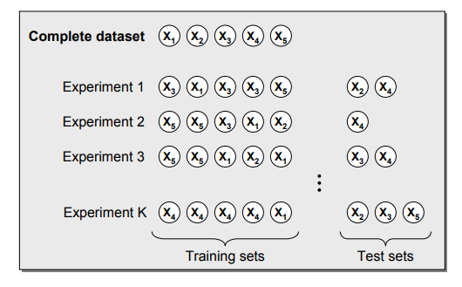
Bootstrapping
In this technique, the training dataset is randomly selected with replacement. The remaining examples that were not selected for training are used for testing. Unlike K-fold cross-validation, the value is likely to change from fold-to-fold. The error rate of the model is average of the error rate of each iteration. The following diagram represents the same.

Slide 9
Classifier Evaluation Metrics: Confusion Matrix
Confusion Matrix:
Actual class\Predicted class | C₁ | ¬ C₁
C₁ | True Positives (TP) | False Negatives (FN)
¬ C₁ | False Positives (FP) | True Negatives (TN)
Example of Confusion Matrix:
Actual class\Predicted class | buy_computer = yes | buy_computer = no | Total
buy_computer = yes | 6954 | 46 | 7000
buy_computer = no | 412 | 2588 | 3000
Total | 7366 | 2634 | 10000
Given m classes, an entry, CM_{i,j} in a confusion matrix indicates # of tuples in class i that were labeled by the classifier as class j
May have extra rows/columns to provide totals
9

Slide 10
Classifier Evaluation Metrics: Accuracy, Error Rate, Sensitivity and Specificity
A\P | C | ¬C
C | TP | FN | P
¬C | FP | TN | N
 | P’ | N’ | All
Class Imbalance Problem:
One class may be rare, e.g. fraud, or HIV-positive
Significant majority of the negative class and minority of the positive class
Sensitivity: True Positive recognition rate
Sensitivity = TP/P
Specificity: True Negative recognition rate
Specificity = TN/N
Classifier Accuracy, or recognition rate: percentage of test set tuples that are correctly classified
Accuracy = (TP + TN)/All
Error rate: 1 – accuracy, or
Error rate = (FP + FN)/All
10

Slide 11
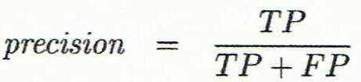
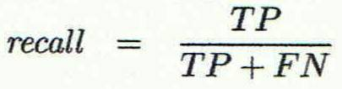
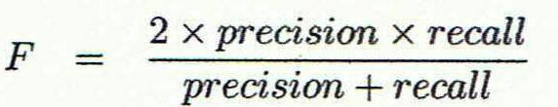
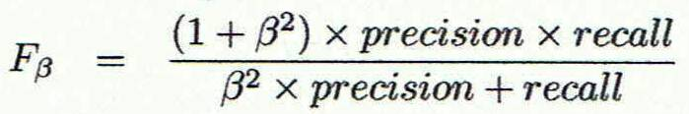
Classifier Evaluation Metrics: Precision and Recall, and F-measures
Precision: exactness – what % of tuples that the classifier labeled as positive are actually positive
Recall: completeness – what % of positive tuples did the classifier label as positive?
Perfect score is 1.0
Inverse relationship between precision & recall
F measure (F₁ or F-score): harmonic mean of precision and recall, (needed when average of rates is required)
F_{ß}: weighted measure of precision and recall
assigns ß times as much weight to recall as to precision
11

Slide 12
Classifier Evaluation Metrics: Example
Actual Class\Predicted class | cancer = yes | cancer = no | Total | Recognition(%)
cancer = yes | 90 | 210 | 300 | 30.00 (sensitivity
cancer = no | 140 | 9560 | 9700 | 98.56 (specificity)
Total | 230 | 9770 | 10000 | 96.40 (accuracy)
Precision = 90/230 = 39.13% Recall = 90/300 = 30.00%
A perfect precision score of 1.0 for a class C means that every tuple that the classifier labeled as belonging to class C does indeed belong to class C. but it does not tell us anything about the number of class C tuples that the classifier mislabeled.
A perfect recall score of 1.0 for C means that every item from class C was labeled as such, but it does not tell us how many other tuples were incorrectly labeled as belonging to class C.
12

Slide 13
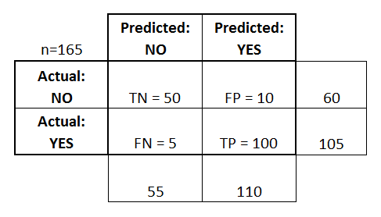

Slide 14
This is a list of rates that are often computed from a confusion matrix:
Accuracy: Overall, how often is the classifier correct?
(TP+TN)/total = (100+50)/165 = 0.91
Misclassification Rate: Overall, how often is it wrong?
(FP+FN)/total = (10+5)/165 = 0.09
equivalent to 1 minus Accuracy
also known as "Error Rate"
True Positive Rate: When it's actually yes, how often does it predict yes?
TP/actual yes = 100/105 = 0.95
also known as "Sensitivity" or "Recall"
False Positive Rate: When it's actually no, how often does it predict yes?
FP/actual no = 10/60 = 0.17
True negative rate : Specificity: When it's actually no, how often does it predict no?
TN/actual no = 50/60 = 0.83
equivalent to 1 minus False Positive Rate
Precision: When it predicts yes, how often is it correct?
TP/predicted yes = 100/110 = 0.91

Slide 15
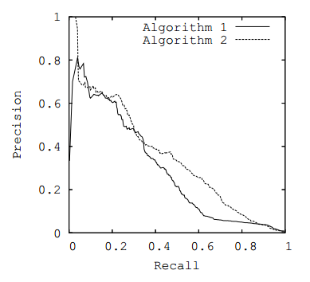
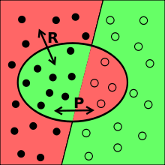
P-R Curve
When you perform a search on any search engine, you are looking to find the most relevant material, while minimizing the junk that is retrieved. This is the basic objective of any search engine. Unfortunately getting "everything important" while avoiding "junk" is difficult, if not impossible, to accomplish. However, it is possible to measure how well a search performed with respect to these two parameters.

Slide 16
Example
If I have a database with 100 documents,
60 are relevant to a particular keyword.
If my IR system returns a total of 50 documents,
out of which 40 are relevant,
the precision for this system is 40/50=0.8 and the recall is 40/60=0.66 If instead there's another IR system that returns only 10 documents,
chances are that at least 9 of them are relevant.
This would increase my precision to 0.9
but decrease it's recall to just 0.15.

Slide 17
Additional aspects for Model Selection
Accuracy
classifier accuracy: predicting class label
Speed
time to construct the model (training time)
time to use the model (classification/prediction time)
Robustness: handling noise and missing values
Scalability: efficiency in disk-resident databases
Interpretability
understanding and insight provided by the model
Other measures, e.g., goodness of rules, such as decision tree size or compactness of classification rules
17
Notes:
17

Slide 18
Evaluating Classifier Accuracy: Holdout & Cross-Validation Methods
Holdout method
Given data is randomly partitioned into two independent sets
Training set (e.g., 2/3) for model construction
Test set (e.g., 1/3) for accuracy estimation
Random sampling: a variation of holdout
Repeat holdout k times, accuracy = avg. of the accuracies obtained
18

Slide 21
Receiver Operating Characteristic Curves

Slide 22
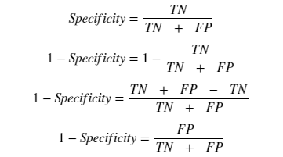
TPR and FPR
So the sensitivity can be called as the “True Positive Rate” and (1 — Specificity) can be called as the “False Positive Rate”.

Slide 23

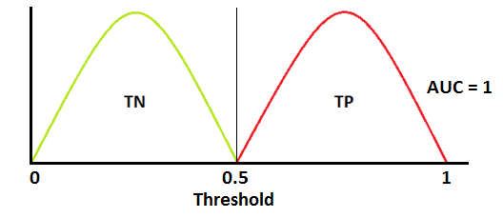
ROC- Best Case

Slide 24
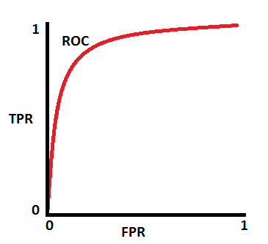
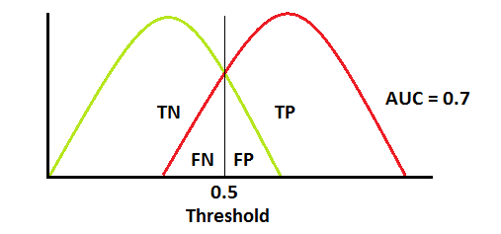
ROC- Avg- Case

Slide 25
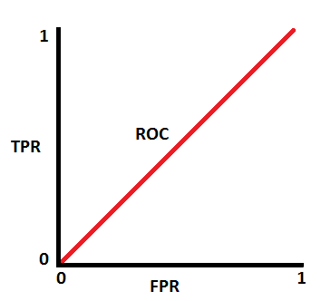
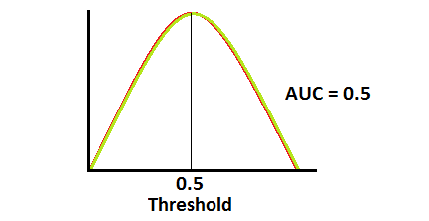
ROC-Worst Case

Slide 26
Techniques to Improve Classification Accuracy: Ensemble Methods
26
Notes:
26

Slide 27
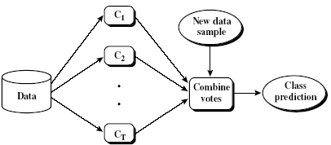
Ensemble Methods: Increasing the Accuracy
Ensemble methods
Use a combination of models to increase accuracy
Combine a series of k learned models, M₁, M₂, …, M_{k}, with the aim of creating an improved model M*
Popular ensemble methods
Bagging: averaging the prediction over a collection of classifiers
Boosting: weighted vote with a collection of classifiers
Ensemble: combining a set of heterogeneous classifiers
27

Slide 28
Bagging: Boostrap Aggregation
Analogy: Diagnosis based on multiple doctors’ majority vote
Training
Given a set D of d tuples, at each iteration i, a training set D_{i} of d tuples is sampled with replacement from D (i.e., bootstrap)
A classifier model M_{i} is learned for each training set D_{i}
Classification: classify an unknown sample X
Each classifier M_{i} returns its class prediction
The bagged classifier M* counts the votes and assigns the class with the most votes to X
Prediction: can be applied to the prediction of continuous values by taking the average value of each prediction for a given test tuple
Accuracy
Often significantly better than a single classifier derived from D
For noise data: not considerably worse, more robust
Proved improved accuracy in prediction
28

Slide 29
Boosting
Analogy: Consult several doctors, based on a combination of weighted diagnoses—weight assigned based on the previous diagnosis accuracy
How boosting works?
Weights are assigned to each training tuple
A series of k classifiers is iteratively learned
After a classifier M_{i} is learned, the weights are updated to allow the subsequent classifier, M_{i+1}, to pay more attention to the training tuples that were misclassified by M_{i}
The final M* combines the votes of each individual classifier, where the weight of each classifier's vote is a function of its accuracy
Boosting algorithm can be extended for numeric prediction
Comparing with bagging: Boosting tends to have greater accuracy, but it also risks overfitting the model to misclassified data
29

Slide 30
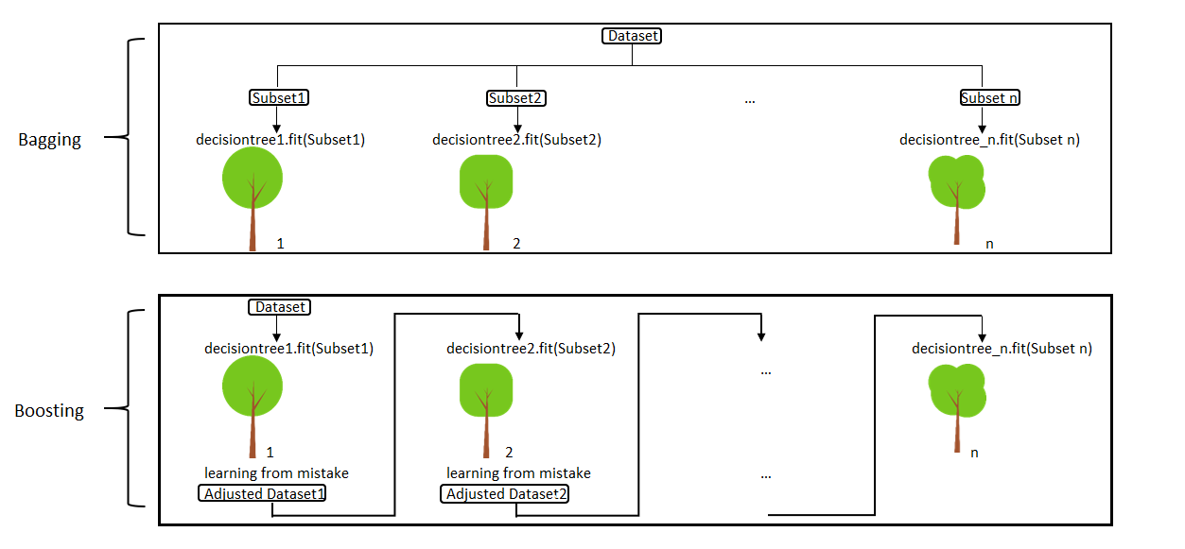
Bagging and Boosting

Slide 31
Adaboost (Freund and Schapire, 1997)
Given a set of d class-labeled tuples, (X₁, y₁), …, (X_{d}, y_{d})
Initially, all the weights of tuples are set the same (1/d)
Generate k classifiers in k rounds. At round i,
Tuples from D are sampled (with replacement) to form a training set D_{i} of the same size
Each tuple’s chance of being selected is based on its weight
A classification model M_{i} is derived from D_{i}
Its error rate is calculated using D_{i} as a test set
If a tuple is misclassified, its weight is increased, o.w. it is decreased
Error rate: err(X_{j}) is the misclassification error of tuple X_{j}. Classifier M_{i} error rate is the sum of the weights of the misclassified tuples:
The weight of classifier M_{i}’s vote is

Slide 32
Random Forest (Breiman 2001)
Random Forest:
Each classifier in the ensemble is a decision tree classifier and is generated using a random selection of attributes at each node to determine the split
During classification, each tree votes and the most popular class is returned
Two Methods to construct Random Forest:
Forest-RI (random input selection): Randomly select, at each node, F attributes as candidates for the split at the node. The CART methodology is used to grow the trees to maximum size
Forest-RC (random linear combinations): Creates new attributes (or features) that are a linear combination of the existing attributes (reduces the correlation between individual classifiers)
Comparable in accuracy to Adaboost, but more robust to errors and outliers
Insensitive to the number of attributes selected for consideration at each split, and faster than bagging or boosting
32

Slide 33
 |  | Predicted
 |  | Positive | Negative
Observed | Positive | 6 | 4
 | Negative | 2 | 8

Slide 34
measure |  | calculated value
Error rate | ERR | 6 / 20 = 0.3
Accuracy | ACC | 14 / 20 = 0.7
Sensitivity True positive rate Recall | SN TPR REC | 6 / 10 = 0.6
Specificity True negative rate | SP TNR | 8 / 10 = 0.8
Precision Positive predictive value | PREC PPV | 6 / 8 =0.75
False positive rate | FPR | 2 / 10 = 0.2

Slide 35
If a classification system has been trained to distinguish between cats, dogs and rabbits, a confusion matrix will summarize the results of testing the algorithm for further inspection. Assuming a sample of 27 animals — 8 cats, 6 dogs, and 13 rabbits, the resulting confusion matrix could look like the table below:
 |  | Predicted
 |  | Cat | Dog | Rabbit
Actual class | Cat | 5 | 3 | 0
 | Dog | 2 | 3 | 1
 | Rabbit | 0 | 2 | 11
:

Slide 36
In this confusion matrix, of the 8 actual cats, the system predicted that three were dogs, and of the six dogs, it predicted that one was a rabbit and two were cats. We can see from the matrix that the system in question has trouble distinguishing between cats and dogs, but can make the distinction between rabbits and other types of animals pretty well. All correct guesses are located in the diagonal of the table, so it's easy to visually inspect the table for errors, as they will be represented by values outside the diagonal.

