Slide 1
K – Nearest Neighbours Classifier / Regressor

Slide 2
K-NN
K-Nearest Neighbors is one of the most basic yet essential classification algorithms in Machine Learning.
It belongs to the supervised learning domain which is applied for pattern recognition, data mining and intrusion detection.
It is non-parametric classification/regression method, meaning, it does not make any underlying assumptions about the distribution of data (as opposed to other algorithms such as GMM, which assume a Gaussian distribution of the given data).
We are given some prior data (also called training data), which classifies coordinates into groups identified by an attribute.

Slide 3
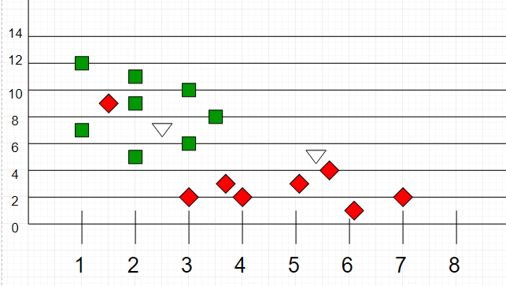

Slide 4
In k-NN classification, the output is a class membership. An object is classified by a plurality vote of its neighbors, with the object being assigned to the class most common among its k nearest neighbors (k is a positive integer, typically small). If k = 1, then the object is simply assigned to the class of that single nearest neighbor.
In k-NN regression, the output is the property value for the object. This value is the average of the values of k nearest neighbors.

Slide 5
k-NN is a type of instance-based learning, or lazy learning, where the function is only approximated locally and all computation is deferred until classification.
Both for classification and regression, a useful technique can be to assign weights to the contributions of the neighbors, so that the nearer neighbors contribute more to the average than the more distant ones.

Slide 6
K-NN classification Algorithm
Let m be the number of training data samples. Let p be an unknown point.
Store the training samples in an array of data points arr[]. This means each element of this array represents a tuple (x₁, x₂, x₃, …., x_{n}).
for i=0 to m: Calculate cosine similarity cosФ = (a * b)/(||a|| ||b||) where a is the input training tuple and b is the targeted tuple.
Make set S of K smallest distances obtained. Each of these distances corresponds to an already classified data point.
Return the majority label / distance weighted label among S.

Slide 9
Cosine Similarity
Cosine similarity is a metric used to determine how similar the documents are irrespective of their size.
Mathematically, it measures the cosine of the angle between two vectors projected in a multi-dimensional space. In this context, the two vectors I am talking about are arrays containing the word counts of two documents.

Slide 10
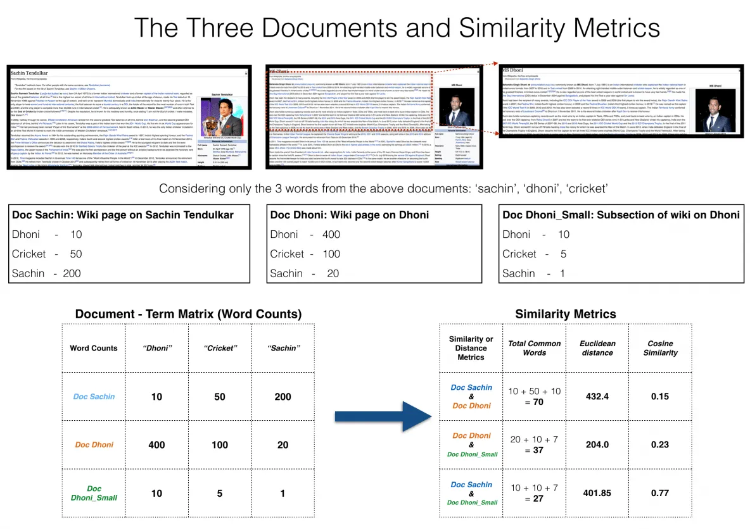

Slide 11
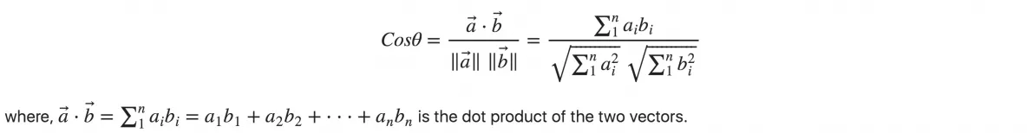
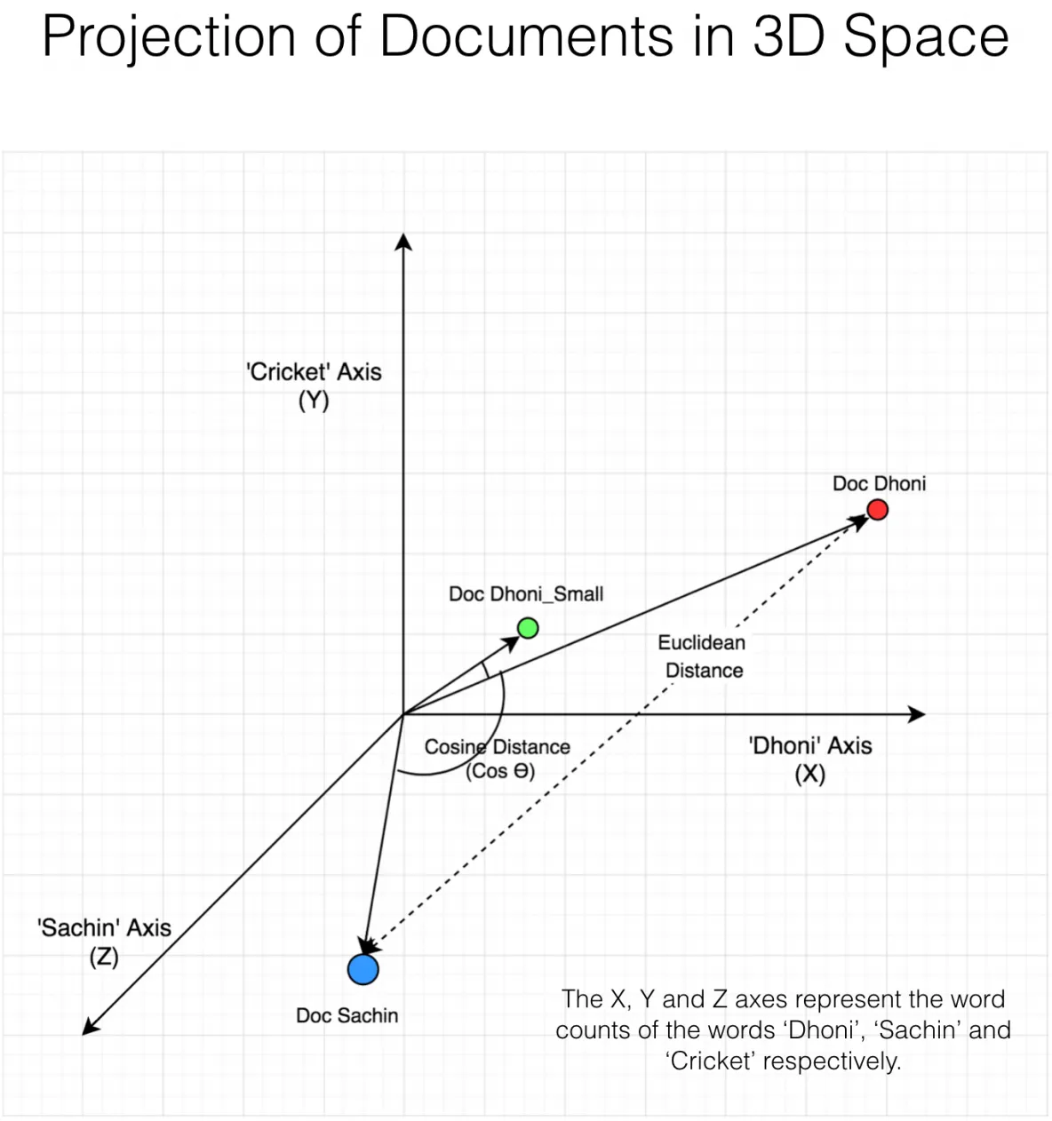

Slide 13
1-NN : B
K-NN:
3-NN : B
5-NN : A
Distance weighted k-NN
Distance weighted 3-NN: B
Distance weighted 19-NN: A

Slide 14
How to choose the value of K?
There is no straightforward method to calculate K. You Play around with different values to choose the optimal K for your problem and data.
Thumb rule is k = sqrt(n), where n is the number of training examples.
But few points to be considered:
K value should be odd.
K value must not be multiples of the number of classes.
Should not be too small or too large (too small – greater influence of noise, too high – biased towards highly probable class)

Slide 15
Naïve Bayes classifier
Bayesian classifiers are statistical classifiers which predict class membership probabilities such as the probability that a given tuple belongs to a particular class.

Slide 16
Bayes’ Theorem: Basics
Total probability Theorem:
Bayes’ Theorem:
Let X be a data sample (“evidence”): class label is unknown
Let H be a hypothesis that X belongs to class C
Classification is to determine P(H|X), (i.e., posteriori probability): the probability that the hypothesis holds given the observed data sample X
P(H) (prior probability): the initial probability
E.g., X will buy computer, regardless of age, income, …
P(X): probability that sample data is observed
P(X|H) (likelihood): the probability of observing the sample X, given that the hypothesis holds
E.g., Given that X will buy computer, the prob. that X is 31..40, medium income

Slide 17
Prediction Based on Bayes’ Theorem
Given training data X, posteriori probability of a hypothesis H, P(H|X), follows the Bayes’ theorem
Informally, this can be viewed as
posteriori = likelihood x prior/evidence
Predicts X belongs to C_{i} iff the probability P(C_{i}|X) is the highest among all the P(C_{k}|X) for all the k classes
Practical difficulty: It requires initial knowledge of many probabilities, involving significant computational cost

Slide 18
Classification is to derive the maximum posteriori
Let D be a training set of tuples and their associated class labels, and each tuple is represented by an n-D attribute vector X = (x₁, x₂, …, x_{n})
Suppose there are m classes C₁, C₂, …, C_{m}.
Classification is to derive the maximum posteriori, i.e., the maximal P(C_{i}|X)
This can be derived from Bayes’ theorem
Since P(X) is constant for all classes, only
needs to be maximized

Slide 19
Naïve Bayes Classifier
A simplified assumption: attributes are conditionally independent (i.e., no dependence relation between attributes):
This greatly reduces the computation cost: Only counts the class distribution
If A_{k} is categorical, P(x_{k}|C_{i}) is the # of tuples in C_{i} having value x_{k} for A_{k} divided by |C_{i, D}| (# of tuples of C_{i} in D)
If A_{k} is continous-valued, P(x_{k}|C_{i}) is usually computed based on Gaussian distribution with a mean μ and standard deviation σ
and P(x_{k}|C_{i}) is

Slide 20
Multivariate Bernoulli Distribution

Slide 21
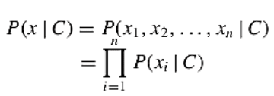

Slide 22
Example

Slide 23
P(C_{i}): P(buys_computer = “yes”) = 9/14 = 0.643
P(buys_computer = “no”) = 5/14= 0.357
Compute P(X|C_{i}) for each class
P(age = “youth” | buys_computer = “yes”) = 2/9 = 0.222
P(age = “youth” | buys_computer = “no”) = 3/5 = 0.6
P(income = “medium” | buys_computer = “yes”) = 4/9 = 0.444
P(income = “medium” | buys_computer = “no”) = 2/5 = 0.4
P(student = “yes” | buys_computer = “yes) = 6/9 = 0.667
P(student = “yes” | buys_computer = “no”) = 1/5 = 0.2
P(credit_rating = “fair” | buys_computer = “yes”) = 6/9 = 0.667
P(credit_rating = “fair” | buys_computer = “no”) = 2/5 = 0.4
P(X|C_{i}) : P(X|buys_computer = “yes”) = 0.222 x 0.444 x 0.667 x 0.667 = 0.044
P(X|buys_computer = “no”) = 0.6 x 0.4 x 0.2 x 0.4 = 0.019
P(X|C_{i})*P(C_{i}) : P(X|buys_computer = “yes”) * P(buys_computer = “yes”) = 0.028
P(X|buys_computer = “no”) * P(buys_computer = “no”) = 0.007
Therefore, X belongs to class (“buys_computer = yes”)

Slide 24
X = (age=middle_aged, income=low, student=yes, credit_rating=fair)
X = (age=senior, income=high, student=no, credit_rating=fair)

Slide 25
Avoiding the Zero-Probability Problem
Naïve Bayesian prediction requires each conditional prob. be non-zero. Otherwise, the predicted prob. will be zero
Ex. Suppose a dataset with 1000 tuples, income=low (0), income= medium (990), and income = high (10)
Use Laplacian correction (or Laplacian estimator)
Adding 1 to each case
Prob(income = low) = 1/1003
Prob(income = medium) = 991/1003
Prob(income = high) = 11/1003
The “corrected” prob. estimates are close to their “uncorrected” counterparts

Slide 26
Gaussian Naïve Bayes classification

Slide 27
Find mean and variance for each attribute
Gaussian Naïve Bayes Classification - Example
Gender | height (feet) | weight (lbs) | foot size(inches)
male | 6 | 180 | 12
male | 5.92 (5'11") | 190 | 11
male | 5.58 (5'7") | 170 | 12
male | 5.92 (5'11") | 165 | 10
female | 5 | 100 | 6
female | 5.5 (5'6") | 150 | 8
female | 5.42 (5'5") | 130 | 7
female | 5.75 (5'9") | 150 | 9

Slide 28
Gender | mean (height) | variance (height) | mean (weight) | variance (weight) | mean (foot size) | variance (foot size)
male | 5.855 | 3.5033e-02 | 176.25 | 1.2292e+02 | 11.25 | 9.1667e-01
female | 5.4175 | 9.7225e-02 | 132.5 | 5.5833e+02 | 7.5 | 1.6667e+00
Let's say we have equiprobable classes so P(male)= P(female) = 0.5. This prior probability distribution might be based on our knowledge of frequencies in the larger population, or on frequency in the training set.
Below is a sample to be classified as a male or female.
Gender | height (feet) | weight (lbs) | foot size(inches)
sample | 6 | 130 | 8

Slide 29
We wish to determine which posterior is greater, male or female. For the classification as male the posterior is given by
For the classification as female the posterior is given by

Slide 30

Where μ and σ are the parameters of normal distribution which have been previously determined from the training set. Note that a value greater than 1 is OK here – it is a probability density rather than a probability, because height is a continuous variable.

Slide 31
Since posterior numerator is greater in the female case, we predict the sample is female.

Slide 32
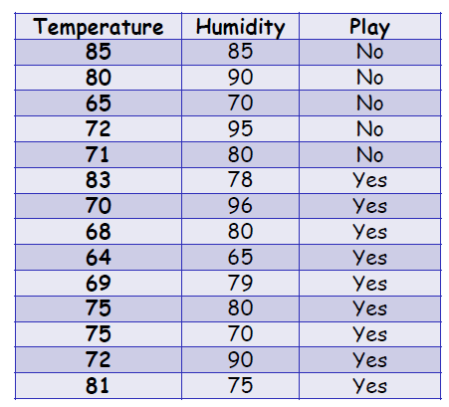
Assume training set shown in the following table.
Assume “Play” as the class attribute. Use naïve Bayes classifier to predict whether play will be possible given the Temperature=83 and Humidity=64. Fit Gaussian distribution to the data.

Slide 33
Multinomial Naïve Bayes Classifier – document classification

Slide 34
i, m –Terms
j, n -Documents

