Slide 1
Heuristic Search
Chapter 3

Slide 2
Outline –Weak Methods (Unable to combat CE)
Generate-and-test
Hill climbing
Best-first search
Problem reduction
Constraint satisfaction
Means-ends analysis

Slide 3
Generate-and-Test
Algorithm
Generate a possible solution. (a point or a path in sS)
Test to see if this is actually a solution.
Quit if a solution has been found.
Otherwise, return to step 1.
DFS / BFS ; Exhaustive / selective (British Museum Algo.)`;
DFS with backtracking

Slide 4
Generate-and-Test
Acceptable for simple problems.
Inefficient for problems with large space.

Slide 5
Generate-and-Test
Exhaustive generate-and-test.
Heuristic generate-and-test: not consider paths that seem unlikely to lead to a solution.
Plan generate-test:
− Create a list of candidates.
− Apply generate-and-test to that list.

Slide 6
Hill Climbing
Searching for a goal state = Climbing to the top of a hill

Slide 7
Hill Climbing
Generate-and-test + direction to move.
Heuristic function to estimate how close a given state is to a goal state.

Slide 8
Simple Hill Climbing
Algorithm
Evaluate the initial state.
Loop until a solution is found or there are no new operators left to be applied:
− Select and apply a new operator
− Evaluate the new state:
goal → quit
better than current state → new current state

Slide 9
Simple Hill Climbing
Evaluation function as a way to inject task-specific knowledge into the control process.

Slide 10
Steepest-Ascent Hill Climbing (Gradient Search)
Considers all the moves from the current state.
Selects the best one as the next state.

Slide 11
Steepest-Ascent Hill Climbing (Gradient Search)
Algorithm
Evaluate the initial state.
Loop until a solution is found or a complete iteration produces no change to current state:
− SUCC = a state such that any possible successor of the
current state will be better than SUCC (the worst state).
− For each operator that applies to the current state, evaluate
the new state:
goal → quit
better than SUCC → set SUCC to this state
− SUCC is better than the current state → set the current
state to SUCC.

Slide 12
Hill Climbing: Disadvantages
Local maximum
A state that is better than all of its neighbours, but not
better than some other states far away.

Slide 13
Hill Climbing: Disadvantages
Plateau
A flat area of the search space in which all neighbouring
states have the same value.

Slide 14
Hill Climbing: Disadvantages
Ridge (special local maximum). Higher than the surrounding areas and itself has a slope
The orientation of the high region, compared to the set
of available moves, makes it impossible to climb up.
However, two moves executed serially may increase
the height.

Slide 15
Hill Climbing: Disadvantages
Ways Out
Backtrack to some earlier node and try going in a different direction.
Make a big jump to try to get in a new section.
Moving in several directions at once.

Slide 16
Hill Climbing: Disadvantages
Hill climbing is a local method:
Decides what to do next by looking only at the “immediate” consequences of its choices.
Global information might be encoded in heuristic functions.

Slide 17
Hill Climbing: Disadvantages
Start
A
Goal
D
D
C
C
B
B
A
Blocks World

Slide 18
Hill Climbing: Disadvantages
Start
A
Goal
D
0
4
D
C
C
B
B
A
Blocks World
Local heuristic:
+1 for each block that is resting on the thing it is supposed to be resting on.
−1 for each block that is resting on a wrong thing.

Slide 19
Hill Climbing: Disadvantages
0
A
2
D
D
C
C
B
B
A

Slide 20
Hill Climbing: Disadvantages
D
2
C
B
A
A
0
0
D
C
C
D
C
0
B
B
A
B
A
D

Slide 21
Hill Climbing: Disadvantages
Start
A
Goal
D
−6
6
D
C
C
B
B
A
Blocks World
Global heuristic:
For each block that has the correct support structure: +1 to every block in the support structure.
For each block that has a wrong support structure: −1 to
every block in the support structure.

Slide 22
Hill Climbing: Disadvantages
D
−3
C
B
A
A
−6
−2
D
C
C
D
C
−1
B
B
A
B
A
D

Slide 23
Hill Climbing: Conclusion
Can be very inefficient in a large, rough problem space.
Global heuristic may have to pay for computational complexity.
Often useful when combined with other methods, getting it started right in the right general neighbourhood.

Slide 24
Simulated Annealing
A variation of hill climbing in which, at the beginning of the process, some downhill moves may be made.
To do enough exploration of the whole space early on, so that the final solution is relatively insensitive to the starting state.
Lowering the chances of getting caught at a local maximum, or plateau, or a ridge.

Slide 25
Simulated Annealing
Physical Annealing
Physical substances are melted and then gradually cooled until some solid state is reached.
The goal is to produce a minimal-energy state.
Annealing schedule: if the temperature is lowered sufficiently slowly, then the goal will be attained.
Nevertheless, there is some probability for a transition to a higher energy state: e^{−ΔE/kT}.

Slide 26
Differences with HC
The annealing schedule must be maintained
Moves to worse states may be accepted
Best state found so far is also maintained. So if the final state is worse than the earlier state (because of accepting move to worse state ) the earlier state is still available.

Slide 27
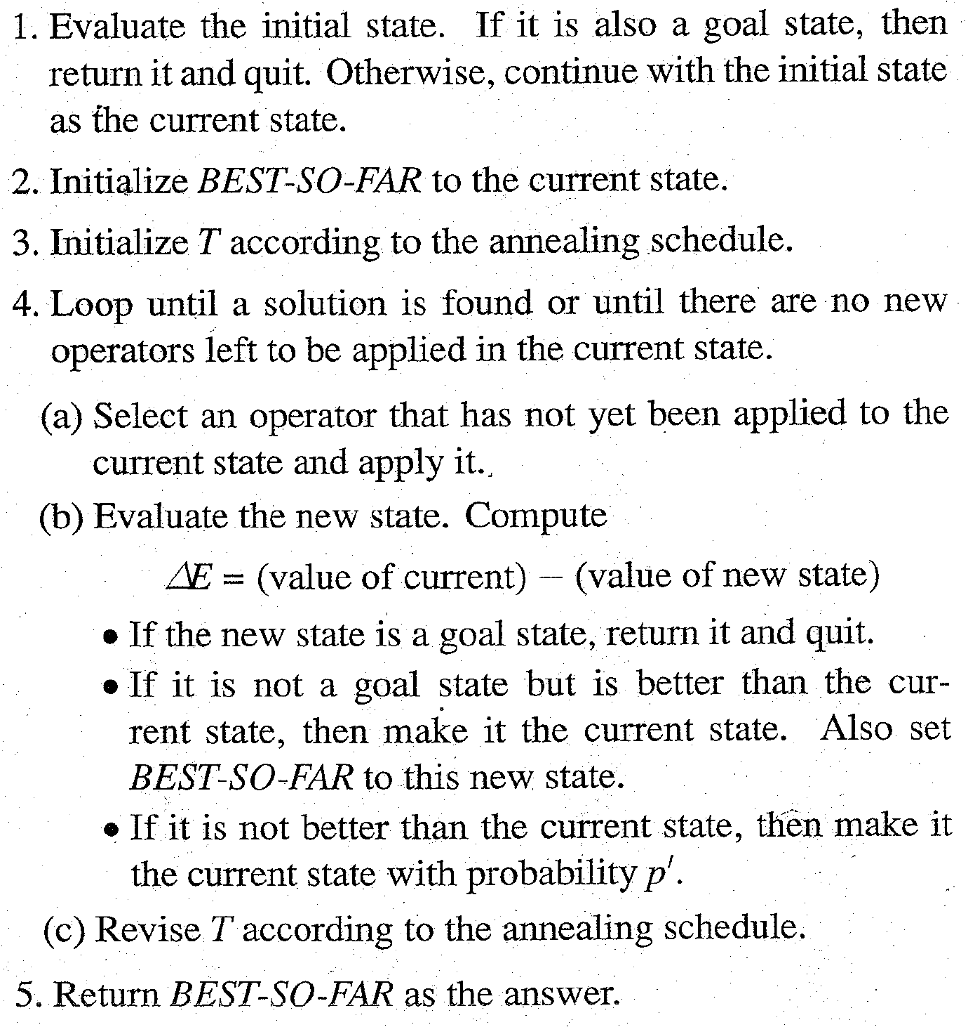
Algorithm : Simulated Annealing
52

Slide 28
Annealing Schedule
(Four Components)
Initial value to be used for temperature T
When the Temperature should be reduced
By what amt. T will be reduced each time it is changed.
When to quit.
Note : Annealing Schedule is to be selected by trying several and observing the effect on quality of the solution and the rate by which the process conveerges.

Slide 29
Annealing Schedule
T → 0 , The p (prob. ) of accepting a worse move goes to zero
P is a ratio so T should be scaled appropriately.

Slide 30
Best-First Search
Depth-first search: not all competing branches having to be expanded.
Breadth-first search: not getting trapped on dead-end paths.
⇒ Combining the two is to follow a single path at a time, but switch paths whenever some competing path look more promising than the current one.

Slide 31
Best-First Search
A
A
A
B
C
D
B
C
D
3
5
1
3
5
E
F
4
6
A
A
B
C
D
B
C
D
5
5
G
H
E
F
G
H
E
F
6
5
4
6
6
5
6
I
J
2
1

Slide 32
Best First Search and SAHC
In SAHC one is selected and others are rejected never to be reconsidered. (Produces straight behaviour )
In Best First Search one is selected and others are kept around to revisit later.
SAHC will stop if there are no SUCC with better values than the current state.
Best First Search : Best available state is selected , even if that state has a value lower than the value of the state , just explored

Slide 33
Tree Vs Graph
Duplicate paths need not to be pursued
Directed graph : Each node ~ point in problem space
Desc. Of problem state
An indication of how promising it is ?
Parent link : point to the best node from which it came
List of nodes , generated from it .
OR GRAPH
Each branch represents an alternative problem-solving path

Slide 34
Best-First Search
OPEN: nodes that have been generated, but have not examined. (had their successors generated)
This is organized as a priority queue.
CLOSED: nodes that have already been examined.
Whenever a new node is generated, check whether it has been generated before.

Slide 35
Outline of uniform Search algorithm
This algorithm assumes that all operators have a cost
1. Initialize : set OPEN = { start state s}
CLOSED = { } Set C(s)=0
2. Fail : If OPEN = { } ; Terminate with failure
3. Select :
select the minimum cost state n, from OPEN and save n in CLOSED.
4. Terminate:
If n belongs to G ; Terminate with success

Slide 36
Outline of uniform Search algorithm
This algorithm assumes that all operators have a cost
5. Expand :
      Generate the successor of n using O
      For each SUCCESSOR m :
      If m not belongs to [OPEN U CLOSED ]
      SET C(m) = C(n) + C(n,m)
      And insert m in OPEN
      IF m belongs to [OPEN U CLOSED ]
      SET C(m) = min{C(m), C(n) + C(n,m)}
      If C(m) has decreased and m belongs to CLOSED, move It to OPEN

Slide 37
Algorithm : Best-First Search
Start with OPEN containing just the initial state.
2. Until a goal is found or there are no nodes left on OPEN do:
(a) Pick them best node on OPEN.
(b) Generate its successors.
(c) For each successor do:
  (i) If it has not been generated before, evaluate it, add it to OPEN, and record its parent.
  (ii) If it has been generated before, change the parent if this new path is better than the previous one. In that case, update the cost of getting to this node and to any successors that this node may already, have.
54

Slide 38
Best-First Search
h(n) = estimated cost of the cheapest path from node n to a goal state.

Slide 39
Best-First Search
Algorithm A* (Hart et al., 1968):
f(n) = g(n) + h(n)
h(n) = cost of the cheapest path from node n to a goal state.
g(n) = cost of the cheapest path from the initial state to node n.

Slide 40
Best-First Search
Uniform-cost search:
g(n) = cost of the cheapest path from the initial state to node n.

Slide 41
Best-First Search
Greedy search:
h(n) = estimated cost of the cheapest path from node n to a goal state.

Slide 42
Best-First Search
h(n) = estimated cost of the cheapest path from node n to a goal state.
g(n) = cost of the cheapest path from the initial state to node n.

Slide 43
Best-First Search
Algorithm A*: The A* algorithm combines features of uniform cost search and pure heuristics search to efficiently compute optimal solutions.
f*(n) = g*(n) + h*(n)
h*(n) (heuristic factor) = estimate of h(n).
g*(n) (depth factor) = approximation of g(n) found by A* so far.

Slide 44
A* Search algorithm
This algorithm assumes that all operators have a cost
1. Initialize : set OPEN = { start state s}
CLOSED = { } g(s)=,F(s)=h(s)
2. Fail : If OPEN = { } ; Terminate with failure
3. Select :
select the minimum cost state n, from OPEN and save n in CLOSED.
4. Terminate:
If n belongs to G ; Terminate with success

Slide 45
Outline of A* Search algorithm
This algorithm assumes that all operators have a cost
5. Expand :
      Generate the successor of n using O
      For each SUCCESSOR m :
      If m not belongs to [OPEN U CLOSED ]
      SET g(m) = g(n) + C(n,m)
      SET f(m)=g(m) + h(m)
      And insert m in OPEN
      IF m belongs to [OPEN U CLOSED ]
      SET g(m) = min{g(m), g(n) + C(n,m)}
      SET f(m)=g(m) + h(m)
      If f(m) has decreased and m belongs to CLOSED, move It to OPEN

Slide 46
Observations
We not only choose which node to expand on the not only on the basis of (Role of g)
How good the node itself looks
Rather also on how good the path to the node is
If we care only about getting to the solution somehow
Set g=0
Set g=1 if we want to find the path involving the fewest no. of steps

Slide 47
Observations
The second observation involves h’ (estimator of h)
If h’ is perfect estimator of h : A* will converge immediately to the goal with no search.
If h’= 0 , the search will be controlled by g.
  If g also equal to 0 , search strategy = Random
  If g = 1, the search will be Breadth first
What If h’ neither perfect nor 0?

Slide 48
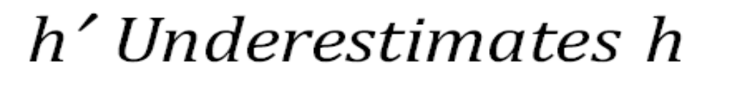
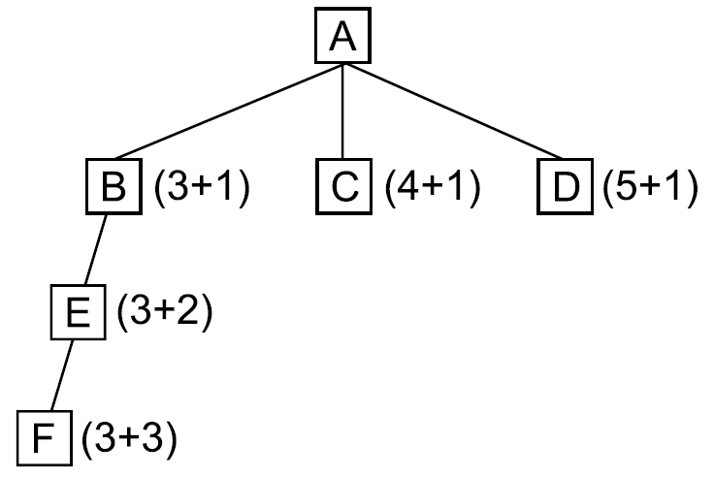
55

Slide 49

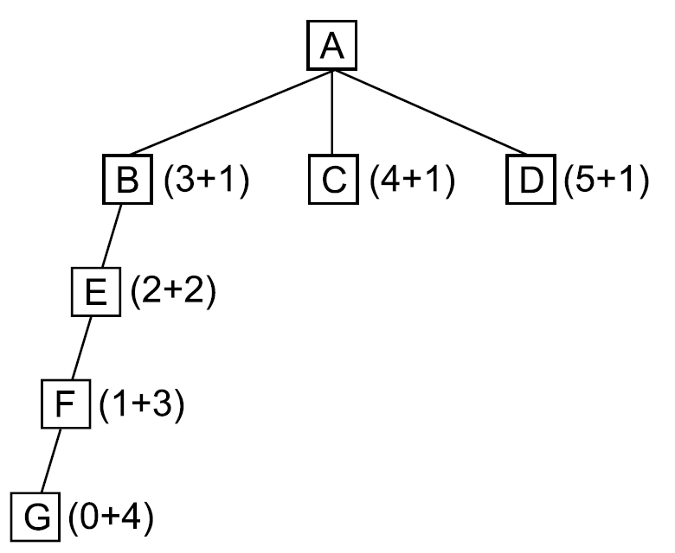
56

Slide 50
Problem Reduction: AND-OR Graphs
Planning how best to solve a problem that can be recursively decomposed into sub-problems in multiple ways.
(What is the best way to decomposition )
Useful for representing the solution of problems that can be solved by decomposing them into smaller problems, all of which then must be solved.

Slide 51
Problem Reduction
Goal: Acquire TV set
Goal: Steal TV set
Goal: Earn some money
Goal: Buy TV set
AND-OR Graphs
Algorithm AO* (Martelli & Montanari 1973, Nilsson 1980)
Matrix Multiplication problem
Tower of Hanoi problem

Slide 52
Problem Reduction: AO*
A
A
6
5
9
B
C
D
3
4
5
A
9
A
11
9
12
B
C
D
10
B
6
C
D
10
3
4
4
E
F
G
H
E
F
4
4
5
7
4
4

Slide 53
Problem Reduction: AO*
A
11
A
14
B
13
C
10
B
13
C
15
D
5
E
6
F
3
D
5
E
6
F
3
G
5
G
10
Necessary backward propagation
H
9

Slide 54
Constraint Satisfaction
Many AI problems can be viewed as problems of constraint satisfaction.
Goal is to discover a state that satisfies a given set of constraints.
Real world labelling problems
Designing problems
Cryptarithmetic puzzle:
SEND
MORE
MONEY
+

Slide 55
Constraint Satisfaction
As compared with a straightforard search procedure, viewing a problem as one of constraint satisfaction can reduce substantially the amount of search.

Slide 56
Constraint Satisfaction
Search procedure which operates in a space of constraint sets.
Initial state contains the original constraints given in the problem.
A goal state is any state that has been constrained “enough”.

Slide 57
Constraint Satisfaction
Two-step process:
1. Constraints are discovered and propagated as far as possible.
2. If there is still not a solution, then search begins, adding new constraints. (How ?)

Slide 58
1st Step – propagation
arises as constraints are interdependent.
Many objects participate in more than one constraint.
Many constraints involve more than one objects.
Also arise from the presence of inference rules that allow additional constraints to be inferred from the given ones.

Slide 59
Propagation
CP terminates due to 2 reasons:
Contradiction is detected
No further changes that can be made on the basis of current knowledge.

Slide 60
Constraint Satisfaction
1st step:The order in which propagation is done does not matter much, since all available propagation are done before the step ends.
2nd step: The order in which guesses are made may have a substantial impact on degree of search that is needed.
(Heuristic can help to select the best guess to try first)

Slide 61
Initial state:
No two letters have
the same value.
The sum of the digits
must be as shown.
M = 1
S = 8 or 9
O = 0
N = E + 1
C2 = 1
N + R > 8
E ≠ 9
SEND
MORE
MONEY
+
E = 2
N = 3
R = 8 or 9
2 + D = Y or 2 + D = 10 + Y
C1 = 0
C1 = 1
2 + D = Y
N + R = 10 + E
R = 9
S =8
2 + D = 10 + Y
D = 8 + Y
D = 8 or 9
D = 8
D = 9
Y = 0
Y = 1

Slide 62
Algorithm : Constraint Satisfaction
1. Propagate available constraints. To do this, first set OPEN to the set of all objects that must have values assigned to them in a complete solution. Then do until an inconsistency is detected or until OPEN is empty:
(a) Select an object OB from OPEN. Strengthen as much as possible the set of constraints that apply to OB.
(b) If this set is different from the set that was assigned the last time OB was examined or if this is the first time OB has been examined, then add to OPEN all objects that share any constraints with OB.
(c) Remove OB from OPEN.
2. If the union of the constraints discovered above defines a solution, then quit and report the solution.
3. If the union of the constraints discovered above defines a contradiction, then return failure.
4. If neither of the above occurs, then it is necessary to make a guess at something in order to proceed. To do this, loop until a solution is found or all possible solutions have been eliminated:
(a) Select an object whose value is not yet determined and select a way of strengthening the constraints on that object.
(b) Recursively invoke constraint satisfaction with the current set of constraints augmented by the strengthening constraint just selected.
66

Slide 63
Constraint Satisfaction
Two kinds of rules:
1. Rules that define valid constraint propagation.
2. Rules that suggest guesses when necessary.

Slide 64
Means –Ends Analysis
Search Strategies can be either forward or backward
For problems one direction must be chosen
Mix of two : solve major parts of the problem first and then go back and solve small problems that arise in gluing the pieces together.

Slide 65
Means-Ends Analysis
Detection of differences between current and goal state.
One such difference is isolated
An operator that reduces the difference is found
If O can not be applied to Current state
  A sub-problem is set up , where O can be applied
If O does not produce the exactly goal state we want
  Second sub-problem of getting from the state it does produce to the goal state
This technique also relies on a set of rules that can transform one problem state into another.

Slide 66
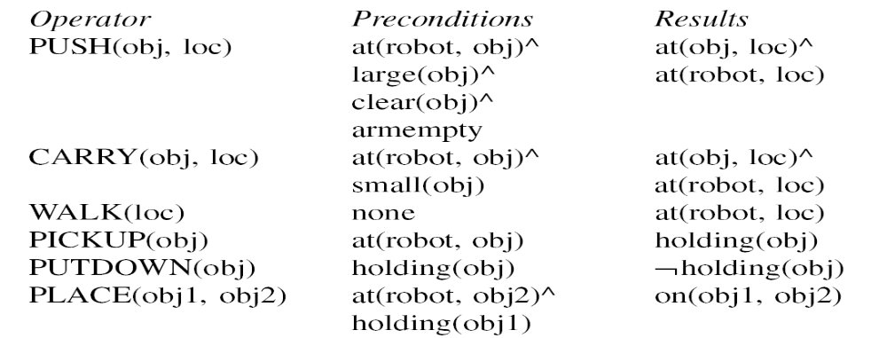
A Robot’s Operators
69

Slide 67
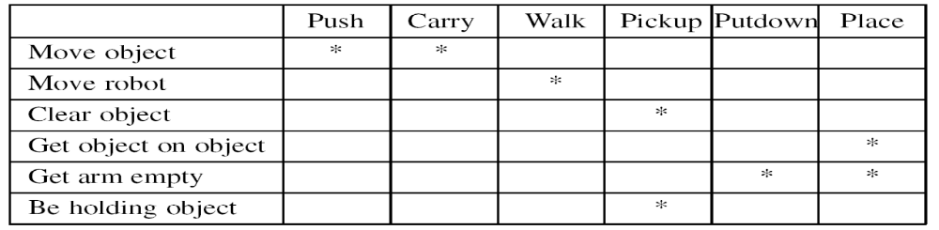
A Difference Table
70

Slide 68
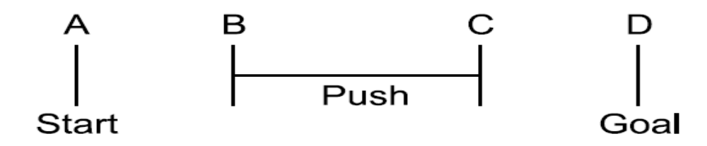
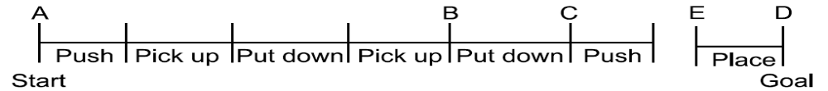
The Progress of the Means-Ends Analysis Methods
71

Slide 69
Algorithm : Means-Ends Analysis
Compare CURRENT to GOAL. If there are no differences between them then return.
2. Otherwise, select the most important difference and reduce it by doing the following until success or failure is signaled:
Select an as yet untried operator O that is applicable to the current difference. If there are no such operators, then signal failure.
(b) Attempt to apply O to CURRENT. Generate descriptions of two states: O-START, a state in which O’s preconditions are satisfied and O-RESULT, the state that would result if O were applied in OSTART.
(c) If
(FIRST-PART ← MEA(CURRENT, O-START))
and
(LAST-PART ← MEMO-RESULT, GOAL))
are successful, then signal success and return the result of concatenating
FIRST-PART, O, and LAST-PART.
72

Slide 70
Example
11
2
11
1
11
2
11
1
2
3
4
1
3
1
3
11
5
11
1
11
5
11
5
6
7
8
1
4
10
15
11
8
11
3
11
1
9
10
11
11
12

