Slide 1
Goal of this course
To introduce you to the field of Artificial Intelligence
To explain the challenges inherent in building an “intelligent System”
To explain the
Key paradigms
Core techniques
Algorithms

Slide 2
Man vs. Machine
What is Artificial Intelligence?

Slide 3
Objectives
Understand the role of basic
Knowledge representation
Problem-solving
In engineering Intelligent system
Develop intelligent systems by assembling solutions to concrete computational problems

Slide 4
Objectives of today’s lecture
Understand the definition of artificial intelligence
Discuss the different faculties involved with intelligent behavior
Examine the different ways of approaching AI
Look at some example systems that use AI

Slide 5
Introduction
Familiar with the different ways of defining artificial Intelligence
Understand what are the different components of intelligent behavior
Types of problems that can be currently solved by computers and those that are as yet beyond their ability

Slide 6
Introduction
Definition of AI
Example Systems
Approaches to AI

Slide 7
What is AI?
Artificial Intelligence
Is concerned with the design of intelligence in artificial devices
Term coined by McCarthy in 1956

Slide 8
What is AI?
Artificial intelligence is concerned with the design of intelligence in artificial devices.
What is intelligence?
Humans?
Behave as intelligently as a human
Behave in the best possible manner
Thinking?
Acting?

Slide 9
Definition of AI
Thought processes/reasoning vs. behavior
Human-like performance vs. Ideal performance
thought/reasoning
Human like Performance
Ideal Performance(rationality)
behaviour

Slide 10
Approaches to AI
Thought processes/reasoning vs. behavior
Human-like performance vs. Ideal performance
thought/reasoning
System that think like human
System that think rationally
Human like Performance
Ideal Performance(rationality)
System that act like humans
System that act rationally
behaviour

Slide 11
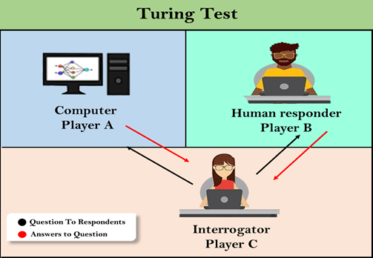

Slide 12
Typical AI problems
Intelligent entities need to be able to do both “mundane” and “expert” tasks
Mundane task:
Planning route, activity
Recognizing(through vision) people , objects
Communicating through natural language.
Navigating round obstacles on the street
Expert task:
Medical diagnosis
Mathematical problem solving

Slide 13
What is easy and what is hard?
It has been very hard to mechanize tasks that lots of animals can do
Walking around without running into things
Catching prey and avoiding predators
Interpreting complex sensory information
Modeling the internal states of other animals from their behaviour

Slide 14
Intelligent behaviour
Perception
Reasoning
Learning
Understanding Language
Solving problems

Slide 15
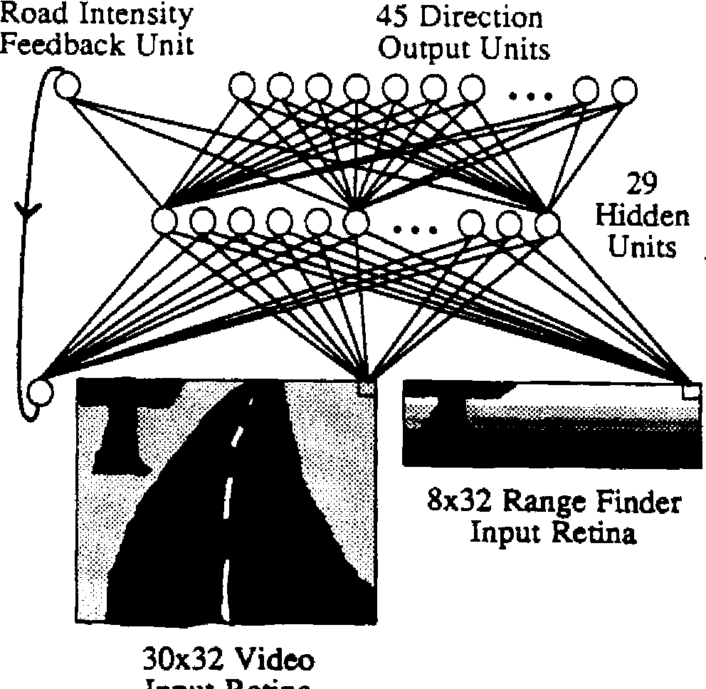
ALVINN

Slide 16
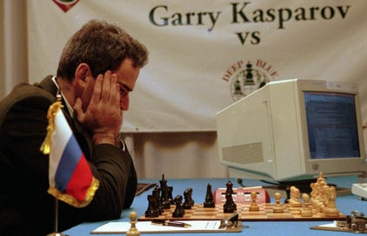
Deep blue chess program

Slide 18
Approaches to AI
Strong AI aims to build machines that can truly reason and solve problems which is self aware and whose overall intellectual ability is indistinguishable from that of a human being
Human like
Non –human like

Slide 19
Weak AI deals with the creation of some form of computer-based artificial intelligence that cannot truly reason and solve problems but can act as if it were intelligent
Weak AI holds that suitably programmed machines can simulate human cognition
Strong AI maintains that suitable programmed machines are capable of cognitive mental states.

Slide 20
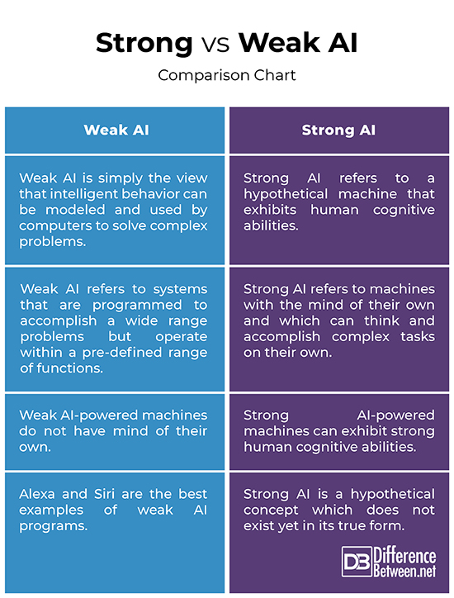

Slide 21
Approaches to AI
Applied AI: aims to produce commercially viable “smart” systems such as, for example, a security system that is able to recognise the faces of people who are permitted to enter a particular building. Applied AI has already enjoyed considerable success.
Cognitive AI: Computers are used to test theories about how the human mind works, for Example, theories about how we recognize faces and other objects or about how we solve the abstract problem.

Slide 22
What can AI system do?

Slide 23
What can AI system do
Computer vision: face recognisation
Robotics: autonomous(mostly) automobile
Natural language processing
Expert system: medical diagnosis in a narrow domain

Slide 24
What can’t AI systems do yet?

Slide 25
Understand natural language robustly(e.g read and understand articles in a newspaper)
Surf the web
Interpret an arbitrary visual scene
Learn a natural language
Construct plans in dynamic real-time domains

