Slide 1
Problems and Search
Chapter 2

Slide 2
Outline
State space search
Search strategies
Problem characteristics
Design of search programs

Slide 3
State Space Search
Problem solving = Searching for a goal state
Building a Problem-Solving Program
Define the problem precisely.
Analyze the problem.
Represent the task knowledge.
Choose and apply representation and reasoning techniques.

Slide 4
State Space Search: Playing Chess
Each position can be described by an 8-by-8 array.
Initial position is the game opening position.
Goal position is any position in which the opponent does not have a legal move and his or her king is under attack.
Legal moves can be described by a set of rules:
− Left sides are matched against the current state.
− Right sides describe the new resulting state.

Slide 5
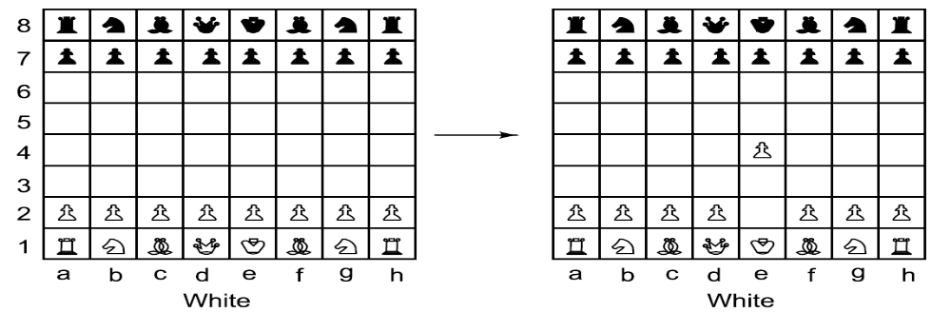
One Legal Chess Move
17

Slide 6
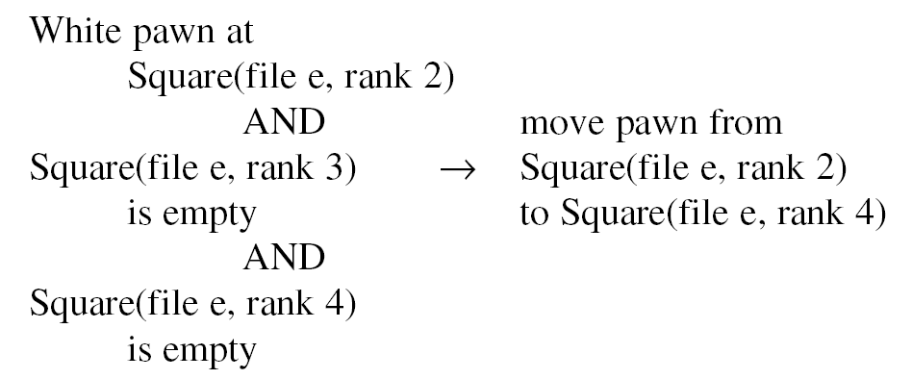
Another Way to Describe Chess Moves
18

Slide 7
State Space Search: Playing Chess
State space is a set of legal positions.
Starting at the initial state.
Using the set of rules to move from one state to another.
Attempting to end up in a goal state.

Slide 8
State Space Search: Water Jug Problem
“You are given two jugs, a 4-litre one and a 3-litre one.
Neither has any measuring markers on it. There is a
pump that can be used to fill the jugs with water. How
can you get exactly 2 litres of water into 4-litre jug.”

Slide 9
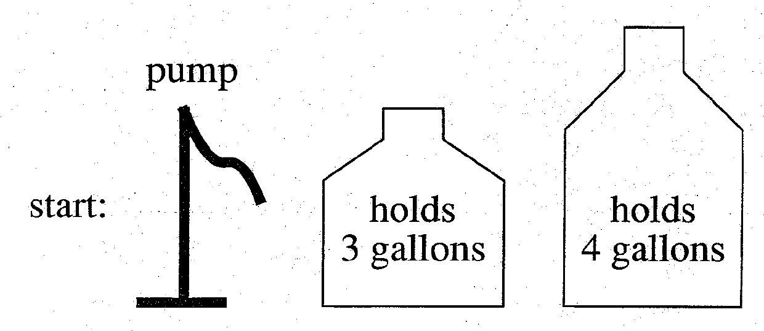
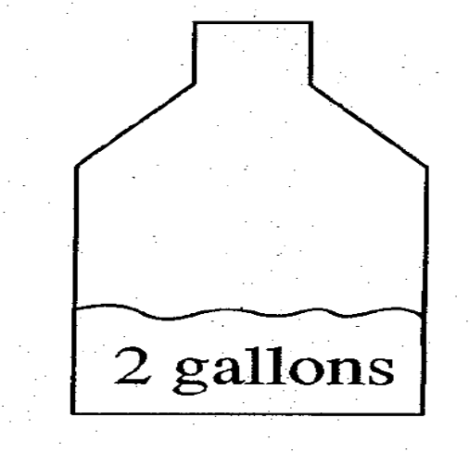
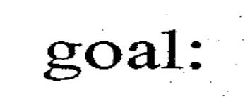
A Water Jug Problem
19

Slide 10
State Space Search: Water Jug Problem
State: (x, y)
x = 0, 1, 2, 3, or 4 y = 0, 1, 2, 3
Start state: (0, 0).
Goal state: (2, n) for any n.
Attempting to end up in a goal state.

Slide 11
Underlying assumptions
We can fill the jugs from pump
We can pour water out of a jug onto the ground
We can pour water from one jug to another
There is no measuring device.

Slide 12
State Space Search: Water Jug Problem
(x, y) → (4, y) Fill the 4-gallon jug
if x < 4
2. (x, y) → (x, 3) Fill the 3-gallon jug
if y < 3
3. (x, y) → (x − d, y) Pour some water out
if x > 0 of 4 gallon jug
4. (x, y) → (x, y − d) Pour some water out
if y > 0 of 3 gallon jug

Slide 13
State Space Search: Water Jug Problem
5. (x, y) → (0, y) Empty 4G on ground
if x > 0
6. (x, y) → (x, 0) Empty 3 G on ground
if y > 0
7. (x, y) → (4, y − (4 − x)) pour from 3G to 4
if x + y ≥ 4, y > 0 G until 4G is full
8. (x, y) → (x − (3 − y), 3) pour from 4G to 3
if x + y ≥ 3, x > 0 until 3G is full

Slide 14
State Space Search: Water Jug Problem
9. (x, y) → (x + y, 0) Pour all water from 3G
if x + y ≤ 4, y > 0 into 4G
10. (x, y) → (0, x + y) Pour all water from 4G
if x + y ≤ 3, x > 0 into 3G
11. (0, 2) → (2, 0)
12. (2, y) → (0, y)

Slide 15
State Space Search: Water Jug Problem
current state = (0, 0)
2. Loop until reaching the goal state (2, 0)
− Apply a rule whose left side matches the current state
− Set the new current state to be the resulting state
(0, 0)
(0, 3) 2
(3, 0) 9
(3, 3) 2
(4, 2) 7
(0, 2) 5 or 12
(2, 0) 9 or 11

Slide 16
State Space Search: Water Jug Problem (Issues of converting an informal PS to formal PS)
The role of the condition in the left side of a rule
restrict the application of the rule to the states in which are most likely to lead to the solution.
⇒ more efficient
1. (x, y) → (4, y)
if x < 4
2. (x, y) → (x, 3)
if y < 3

Slide 17
Further discussion…
Rule 3 and 4
Should they be included or not???
Emptying an unmeasured amt. of water on ground
Will never get close to the solution
Writing a set of rules that describe just the problem Vs that describe both the problem and some knowledge about its solution

Slide 18
State Space Search: Water Jug Problem
Special-purpose rules to capture special-case
knowledge that can be used at some stage in solving a
problem
11. (0, 2) → (2, 0)
12. (2, y) → (0, y)
Note: they don’t add power to the system
These rule may improve performance (depending upon control strategy) if preference is given to a special case rules.

Slide 19
State Space Search: Summary
Define a state space that contains all the possible configurations of the relevant objects.
2. Specify the initial states.
3. Specify the goal states.
4. Specify a set of rules:
− What are unstated assumptions?
− How general should the rules be?
− How much knowledge for solutions should be in the
rules?

Slide 20
Search Strategies
1. Uninformed search (blind search)
Having no information about the number of steps from the current state to the goal.
Domain Specific Knowledge is not there to guide us
2. Informed search (heuristic search)
More efficient than uninformed search.
We have function to guide the search procedure

Slide 21
Control Strategies
Operationalization : Informal to formal description
Requirements of a good search strategy:
1. It causes motion
Otherwise, it will never lead to a solution.
2. It is systematic
Otherwise, it may use more steps than necessary.
3. It is efficient
Find a good, but not necessarily the best, answer.

Slide 22
Outline of Basic Search algorithm
1. Initialize : set OPEN = { start state s}
2. Fail : If OPEN = { } ; Terminate with failure
3. Select : select a state n from OPEN ,
4. Check: If n belongs to G ; Terminate with success
5. Expand : Generate the successor of n using O and insert into OPEN
6. Loop : Step 2

Slide 23
Search Strategies (queue – BFS stack – DFS)
(0, 0)
(4, 0)
(0, 3)
(4, 3)
(0, 0)
(1, 3)
(4, 3)
(0, 0)
(3, 0)

Slide 24
Search Strategies: Blind Search
Breadth-first search
Expand all the nodes of
one level first.
requires more memory
If many Goals exists beneficial
will not get trapped into blind alley
Depth-first search
Expand one of the nodes at
the deepest level.
requires less memory
may find solution without examining
much of the search space at all

Slide 25
Search Strategies: Blind Search
Criterion | Breadth-First | Depth-First
Time
Space
Optimal?
Complete?
b: branching factor d: solution depth m: maximum depth

Slide 26
Search Strategies: Blind Search
Criterion | Breadth-First | Depth-First
Time | b^{d} | b^{m}
Space | b^{d} | bm
Optimal? | Yes | No
Complete? | Yes | No
b: branching factor d: solution depth m: maximum depth

Slide 27
Issues
Uninformed search : motion causing and systematic control structure would do for simple problems
TSP
Combinatorial explosion
Branch and bound

Slide 28
Search Strategies: Heuristic Search
The Travelling Salesman Problem
“A salesman has a list of cities, each of which he must
visit exactly once. There are direct roads between each
pair of cities on the list. Find the route the salesman
should follow for the shortest possible round trip that
both starts and finishes at any one of the cities.”
A
1
10
B
D
E
5
5
15
5
C

Slide 29
Search Strategies: Heuristic Search
Heuristic: involving or serving as an aid to learning, discovery, or problem-solving by experimental and especially trial-and-error methods.
(Merriam-Webster’s dictionary)
Heuristic technique improves the efficiency of a search process, possibly by sacrificing claims of completeness or optimality.

Slide 30
Search Strategies: Heuristic Search
Heuristic is for combinatorial explosion.
Optimal solutions are rarely needed.

Slide 31
Search Strategies: Heuristic Search
Nearest neighbour heuristic:
1. Select a starting city.
2. Select the one closest to the current city.
3. Repeat step 2 until all cities have been visited.

Slide 32
Search Strategies: Heuristic Search
Nearest neighbour heuristic:
1. Select a starting city arbitrarily.
2. Select the one closest to the current city.
3. Repeat step 2 until all cities have been visited.
O(n²) vs. O(n!)

Slide 33
Search Strategies: Heuristic Search
Not possible to produce such bounds always so naturally.
Unstructured knowledge
Heuristic function:
state descriptions → measures of desirability

Slide 34
Problem Characteristics
To choose an appropriate method for a particular
problem:
Is the problem decomposable?
Can solution steps be ignored or undone?
Is the universe predictable?
Is a good solution absolute or relative?
Is the solution a state or a path?
What is the role of knowledge?
Does the task require human-interaction?

Slide 35
Is the problem decomposable?
Can the problem be broken down to smaller problems to be solved independently?
Decomposable problem can be solved easily.

Slide 36
Is the problem decomposable?
∫(x² + 3x + sin²x.cos²x)dx
∫x²dx ∫3xdx ∫sin²x.cos²xdx
∫(1 − cos²x)cos²xdx
∫cos²xdx −∫cos⁴xdx

Slide 37
Is the problem decomposable?
Start
Goal
CLEAR(x) → ON(x, Table)
CLEAR(x) and CLEAR(y) → ON(x, y)
A
C
B
A
B
C
Blocks World

Slide 38
Is the problem decomposable?
ON(B, C) and ON(A, B)
ON(B, C)
ON(A, B)
CLEAR(A)
ON(A, B)
A
C
B
A
B
C

Slide 39
Can solution steps be ignored or undone?
Theorem Proving
A lemma that has been proved can be ignored for next
steps.
Ignorable!

Slide 40
Can solution steps be ignored or undone?
The 8-Puzzle
Moves can be undone and backtracked.
Recoverable!
2 | 8 | 3
1 | 6 | 4
7 |  | 5
1 | 2 | 3
8 |  | 4
7 | 6 | 5

Slide 41
Can solution steps be ignored or undone?
Playing Chess
Moves cannot be retracted.
Irrecoverable!

Slide 42
Can solution steps be ignored or undone?
Ignorable problems can be solved using a simple
control structure that never backtracks.
Recoverable problems can be solved using backtracking.
Irrecoverable problems can be solved by recoverable style methods via planning.

Slide 43
Is the universe predictable?
The 8-Puzzle
Every time we make a move, we know exactly what will
happen.
Certain outcome!

Slide 44
Is the universe predictable?
Playing Bridge
We cannot know exactly where all the cards are or what
the other players will do on their turns.
Uncertain outcome!

Slide 45
Is the universe predictable?
For certain-outcome problems, planning can used to generate a sequence of operators that is guaranteed to lead to a solution.
For uncertain-outcome problems, a sequence of generated operators can only have a good probability of leading to a solution.
Plan revision is made as the plan is carried out and the necessary feedback is provided.

Slide 46
Is a good solution absolute or relative?
Marcus was a man.
2. Marcus was a Pompeian.
3. Marcus was born in 40 A.D.
4. All men are mortal.
5. All Pompeians died when the volcano
erupted in 79 A.D.
6. No mortal lives longer than 150 years.
7. It is now 2004 A.D.

Slide 47
Is a good solution absolute or relative?
Marcus was a man.
2. Marcus was a Pompeian.
3. Marcus was born in 40 A.D.
4. All men are mortal.
5. All Pompeians died when the volcano
erupted in 79 A.D.
6. No mortal lives longer than 150 years.
7. It is now 2004 A.D.
Is Marcus alive?

Slide 48
Is a good solution absolute or relative?
Marcus was a man.
2. Marcus was a Pompeian.
3. Marcus was born in 40 A.D.
4. All men are mortal.
5. All Pompeians died when the volcano
erupted in 79 A.D.
6. No mortal lives longer than 150 years.
7. It is now 2004 A.D.
Is Marcus alive?
Different reasoning paths lead to the answer. It does not
matter which path we follow.

Slide 49
Is a good solution absolute or relative?
The Travelling Salesman Problem
We have to try all paths to find the shortest one.

Slide 50
Is a good solution absolute or relative?
Any-path problems can be solved using heuristics that suggest good paths to explore.
For best-path problems, much more exhaustive search will be performed.

Slide 51
Is the solution a state or a path?
Finding a consistent intepretation
“The bank president ate a dish of pasta salad with
the fork”.
  “bank” refers to a financial situation or to a side of a river?
  “dish” or “pasta salad” was eaten?
  Does “pasta salad” contain pasta, as “dog food” does not contain “dog”?
  Which part of the sentence does “with the fork” modify?
  What if “with vegetables” is there?
No record of the processing is necessary.

Slide 52
Is the solution a state or a path?
The Water Jug Problem
The path that leads to the goal must be reported.

Slide 53
Is the solution a state or a path?
A path-solution problem can be reformulated as a state-solution problem by describing a state as a partial path to a solution.
The question is whether that is natural or not.

Slide 54
What is the role of knowledge
Playing Chess
Knowledge is important only to constrain the search for
a solution.
Reading Newspaper
Knowledge is required even to be able to recognize a
solution.

Slide 55
Does the task require human-interaction?
Solitary problem, in which there is no intermediate communication and no demand for an explanation of the reasoning process.
Conversational problem, in which intermediate communication is to provide either additional assistance to the computer or additional information to the user.

Slide 56
Problem Classification
There is a variety of problem-solving methods, but there is no one single way of solving all problems.
Not all new problems should be considered as totally new. Solutions of similar problems can be exploited.
Generic problem of classification : diagnostic tasks
    Propose and refine

Slide 57
Production system
Search forms the core of many intelligent processes
AI problems must be structured to facilitate describing and performing search process
PS are good way to describe the operations that can be performed in a search for a solution to a problem
A set of rules
One or more knowledge/databases
A control strategy
A rule applier

Slide 58
Production system Characteristics
Can PS like problems be described by a set of characteristics that shed some light on how easily they can be implemented
How to choose production system?
Types of production systems
What relationship are there between problem types and type of production system?

Slide 59
Types of PS
Monotonic : Application of rules never prevents the later application of another rule that could also have been applied at the time first rule was selected.
Non Monotonic : prevents
Partially communicative PS: If the application of a particular sequence of rules transforms state x into y , then any permutation of those rules , that is allowable
Also transforms state x into y.
Not Partially communicative PS
Commutative PS : Both monotonic and partially commutative.

Slide 60
Relation of PS and classes of problems
 | Monotonic | Non Monotonic
Par. Comm | Ignorable problems (Theorem Proving) Without the ability to backtrack. Change is not made to the existing ones rather new things are created | Changes occur but can be reversed but the order of reversal is not important ( Robot Navigation , 8 –puzzle)
Not Partially Commutative | Irreversible changes occur , order is imp Less likely to produce same node many times in the search process Chemical synthesis | Changes occur can not be reversed , order is not imp. Bridge

Slide 61
Issues in Design of Search Program
Every search process can be viewed as traversal of tree structure . Nodes = states ;
Arcs = relationship between states
Direction (Forward Vs Backward reasoning)
How to decide?
How to select applicable rule (Matching)
How to represent each node of the search process
( Knowledge representation)

Slide 62
Issues
Search Tree Vs Graph
Same node is generated again and again. So processed more than once

