Slide 1
University Efficiency Project Report
Dimpi Dedhia (NUID – 001342018)
Dhruvil Shah (NUID – 001873473)

Slide 2
Entity: University
This entity is the root node of the Design. It is responsible for administering all the academic matters of the college and heads the entities of Department, Student etc. It maintains record of all the students enrolled in the university in various departments/courses, data regarding companies hiring their students and financial matters of the institution.
METHODS:
totalNumOfStudentsPlaced(): This method calculates the total number of students who received an offer from a Company
companiesInWhichStudArePlaced(): Stores the Companies that hire the University students in an ArrayList
efficiencyOfUniversity(): Calculates the Efficiency of the university which is the main aim of the project. It generates the efficiency after gathering dependent data from all the entities.
For example:
University Efficiency ∝ No. of students getting top companies/ No. of students getting promoted

Slide 3
Entity: Company
This entity is responsible for founding the career of students of the University by hiring them for a respective position in their organization.
The companies are ranked from the following attributes:
Brand Value
Positions offered
Average Salary of Employees
Using this entity, we also get an idea of what is the efficiency of the university as according to the ranks of companies if a greater number of students are placed in highly ranked companies then it is a factor for the university on being efficient.
METHODS:
getCompanyList(): This methods gets the List of all the companies that hire students from a particular university. It returns an ArrayList of object Company.
getTopPositions(): This method gets all the positions that a particular company offers to the students. It returns an ArrayList of type String

Slide 4
Entity: Student
This entity is a hub connection for several entities in this design. Student entity contains information about student’s name, department, courses enrolled, GPA on graduation, certifications, Internships, years of experience and promotions.
All of these attributes are passed on to other entities like Company to divide students into 3 Levels for better understanding the raw data. Apart from students also the companies are classified into ranks to produce simplified comparison of both.
In brief the University efficiency is calculated by the following factors.
No. of Level1 students getting high ranking companies.
No. of promotions and certifications of students who got high rank companies
No. of Internships students has undertaken
No. of High ranking companies hiring students from a particular university
Courses enrolled by different level of students that are in demand in the industry

Slide 5
Entity: Student
After gathering the above data we can effectively predict future requisites of a student to get into high rank companies and get promotions in their career. For example:
Average GPA of students who got into good companies --> from this factor a new student gets an idea what his/her approximate GPA should be for getting top companies.
Certifications and internships needed by a student.
What courses a student should opt for that is relevant to the demand in the industry.
METHODS:
addStudent(student): This method registers a Student into the University Directory that means stores it in an ArrayList.
getStudentsWithCertificationsAndCompExams(): This Method returns an ArrayList of students that have completed a certain number of Certifications and Competitive exams
getLevel1Students(companies,promotions,certificates): returns an ArrayList of students that fall into the Level1 category with respect to the parameters passed in the method. Similar methods for Level2 and Level3 students.
avgGPAForGettingTopCompanies(): Calculates the average GPA of students that got hired by top ranking companies. The rank of companies is calculated by the Company Entity.

Slide 6
Entity: Employment
This entity plays one of the main roles to get the information on the employment status of a student after completing his graduation from the University. It also stores the data of student applying for jobs after graduation to current company working and number of promotions till date. One of the major data produced in this entity is to get the ratio of number of interviews given by a student to the job offers received from the company. This will have a long-sighted benefit on future students who shall approach the placement phase with available statistics beforehand so as to boost their confidence in the hiring phase.
METHODS:
addJob(Company): This method adds a Job in an ArrayList of Company
searchJob(Company): This method is used to find a particular job of a student with x number of jobs
getStudentsWithMorethanTwoPromotions(): returns an ArrayList of students having more than two promotions till the current date
getStudentsWithTopPositions(): This method gives a list of students working for Top positions in a given company
getStudentsWorkingForTopCompanies(): This method give us a list of students hired by top ranking companies

Slide 7
Entity: Course
This entity gives details about various courses available in the university. It also contains the syllabus details which can be used by students to find the courses of their interest. Course entity is used to get courses taken by the top students and help future/present students to select courses accordingly. Along with other entities, it can be used to get courses opted by top level students that are relevant to the current demand in the industry.
METHODS:
setCourseDemandByLevel(): This method sets levels for courses as per their demand in the current industry.
Entity: Department
This entity contains information about various departments of university. Department consists of a group of courses. Department that contain more top courses gets good rank and is profitable to the university as there are chances of more future students enrolling for that department.
METHODS:
rankDepartment(): This methods gives a rank to individual department based on the course’s rank.

Slide 8
Entity: CourseEnrolled
This entity is responsible for getting courses enrolled by students level-wise. It contains information about which course was enrolled by a student in which semester. This entity will help future/present students to plan their graduation courses so that they can get a good internship and full-time opportunities. One can also get information about total no. of students enrolled in a particular course. Using this information we can rank courses on the basis of their demand in the industry opted by top level students, which can further be used to enhance the efficiency of university.
METHODS:
totalNumOfStudentsEnrolled(course,semesterNum): This method gives total number of students that are enrolled in a particular course and semester.
getCoursesEnrolledByLevel1(): This method gives the list of courses enrolled by Level1 students. This can be used as one dimension to find top courses of the university
getCoursesEnrolledByLevel2(): This method gives the list of courses enrolled by Level2 students.
getCoursesEnrolledByLevel3(): This method gives the list of courses enrolled by Level3 students. One can believe that these courses are not profit making and rework on the courses.

Slide 9
Entity: Faculty
This entity acts as an integral part of university model. Faculty with good course knowledge and good teaching skills pave a pathway for a students successful career.
Faculty can be ranked as per total number of top students opting his/her course.
METHODS:
addFaculty(), deleteFaculty(Faculty), updateFaculty() - These methods are used to perform operations on faculty like adding a new faculty, deleting the existing faculty or updating any faculty information.
totalNumOfStudents(Faculty) - This method gives total number of students enrolled in the course undertaken by the given faculty.
facultyEfficiency(): This method caculates faculty efficiency based on number of students enrolled. If more number of top students are enrolled for a faculty, he/she is more efficient to the university.

Slide 10
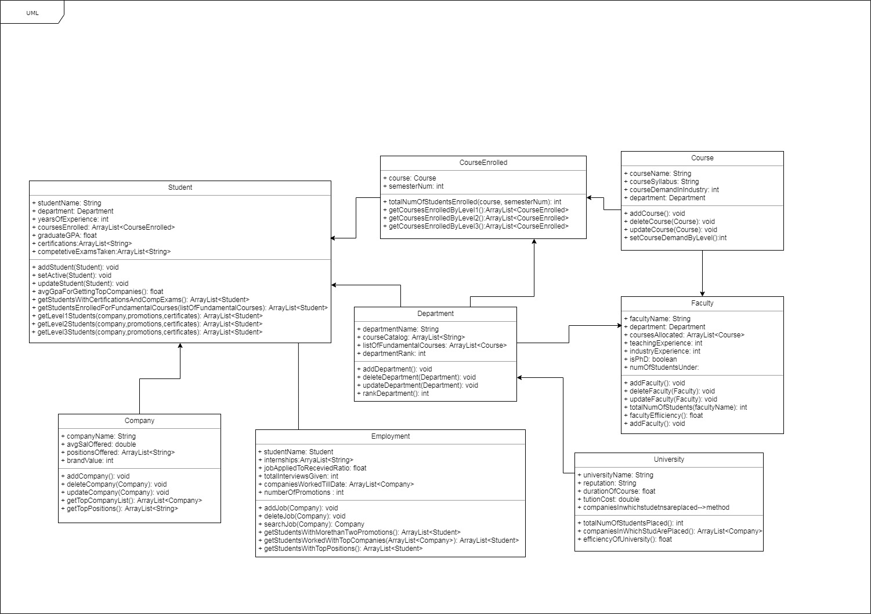
Class Diagram

Slide 11
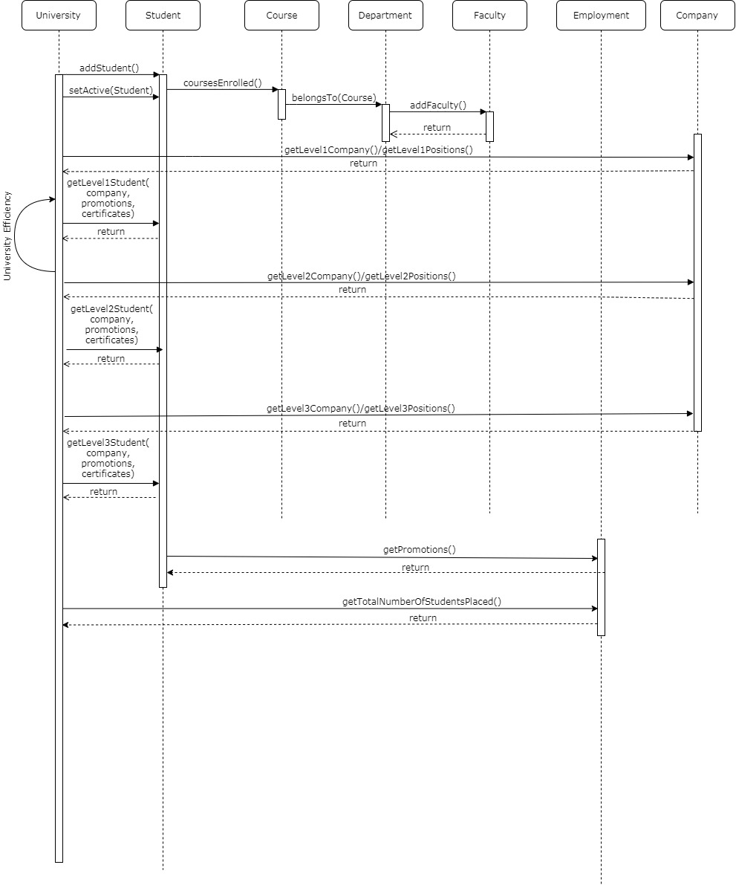
Sequence Diagram

Slide 12
Dashboard

