Slide 1
Travel Agency Project Report
Dimpi Dedhia (NUID – 001342018)
Dhruvil Shah (NUID – 001873473)

Slide 2
Entity: Travel Agency
This entity is the root node of the reservation system that manages the three entities of Car, Hotel and Flights and provides customers facility to book Flights, Hotels and Cars at reasonable cost. It also adds new Cars, Hotels, Airliners and Flight Schedule.
METHODS:
addFlight(): This method adds new available Flight for booking
addCar(): This method adds new available Car for booking
addHotel(): This method adds new available Hotel for booking
viewBooking(): This method helps Travel Agent to view details of customer bookings

Slide 3
Entity: Customer
This entity is another root node of the reservation system that stores user data. Every customer/user has a unique account which he/she can use to view and book flights, cars and hotels.
Future scope:
Addition of online payment options
Refund facility
Feedback
Rating Flights/ Cars/ Hotels
METHODS:
bookFlight(): This method books available flight for the customer
bookCar(): This method books available car for the customer
bookHotel(): This method books hotel for the customer
viewBooking(): This method lets customer view their current bookings

Slide 4
Entity: Airliner
This entity gives details about the Airliner. It is used to create a database of Airlines and update it in realtime
METHODS:
createAirliner(): This method creates new Airliner
viewAirliner(Airliner): This method displays information of a specified airliner
updateAirliner(Airliner): This method updates the information of selected airliner.
Entity: Flight
This Entity gives details about all flights available in the Travel Agency database. It is also used to manage the attributes and timings of the flight of a respective airliner
METHODS:
createFlight(): This methods creates a new flight in the database for a specific airliner.
deleteFlight(Flight):This method deletes a flight from the database.
updateFlight(Flight):This method updates the attributes of a selected flight from the database.

Slide 5
Entity: Hotel
This entity stores the details of all hotels registered under the Travel Agency. It stores all the attributes of a specific hotel, for example name, address, reception contact number.
METHODS:
createHotel(): This method creates a Hotel with designated attributes and stores in the database.
viewHotel(Hotel):This method lets the entity view the hotels stored in the database.
updateHotel(Hotel): This method updates the attributes of selected Hotel
Entity: Car
This entity stores the details of all Cars available for rental under the Travel Agency. It stores all the attributes of a specific Car, for example modelNumber,serial number, number of seats
METHODS:
createHotel(): This method creates a Hotel with designated attributes and stores in the database.
viewHotel(Hotel):This method lets the entity view the hotels stored in the database.
updateHotel(Hotel): This method updates the attributes of selected Hotel

Slide 6
Entity: BookingDetails
This is an interface entity that stores customer and his/her booking details
METHODS:
viewDetails(): This method gives all the booking details to Travel Agency and individual booking details to customer
Entity: FlightBookingDetails
This entity implements BookingDetails interface and
METHODS:
rankDepartment(): This methods gives a rank to individual department based on the course’s rank.

Slide 7
Entity: HotelBookingDetails
This entity gives details about various courses available in the university. It also contains the syllabus details which can be used by students to find the courses of their interest. Course entity is used to get courses taken by the top students and help future/present students to select courses accordingly. Along with other entities, it can be used to get courses opted by top level students that are relevant to the current demand in the industry.
METHODS:
setCourseDemandByLevel(): This method sets levels for courses as per their demand in the current industry.
Entity: CarBookingDetails
This entity contains information about various departments of university. Department consists of a group of courses. Department that contain more top courses gets good rank and is profitable to the university as there are chances of more future students enrolling for that department.
METHODS:
rankDepartment(): This methods gives a rank to individual department based on the course’s rank.

Slide 8
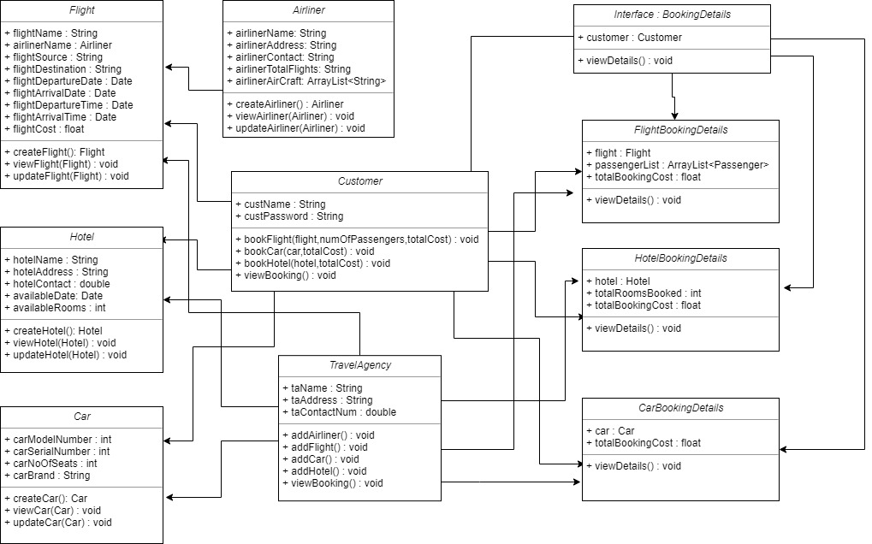
Class Diagram

