Slide 1
Announcements
Upcoming due dates
HW 1. Deadline: Friday 16 Sep, 11:59pm EST
Project 0. Deadline: Friday 23 Sep, 11:59 pm PST

Slide 2
Future
We are doing AI…
To create intelligent systems
The more intelligent, the better
To gain a better understanding of human intelligence
To magnify those benefits that flow from it
E.g., net present value of human-level AI ≥ $13,500T
Might help us avoid war and ecological catastrophes, achieve immortality and expand throughout the universe
What if we succeed?

Slide 3
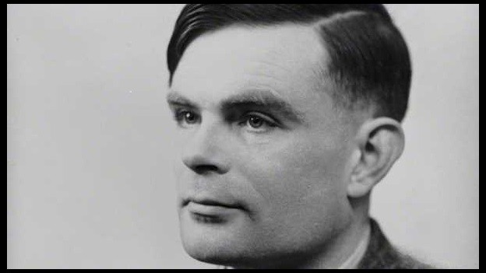
It seems probable that once the machine thinking method had started, it would not take long to outstrip our feeble powers. … At some stage therefore we should have to expect the machines to take control

Slide 4
What’s bad about better AI?
AI that is incredibly good at achieving something other than what we really want
AI, economics, statistics, operations research, control theory all assume utility to be fixed, known, and exogenously specified
Machines are intelligent to the extent that their actions can be expected to achieve their objectives
Machines are beneficial to the extent that their actions can be expected to achieve our objectives

Slide 5
A new model for AI
1. The machine’s only objective is to maximize the realization of human preferences
2. The robot is initially uncertain about what those preferences are
3. Human behavior provides evidence about human preferences
“The essential task of our age” [Nick Bostrom, Professor of Philosophy, Oxford]

Slide 6
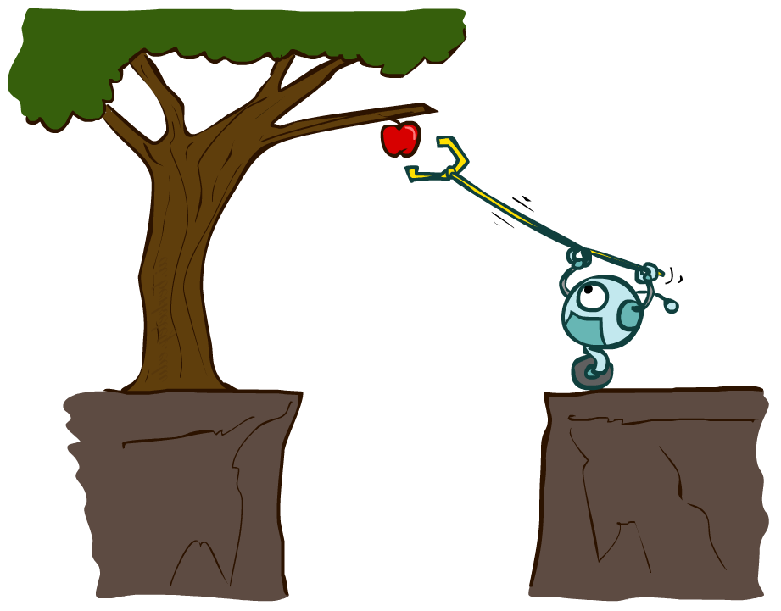
CS 370: Artificial Intelligence
Agents and environments
Instructors: William DeMeo, NJIT
slides courtesy of: Stuart Russell and Dawn Song (ai.berkeley.edu)
Notes:
Please retain proper attribution and the reference to ai.berkeley.edu. Thanks!

Slide 7
Outline
Agents and environments
Rationality
PEAS (Performance measure, Environment, Actuators, Sensors)
Environment types
Agent types

Slide 8
Agents and environments
Agent
Environment
Sensors
Percepts
?
Actuators
Actions
An agent perceives its environment through sensors and acts upon it through actuators (or effectors, depending on whom you ask)

Slide 9
Agents and environments
Agent
Environment
Sensors
Percepts
?
Actuators
Actions
Are humans agents?
Yes!
Sensors = vision, audio, touch, smell, taste, proprioception
Actuators = muscles, secretions, changing brain state

Slide 10
Agents and environments
Agent
Environment
Sensors
Percepts
?
Actuators
Actions
Are pocket calculators agents?
Yes!
Sensors = key state sensors
Actuators = digit display

Slide 11
Agents and environments
Agent
Environment
Sensors
Percepts
?
Actuators
Actions
AI is more interested in agents with large computational resources and environments that require nontrivial decision making

Slide 12
Agent functions
The agent function maps from percept histories to actions:
f : P* → A
I.e., the agent’s actual response to any sequence of percepts
Percept
NEXT
NEXT
NEXT
NEXT
Action
LEFT
LEFT
DROP
RIGHT
Notes:
Is there any reason to pay attention to more than just the current percept?
No – the correct decision depends only on the current percept because the world is fully observable!

Slide 13
Agent programs
The agent program l runs on some machine M to implement f :
f = Agent(l,M)
Real machines have limited speed and memory, introducing delay, so agent function f depends on M as well as l
Percept
NEXT
NEXT
NEXT
NEXT
Action
NOOP
NOOP
NOOP
LEFT

Slide 14
Agent functions and agent programs
Can every agent function be implemented by some agent program?
No! Consider agent for halting problems, NP-hard problems, chess with a slow PC

Slide 15
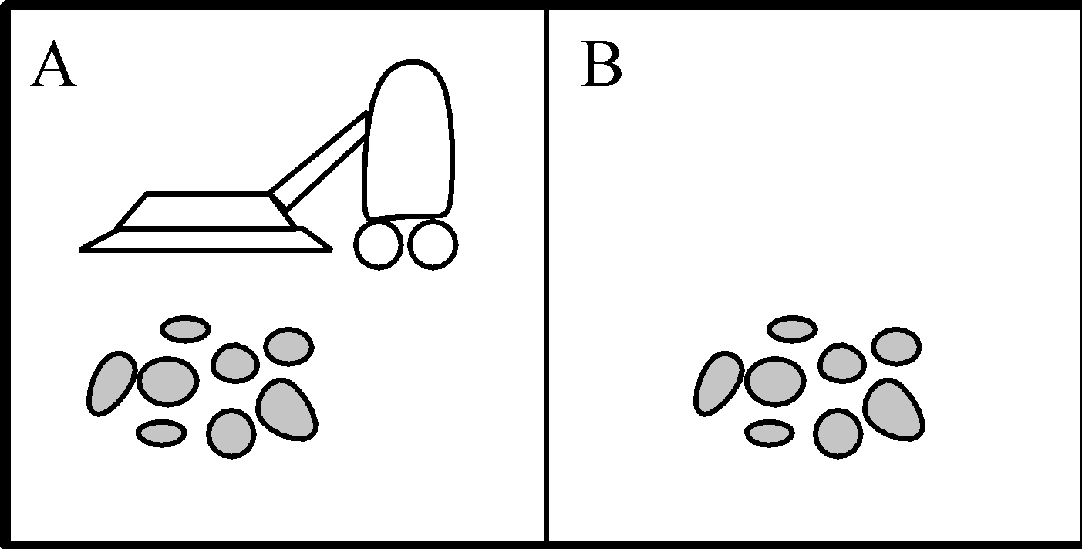
Example: Vacuum world
Percepts: [location,status], e.g., [A,Dirty]
Actions: Left, Right, Suck, NoOp

Slide 16
Vacuum cleaner agent
Agent function
Agent program
Percept sequence | Action
[A,Clean] | Right
[A,Dirty] | Suck
[B,Clean] | Left
[B,Dirty] | Suck
[A,Clean],[B,Clean] | Left
[A,Clean],[B,Dirty] | Suck
etc | etc
function Reflex-Vacuum-Agent([location,status])
returns an action
if status = Dirty then return Suck
else if location = A then return Right
else if location = B then return Left
What is the right agent function?
Can it be implemented by a small agent program?
(Can we ask, “What is the right agent program?”)

Slide 17
Rationality
Fixed performance measure evaluates the environment sequence
one point per square cleaned up?
NO! Rewards an agent who dumps dirt and cleans it up
one point per clean square per time step, for t = 1,…,T
A rational agent chooses whichever action maximizes the expected value of the performance measure
given the percept sequence to date and prior knowledge of environment
Does Reflex-Vacuum-Agent implement a rational agent function?
Yes, if movement is free, or new dirt arrives frequently
Notes:
The dirt-dumping problem is an example of the King Midas problem – mis-specifying the objective

Slide 18
Rationality, contd.
Are rational agents omniscient?
No – they are limited by the available percepts
Are rational agents clairvoyant?
No – they may lack knowledge of the environment dynamics
Do rational agents explore and learn?
Yes – in unknown environments these are essential
Do rational agents make mistakes?
No – but their actions may be unsuccessful
Are rational agents autonomous (i.e., transcend initial program)?
Yes – as they learn, their behavior depends more on their own experience

Slide 19
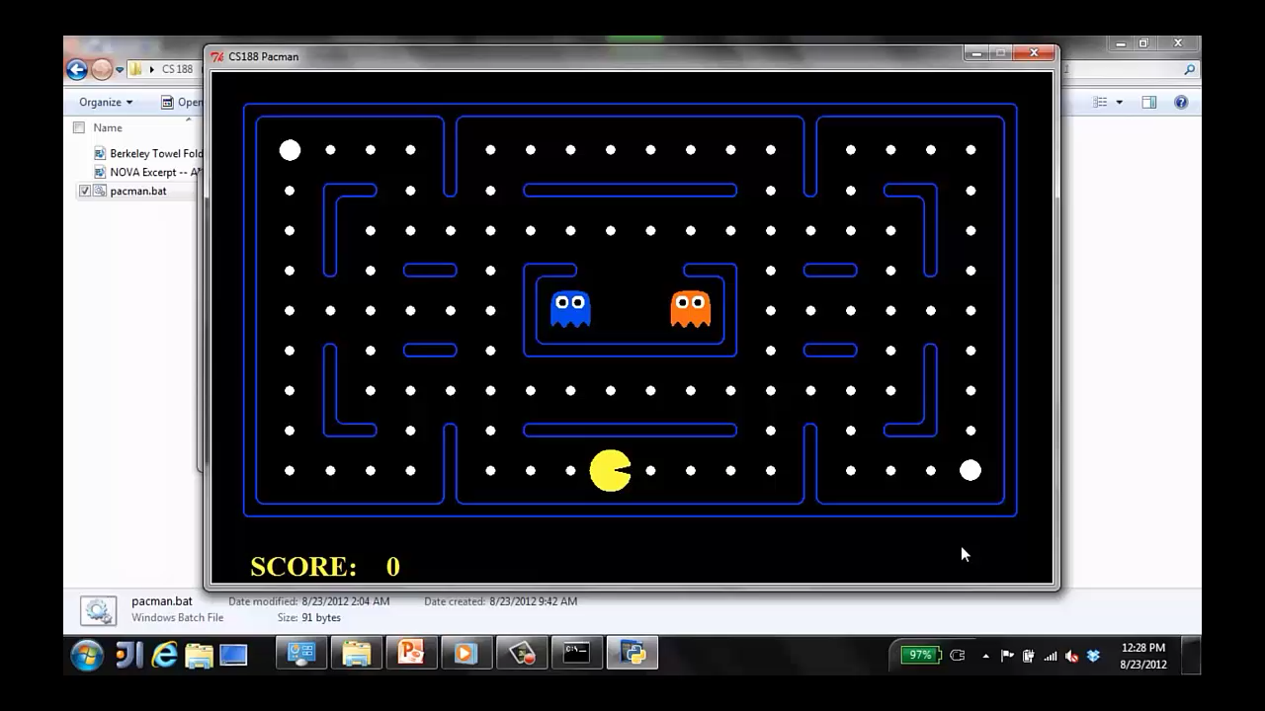
A human agent in Pacman

Slide 20
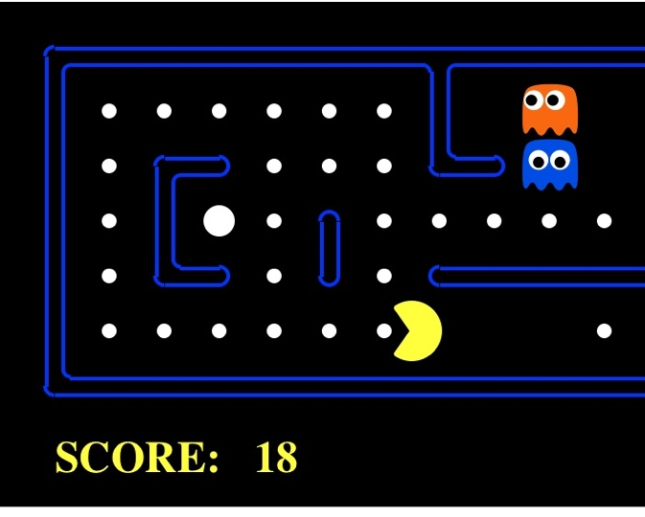
The task environment - PEAS
Performance measure
-1 per step; + 10 food; +500 win; -500 die; +200 hit scared ghost
Environment
Pacman dynamics (incl ghost behavior)
Actuators
Left Right Up Down
Sensors
Entire state is visible (except power pellet duration)

Slide 21
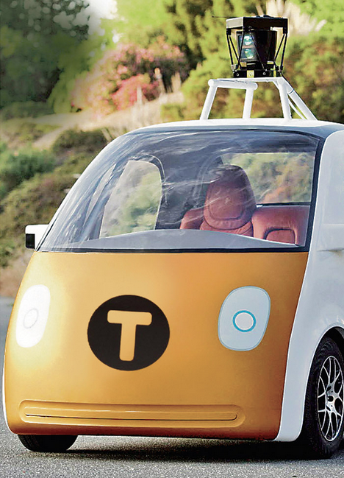
PEAS: Automated taxi
Performance measure
Income, happy customer, vehicle costs, fines, insurance premiums
Environment
US streets, other drivers, customers, weather, police…
Actuators
Steering, brake, gas, display/speaker
Sensors
Camera, radar, accelerometer, engine sensors, microphone, GPS
Image: http://nypost.com/2014/06/21/how-google-might-put-taxi-drivers-out-of-business/

Slide 22

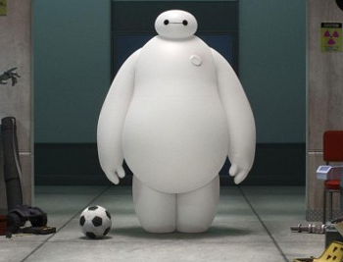
PEAS: Medical diagnosis system
Performance measure
Patient health, cost, reputation
Environment
Patients, medical staff, insurers, courts
Actuators
Screen display, email
Sensors
Keyboard/mouse

Slide 23
Environment types
 | Pacman | Backgammon | Diagnosis | Taxi
Fully or partially observable
Single-agent or multiagent
Deterministic or stochastic
Static or dynamic
Discrete or continuous
Known physics?
Known perf. measure?

Slide 24
Agent design
The environment type largely determines the agent design
Partially observable => agent requires memory (internal state)
Stochastic => agent may have to prepare for contingencies
Multi-agent => agent may need to behave randomly
Static => agent has time to compute a rational decision
Continuous time => continuously operating controller
Unknown physics => need for exploration
Unknown perf. measure => observe/interact with human principal

Slide 25
Agent types
In order of increasing generality and complexity
Simple reflex agents
Reflex agents with state
Goal-based agents
Utility-based agents

Slide 26
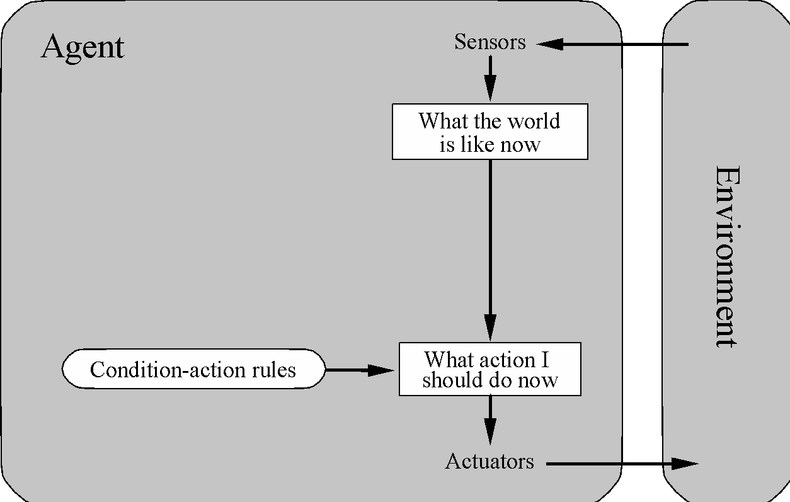
Simple reflex agents

Slide 27
Pacman agent in Python
class GoWestAgent(Agent):
def getAction(self, percept):
if Directions.WEST in percept.getLegalPacmanActions():
return Directions.WEST
else:
return Directions.STOP

Slide 28
Pacman agent contd.
Can we (in principle) extend this reflex agent to behave well in all standard Pacman environments?
No – Pacman is not quite fully observable (power pellet duration)
Otherwise, yes – we can (in principle) make a lookup table…..
Notes:
106 locations so 106^3 * 2^106 (ignoring power pellet stuff) =~ 10^38 states
Worse if the map is not fixed – all possible physics? No – can simply say 3^150 or whatever

Slide 29
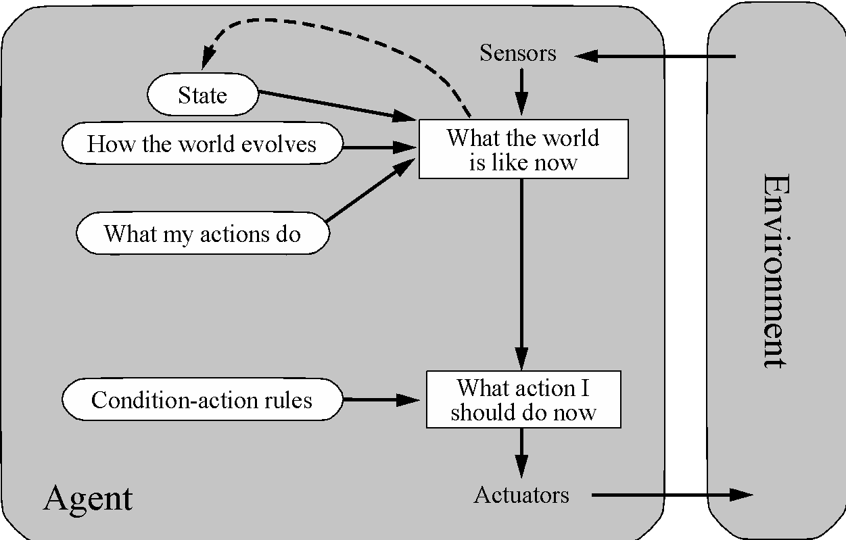
Reflex agents with state

Slide 30
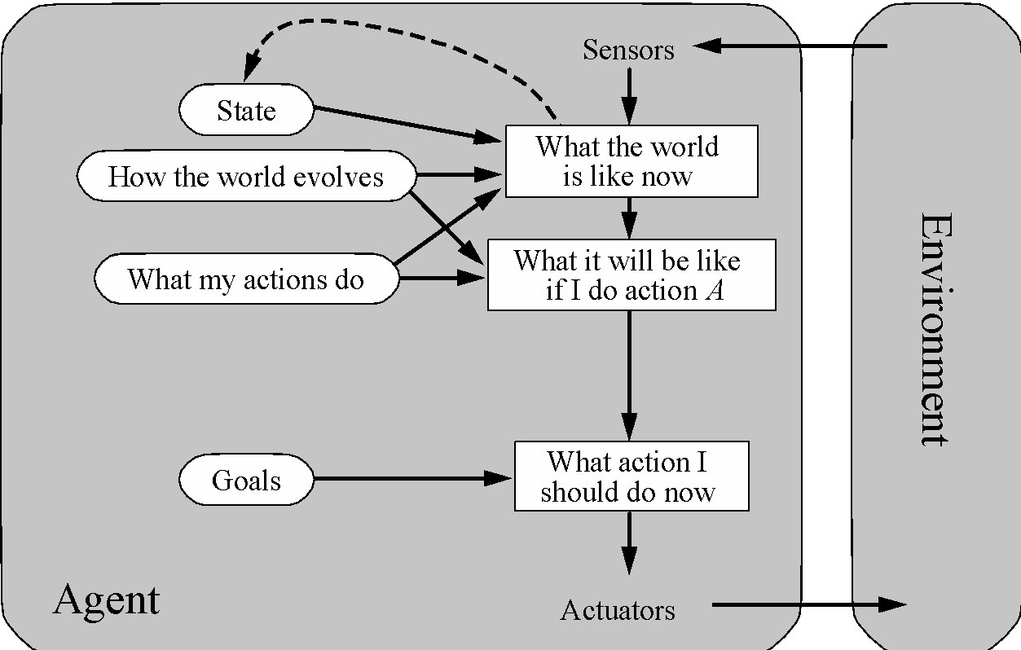
Goal-based agents
Notes:
Act to achieve a goal
Pro: use goal to index into actions that might achieve it, eg “Have milk” -> “buy milk”
Con: cannot handle tradeoffs among goals, failure probability etc.

Slide 31
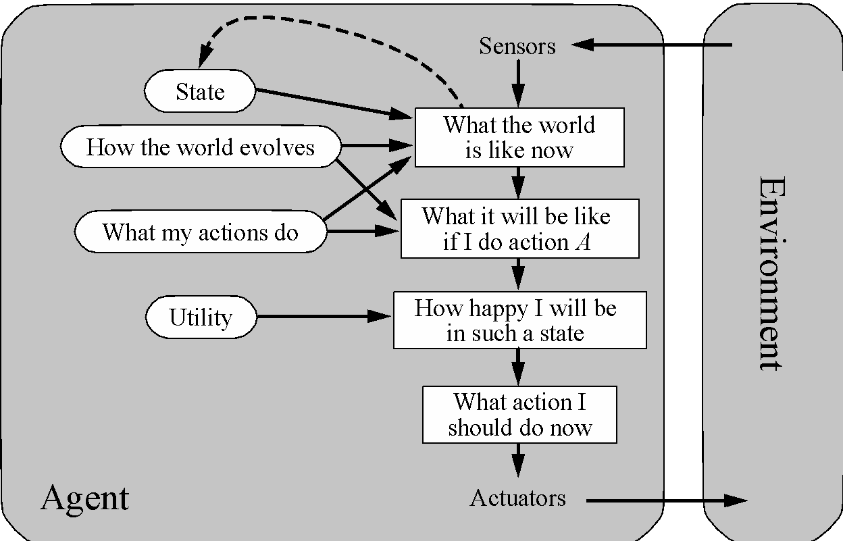
Utility-based agents
Notes:
Utility is a numeric scale
Pro: can compute expected values for actions, handle tradeoffs and uncertainty
Con: cannot (easily) index into actions

Slide 32
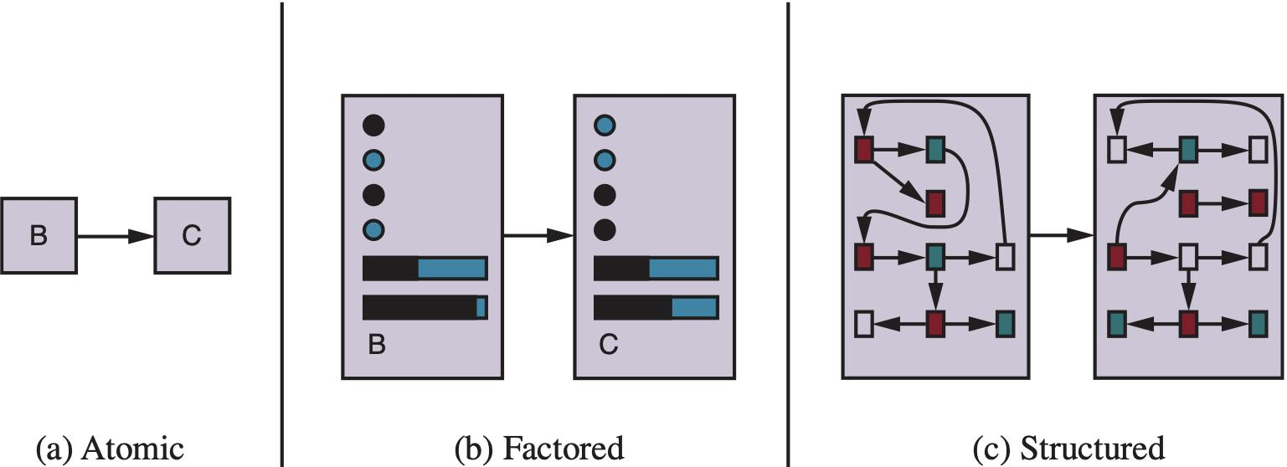
Spectrum of representations

Slide 33
Summary
An agent interacts with an environment through sensors and actuators
The agent function, implemented by an agent program running on a machine, describes what the agent does in all circumstances
Rational agents choose actions that maximize their expected utility
PEAS descriptions define task environments; precise PEAS specifications are essential and strongly influence agent designs
More difficult environments require more complex agent designs and more sophisticated representations

