Slide 1
Announcements
Upcoming due dates
HW 1. Deadline: Friday 16 Sep, 11:59pm EST (TODAY!)
HW 2 & Project 0. Deadline: Friday 23 Sep
HW 3. Deadline: Friday 30 Sep

Slide 2
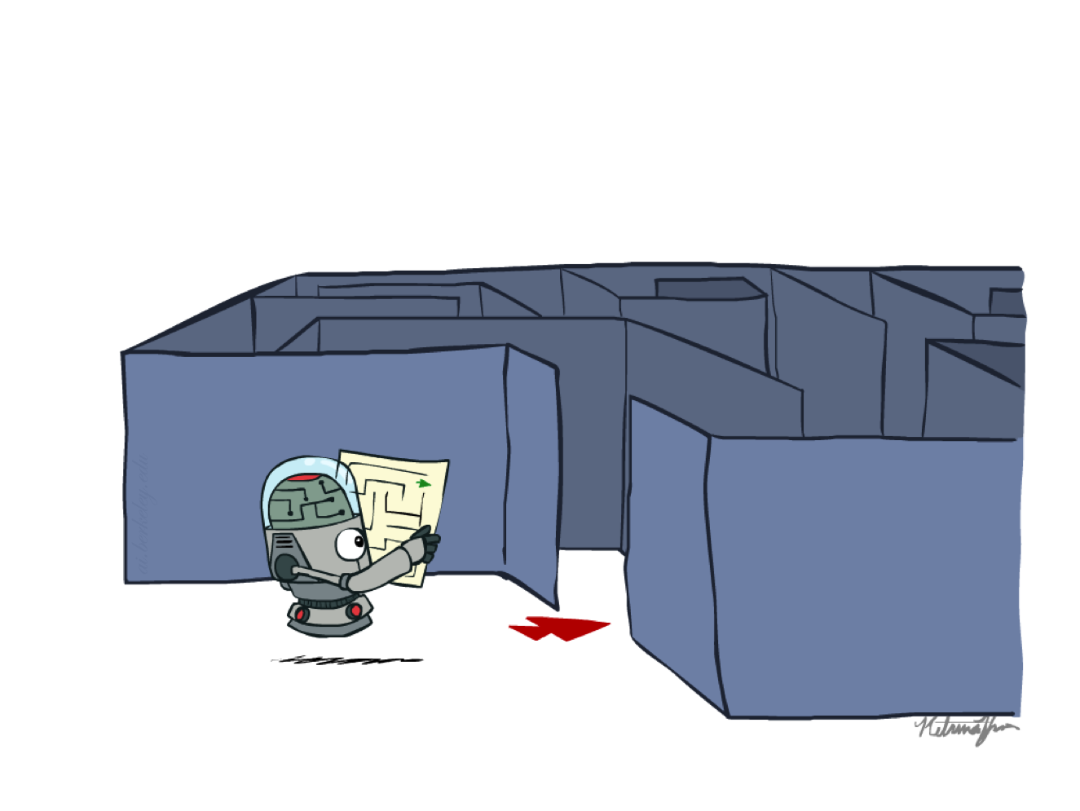
CS 370: Artificial Intelligence
Search
Instructor: William DeMeo, NJIT
Slides courtesy of Dan Klein and Pieter Abbeel (UC Berkeley); available at ai.berkeley.edu.
Notes:
Please retain proper attribution, including the reference to ai.berkeley.edu. Thanks!

Slide 3
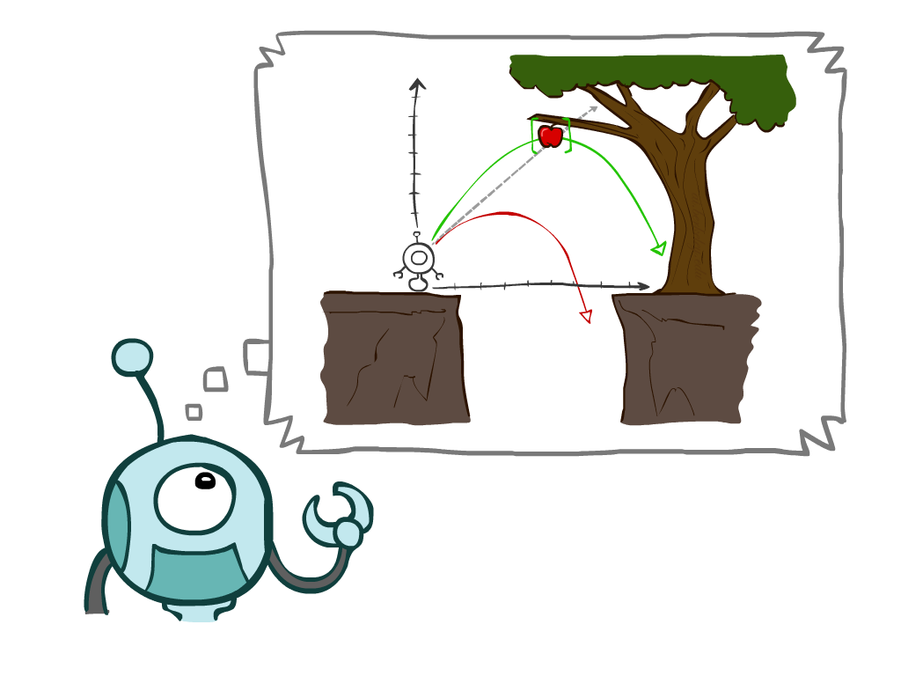
Today
Agents that Plan Ahead
Search Problems
Uninformed Search Methods
Depth-First Search
Breadth-First Search
Uniform-Cost Search
Notes:
General theme in the class:
A goal we have in mind.
A mathematical abstraction to formalize this
Algorithms that operate on these abstractions

Slide 4
Agents that Plan

Slide 5

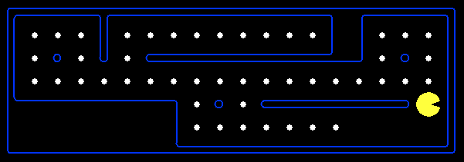
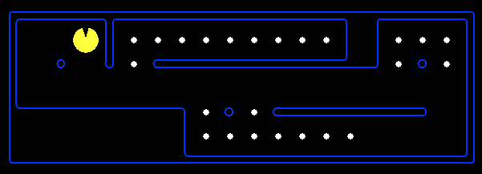
Reflex Agents
Reflex agents:
Choose action based on current percept (and maybe memory)
May have memory or a model of the world’s current state
Do not consider the future consequences of their actions
Consider how the world IS
Can a reflex agent be rational?
[Demo: reflex optimal (L2D1)]
[Demo: reflex optimal (L2D2)]
Notes:
Examples: blinking your eye (not using your entire thinking capabilities), vacuum cleaner moving towards nearest dirt

Slide 6
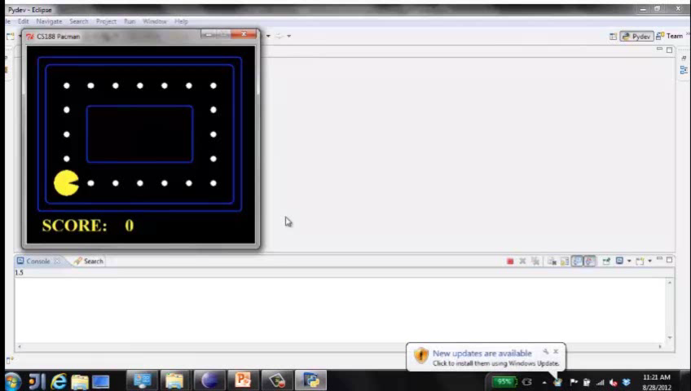
Video of Demo Reflex Optimal

Slide 7
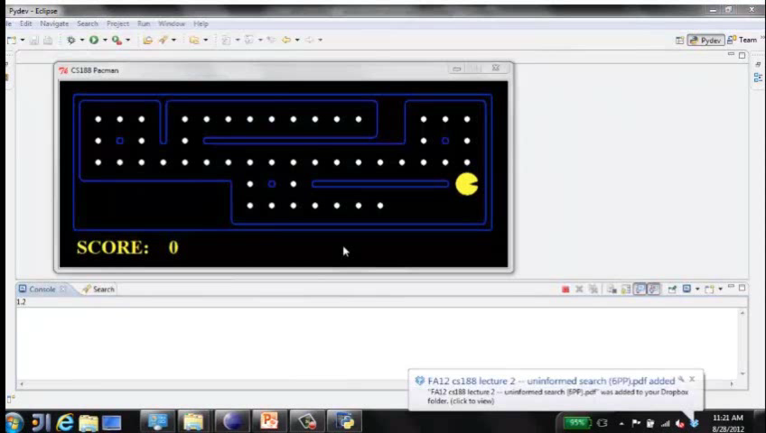
Video of Demo Reflex Odd

Slide 8
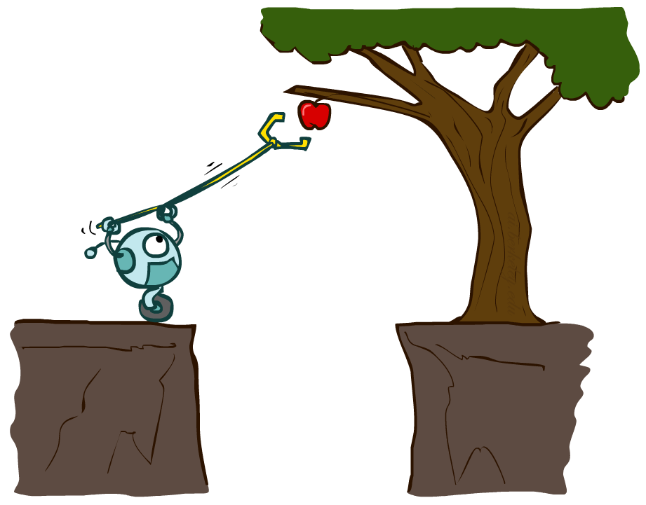
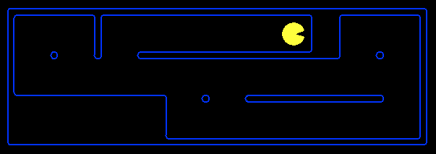
Planning Agents
Planning agents:
Ask “what if”
Decisions based on (hypothesized) consequences of actions
Must have a model of how the world evolves in response to actions
Must formulate a goal (test)
Consider how the world WOULD BE
Optimal vs. complete planning
Planning vs. replanning
[Demo: re-planning (L2D3)]
[Demo: mastermind (L2D4)]

Slide 9
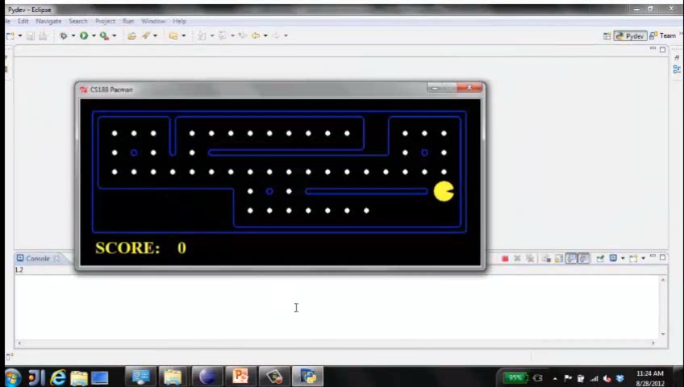
Video of Demo Replanning

Slide 10
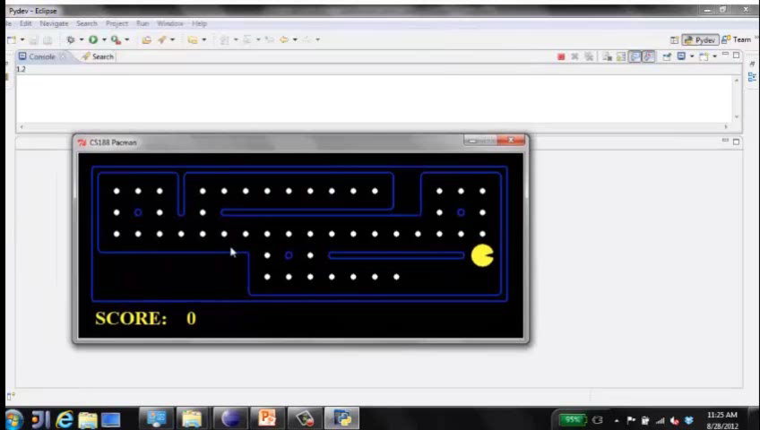
Video of Demo Mastermind

Slide 11

Search Problems

Slide 12

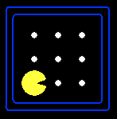





Search Problems
A search problem consists of:
A state space
A successor function
(with actions, costs)
A start state and a goal test
A solution is a sequence of actions (a plan) which transforms the start state to a goal state
“N”, 1.0
“E”, 1.0
Notes:
Often comes back on exams
Goal test – sometimes more than one state that satisfies having achieved the goal, for example, “eat all the dots”
Abstraction

Slide 13

Search Problems Are Models

Slide 14
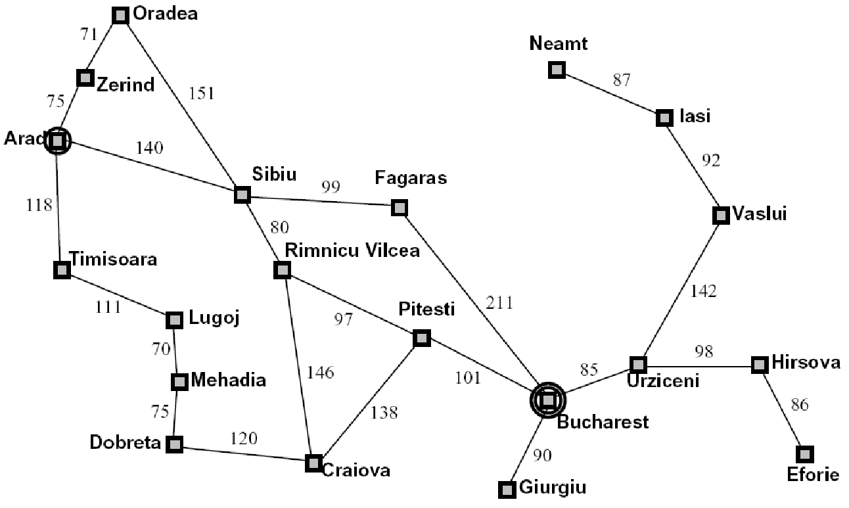
Example: Traveling in Romania
State space:
Cities
Successor function:
Roads: Go to adjacent city with cost = distance
Start state:
Arad
Goal test:
Is state == Bucharest?
Solution?

Slide 15
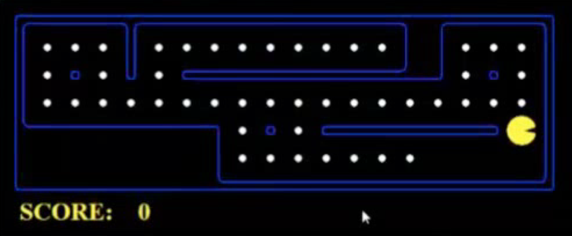
What’s in a State Space?
The world state includes every last detail of the environment
A search state keeps only the details needed for planning (abstraction)
Problem: Pathing
States: (x,y) location
Actions: NSEW
Successor: update location only
Goal test: is (x,y)=END
Problem: Eat-All-Dots
States: {(x,y), dot booleans}
Actions: NSEW
Successor: update location and possibly a dot boolean
Goal test: dots all false
Notes:
Wrong example for “eat-all-dots”: (x, y, dot count)

Slide 16
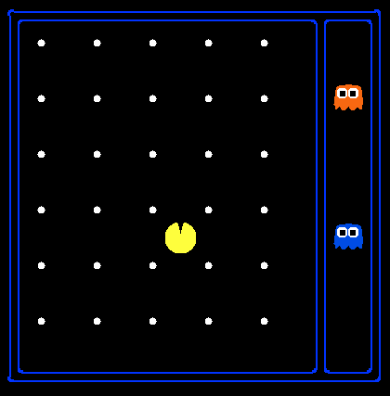
State Space Sizes?
World state:
Agent positions: 120
Food count: 30
Ghost positions: 12
Agent facing: NSEW
How many
World states?
120x(2³⁰)x(12²)x4
States for pathing?
120
States for eat-all-dots?
120x(2³⁰)
Notes:
90 * (2^30-1) + 30 * 2^29 = 145 billion
2^29 = 536 870 912

Slide 17
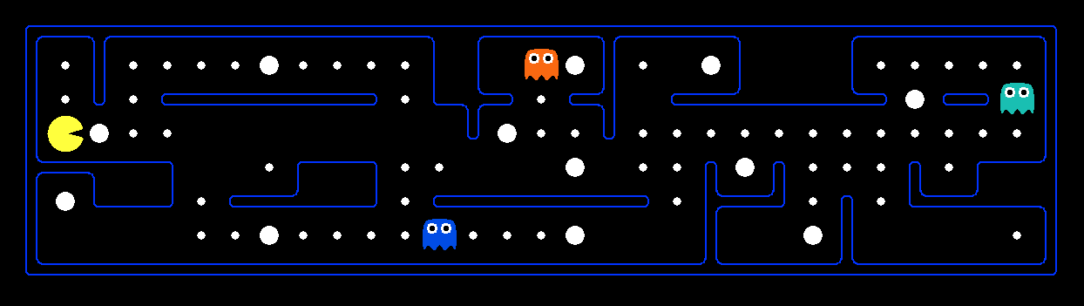
Quiz: Safe Passage
Problem: eat all dots while keeping the ghosts perma-scared
What does the state space have to specify?
(agent position, dot booleans, power pellet booleans, remaining scared time)

Slide 18
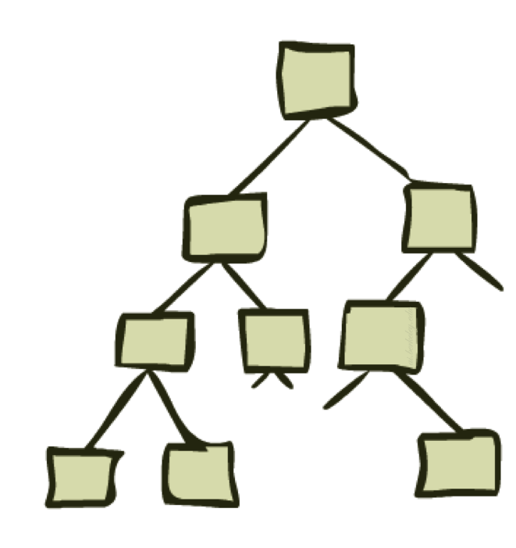
State Space Graphs and Search Trees

Slide 19
State Space Graphs
State space graph: A mathematical representation of a search problem
Nodes are (abstracted) world configurations
Arcs represent successors (action results)
The goal test is a set of goal nodes (maybe only one)
In a state space graph, each state occurs only once!
We can rarely build this full graph in memory (it’s too big), but it’s a useful idea

Slide 20
State Space Graphs
State space graph: A mathematical representation of a search problem
Nodes are (abstracted) world configurations
Arcs represent successors (action results)
The goal test is a set of goal nodes (maybe only one)
In a state space graph, each state occurs only once!
We can rarely build this full graph in memory (it’s too big), but it’s a useful idea
a
G
b
c
e
d
f
S
h
p
q
r
Tiny state space graph for a tiny search problem

Slide 21
Search Trees
This is now / start
“N”, 1.0
“E”, 1.0
Possible futures
A search tree:
A “what if” tree of plans and their outcomes
The start state is the root node
Children correspond to successors
Nodes show states, but correspond to PLANS that achieve those states
For most problems, we can never actually build the whole tree
Notes:
Different plans that achieve the same state, will be different nodes in the tree.

Slide 22
State Space Graphs vs. Search Trees
State Space Graph
Each NODE in in the search tree is an entire PATH in the state space graph.
Search Tree
S
a
G
d
e
p
b
c
q
b
c
e
h
r
d
e
f
a
a
h
r
p
q
f
S
h
We construct both on demand – and we construct as little as possible.
p
q
f
q
c
G
p
q
r
q
c
G
a
a

Slide 23

Quiz: State Space Graphs vs. Search Trees
Consider this 4-state graph:
How big is its search tree (from S)?
a
S
G
b
Important: Lots of repeated structure in the search tree!

Slide 24
Quiz: State Space Graphs vs. Search Trees
Consider this 4-state graph:
How big is its search tree (from S)?
a
S
G
b

Slide 25
Quiz: State Space Graphs vs. Search Trees
Consider this 4-state graph:
How big is its search tree (from S)?
a
s
a
b
S
G
b
G
a
G
b
a
G
b
G
…
…
Important: Lots of repeated structure in the search tree!

Slide 26
Tree Search

Slide 27
Search Example: Romania

Slide 28
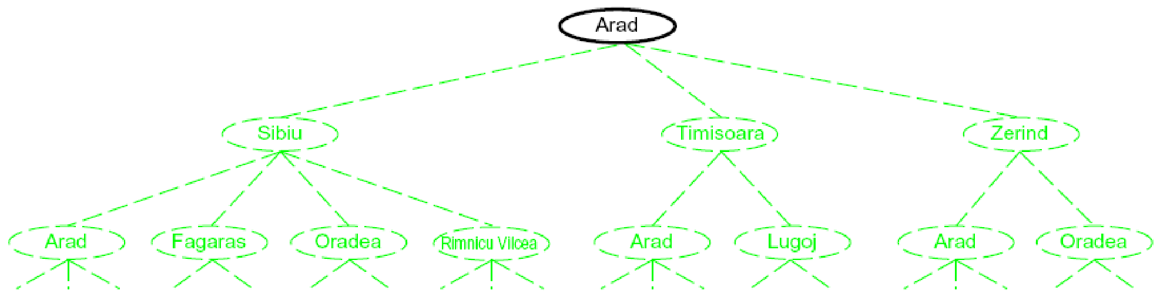
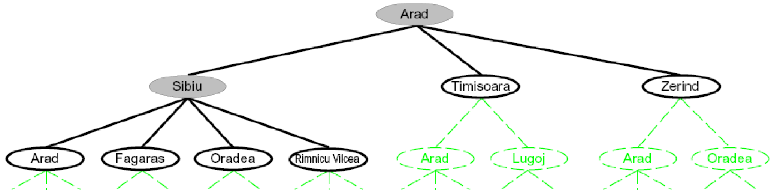
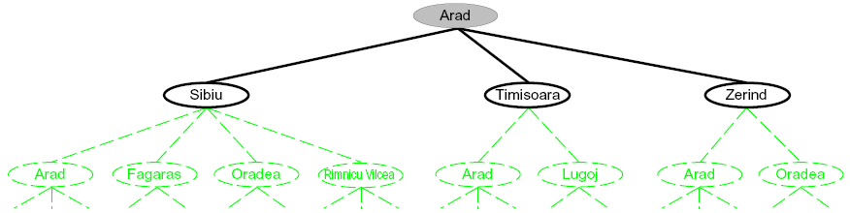
Searching with a Search Tree
Search:
Expand out potential plans (tree nodes)
Maintain a fringe of partial plans under consideration
Try to expand as few tree nodes as possible

Slide 29
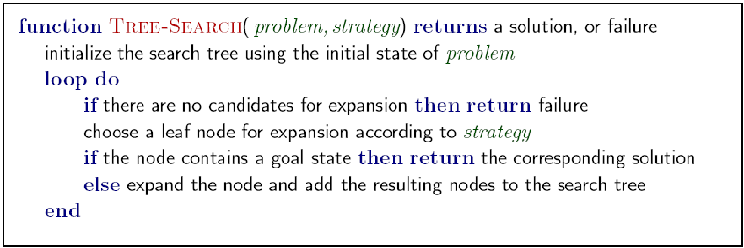
General Tree Search
Important ideas:
Fringe
Expansion
Exploration strategy
Main question: which fringe nodes to explore?

Slide 30
Example: Tree Search
a
G
b
c
d
e
f
S
h
p
q
r
Notes:
Left: show tree
Right: fringe

Slide 31
Example: Tree Search
a
G
b
c
e
d
e
d
f
f
S
h
p
r
q
r
S
s
s 🡪 d
s 🡪 e
s 🡪 p
s 🡪 d 🡪 b
s 🡪 d 🡪 c
s 🡪 d 🡪 e
s 🡪 d 🡪 e 🡪 h
s 🡪 d 🡪 e 🡪 r
s 🡪 d 🡪 e 🡪 r 🡪 f
s 🡪 d 🡪 e 🡪 r 🡪 f 🡪 c
s 🡪 d 🡪 e 🡪 r 🡪 f 🡪 G
d
e
p
b
c
e
h
r
q
a
a
h
r
p
q
f
p
q
f
q
c
G
q
c
G
a
a

Slide 32
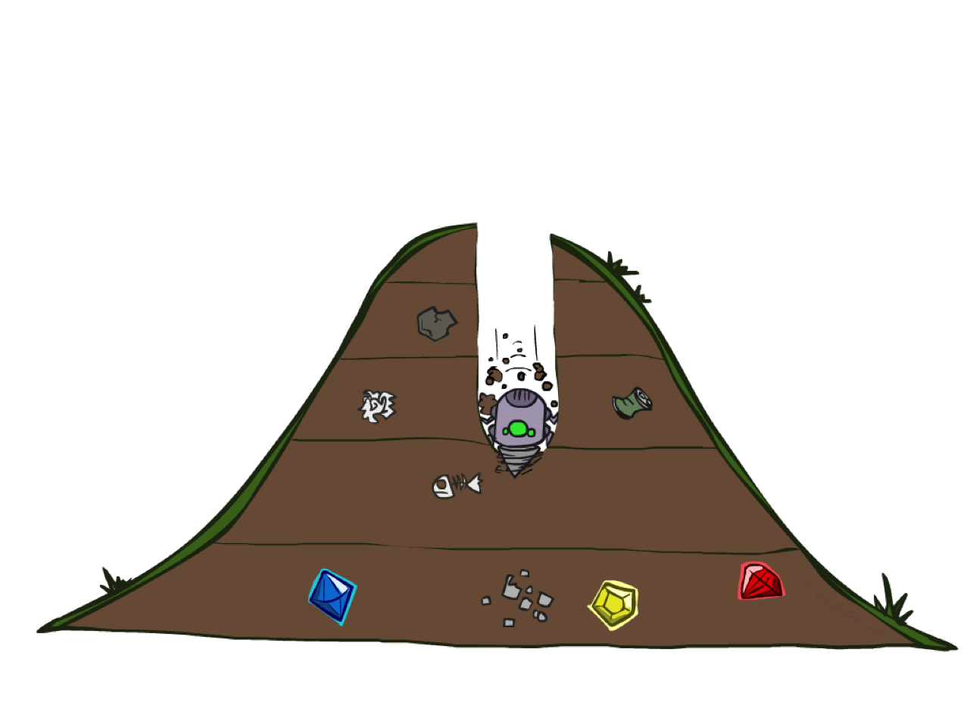
Depth-First Search

Slide 33
Depth-First Search
Strategy: expand a deepest node first
Implementation: Fringe is a LIFO stack
a
G
a
c
b
c
b
e
d
e
d
f
f
S
h
h
p
p
r
q
r
q
S
d
e
p
b
c
e
h
r
q
a
a
h
r
p
q
f
p
q
f
q
c
G
q
c
G
a
a

Slide 34
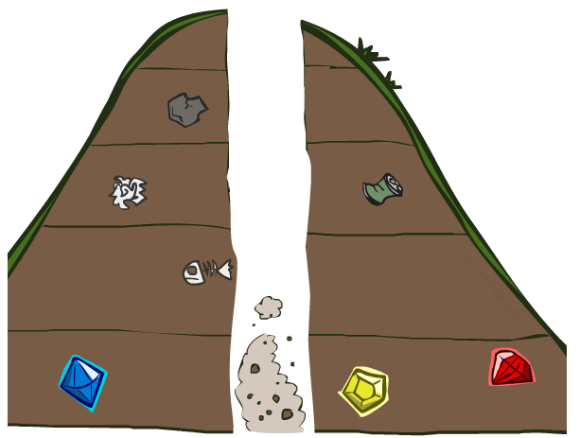
Search Algorithm Properties

Slide 35
Search Algorithm Properties
Complete: Guaranteed to find a solution if one exists?
Optimal: Guaranteed to find the least cost path?
Time complexity?
Space complexity?
Cartoon of search tree:
b is the branching factor
m is the maximum depth
solutions at various depths
Number of nodes in entire tree?
1 + b + b² + …. b^{m} = O(b^{m})
1 node
b
…
b nodes
b² nodes
m tiers
b^{m} nodes

Slide 36
Depth-First Search (DFS) Properties
What nodes DFS expand?
Some left prefix of the tree.
Could process the whole tree!
If m is finite, takes time O(b^{m})
How much space does the fringe take?
Only has siblings on path to root, so O(bm)
Is it complete?
m could be infinite, so only if we prevent cycles (more later)
Is it optimal?
No, it finds the “leftmost” solution, regardless of depth or cost
1 node
b
…
b nodes
b² nodes
m tiers
b^{m} nodes

Slide 37
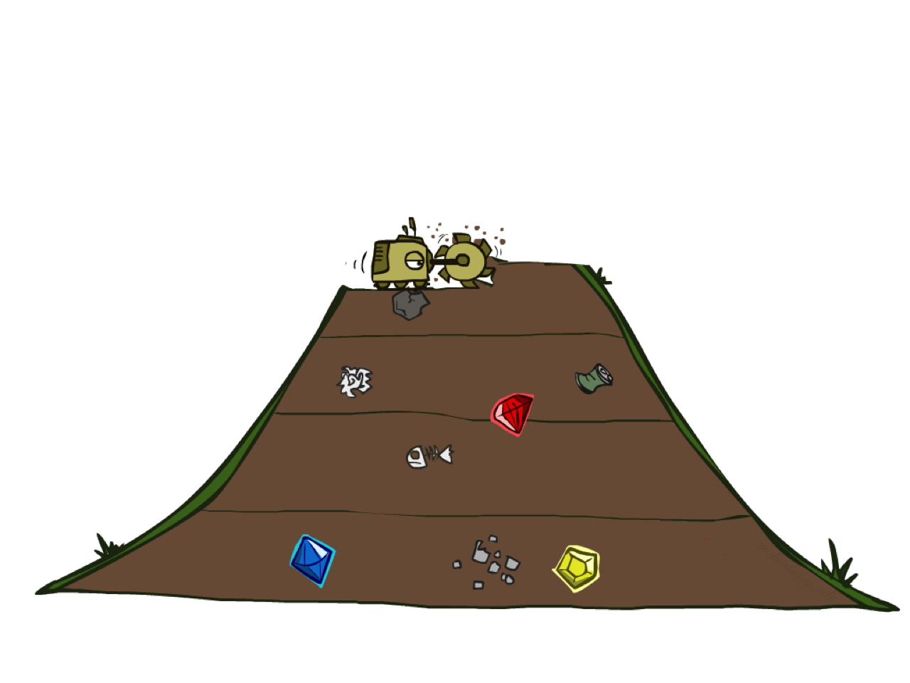
Breadth-First Search

Slide 38
Breadth-First Search
Strategy: expand a shallowest node first
Implementation: Fringe is a FIFO queue
a
G
b
c
d
e
f
S
h
p
q
r
S
d
e
p
Search
Tiers
b
c
e
h
r
q
a
a
h
r
p
q
f
p
q
f
q
c
G
q
c
G
a
a

Slide 39
Breadth-First Search (BFS) Properties
What nodes does BFS expand?
Processes all nodes above shallowest solution
Let depth of shallowest solution be s
Search takes time O(b^{s})
How much space does the fringe take?
Has roughly the last tier, so O(b^{s})
Is it complete?
s must be finite if a solution exists, so yes!
Is it optimal?
Only if costs are all 1 (more on costs later)
1 node
b
…
b nodes
s tiers
b² nodes
b^{s} nodes
b^{m} nodes

Slide 40
Quiz: DFS vs BFS

Slide 41
Quiz: DFS vs BFS
When will BFS outperform DFS?
When will DFS outperform BFS?
[Demo: dfs/bfs maze water (L2D6)]

Slide 42

Video of Demo Maze Water DFS/BFS (part 1)

Slide 43
Video of Demo Maze Water DFS/BFS (part 2)

Slide 44
Iterative Deepening
Idea: get DFS’s space advantage with BFS’s time / shallow-solution advantages
Run a DFS with depth limit 1. If no solution…
Run a DFS with depth limit 2. If no solution…
Run a DFS with depth limit 3. …..
Isn’t that wastefully redundant?
Generally most work happens in the lowest level searched, so not so bad!
b
…

Slide 45
Cost-Sensitive Search
a
GOAL
2
2
b
c
3
2
1
8
2
e
d
f
3
9
8
2
START
h
1
4
2
p
4
r
15
q
BFS finds the shortest path in terms of number of actions.
It does not find the least-cost path. We will now cover
a similar algorithm which does find the least-cost path.

Slide 46
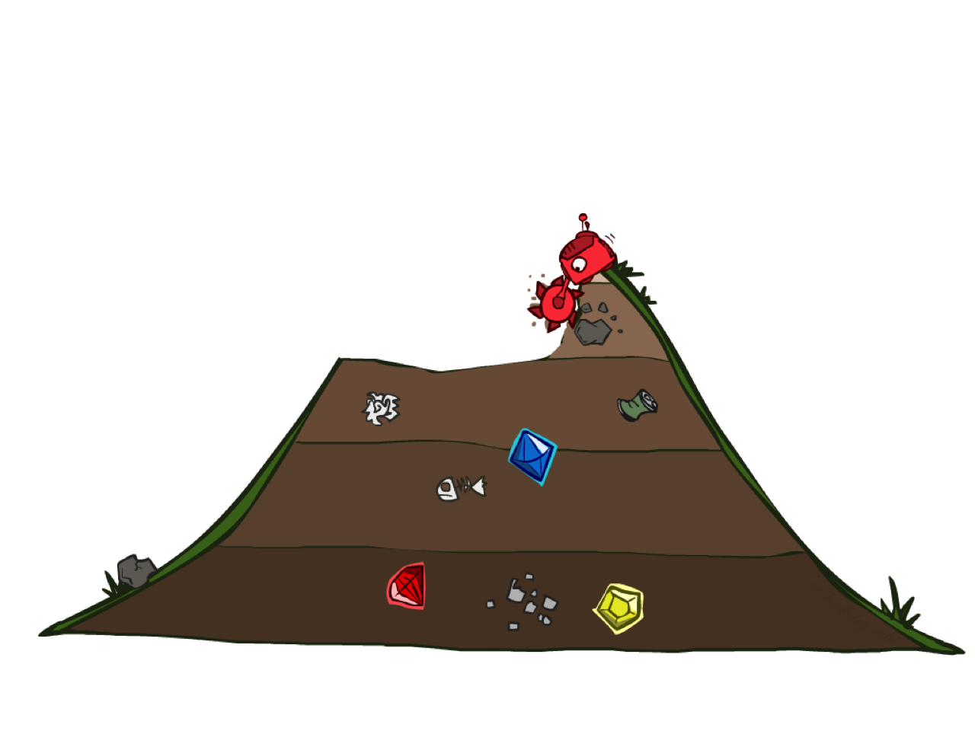
Uniform Cost Search

Slide 47
Uniform Cost Search
2
G
a
Strategy: expand a cheapest node first:
Fringe is a priority queue (priority: cumulative cost)
b
c
1
8
2
2
e
3
d
f
9
8
2
S
h
1
1
p
q
r
15
0
S
d
3
e
9
p
1
b
4
e
5
h
17
r
11
q
16
c
11
Cost contours
a
6
a
h
13
r
7
p
q
f
p
q
f
8
q
c
G
q
c
a
11
G
10
a

Slide 48
Uniform Cost Search (UCS) Properties
What nodes does UCS expand?
Processes all nodes with cost less than cheapest solution!
If that solution costs C* and arcs cost at least ε , then the “effective depth” is roughly C*/ε
Takes time O(b^{C*/ε}) (exponential in effective depth)
How much space does the fringe take?
Has roughly the last tier, so O(b^{C*/ε})
Is it complete?
Assuming best solution has a finite cost and minimum arc cost is positive, yes!
Is it optimal?
Yes! (Proof next lecture via A*)
b
c ≤ 1
…
C*/ε “tiers”
c ≤ 2
c ≤ 3

Slide 49
Uniform Cost Issues
Remember: UCS explores increasing cost contours
The good: UCS is complete and optimal!
The bad:
Explores options in every “direction”
No information about goal location
We’ll fix that soon!
…
c ≤ 1
c ≤ 2
c ≤ 3
Start
Goal
[Demo: empty grid UCS (L2D5)]
[Demo: maze with deep/shallow water DFS/BFS/UCS (L2D7)]

Slide 50
Video of Demo Empty UCS

Slide 51
Video of Demo Maze with Deep/Shallow Water --- DFS, BFS, or UCS? (part 1)
Notes:
Let students guess which one of the three it is. (This is BFS.)

Slide 52
Video of Demo Maze with Deep/Shallow Water --- DFS, BFS, or UCS? (part 2)
Notes:
Let students guess which one of the three it is. (This is UCS.)

Slide 53
Video of Demo Maze with Deep/Shallow Water --- DFS, BFS, or UCS? (part 3)
Notes:
Let students guess which one of the three it is. (This is DFS.)

Slide 54

The One Queue
All these search algorithms are the same except for fringe strategies
Conceptually, all fringes are priority queues (i.e. collections of nodes with attached priorities)
Practically, for DFS and BFS, you can avoid the log(n) overhead from an actual priority queue, by using stacks and queues
Can even code one implementation that takes a variable queuing object

Slide 55
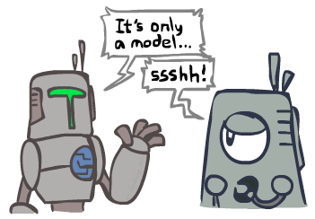
Search and Models
Search operates over models of the world
The agent doesn’t actually try all the plans out in the real world!
Planning is all “in simulation”
Your search is only as good as your models…

Slide 56
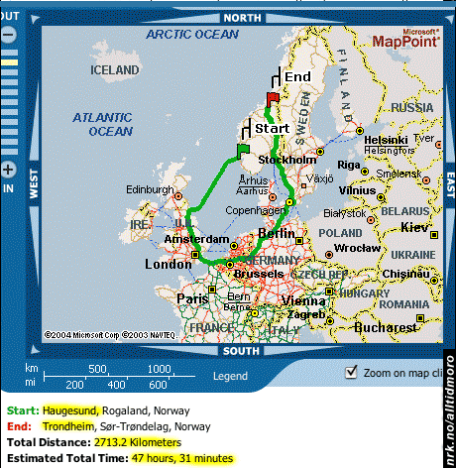
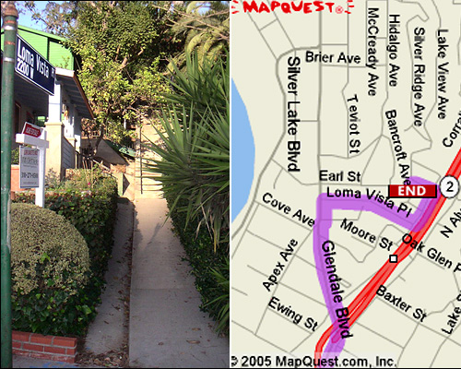

Search Gone Wrong?

