Slide 1
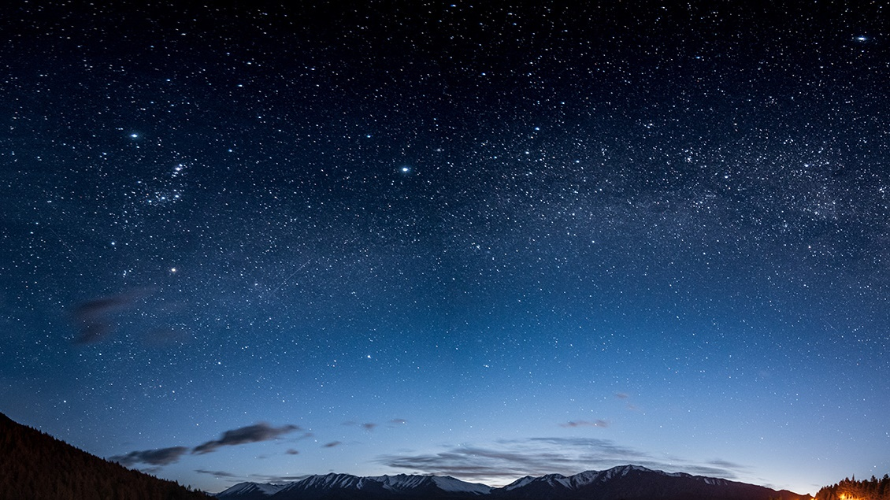
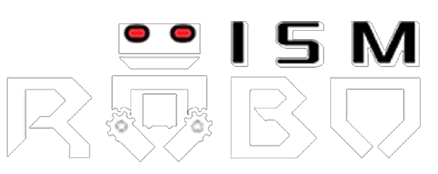
ATULYA
NAME: DHRUVIL PATEL
Admn no. 21JE0312

Slide 2
Topics to be covered
PROBLEM STATEMENT
APPROACH
Detect square in image
Detect color of square
Select arucomarker for the square according to color.
Rotate and resize arucomarker according to angle and size of square respectively.
Replace square with arucomarker.

Slide 3
Problem statement
You work in a firm where they have a specific department, to autonomously put aruco markers on square boxes. Your task is to write a python code, for finding square boxes in an image and then place aruco markers exactly overlapping on it.

Slide 4
Approach
To complete the task following steps are to be followed
Detect square in image
Detect color of square
Select arucomarker for the square according to color.
Rotate and resize arucomarker according to angle and size of square respectively.
Replace square with arucomarker.

Slide 5
DETECT SQUARE
To detect squares in image first I converted my image to grayscale image and then I created a threshold image to detect all shapes in image.
With help of threshold image countours(coordinates of corners) were found.
And object with 4 contours and aspectratio(width/height)=1 is a square .
By above algorithm I found squares in image.

Slide 6
Color of square
Since we have coordinates of square, we can easily find center of square . And color at center of square is color of whole square.
By passing coordinates of center in image array we can get pixel value at center , and by comparing its pixel value with different colors we get exact color of image.

Slide 7
Select arucomarkers
As we have detected color and I have created a dictionary containing ids of arucomarkers with respect to color. By using above dictionary we can find needed arucomarker.

Slide 8
Resize and rotate arucomarker
Here I have created function(arucoangle) to find angle of arucomarker w.r.t x-axis and function(rotate_image) to rotate arucomarker.
In rotate_image I have used getRotationMatrix2D function to get rotation matrix and warpAffine to find rotated image.
For angle I have used normal slope method .

Slide 9
replace square with arucomarker
After rotating and resizing arucomarker I have placed it in new image with white background.
After pasting all arucomarkers in new image I copied all other shapes from original image to new image to get final output.

Slide 10

Thank You!

