Slide 1
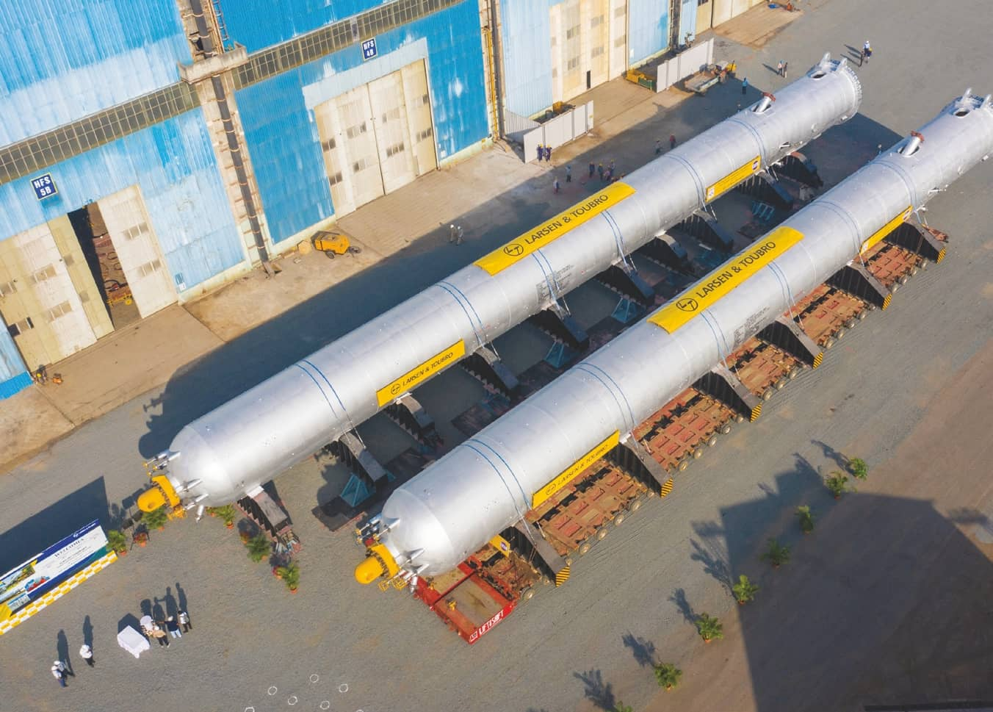
Project Detail: HPCL Vizag refinery revamp
Technology licensor: Chevron Lummus Global
Manufacturer: L&T Heavy Engineering
Key statistics:
3 reactors over 2300 Tons each
2 reactors over 1200 Tons each
Material of Construction: Cr-Mo-V
Source: LC-Max Reactor: Heaviest reactor in world by EIL, Vizag Refinery Modernization Project (psuconnect.in)

Slide 2
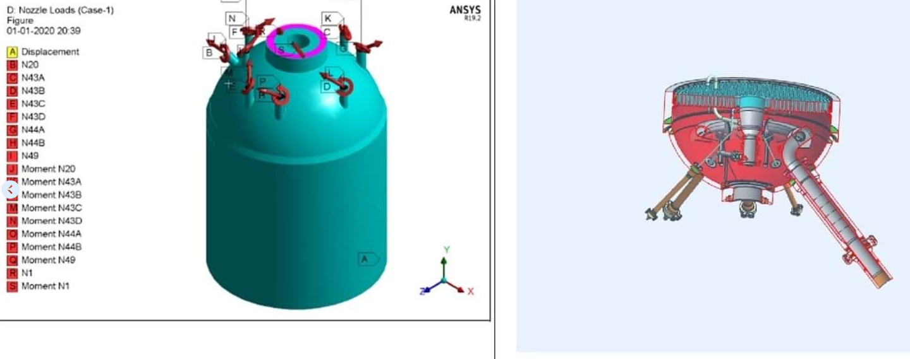
Stress analysis of Head & Nozzle junction ASME Section VIII Div 2
Key advancement:
Automated data acquisition using python scripts, reducing post-processing and report preparation times
Evaluated for protection against:
Plastic collapse
Thermal Ratcheting
Local failure
Fatigue accumulation
Source: Engineers India Limited added a... - Engineers India Limited (facebook.com)

Slide 3
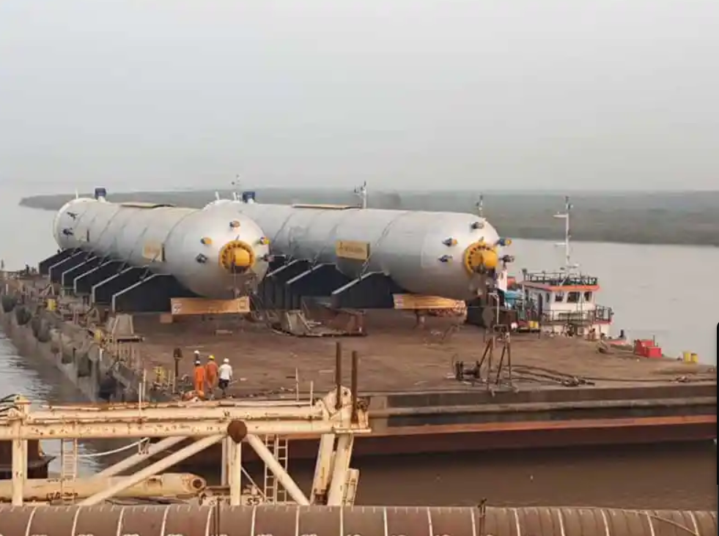
Reactor transportation simulation
Iterative design and optimization of transportation arrangement including:
Transportation load case evaluation (Handling, road transport, ocean transport)
Saddle design
Jack stools design
Source: LC-Max Reactor: Heaviest reactor in world by EIL, Vizag Refinery Modernization Project (psuconnect.in)
44211-LC-Max-Reactors.webp (800×600) (nbmcw.com)

Slide 4
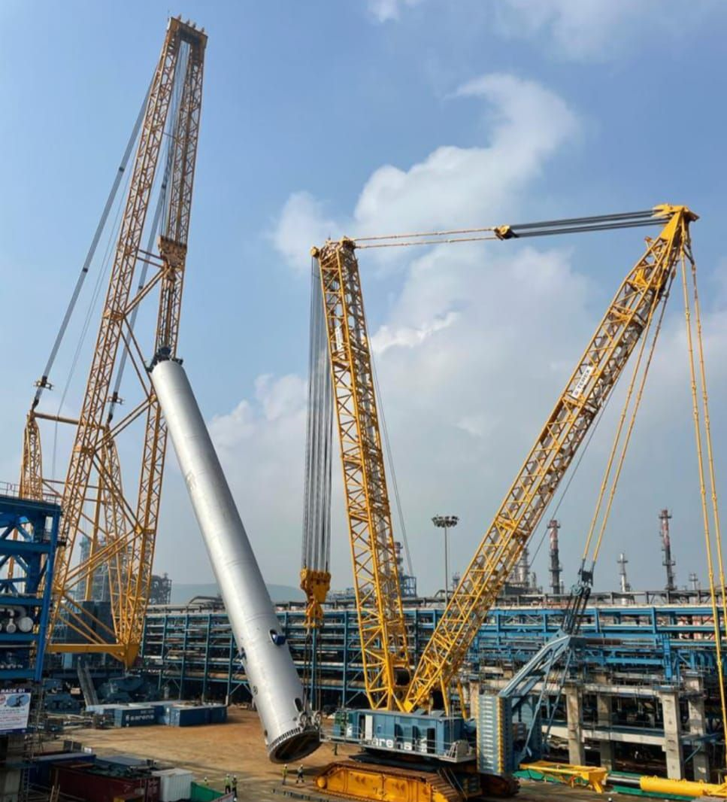
Reactor lifting simulation
Iterative design of following:
Top lug
Tailing lugs
Reactor stiffeners
New internal benchmark for lifting simulation:
Old method:
Stresses evaluated for 4 load cases only:
0°, max F_horizontal, max F_vertical, 90°
New method:
Prepared python script to evaluate stresses at every 5° increments (19 load cases) form horizontal to vertical
Advantages: Accurate simulation in similar time
Source: Post | Feed | LinkedIn

