Slide 1
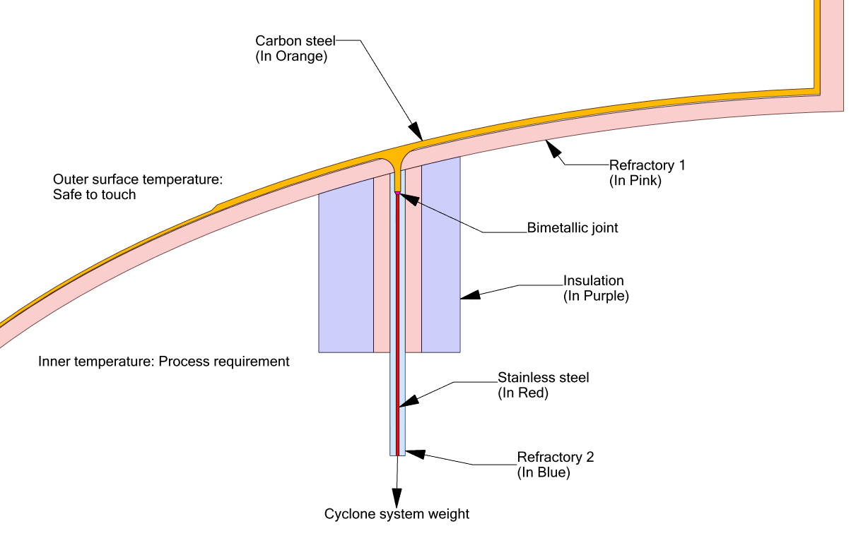
Bimetallic junction design for extreme thermal stresses
FCC Reactor and regenerator plenum to head junction
Challenge faced:
Contrary to intuition, increasing the thickness of high stress members will increase the stress further due to thermal gradients.
Solution:
1. Control structure stiffness by reducing as well as increasing thicknesses in different areas
2. Control thermal gradients by adjusting insulation thickness
Disclaimer: A simplified-representative sketch is created without use of any proprietary information
(Dimensions are assumed, Sketch is not to scale)

