Slide 1
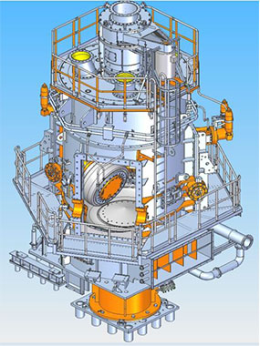
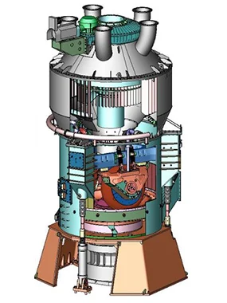
Lead Engineer – Separator Assembly
Pulverizer product engineering team – L&T MHI Power Boilers
Mitsubishi Design
B&W/Hitachi Design
Source: Mitsubishi Power | Pulverizers (mhi.com)

