Slide 1
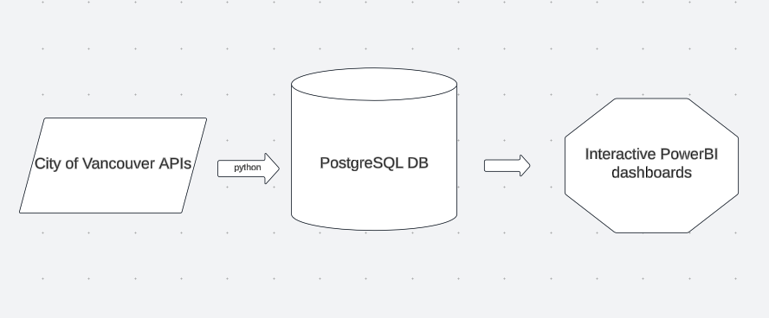
Automating Data Collection and Visualization for City of Vancouver Programs
Objective: Create a streamlined process that automatically fetches data, loads it into a PostgreSQL database, and visualizes it in Power BI.
Skills showcased: Python for data extraction, PostgreSQL for database management, and Power BI for data analysis and visualization.

Slide 2
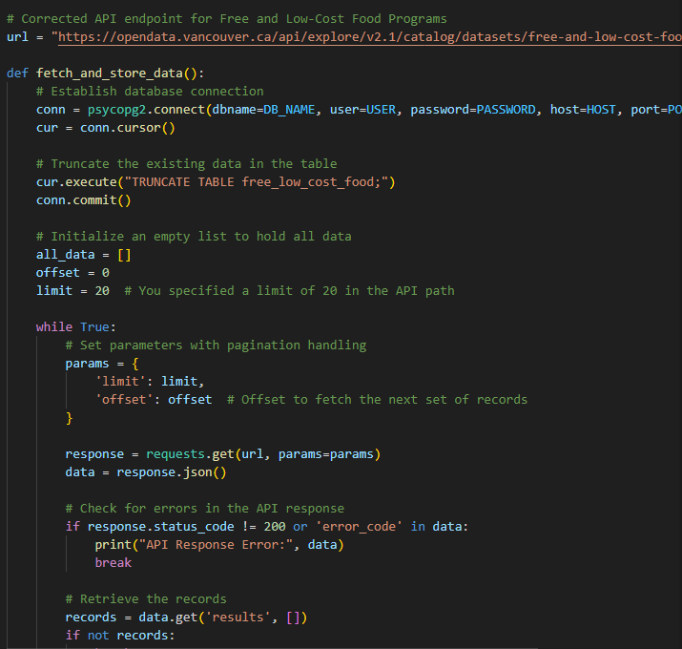
Data Extraction and API Integration with Python
Key steps: API requests with pagination handling to retrieve large datasets.
Data cleaning and transformation using Python (e.g., handling dates, booleans, and coordinates).
Error handling and data integrity checks (e.g., identifying and fixing data types like latitude/longitude and last update date).
Technologies used: Python, requests, json, psycopg2, geoalchemy2

Slide 3
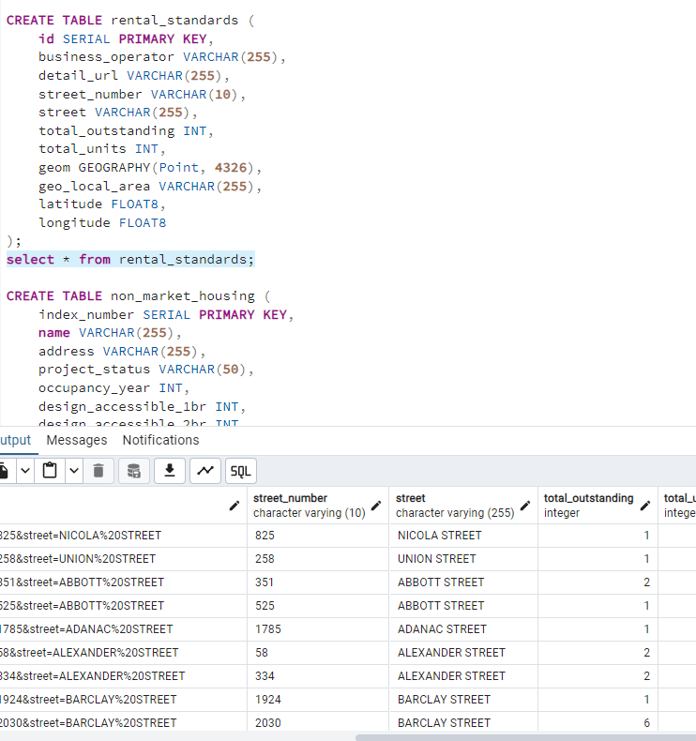
Database Management with PostgreSQL
Designing and creating normalized tables in PostgreSQL (e.g., tables for community gardens, free low-cost food programs, rental standards, etc.).
Handling data types for efficient storage and querying (e.g., timestamps, geometry data for latitude/longitude).
Automating ETL (Extract, Transform, Load) with Python scripts to regularly update the database.

Slide 4
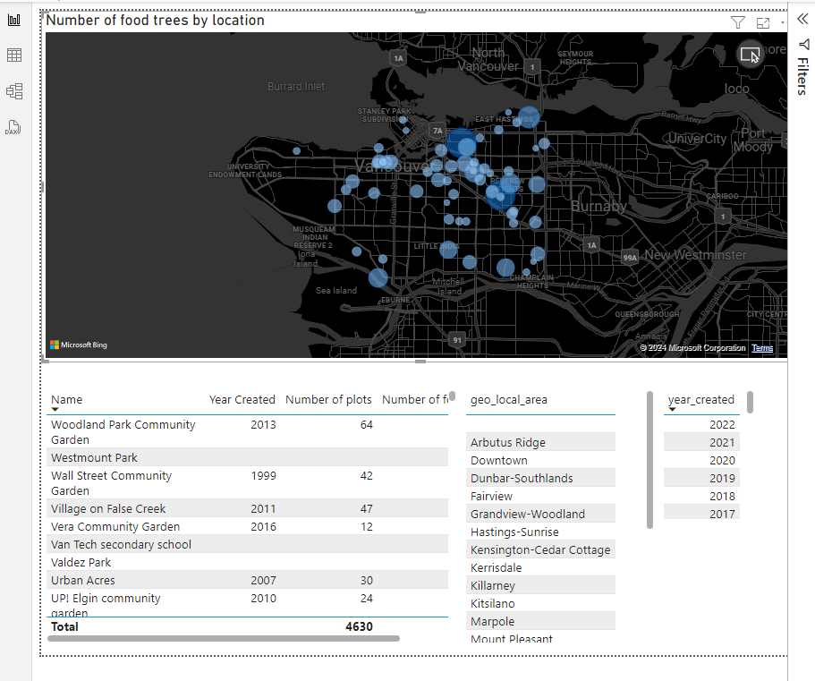
Interactive Power BI Dashboards
Interactive elements like slicers and filters to allow users to explore data dynamically
Example screenshot showcasing community garden locations and program distributions across geo-local areas.

Slide 5

Automation and Deployment Strategy
Overview of the full automated pipeline
Scheduling Python scripts to fetch and load data into PostgreSQL regularly.
Automating data refreshes in Power BI to keep dashboards up to date.
Strategy for maintaining data integrity (e.g., monitoring API changes, updating ETL scripts).
Key benefits of the solution
Scalable and repeatable workflow.
Real-time data analysis and visualization for stakeholders.

