Slide 1
Abstract Clustering
Dhruvin Patel

Slide 2
Preprocessing
Remove all non-letters or numbers
Lowercase all words
Remove stop words
Each word in the abstract was stemmed with PorterStemmer and lemmatize with WordNet from NLTK
Remove abstracts with less than 5 words

Slide 3
Different approaches
TF-IDF
Large vector space
Doc2Vec
Word2Vec

Slide 4
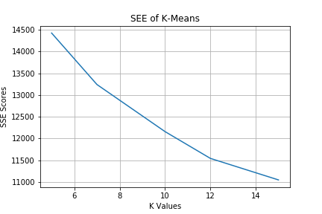
Doc2Vec

Slide 5
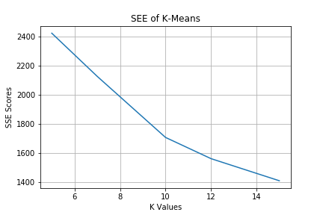
Word2Vec

Slide 6
DBSCAN
Eps: .13
Min points: 10
SSE = 6702.86
A lot of abstracts assigned to one cluster

Slide 7
Comparison
I think K-Means is better than DBSCAN
Lower SSE score
Better distribution of abstracts

