Slide 1




DATA CENTER
From Big Data to Big Success.

Slide 2





CONTENTS & Motive OF This Presentation
Here’s what you’ll find in this Data Presentation:
How can we solve our Math problems ?
How can we make our project better than good ?
How do we build our projects in less time ?
Try to make our project easily understandable to others ?
I Try My Best To You All Understand my presentation Verywell .
Our today’s Presentation is to build a machine learning model .
So Let’s Start Our Presentation .

Slide 3








Project STATEMENT
Will you get a loan or not?
What factors are responsible for getting a loan?
After taking the loan, the customer EMI on time or not .

Slide 4












TABLE OF CONTENTS
01
02
03
Project overview
Check Value
Outliers
Loans Apply And Get Loan
Cheak Value Null Or Not.
Find Outliers or Not.
or Not.
Filling Or Cleaning Value
04
05
06
Explain With Chart
Find IQRS
QNA
All Data Too Better
Find IQR All Columns.
There are a few questions
Understand With Charts.
and answers from across
the project
that we will look at

Slide 5










01
Project OVERVIEW
Loans Apply And Get Loan or Not.

Slide 6

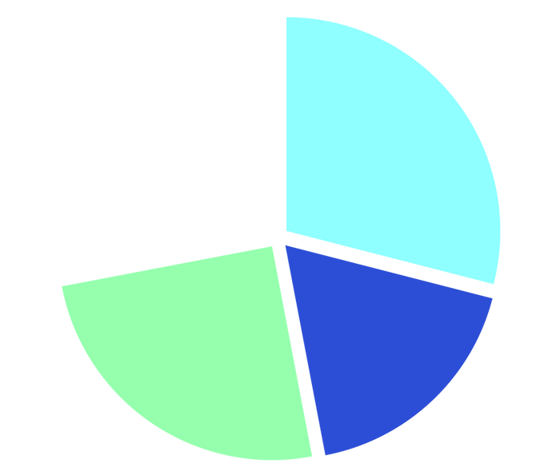


Project TRENDS
29%
28%
Data-Cleaning & Filling
Outliers
25%
18%
QNA
IQR

Slide 7






Project Shorts
import pandas as pd import matplotlib.pyplot as plt
import seaborn as sns import numpy as np import warnings
warnings.filterwarnings("ignore")

Slide 8
Project Shorts
Loan_ID
0
Gender 13
Married Dependent Education
13
03
15
00
Self_Employed
ApplicantIncome
CoapplicantIncome LoanAmount
32
00
00
22
Loan_Amount_Term
Credit_History Property_Area Loan_Status
14
50
00
00

Slide 9








02
Check Value ANALYSIS
Null Or Not

Slide 10
Import File And Analysis With Functions
df = pd.read_csv('Loan Data.csv')
df.head()
df.smaple()
df.describe()
df.info()
df.Shape

Slide 11
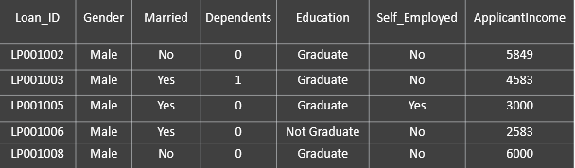
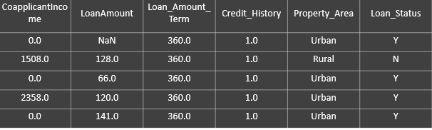

Slide 12
Cleaning Or Filling Data
&
Convert Data Type To be Desverd
Measures of central tendency Mean : Avrage Of Value.
Median: Middle value when the data set. Mode: Howmany Times Repeat The Data.

Slide 13
Project Shorts
Loan_ID
00
Gender 13
Married Dependent Education
00
00
00
00
Self_Employed
ApplicantIncome
CoapplicantIncome LoanAmount
00
00
00
00
Loan_Amount_Term
Credit_History Property_Area Loan_Status
00
00
00
00

Slide 14
03
Find Outliers or Not.
Something & Something Not..

Slide 15
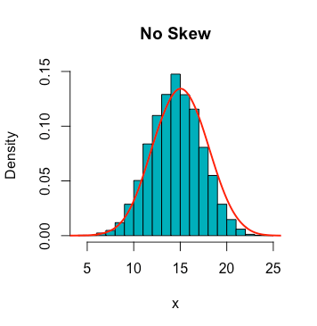
skew(): A statistical measure of asymmetric
distribution of data
df['ApplicantIncome'].skew()
df['CoapplicantIncome'].skew() df['LoanAmount'].skew()

Slide 16
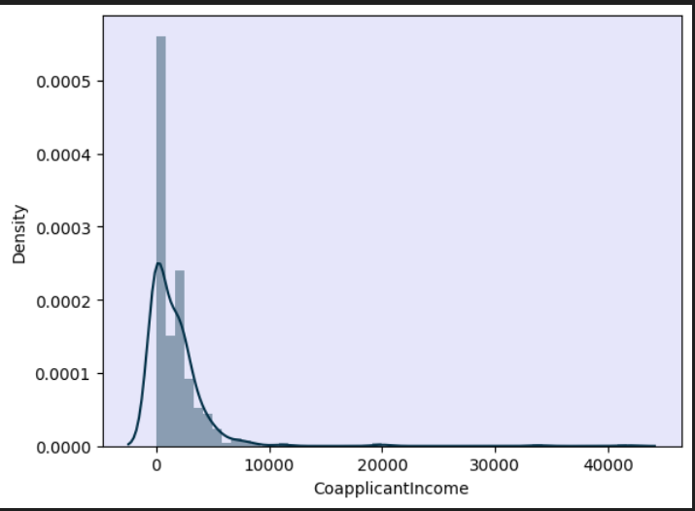
FIND OUTLIERS OR NOT WITH DISTPLOT
CHARTS
Coapplicantincome

Slide 17
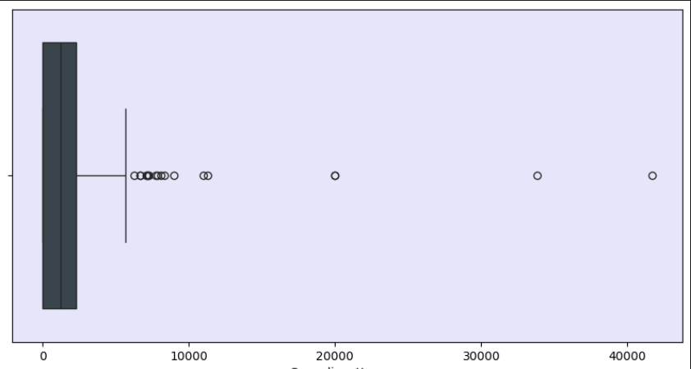
Describe With Boxplot CHARTS .

Slide 18
03
Find IQR.
Better Analysis ..

Slide 19

FINDING THE IQR ALL COLUMNS.
iqr = per75 - per25 upper_limit = per75 + 1.5 * iqr
lower_limit = per25 - 1.5 * iqr
df[df['Col_Name'] > upper_limit]
Print The Full List Of > Upperlimit
df[df['Col_Name'] < lower_limit]
Print Blank List

Slide 20
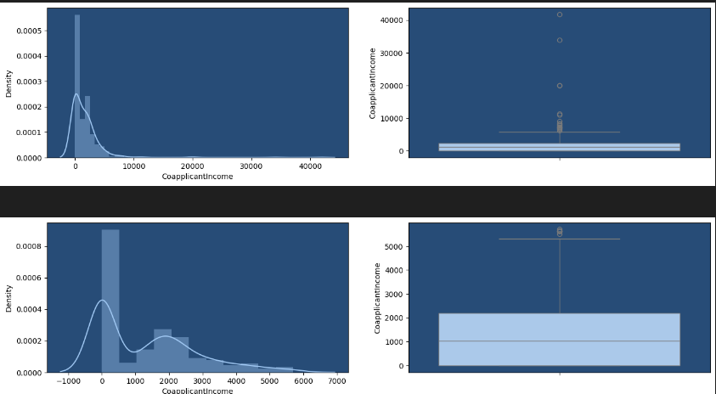
trim_df =df[df['Col_Name'] < upper_limit]

Slide 21
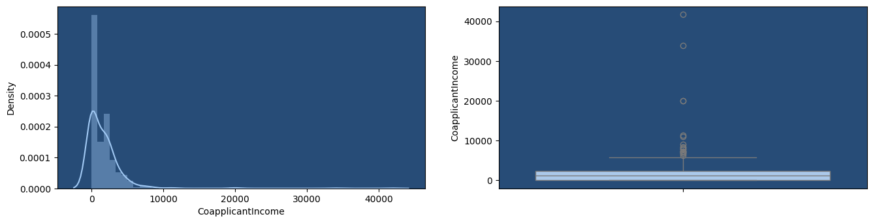
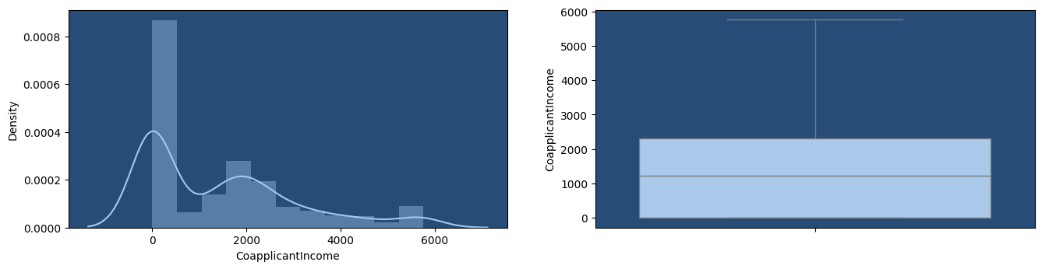
Cap_df

Slide 22
04
QNAS .
From the Teaching of Data Analysis..

Slide 23











QNAS
Married
Yes or No
Gender
Male or Female
Dependents
Howmany Depents on One Person
Education
Graduate or Not Graduate.
Self_Employed
Yes Or No
credit history
Good Or Bad.

Slide 24
QNAS
Property
Loan status
Which Place
Deal Or Not Deal .

Slide 25
How many are married and how many are not ?

Slide 26
How many Male & Female?

Slide 27
How many people depend on one person ?

Slide 28
How many people are graduate or Not?

Slide 29
Where is people's property area?

Slide 30
What is the loan status of people ?

Slide 31










Thanks!
Dhruvin Dhameliya

