Slide 1
Order Processing System
By The Semicolons

Slide 2
Problem Statement
To create an application for an Order Management System. Create profiles for Customers and Employees alike, and give them the ability to create Quotes/Orders and Generate Invoices.

Slide 3
Introduction
An Order Processing System provides a comprehensive interface to connect Companies to prospective Customers
Through our system, the Employees create a Quote for an Order.
If the Order satisfies the Customer's needs, an Invoice can be generated

Slide 4
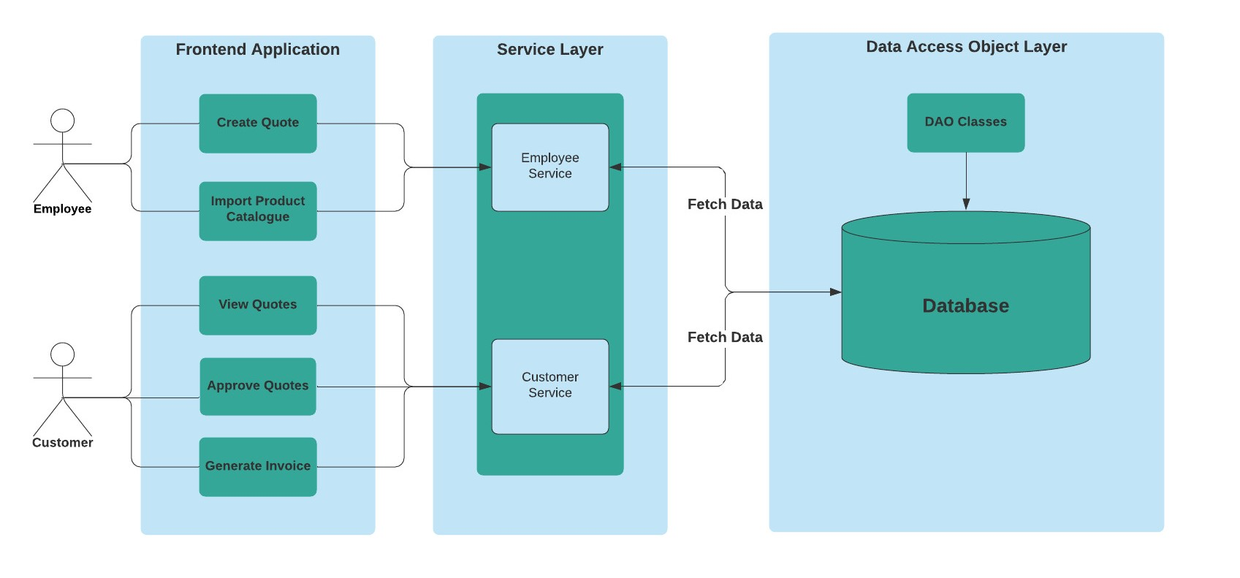
High Level View

Slide 5
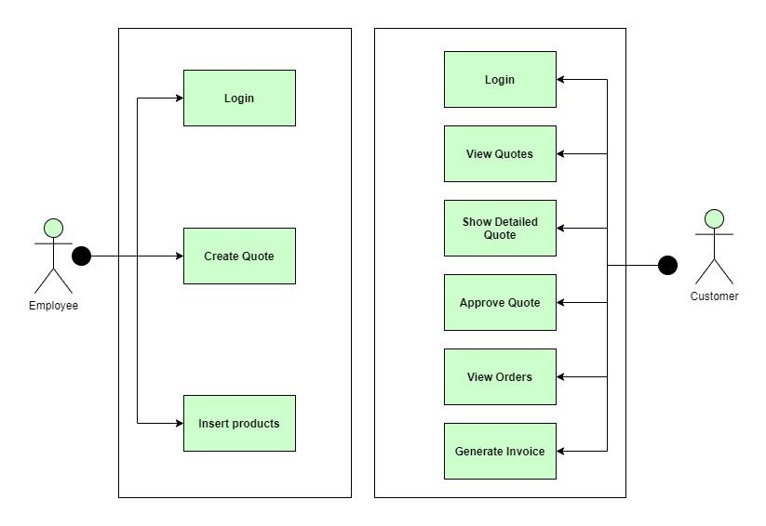
Use Case Diagram

Slide 6
Scope
Employee
Create a new Quote for a specific Customer by selecting Products
Ability to import Products from a JSON file
On creation of a quote, Shipping Cost and GST is automatically generated

Slide 7

Employee Workflow

Slide 8
Scope
Customer
Can view a list of Quotes(Status : Pending) and Orders(Status : Approved)
Can view a Detailed Quote and Approve it
Can generate the Invoice for an Order
Can download a PDF of the Invoice

Slide 9
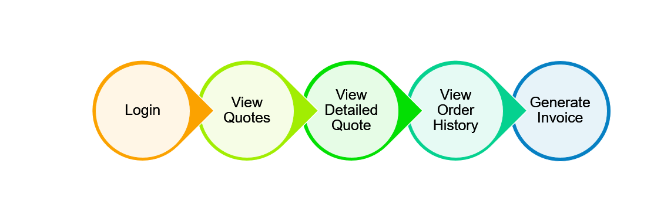
Customer Workflow

Slide 10
Technology Stack
Frontend : HTML, CSS, Bootstrap, JavaScript, AJAX, JSP
Backend : Servlets, Java, MySQL
Apache Tomcat Server
Data Interchange Format : JSON
Dependencies -
JDBC Connector
Jackson Library
JSTL Functionality

Slide 11
Future Scope
Give Employee rights to create a new Customer and enter details.
Give Customer an option to select their Order on their own.
Add third-party Payment Gateway APIs.
Add images for the product catalogue.

Slide 12
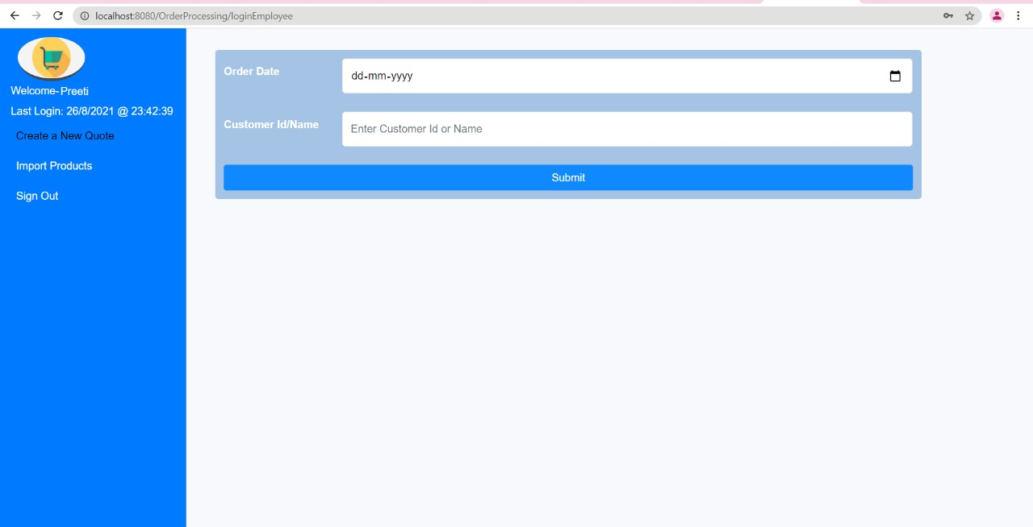
Screenshots

Slide 13
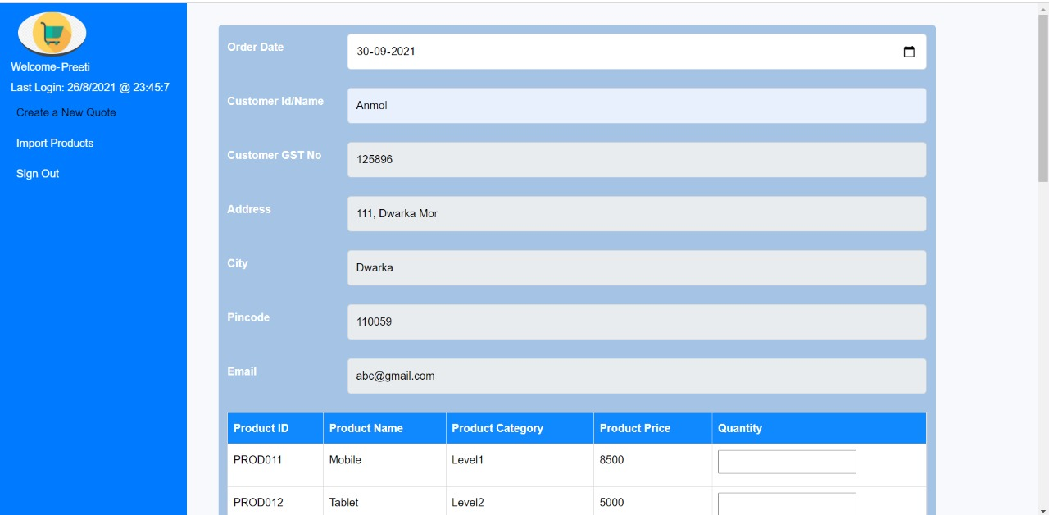
Screenshots

Slide 14
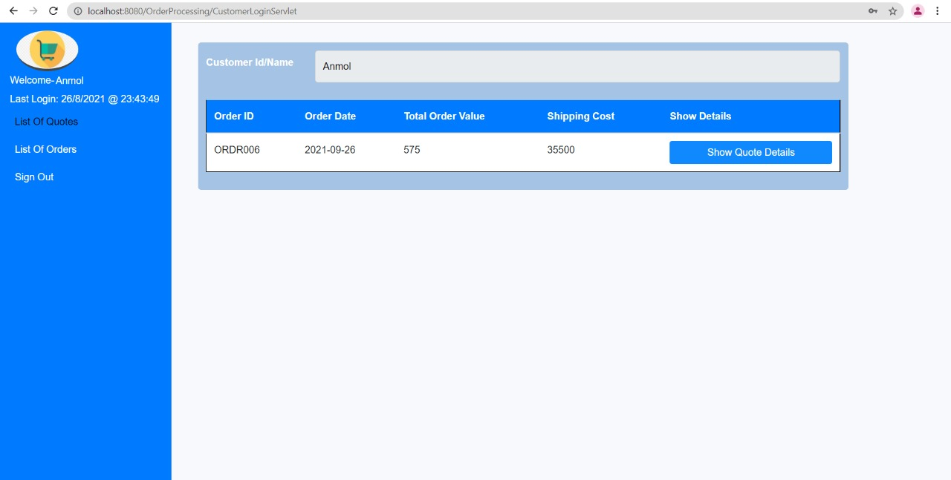
Screenshots

Slide 15
Important Links
Project Repository | https://github.com/dhruvinamdar/TheSemicolonsProject
Demonstration Video
Documentation

Slide 16
Conclusion
We were able to successfully create a Dynamic Web Project for an Order Processing System according to the Software Requirements
All the specifications were mapped and the application passed all the required test cases

Slide 17
Team Members
Preeti Hinwal
Vedant Puranik
Amol Gandhi
Dhruv Inamdar
Tejal Lolap
Simran Goel
Apurva Shukla
Shrashti Padarha
Kanushka Gupta
Varsha Shukla

Slide 18

Thank You

