Slide 1
C# or COOL

Slide 2
Introduction
Developed in 1999 in Microsoft,
Named as COOL first C Object Oriented Language.
Anders Hejlberg – Developer
Strongly Types Language – checks type specifications for objects
Object Oriented – OOPS Features
Encapsulation, Polymorphism, Message Passing
Classes, Objects, Inheritance
Component Oriented – Custom components
Like Library Classes
Packages for reuse
Unified Type System – One root for all types i.e. Object

Slide 3
Visual Studio
Link for software:-
https://www.visualstudio.com/downloads/#d-community?wt.mc_id=DXLEX_EDX_DEV204X

Slide 4
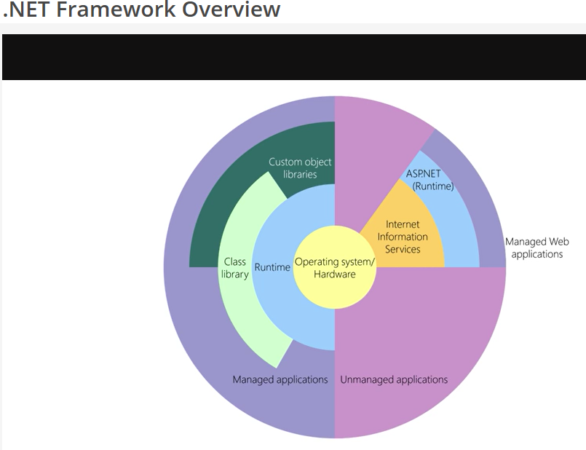

Slide 5
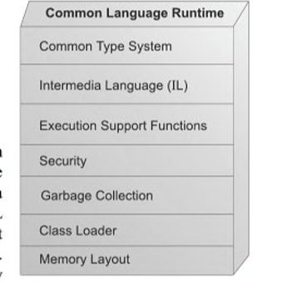
CLR
Common Language Runtime
Managed Applications
.Net & Azure Applications
Unmanaged Applications
Support managed Applications
Just-in-time Compiler
Memory Management
Remoting
Thread Management
Type Safety & Security
Robustness

Slide 6
Visual Studio 2012 IDE
Code Autocomplete
Inteli-sense
Indentation of code
Keywords and coding color marking
Xamarin – to develop
Window, IOS and Android Apps
Link:- https://www.xamarin.com/platform
Easy deployment of code over
Mobile Devices
Web-Server
Cloud etc.

Slide 7
MONODEVELOP
Allows to write Desktop or Web Applications
It Provides
Multi-Platform Support
Code Completion
Integrated Debugger
Visual Debugger
Source Control
Unit Testing
Packaging and Deployment
Link:- http://www.monodevelop.com

Slide 8
Textpad
Editor for writing C# applications.
Requires Manual Debugging and Deployment.
Compilation will be possible with Command line tools.
Manual management of multiple files
Link :- http://textpad.com/download/index.html

Slide 9
Notepad
Notepad or Notepad++ both can be used to write C# code.
Notepad requires command line compiler named
Csc.exe compiler required
Notepad++ is much better than Notepad as it provides many benefits
Intellisense
Autocomplete code
Code Indentation
Syntax highlights

Slide 10
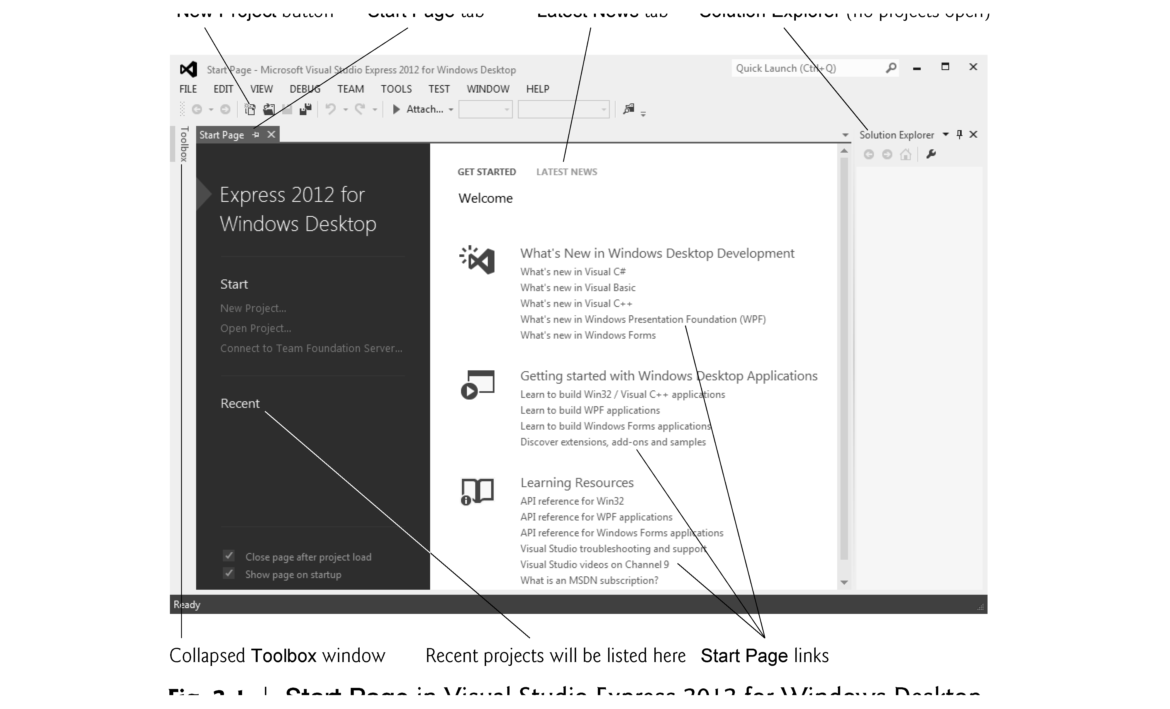
A Tour to Visual Studio

Slide 11
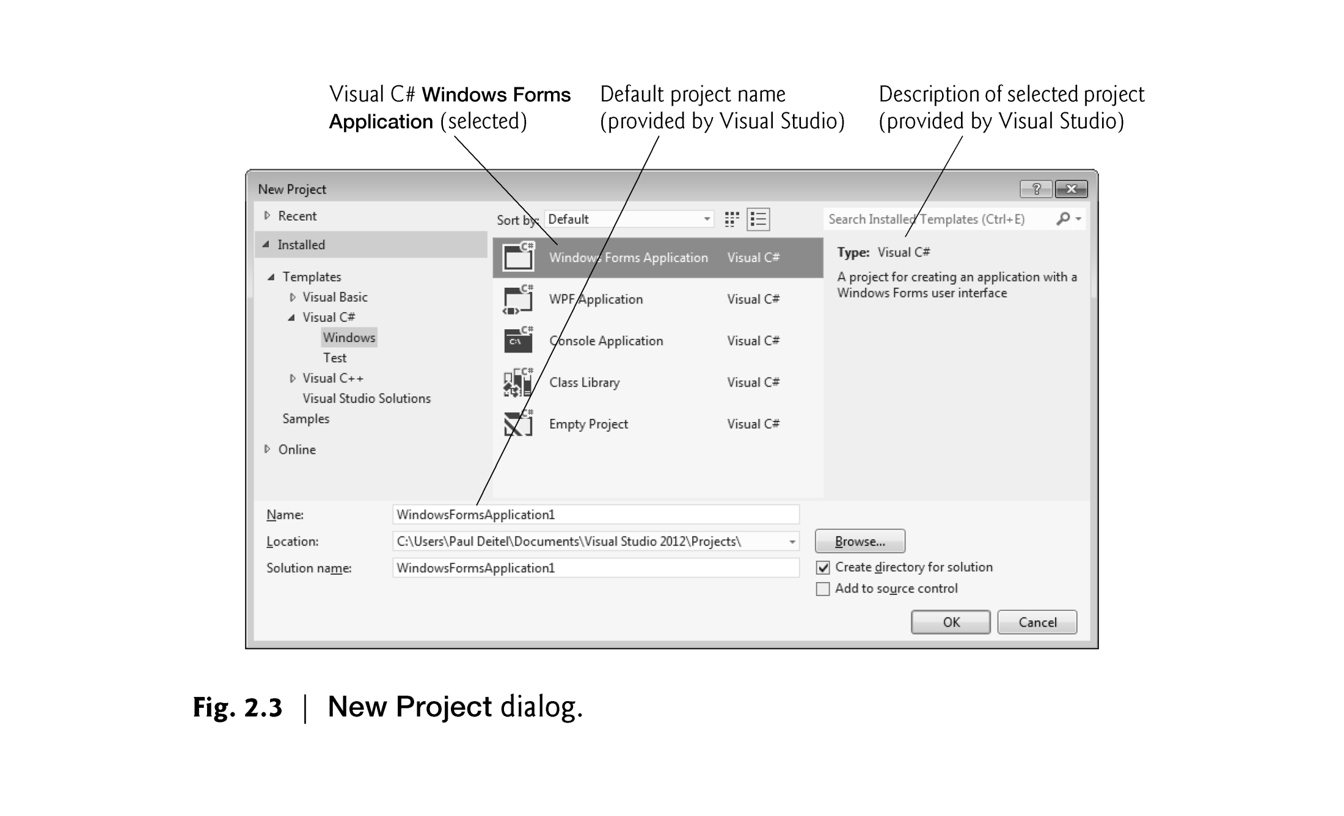

Slide 12
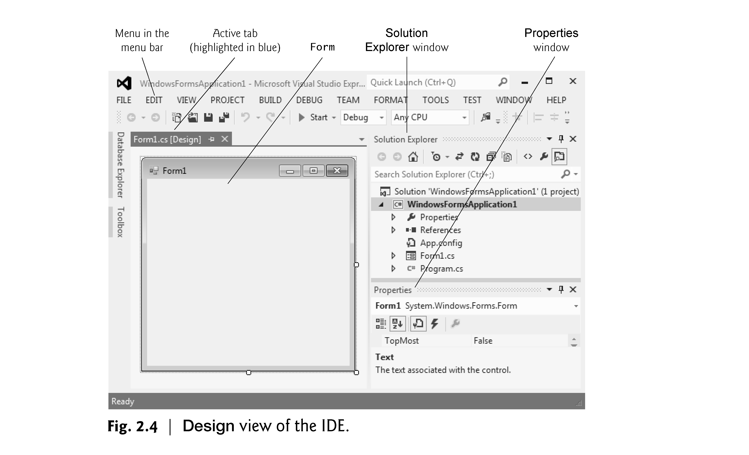

Slide 13
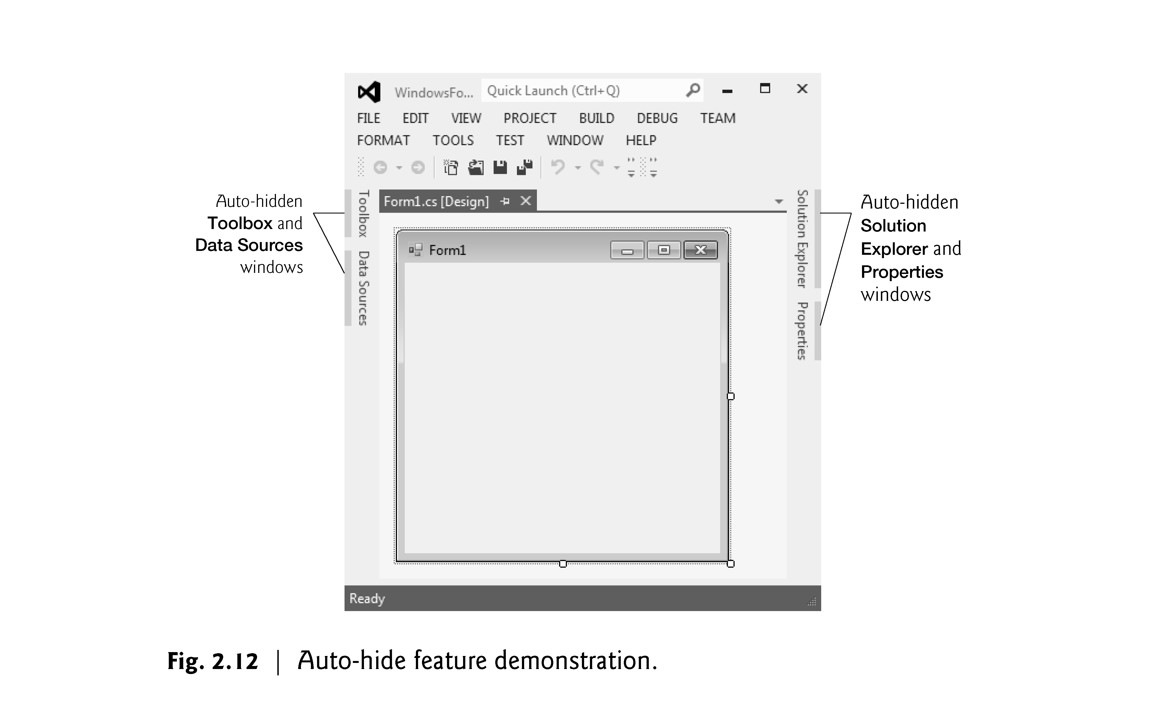

Slide 14
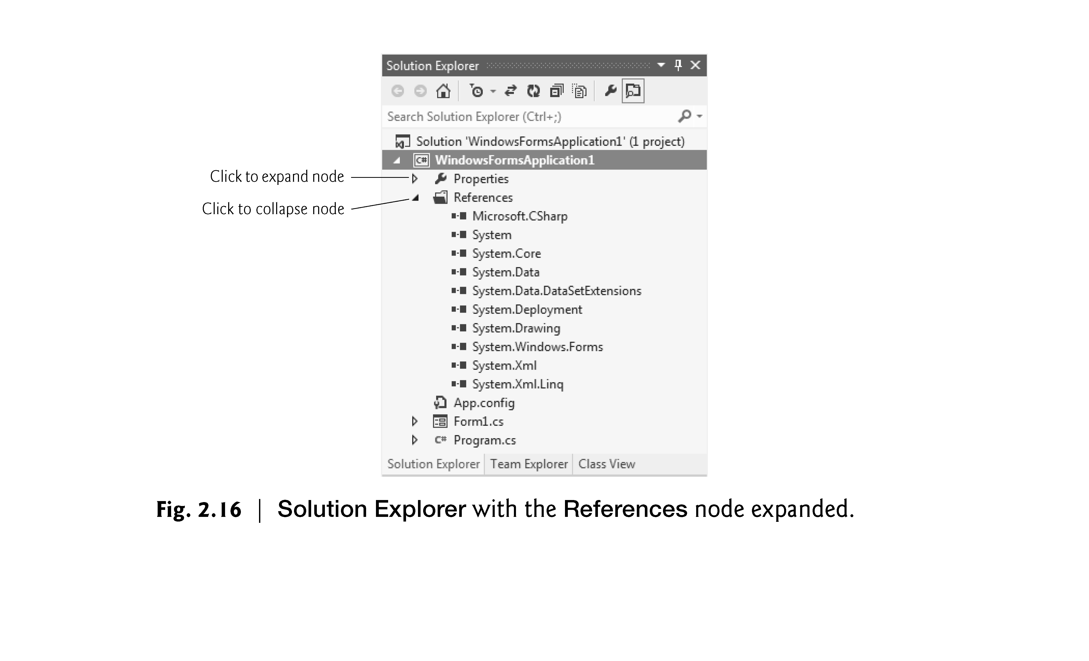

Slide 15
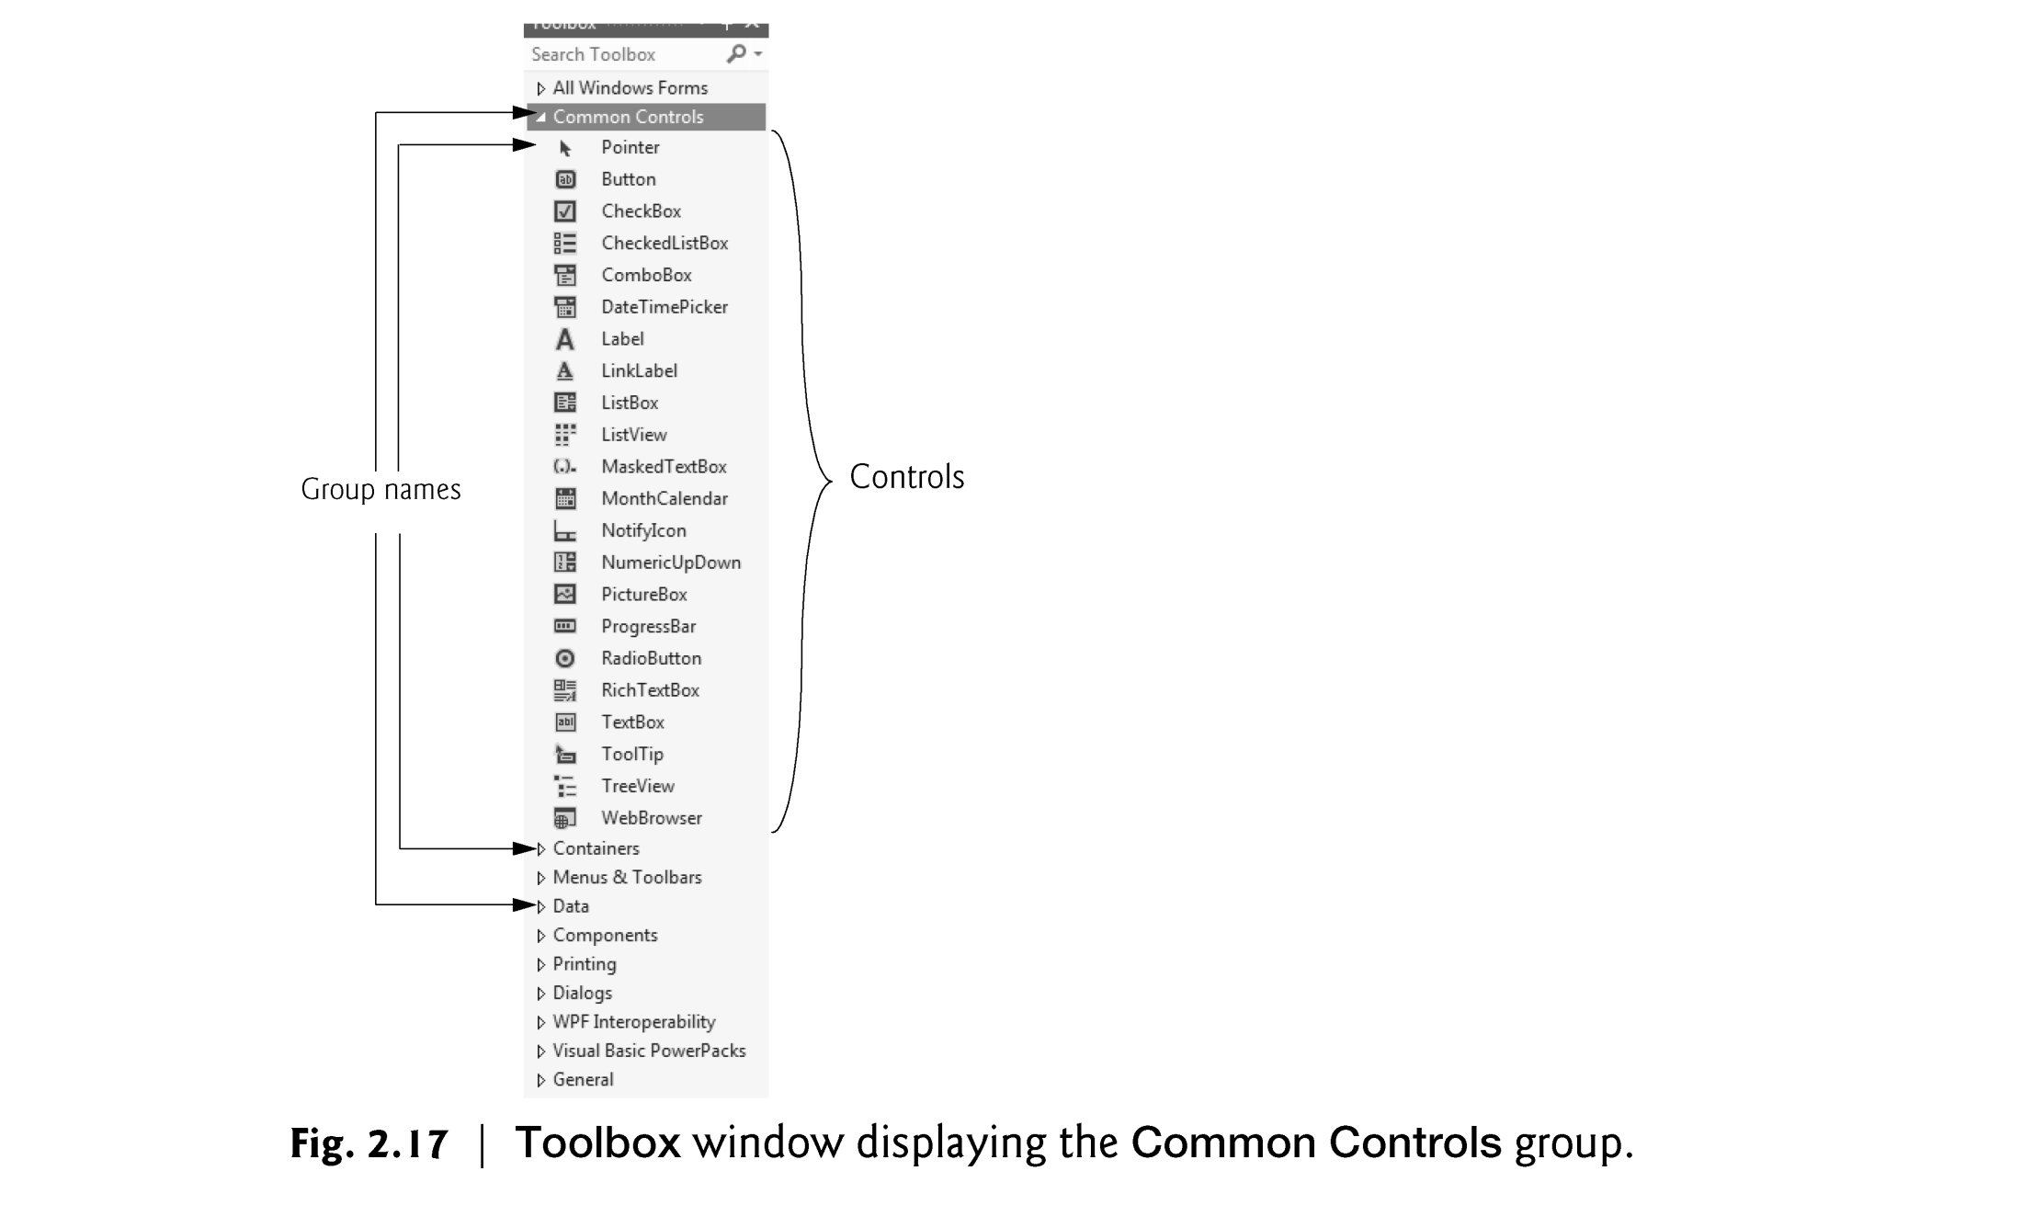

Slide 16
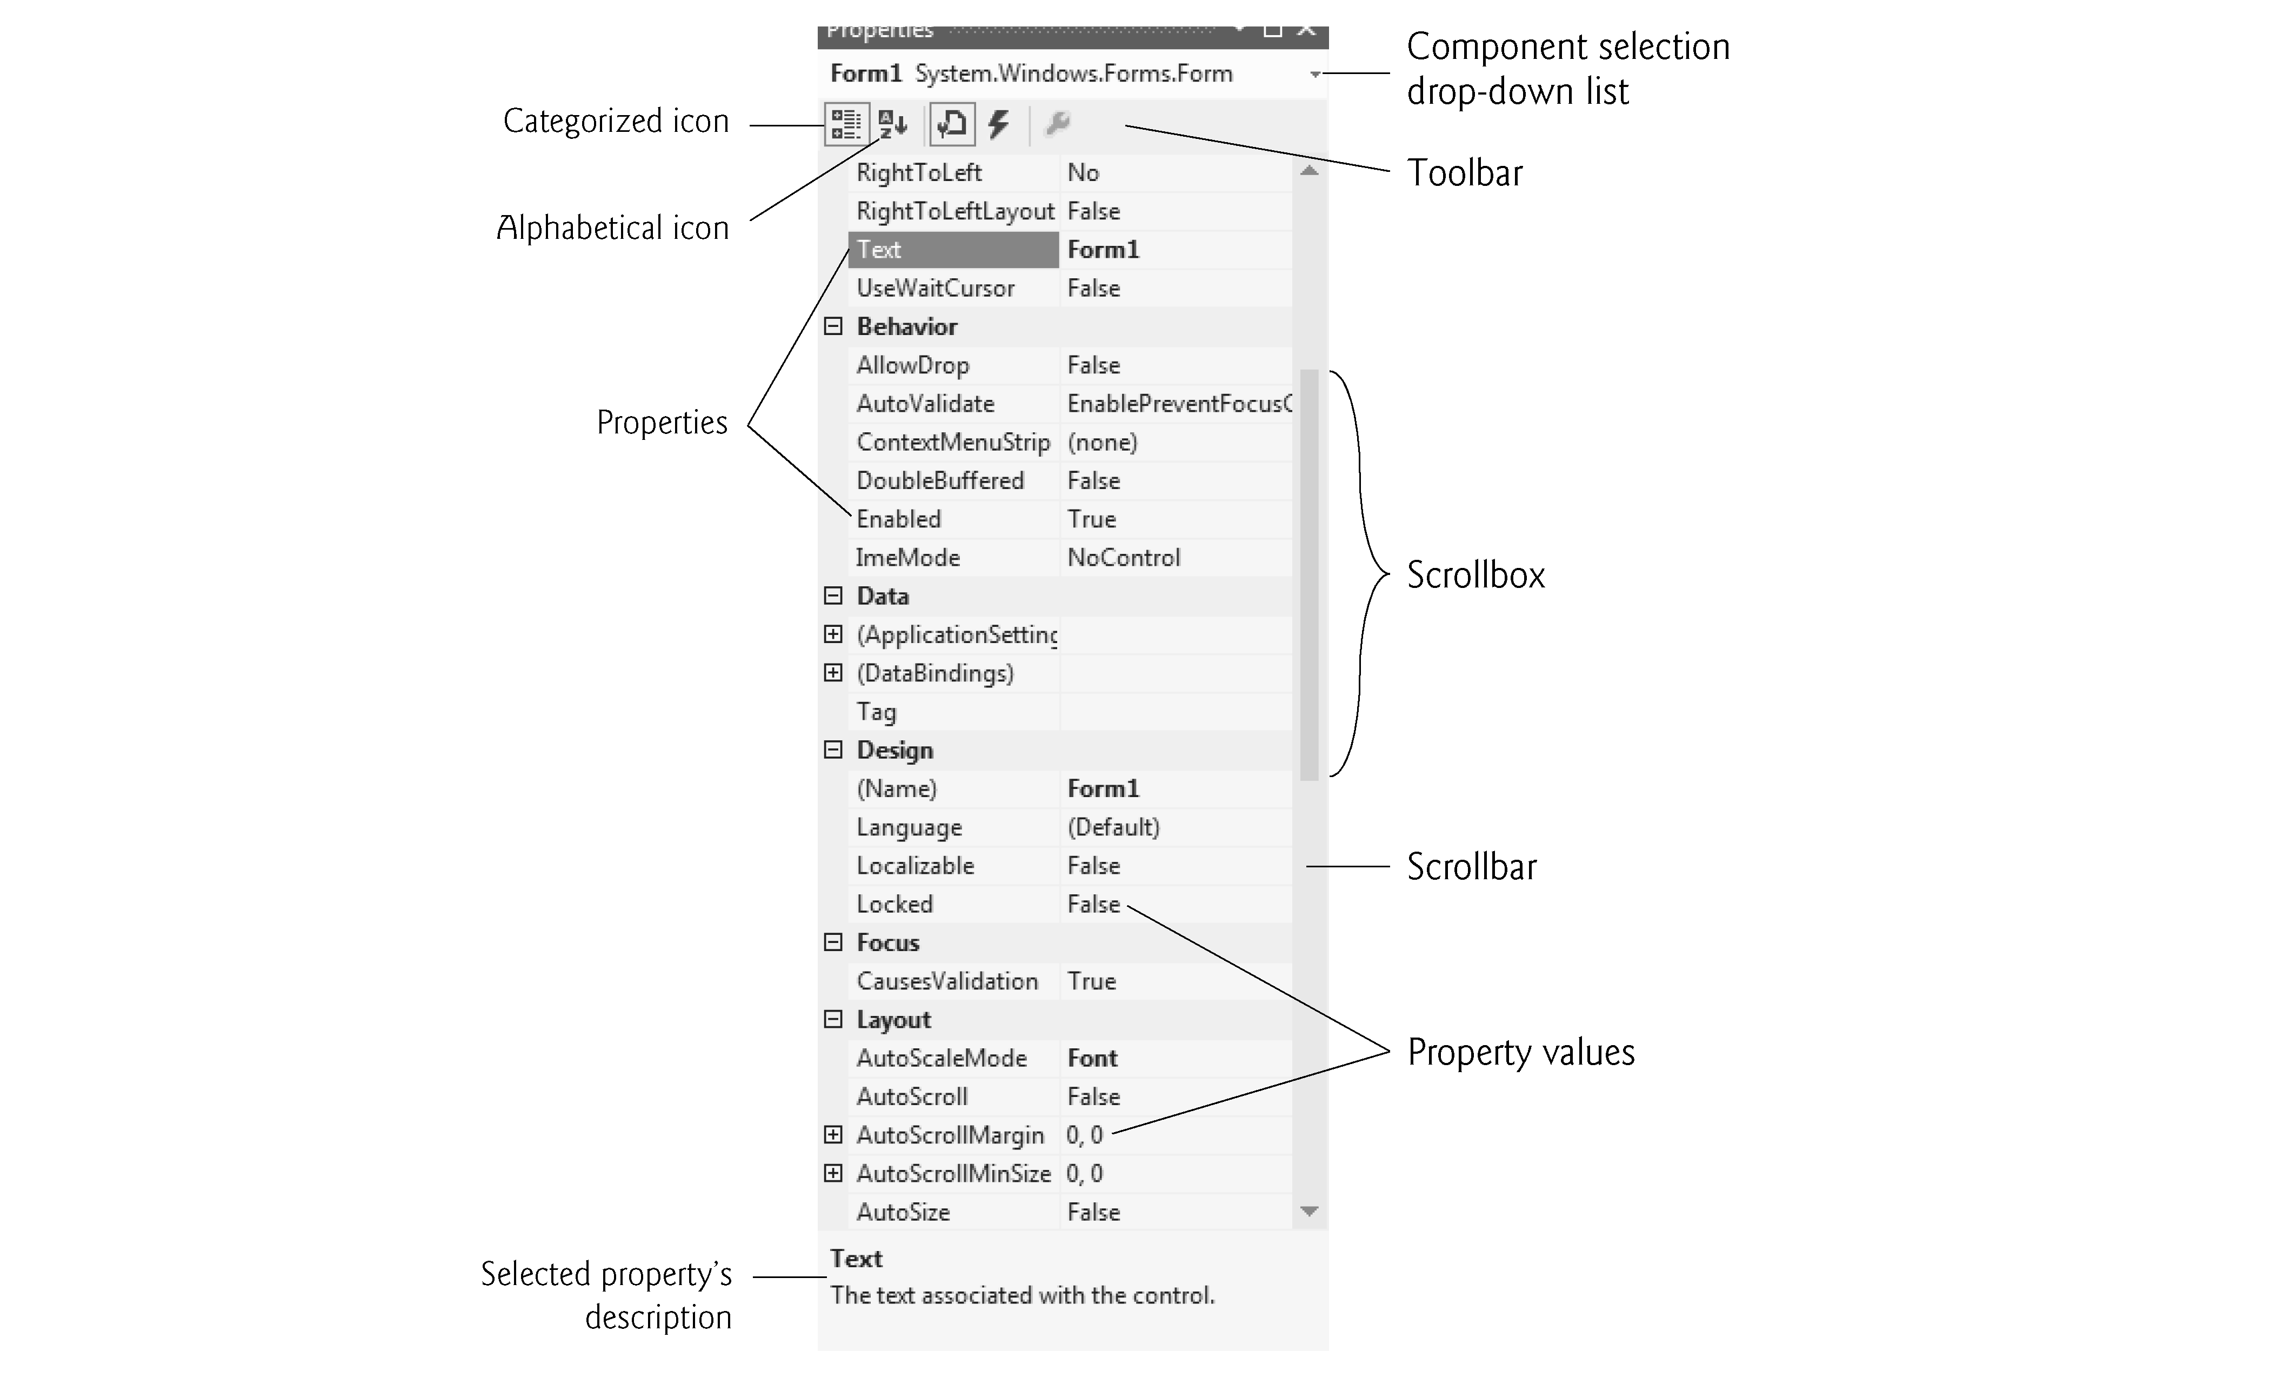
Properties Window

Slide 17
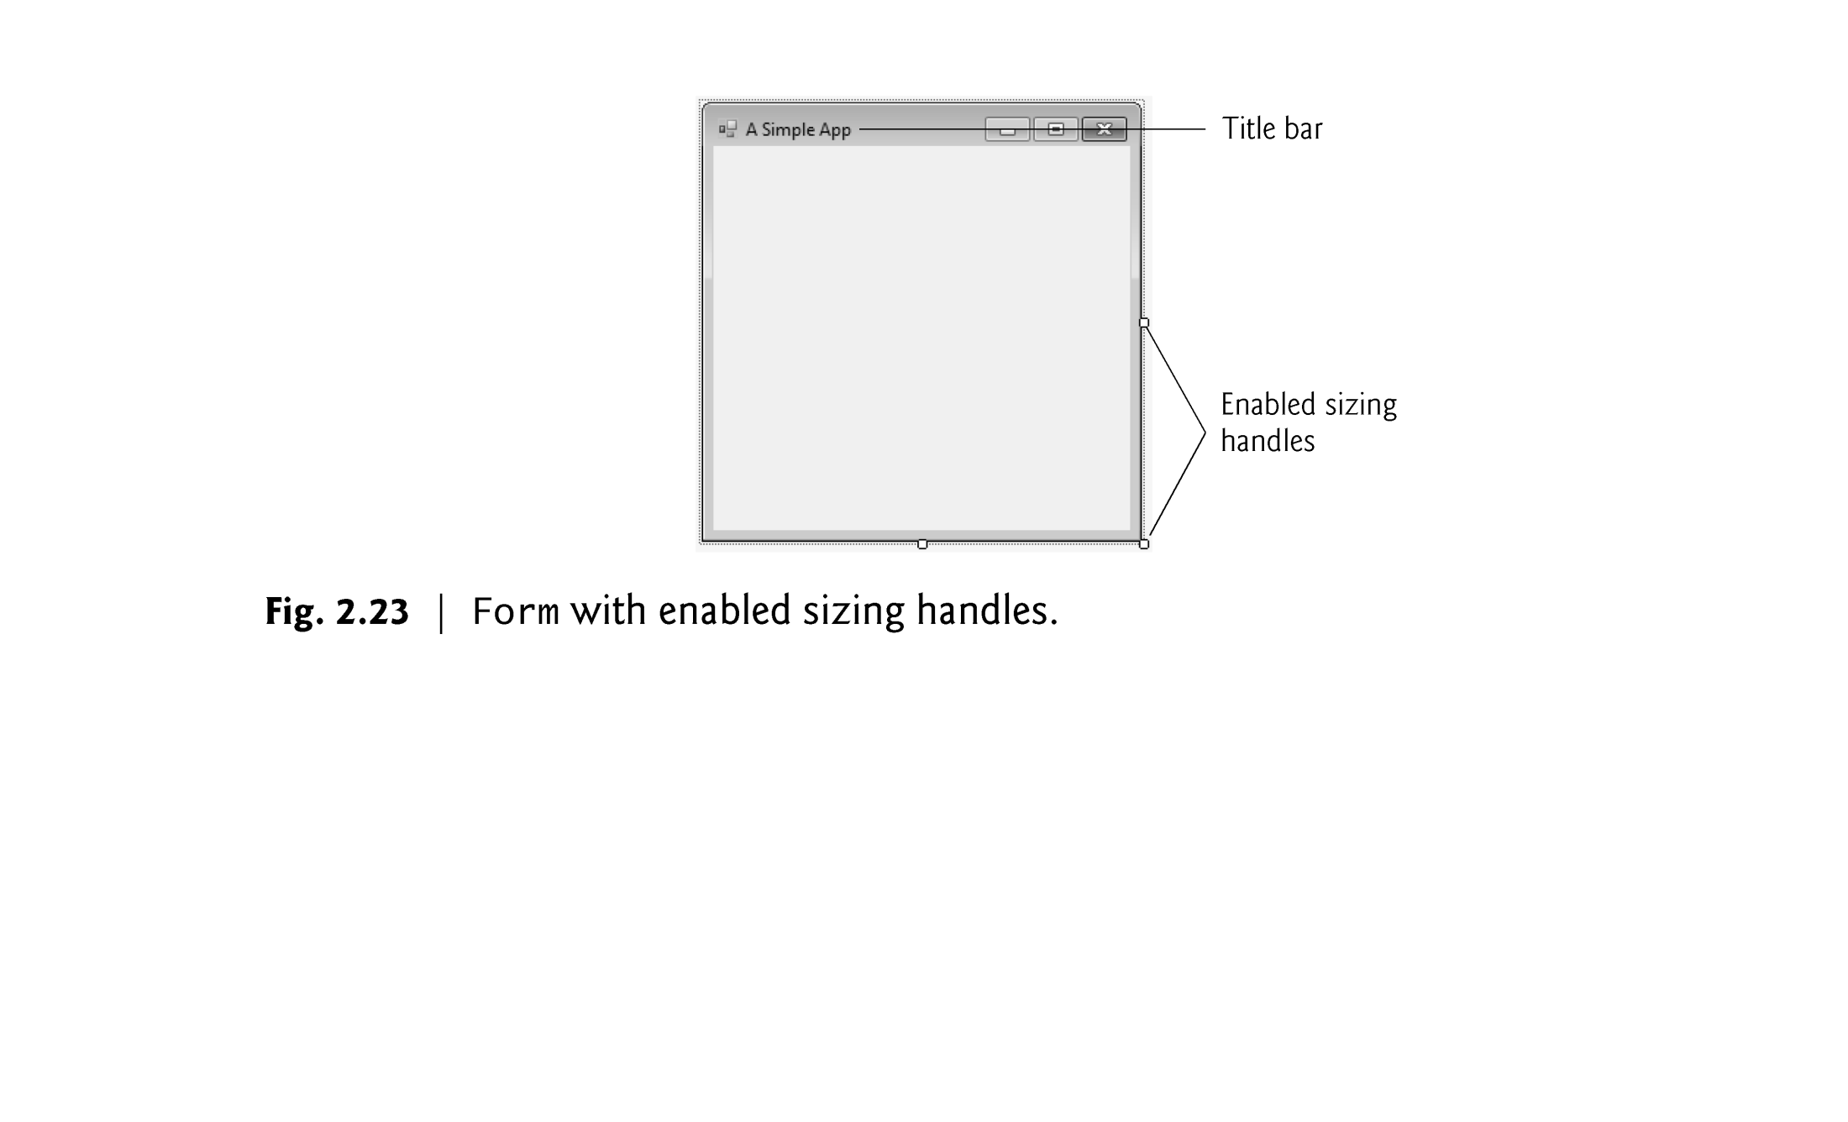

Slide 18
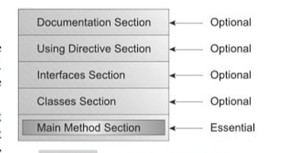
C# Program Structure

Slide 19
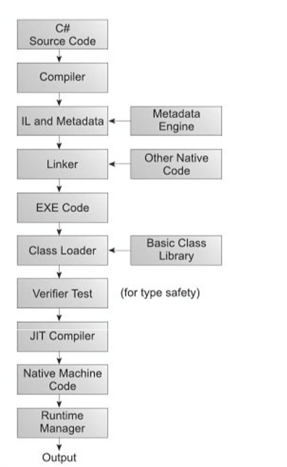
Program Execution steps

Slide 20
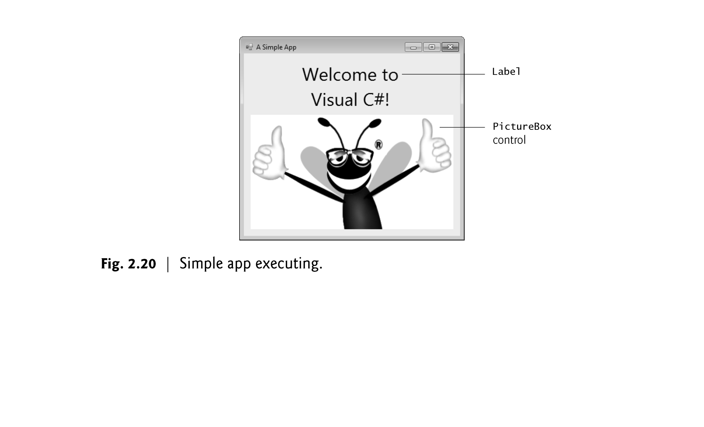
Lets Create new App GUI

Slide 21
Properties to deal with…
Make sure
Give appropriate names
Properties – Label
Name, text
BackColor
Font – Size, bold, font family
Autosize – Switch True/False
TextAlign – Middle Center
Size
TextAlign
Properties of - Image
Background Image – Pic should be either Background Image/ Image
Image – Image Resource
SizeMode – Stretch Mode

Slide 22
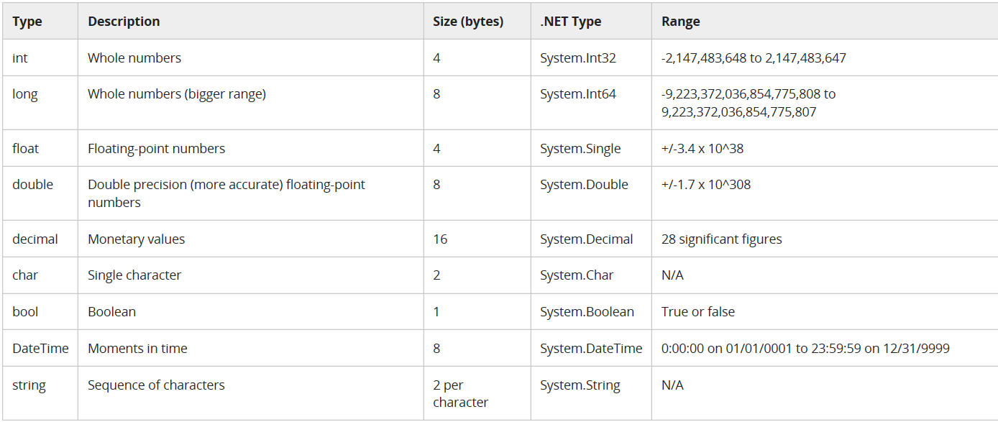
Datatypes

Slide 23
Few Familiar terms
Identifiers
Namespaces
Classes
Methods
Variables
Constants
Variables
Keywords
comments

Slide 24
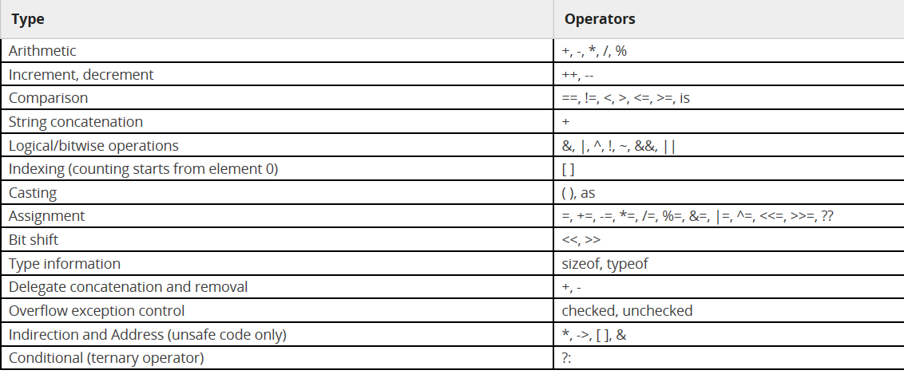
Operators

Slide 25
Type Conversion
Implicit
Explicit
Narrowing
Widening
Widening can be done anyways
(long)intnumber
Convert.ToInt32(num);
double value=3.2;
Int32.TryParse(value, out number) – return Boolean
Int n=Int32.parse(value)

Slide 26
Shortcuts
Run code
Cntrl + F5 -- console Application and GUI both
Uncomment code:
Select code
Press Cntrl + k
Comment code
Select code
Press cntrl + k + c

Slide 27
TEST YOURSELF – Console Methods
Console.WriteLine(“msg”);
Console.WriteLine(“value of x is {0}”,variable);
Console.ReadLine();

Slide 28
What datatype you will use to store currency values in your App?
Long
Double
Decimal
Float
Your Answer?

Slide 29
Test your Skills

Slide 30
Which operator is overloaded in C# to allow string concatenation?
. (dot)
+ (Plus)
++
Your Answer?

Slide 31
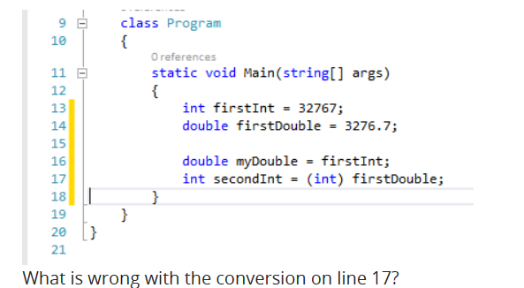

Slide 32
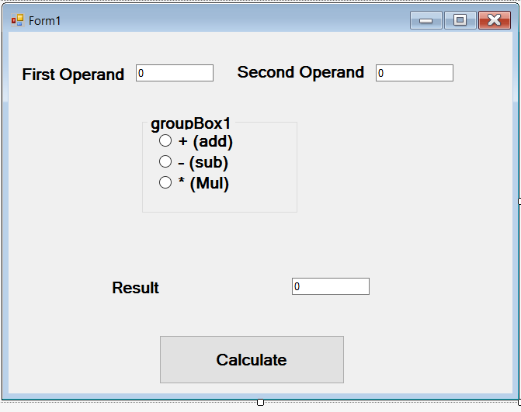
Create GUI and make it working

Slide 33
Try it Yourself -- Operators
Blackboard → Introduction to C# → MathOpeartor.zip file → download and run solution file in Visual Studio using
File Menu → Open → Project/ Solution → upload solution file
Run this file and observe the output, do necessary changes and make it working.

Slide 34
Try it yourself
Open Primitive Data Types exercise yourself
Select datatype in given list box, and see the sample data.
Some code is not working, Make it working, so that all datatype should show sample values for given datatypes

Slide 35
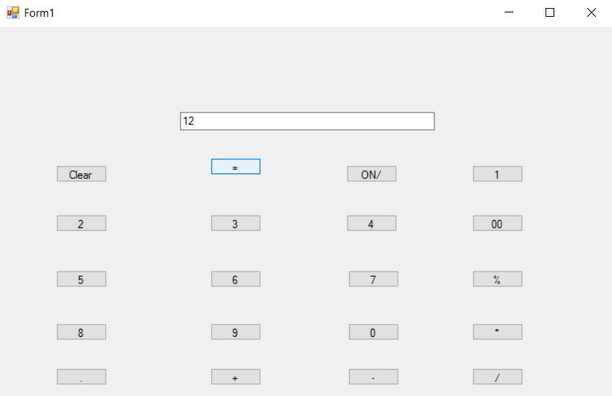
Lets create Calculator Altogether

Slide 36
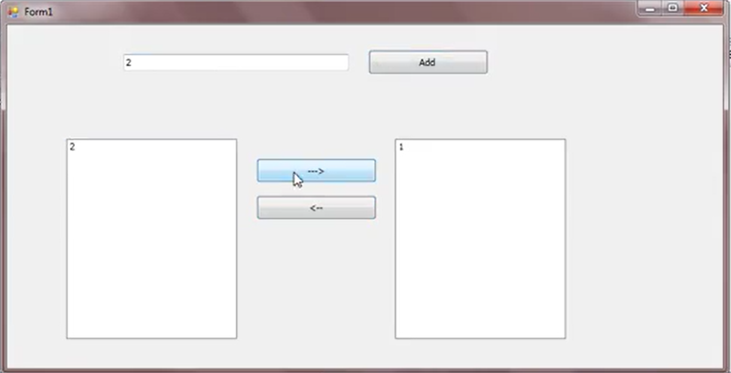
Lets Play with Listbox

Slide 37
Listbox
Listbox.items.add(String); // to add item to listbox
Listbox.items.remove(listbox.selecteditem); //to remove selected item from listbox
Listbox.Items[index]; // to access element at a given index
Listbox.SelectedItem; // to display selected item from a listbox
MessageBox.show(“”); // to display the message window to user
For InputBox follow given steps:-
Interactiion.InputBox(prompt,title,def value,xpos,ypos);
Right click on project → add → references → Microsoft visual basic
After adding it use namespace
Using Microsoft.Visualbasic;

Slide 38
Lab Assignment
Name Guess Game using ListBox…….

