Slide 1
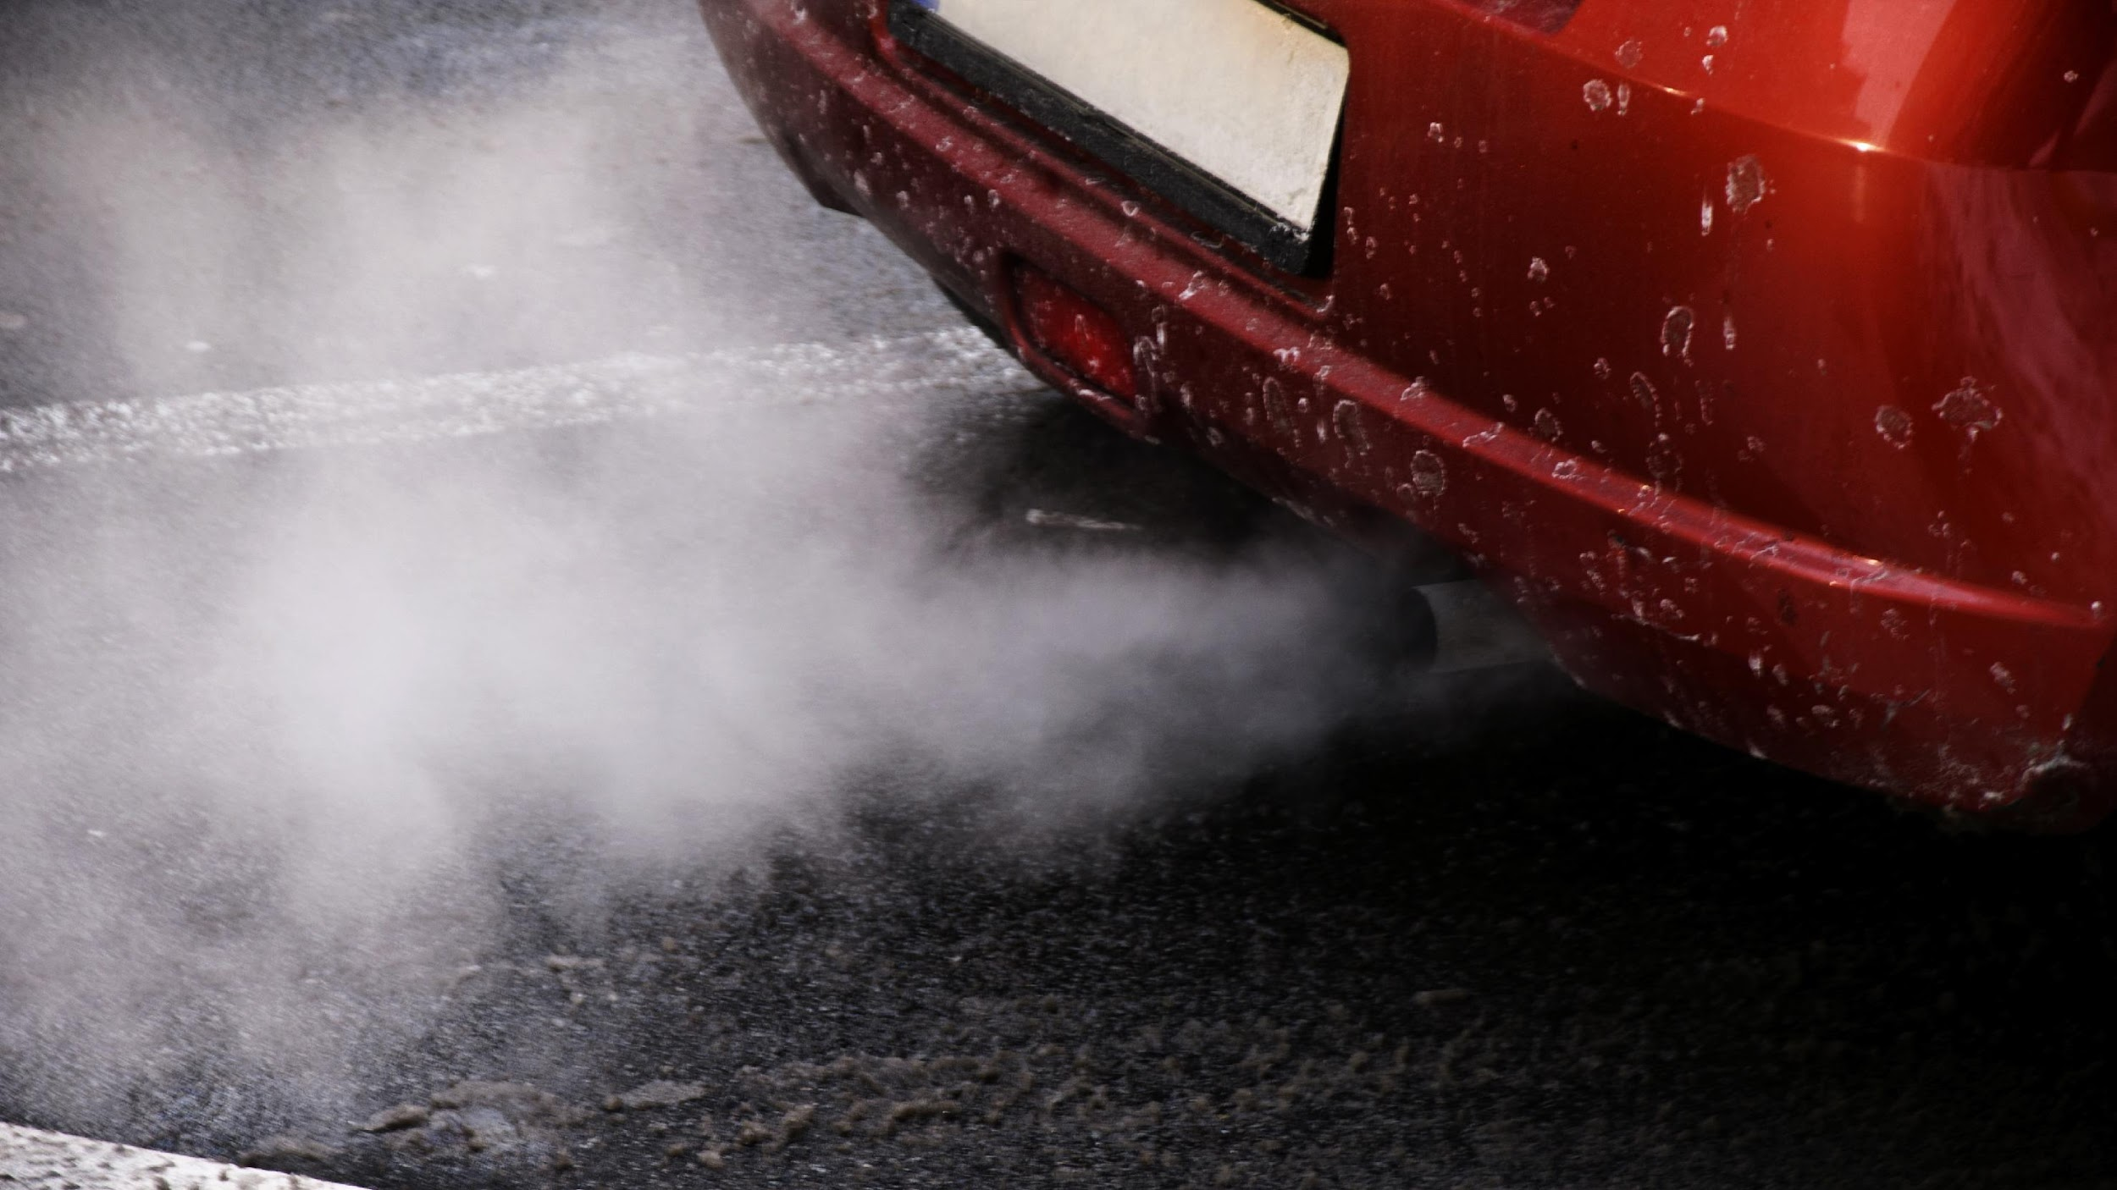
The CO2 emissions as a function of several car engine
features
Team Members:
Dhanunjay Reddy B
Dhanashri Matte
Dhruvi Ramani
Harshada Patil
Kusuma Priya K
Neel Kulkarni
Pavan Kumar GR
Mentor Name :
Varun

Slide 2
Business Objective:-
To make a model which can be work on CO2 emissions as a function of serval car engine features.

Slide 3
Project Architecture / Project Flow :-
Define Goal
Get Data
Explore & Visualization series
Apply Regression Method
Module Building
EDA
Evalute and Compare Performance

Slide 4
Exploratory Data Analysis (EDA)

Slide 5
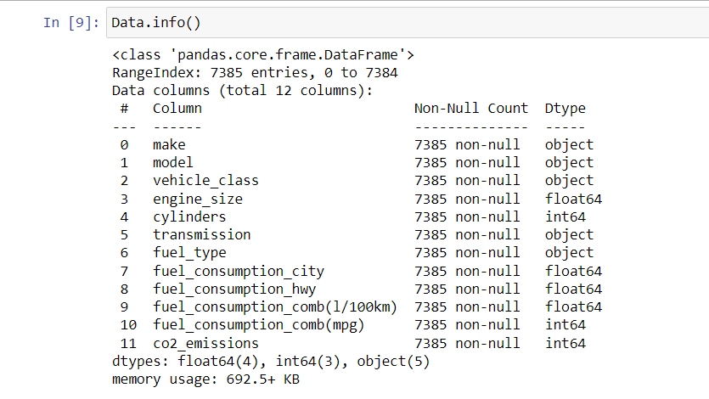
Dataset Description:-
Dataset Contain :
7385 rows
12 columns
Dataset contain 12 variables :
Make
Model
vehicle_class
engine_size
cylinders
transmission
select shift
fuel_type
fuel_consumption_city
fuel_consumption_hwy
fuel_consumption_comb(l/100km)
fuel_consumption_comb(mpg)
co2_emissions

Slide 6
There is no any Nan or Null Values as well as no Missing Values :
Dataset contains 3 data types :
Int64: Integer Variables , cylinders, fuel_consumption_comb(mpg, co2_emissions)
Float64: Variables Containing Some Decimal Values, engine_size, fuel_consumption_city,fuel_consumption_hwy,fuel_consumption_comb(l/100 km)
Object: make, model, vehicle_class, transmission, fuel_type.

Slide 7
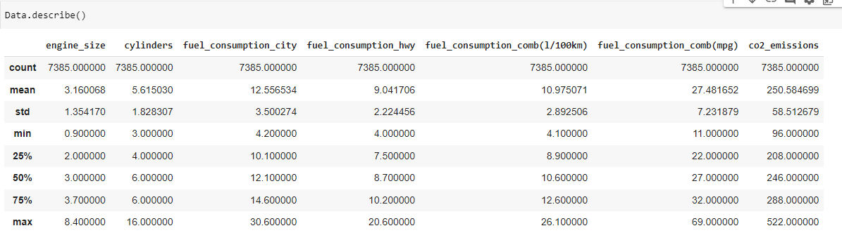
Descriptive Statistics:-
Conclusion: We can see here, Minimum CO2 Emission Is 96.00, Maximum CO2 Emission is 522.0 With Average CO2 Emission of 250.58

Slide 8
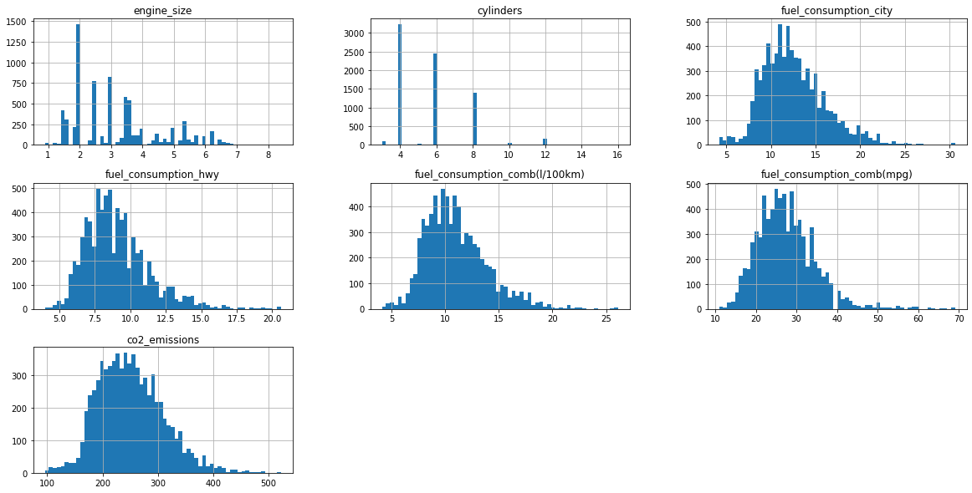
Visualization Histogram :-

Slide 9
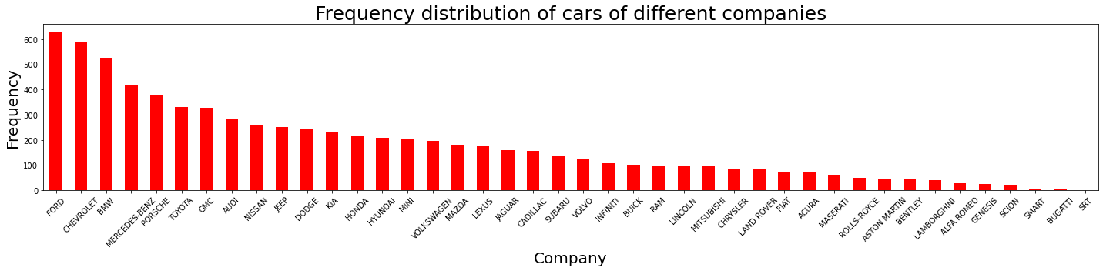
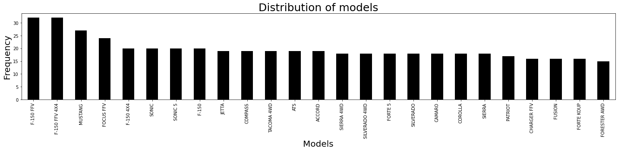
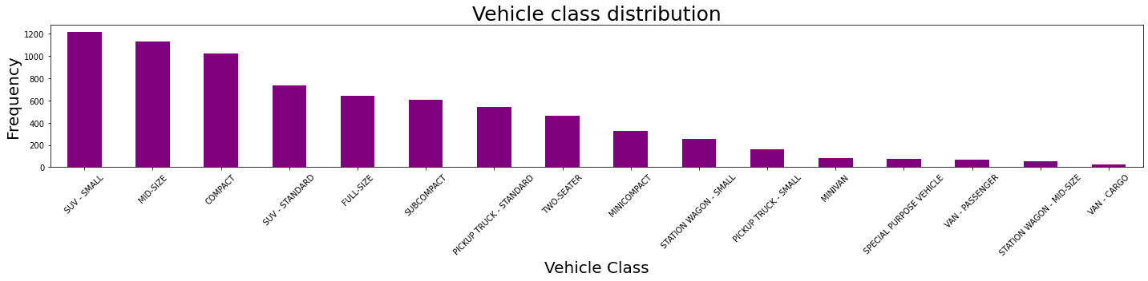
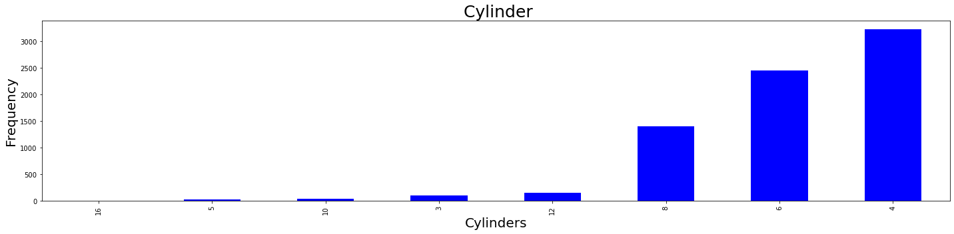
FREQUENCY DISTRIBUTION

Slide 10
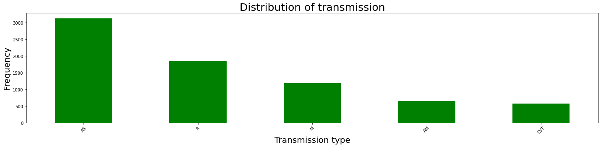
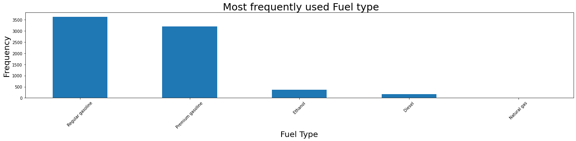
From Frequency Distribution we can conclude that Ford Company has Highest no of cars and SRT has least no of cars
Distribution of models F-150 FFV and F-150 FFV 4*4 are more and FORESTER AWD are less
From the Image SUV small has large Distribution and Van Cargo has less Distribution
Distribution of 4-cylinder is more compare to 16-cylinder
Distribution of Regular Gasoline is more and Natural gas is Less

Slide 11
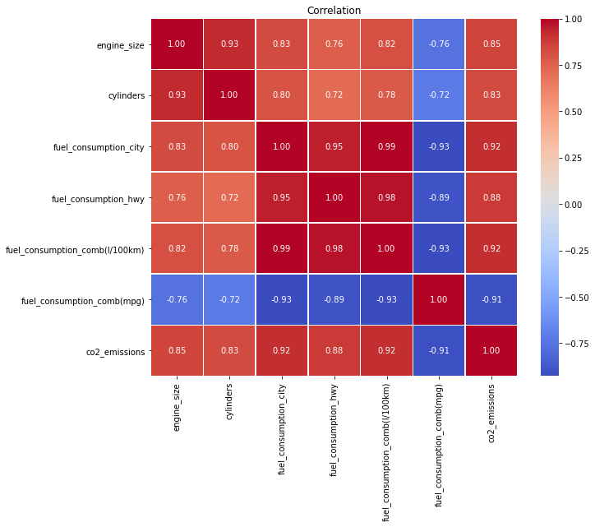
HEAT MAP :-
By the use of Heat map we can Easily get the correlation between the variables and get to know the relationship between them is strong or weak.

Slide 12
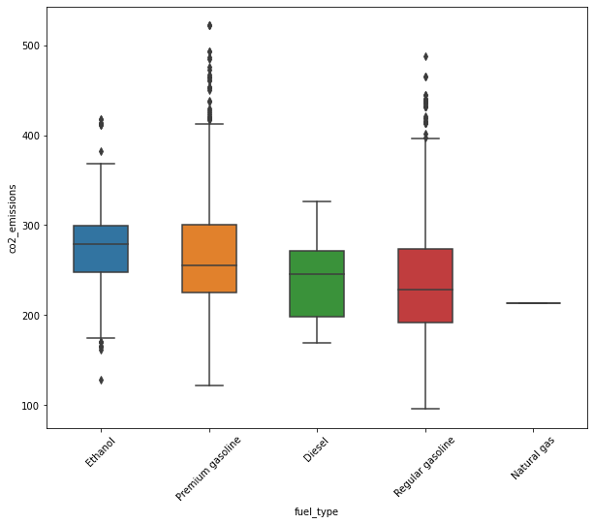
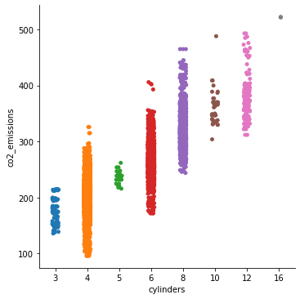
BOX PLOT AND CATPLOT:-

Slide 13
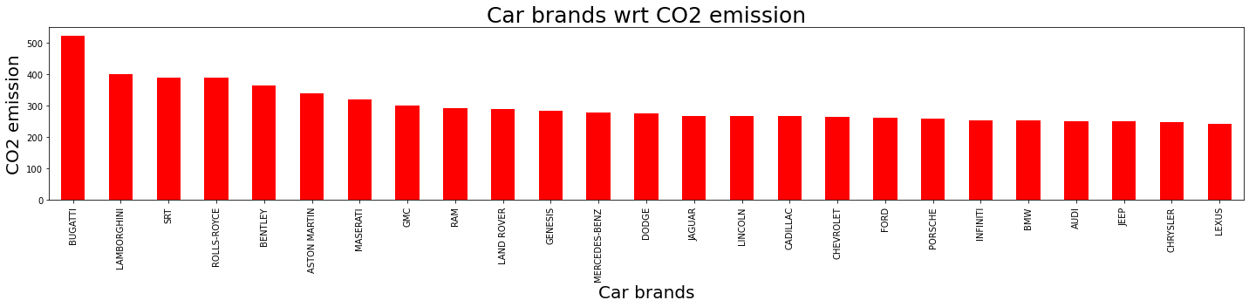
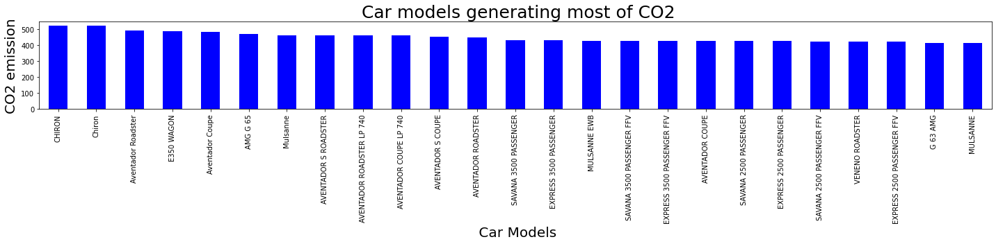
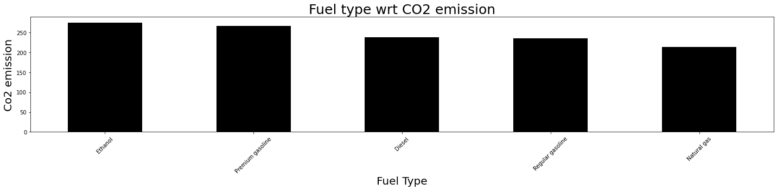
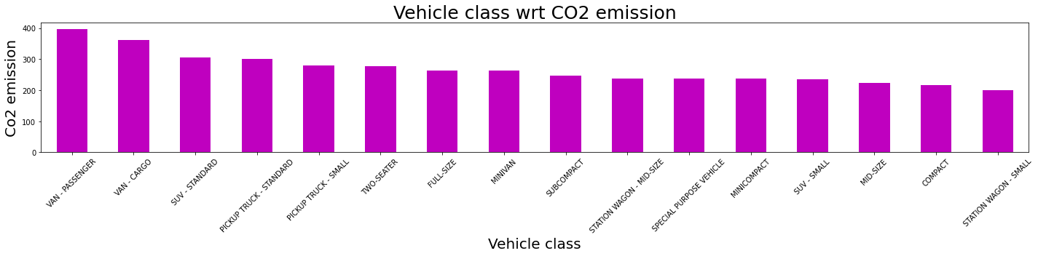
Frequencies wrt CO2 EMISSION
From the above image we can conclude that BUGATTI(Car brand), CHIRON(car model), ETHANOL(fuel type), VAN PASSANGER(vehicle class) has large amount of CO2 Emission

Slide 14
AUTO EDA
1. PANDAS PROFILING
2. SWEETVIZ

Slide 15
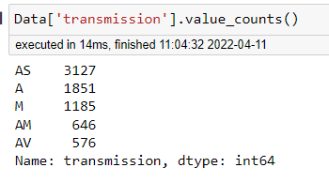
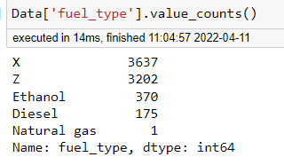
Feature Engineering
1) DATA PREPROCESSING : In data processing counts the value of Transmission and Fuel type.
Conclusion: Dropping natural gas as there is only one data we have which would not make much difference in modelling.

Slide 16
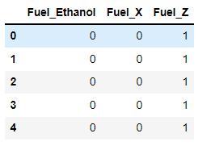
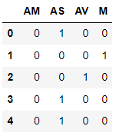
Creating dummy variables of fuel type and transmission (categorical features) :
Fuel Type : Transmission:

Slide 17
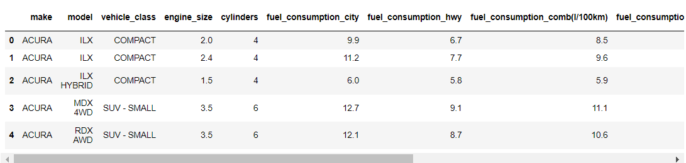
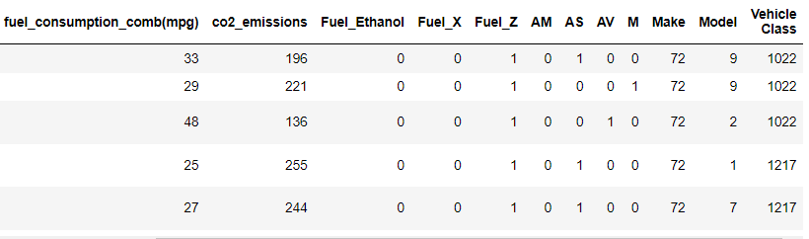
HANDLING OTHER CATAGORICAL FEATURES HAVING MULTIPLE CATAGORIES (MAKE , MODEL, VEHICLE CLASS) :

Slide 18
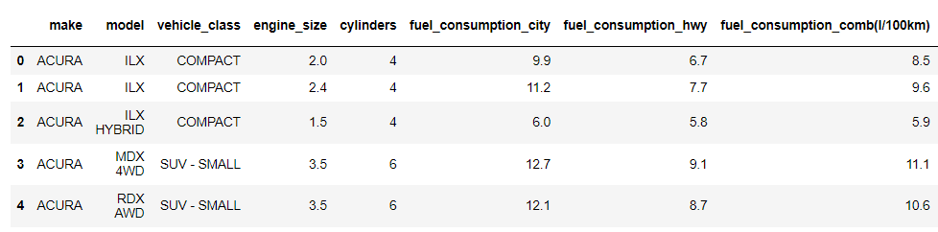
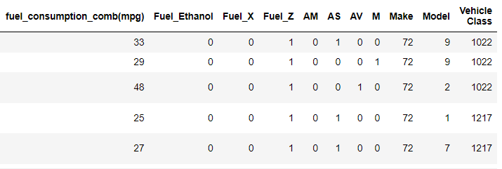
DIVIDING DATA SET INTO INDEPENDENT AND DEPENDENT VARIABLE :

Slide 19
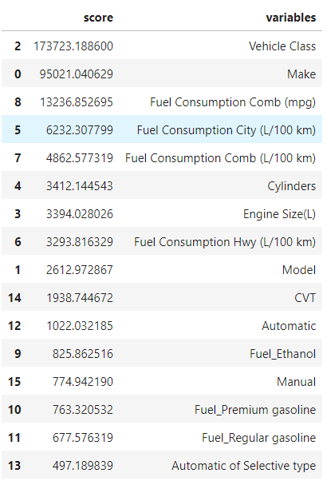
FEATURE SELECTION USING CHI-SQUARE TEST :

Slide 20
Model Building
Linear Regression
Lasso Regression
Ridge Regression
Decision Tree Regression
Random Forest Regression
Simple Vector Regression

Slide 21
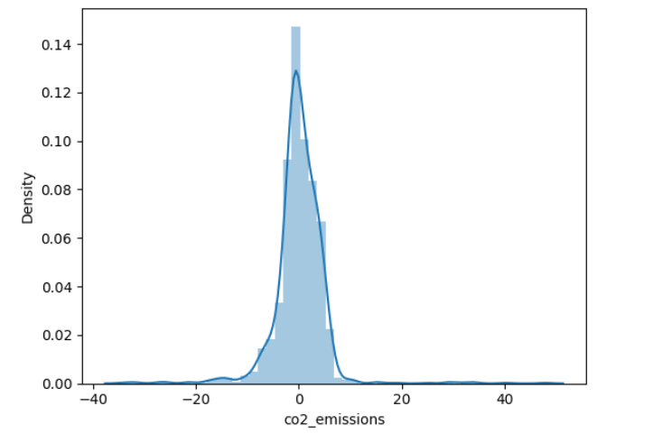
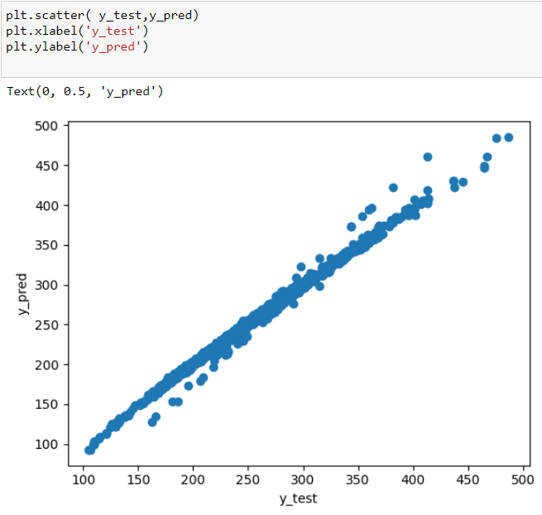
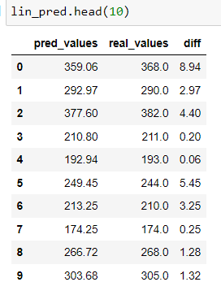
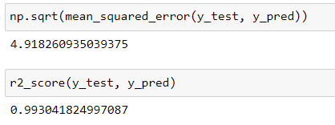
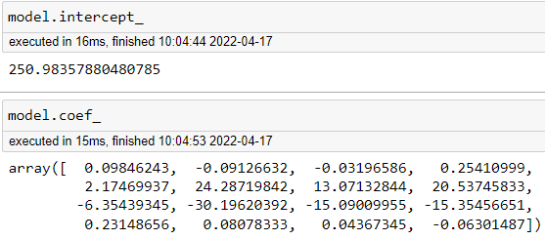
1. Linear Regression
Using Linear Regression:
r2_score: 0.993

Slide 22
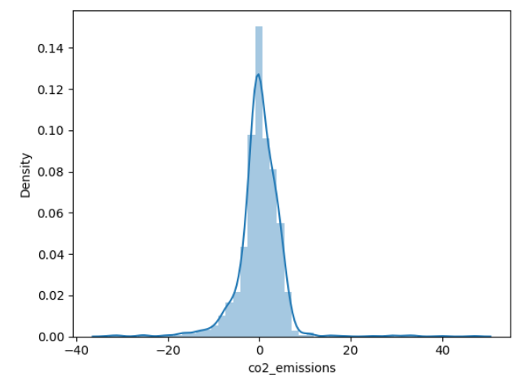
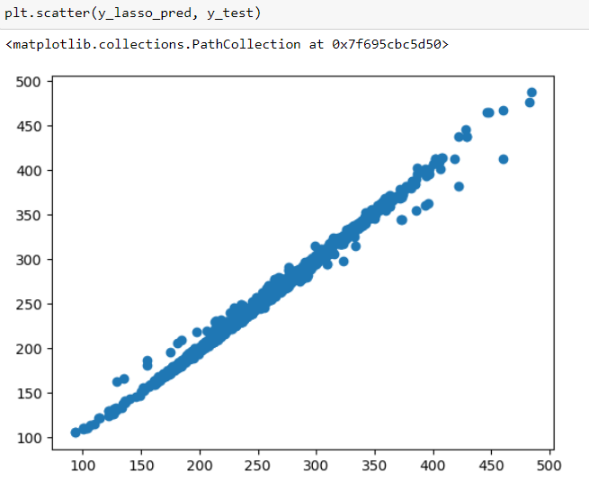
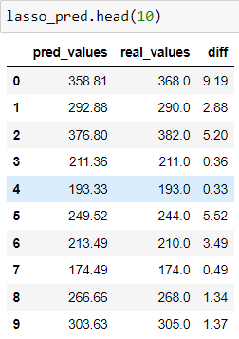
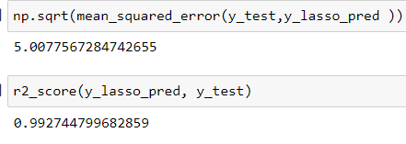
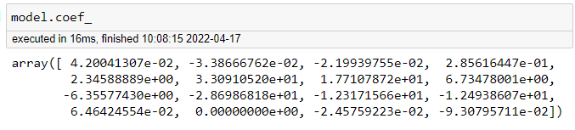
2. Lasso Regression
Using Lasso Regression:
r2_score: 0.992

Slide 23
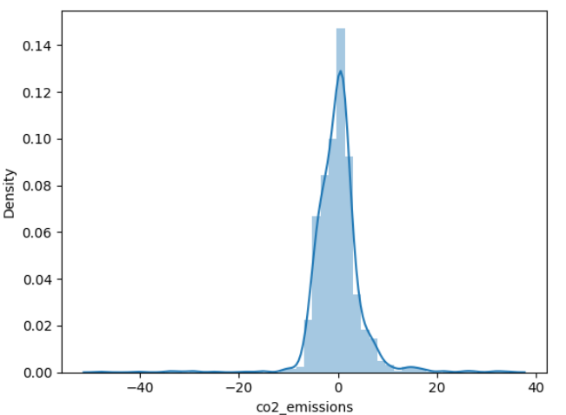
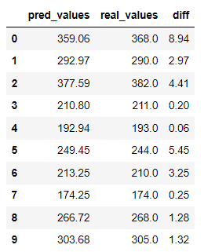
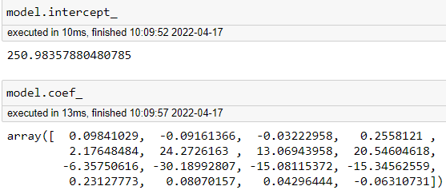
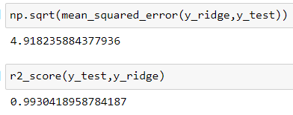
3. Ridge Regression
Using Ridge Regression:
r2_score: 0.993

Slide 24
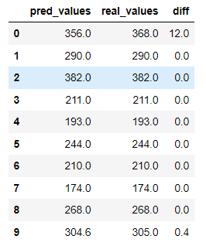
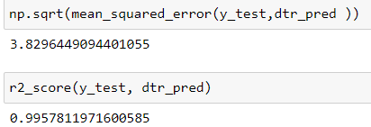
4. Decision Tree Regression
Using decision tree Regression:
r2_score: 0995

Slide 25
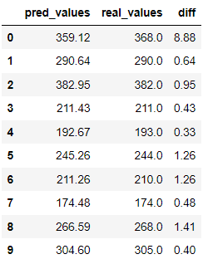

5. Random Forest Regression
Using Random Forest Regression:
r2_score: 0.9970

Slide 26
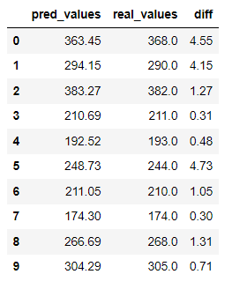
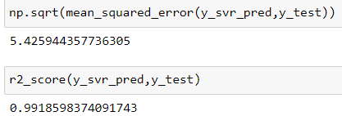
6. Simple Vector machine
Using Simple Vector machine:
r2_score: 0.991

Slide 27
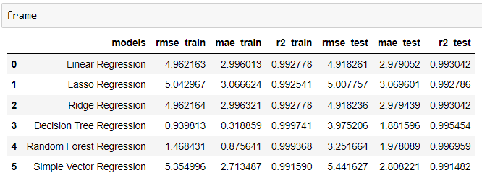
OVERALL PERFORMANCE OF ALL MODELS IN A DATAFRAME
Random Forest has high r2_score value.

Slide 28
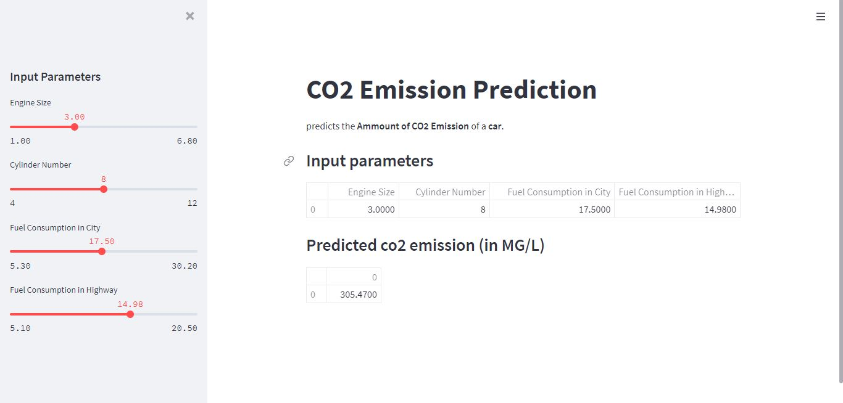
DEPLOYMENT

