Slide 1

Resume Parsing
By Group 4 :
•Dhruvi Ramani
•Gokulakrishna
•Jaya Gupta
•Manan Malhotra
•Renu Rawat
•Rohit Pawar
•Shubham Patel
Mentor: Ms. Bhanupriya

Slide 2


Resume Parser
Resume Parsing, is the conversion of a free-form CV/resume document into structured information — suitable for storage, reporting, and manipulation by a computer.
Resume parsers analyze a resume, extract the desired information, and insert the information into a database with a unique entry for each candidate. Once the resume has been analyzed, a recruiter can search the database for keywords and phrases and get a list of relevant candidates.
Text Extraction
Information Extraction

Slide 3





Benefits of ML-based Resume Parsing
Processes various file formats: The ML-based resume parser can process all popular file types including PDF, DOC, DOCX, ZIP, giving candidates the freedom to upload their resume in any format.
Deciphers complex resumes: The ML-based parser recognizes and extracts information from divergent formats. Example: Tabular templates
Machine learning for better accuracy: Optical Character Recognition (OCR) and Deep NLP algorithms to extract text from resumes.
Lightning-fast processing: The ML-enabled parser takes 1-3 seconds to process the most complex of the resumes.
Resume Quality Score: Indexes resume based on their pedigree with AI-backed score, irrespective of the job profile.

Slide 4
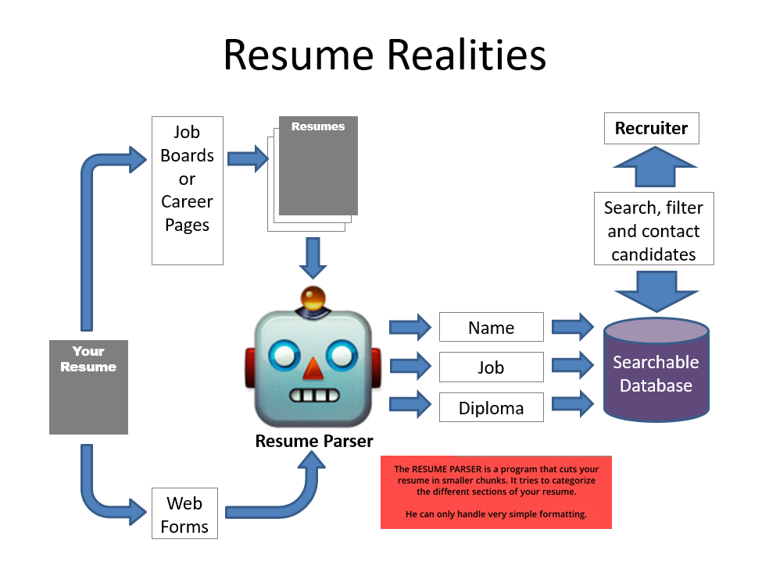
Approaches to create Dataset
Natural Language Processing (NLP)
Python libraries/Python Packages
Predictive Analytics
Regular Expression/Rule Based Parsing
Named Entity Recognition (NER)
Spacy’s NER
BERT NER

Slide 5
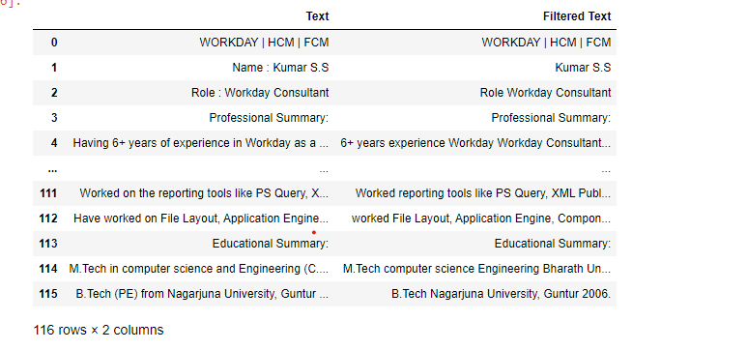
Dataset – Extracted from Resume

Slide 6
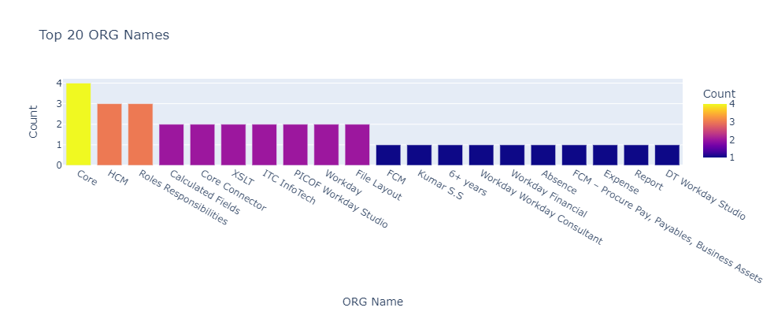
Exploratory Data Analysis

Slide 7
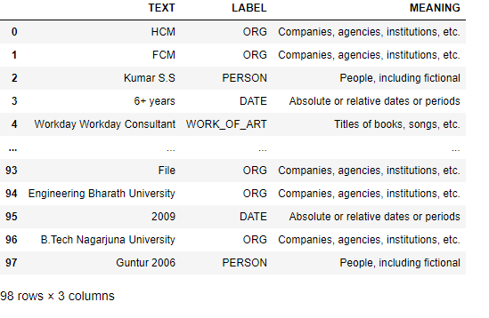
Named Entity Recognition

Slide 8
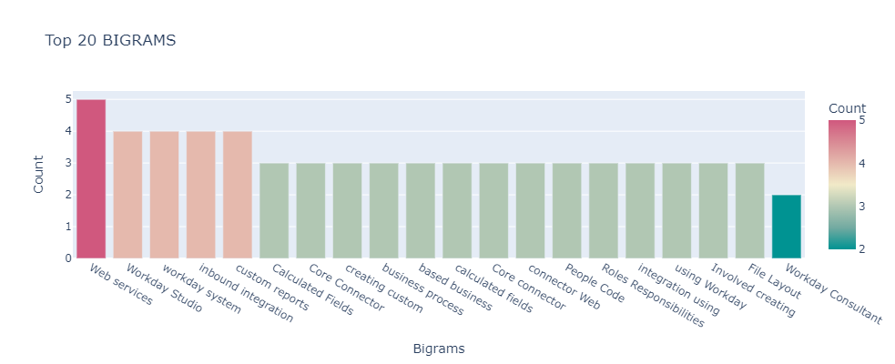
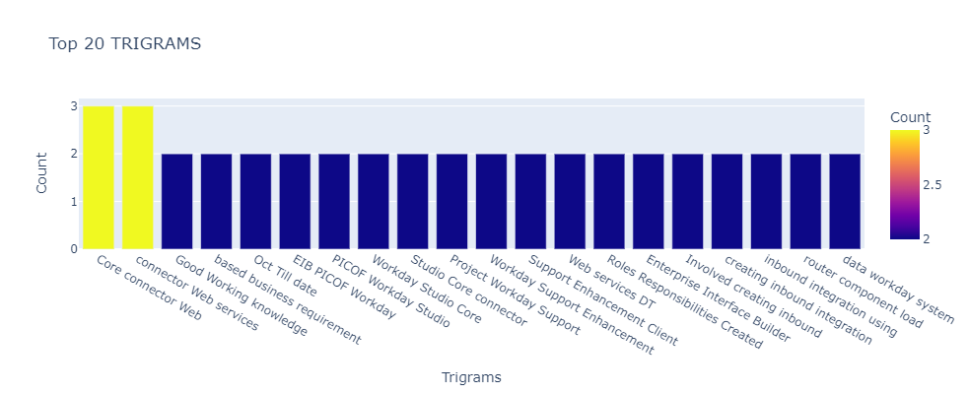
Bigrams & Trigrams

Slide 9
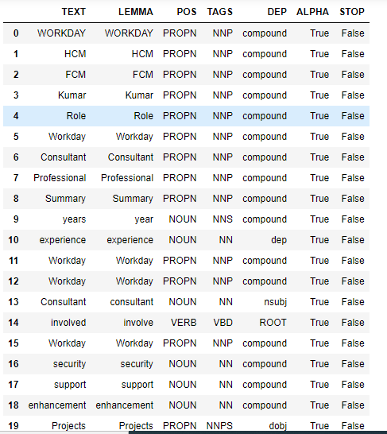
Parts of Speech

