Slide 1
Warranty Claim
Business Problem
High warranty cost and not sure if all the claims are genuine
Objective
The objective of the analysis is to predict an item when sold, what is the probability that customer would file fraudulent / Genuine warranty and to understand important factors associated with them

Slide 2
Project name : Warranty Claim Fraud
Detection
Team Name : Group 1
Mentor Name : Neha
Date :10/10/21

Slide 3
Project Architecture / Project Flow
Exploratory Data Analysis (EDA)
Feature Engineering
Model Building
Model Predictions
Deployment

Slide 4
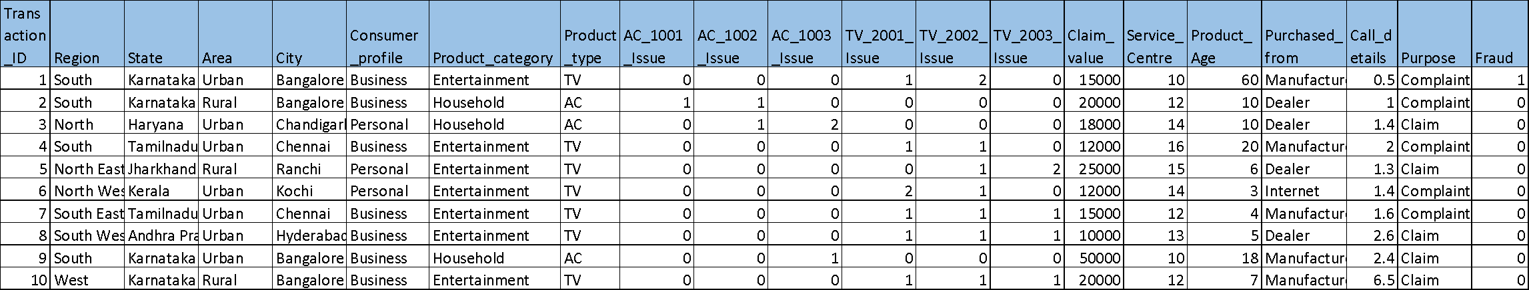
Data set details
Dataset Details :
Raw Dataset contains 358 Rows and 21 columns, it doesn’t have
any NAN values , Every Columns has 358 data points . Fraud
column is target column else 20 columns are independent ,
Data set is combination of categorical , numerical values.
Target Column :
“ Fraud “ column is a target column of dataset , which indicate
wheather the claimant applied for warrenty is Fraudulent or Not.
column consist of 1 and 0 , 1 is Fraudulent 0 is non Fraudulent.
Product Type :
Claimants are claiming warranty on TV and AC.

Slide 5
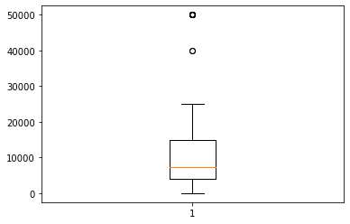
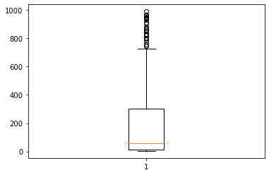
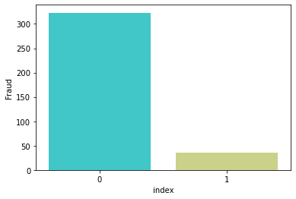
EDA
In Warranty Claim dataset columns such as “Claim_Value” ,“Product_Age”
contains outlier as shown in below char.
Claim _ Value
Product _ Age
Fraud column which consist of unique value 0 & 1 have imbalce between
two classes

Slide 6
Exploratory Data Analysis (EDA)
There are columns such as “Region” , “City” , “State” , “Are” … which was containing string .So to convert that into numeric form we used One Hot In-coder .
 | Region | State | Area | City | Consumer profile | Product category
0 | South | Karnataka | Urban | Bangalore | Business | Entertainment
1 | South | Karnataka | Rural | Bangalore | Business | Household
2 | North | Haryana | Urban | Chandigarh | Personal | Household
3 | South | Tamil Nadu | Urban | Chennai | Business | Entertainment
4 | North East | Jharkhand | Rural | Ranchi | Personal | Entertainment
5 | North West | Kerala | Urban | Kochi | Personal | Entertainment

Slide 7
Sampling
There are lesser number of Farud cases as comaired to Non Fraudulant cases therefore data is Imbalance .In such situation Sampling Technique should be applied on data before model building.
Sampling Technique
Over Sampling
After checking accuracy of model by appling different samplaing technique we decided to go up with Over Sampling
l | Model | Best Score |  | test_score
0 | Logistic Regression | 0.791345 |  | 0.796296
1 | Decision Tree Classifier | 0.911125 |  | 0.901235
2 | Gaussian NB | 0.706680 |  | 0.679012
3 | Random Forest Classifier | 0.954510 |  | 0.944444
4 | SVM | 0.909042 |  | 0.907407

Slide 8
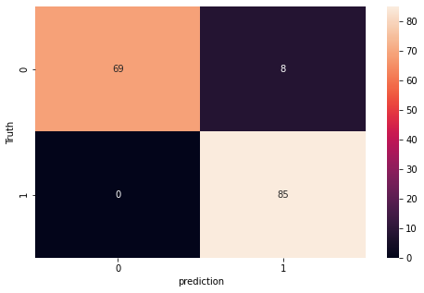
Model Building
Random Forest Classifier
Random Forest Classifier out perform all the classification model for the given dataset (Warranty Claim) . The accuracy displayed by random forest was much better than other classification model
Performance of Random
Forest Classifier

Slide 9
Template for Model results presentation
Model : Random Forest Classifier
Algorithm details and configuration
Random Forest Classifier is a Supervised Machine Learning
Algorithm that is used in classification problem . It builds decision
trees on different samples and takes their majority vote for classification and average in case of regression. ... It performs better results for classification problem
Accuracy :
Train Accuracy 0.97
Test Accuracy 0.95
precision recall f1-score support
0 1.00 0.91 0.95 77
1 0.92 1.00 0.96 85
accuracy 0.96 162
macro avg 0.96 0.95 0.96 162
weighted avg 0.96 0.96 0.96 162

Slide 10
Model Deployment
Model Deployment is done using Streamlit

Slide 11
Challenges faced?
As data was highly imbalanced . So Challenged faced was how to predict model accurately .
How did you overcome?
We tried different sampling technique in order to balance the data at last as per the accuracy we selected Over sampeling technique to balance data

Slide 12
Thank you

