Slide 1
DIGITAL TWIN CHALLENGE 2026
RespiraTwin:
An Asthma Digital Twin
for Early Warning
A simulation-based respiratory risk forecasting prototype
TEAM NAME
COLLEGE
MEMBERS
Adani University
Dhruvi Shah
AuraTwin
All patient, wearable, pollution and event data are simulated. Not for clinical use.
Notes:
Hello, and thank you for reviewing RespiraTwin. This project is our prototype for the Happiest Health Digital Twin Challenge 2026. Our focus is asthma exacerbation early warning: how a patient-specific representation can combine historical health context with changing daily signals and estimate risk over the next twenty-four hours. The key word is prototype. Every patient record, wearable value, pollution series, and event label in this demonstration is simulated. We do not use real patient data, and the results do not represent clinical performance. We built the project to demonstrate an end-to-end pipeline: data generation, time-aware feature engineering, a constrained predictive model, a stateful virtual patient, explanations, replay, and what-if scenarios. The goal is to make the pipeline inspectable and reproducible, rather than to claim that a simulated system is ready for clinical use. In the presentation, I will explain the problem, the digital-twin workflow, the assumptions behind the simulator, the reported evaluation results, and the work that would be required before real-world testing. We welcome the evaluation team's review of this submission.

Slide 2
THE PROBLEM
Asthma changes between clinic visits
Day-to-day signals can shift while the care team is not observing the patient.
POLLUTION
SYMPTOMS
ADHERENCE
INDIA CONTEXT
Exposure changes
Breathing changes
Treatment patterns
Air pollution
and respiratory health
The gap
A clinic snapshot may miss changing patterns between visits.
12.9% of global asthma cases, 42.3% of global asthma deaths
Early warning could support earlier review of a changing pattern.
India, GBD 2019 estimates (Lung India, 2022).
Notes:
Asthma can change between appointments. A clinic visit captures a point in time, while a person's day-to-day environment, symptoms, medication adherence, sleep, and physiological signals may change between visits. Air pollution is a relevant context for respiratory health in India, but a pollution reading alone does not tell us how a specific virtual patient may respond. The gap we are exploring is how to organize historical context and changing observations into a patient-specific state that can be inspected over time. This context highlights the importance of environmental triggers alongside clinical history. Early warning matters because it may help a care team notice a changing pattern sooner and decide whether further review is appropriate. This project does not claim that an alert prevents an exacerbation, and it does not diagnose or prescribe treatment. It is a research and decision-support prototype designed to demonstrate the engineering workflow and make its assumptions visible.

Slide 3
THE TWIN
A patient-specific state, updated over time
Six steps from historical context to an explorable forecast.
01
02
03
Load EHR profile
Ingest hourly signals
Update twin state
History + baseline
Pollution · wearable · adherence · symptoms
Align and validate observations
04
05
06
Forecast 24h risk
Explain the output
Ask what-if questions
Model estimates event probability
Signal families + history
Hypothetical inputs only
State updates and what-if responses are recorded separately from original observations.
Notes:
We describe the system as a digital twin because it maintains a patient-specific state and updates that state as new observations arrive. The flow begins by loading the historical electronic health record profile. The next step ingests hourly inputs: the synthetic pollution series, simulated wearable signals, adherence events, and symptom diary. The fusion layer checks and aligns those inputs, then calculates past-looking features so the model does not use information from the future. The twin engine updates the current virtual state and generates a forecast for the next twenty-four hours. It also produces reason codes grouped by signal family and records the prediction in the state history. Finally, the what-if laboratory lets a user change hypothetical inputs and observe the model response without overwriting the original data. This last distinction matters: a scenario is not a real intervention and does not prove that an intervention would change a patient's outcome. Each step is designed to be visible in the dashboard so that a reviewer can follow the path from source data to the displayed forecast.

Slide 4
SYSTEM ARCHITECTURE
Two streams. One virtual patient. A traceable forecast.
Architecture at a glance
INPUT STREAMS
FEATURE FUSION
TWIN ENGINE
DOCTOR DASHBOARD
Synthetic EHR
Synthetic pollution
Simulated wearables, adherence and symptoms
Schema + timestamp checks
Past-looking features
Personal baseline
Current state
24h forecast
Reason codes + history
Risk forecast
Replay and early-warning view
What-if laboratory
EHR + pollution + wearables → feature fusion → twin engine (state, forecast, explanations, history) → doctor dashboard and what-if
All input data shown in this prototype is simulated.
Notes:
This architecture slide summarizes the path from data to interface. The historical EHR stream provides context such as asthma severity, prior exacerbations, and the patient's baseline. The dynamic stream supplies the synthetic pollution series and simulated wearable, adherence, and symptom observations. Validation checks provenance, timestamps, missingness, and quality before feature fusion. The feature layer calculates past-looking rolling summaries and deviations from each virtual patient's baseline. The twin engine then holds the current virtual state, runs the forecast, groups the explanatory signals, and records the prediction history. The clinician dashboard presents this information and supports replay and what-if exploration. Training and evaluation are separate from the live prediction path: the saved model artifact is loaded by the application rather than retrained in the middle of every interaction. The diagram is intended to show the implemented concept, not to imply that every external integration is already live. The pollution stream used for this demonstration is synthetic, and no real patient data is used. The architecture can later be extended to supported environmental data and appropriately governed clinical datasets, but those would require separate engineering, provenance checks, and validation.

Slide 5
DATA AND PROVENANCE
Every stream is simulated
Designed for a reproducible prototype without real patient records.
STREAM
FIELDS / CONTENT
PROVENANCE
EHR profiles
History, severity, prior events, baseline
300 synthetic patients
Pollution
PM2.5 / PM10 and illustrative AQI
Synthetic urban Delhi-range series; not real measurements
Wearables
Respiratory rate, SpO₂, heart rate, HRV, sleep, steps
Simulated time series
Adherence + diary
Controller adherence, rescue inhaler use, symptoms
Simulated logs
Cohort: 300 patients × 60 days × hourly
ALL DATA SIMULATED; NO REAL PATIENT DATA USED
Notes:
All four data streams in this prototype are simulated. The EHR profiles represent a synthetic cohort of three hundred patients. The pollution input is a synthetic series with illustrative urban Delhi-range levels; it is not a measurement downloaded from an air-quality station. Wearable signals such as respiratory rate, oxygen saturation, heart rate, heart-rate variability, sleep, and steps are generated for the demo. Medication adherence, rescue inhaler use, and symptom diary entries are also simulated. The cohort spans sixty days at hourly resolution, giving the pipeline a consistent timeline on which to demonstrate rolling features, state updates, and event replay. The purpose of simulation is to make the project reproducible without handling real patient data. It also lets us control the event-generation assumptions and test whether the model learns the synthetic process that produced the labels. That convenience creates a major limitation: model performance on this dataset is not evidence of clinical accuracy. The prominent note on this slide is deliberately direct. No real patient data is used. Before any real-world experiment, the team would need data-use permissions, appropriate consent and de-identification, secure handling, and a clearly governed validation protocol.

Slide 6
EVENT GENERATION
The model learns a simulator—not asthma biology
Outcome labels are generated by explicit assumptions.
HAZARD DRIVERS
SIMULATED EVENT BEHAVIOR
Pollution and asthma severity
6–24h
Prodrome: respiratory rate up, SpO₂ down, rescue use and symptoms up
Prior exacerbations and sensitivity
30%
Silent episodes with weak or no prodrome
Adherence and hidden vulnerability
72h
Refractory period after an onset
1,398 episodes · Positive label rate: 7.77%
Assumptions for modelling—not clinical facts.
Notes:
The event simulator is the source of the outcome labels, so its assumptions are central to interpreting every metric. An hourly hazard is influenced by pollution, asthma severity, previous exacerbations, trigger sensitivity, adherence, and a hidden vulnerability variable. In the generated sequences, a simulated onset may have a prodrome lasting six to twenty-four hours, with respiratory rate rising, oxygen saturation falling, rescue use increasing, and symptoms worsening. The simulator also includes silent episodes: thirty percent are designed to have weak or no prodrome. A seventy-two-hour refractory period limits repeated event generation after an onset, and the resulting run contains one thousand three hundred ninety-eight episodes with a positive label rate of seven point seven seven percent. These are modelling assumptions, not clinical facts. They describe how the training and test labels are generated, rather than a claim about the natural history of asthma. This distinction is important because the model is learning patterns created by this simulator. If we change the simulator, the metrics could change. A future research version would need externally sourced outcome labels and careful validation before any claims about real patients could be made.

Slide 7
MODEL AND SAFEGUARDS
Constrained learning with explicit leakage checks
Model choices are documented and repeatable.
52
25
210 / 45 / 45
49
PAST-LOOKING FEATURES
MONOTONE CONSTRAINTS
PATIENT SPLIT
AUTOMATED TESTS
No future observations in features
Directionally consistent inputs
Train / validation / test
Including temporal-leakage test
CONSTRAINT DIRECTION
Pollution, rescue use, symptoms and respiratory rate rising cannot lower constrained risk.
Improved adherence or SpO₂ cannot raise constrained risk.
Isotonic calibration fitted on validation patients only
A higher-scoring relaxed-constraint variant was rejected after failing what-if consistency checks.
Notes:
The model pipeline uses fifty-two past-looking features. We compare candidate models and use a monotone-constrained gradient-boosting model for the operational forecast. The model has twenty-five constraints so that selected relationships behave consistently with the intended direction: increasing pollution, rescue use, symptoms, or respiratory rate cannot reduce risk through the constrained relationship, while improvements in adherence or oxygen saturation cannot raise risk through the constrained relationship. Isotonic calibration is applied to the output probabilities. A higher-scoring relaxed-constraint variant was rejected after failing what-if consistency checks. Patient-level splitting keeps the same synthetic patient's records from being spread across training and held-out evaluation groups: two hundred ten patients for training, forty-five for validation, and forty-five for test. We also run a strict temporal-leakage test to detect the accidental use of future information. The repository documents forty-nine automated tests. These safeguards improve reproducibility and make the training pipeline more defensible, but they do not remove the simulation-to-reality gap. A constrained model can still learn simulator-specific patterns, and calibration on synthetic validation data is not clinical calibration. The next requirement would be to repeat this approach with real, appropriately governed data, while preserving patient-level and temporal separation.

Slide 8
PREDICTIVE PERFORMANCE
Held-out test performance
45 patients · 2,700 patient-days · synthetic event labels
ROC-AUC
PR-AUC
BRIER SCORE
0.82
95% CI 0.795–0.851
0.45
CI 0.404–0.510
Base rate about 7–8%
0.0526
vs 0.0705
base-rate predictor
Observed event rate by demo risk band
These are presentation bands, not clinical thresholds.
INTERPRETATION
The pipeline learns a simulated process.
No real patient outcomes were used. Metrics are not clinical performance.
Simulation-based results; not clinical performance.
Notes:
This slide reports the held-out test performance on forty-five synthetic patients and two thousand seven hundred patient-days. The ROC-AUC is zero point eight two, with the confidence interval shown here. The PR-AUC is zero point four five, with its interval shown next to it; the base event rate is about seven to eight percent, so precision-recall performance is particularly relevant. The Brier score is zero point zero five two six, compared with zero point zero seven zero five for a model that always predicts the base rate. The chart shows the observed event rate in the demonstration risk bands: Low at two point six percent, Watch at nine point three percent, and High at thirty-eight point four percent. These bands are dashboard categories, not clinical thresholds. The metrics should be read as evidence that the pipeline learns a relationship in the synthetic process and separates the simulated risk groups. They are not evidence of performance in clinical settings. The data slide and simulator slide explain how the labels were created, and the limitations slide returns to the fact that all data and outcomes are simulated. We would need an external dataset and clinical evaluation before making any real-world performance claim.

Slide 9
EARLY WARNING
Onset replay reveals where the model struggles
206 true simulated onsets in the held-out test set
78.6%
Anticipated · 162
206
5.3%
Late within 6h · 11
true onsets
16.0%
Missed · 33
Median lead time: 12 hours
Episode type
Anticipated
Late
Missed
Non-silent
100% (138/138)
—
—
Silent
35.3% (24/68)
16.2%
48.5%
Simulation-based results; not clinical performance.
Notes:
This evaluation counts two hundred six true simulated onsets in the test set. An onset is anticipated when an alert occurs at least one hour before it. The system anticipated one hundred sixty-two onsets, which is seventy-eight point six percent. Eleven onsets, or five point three percent, were detected late within six hours after onset. Thirty-three, or sixteen point zero percent, were missed. Among anticipated events, the median lead time was twelve hours. The lower split is especially important: all of the non-silent episodes in this test set were anticipated, while silent episodes were much harder. Of the sixty-eight silent episodes, twenty-four were anticipated, eleven were late, and thirty-three were missed. These results illustrate a behavior of this specific simulator: the model performs better when there is a recognizable prodrome and struggles when the simulator generates weak or no warning signals. That is an important limitation, not a detail to hide. These figures describe simulated onsets only. They do not estimate how often a real asthma event would be forecast, missed, or detected late. The prototype's replay interface is designed to let reviewers inspect examples of both anticipated events and misses rather than looking only at aggregate metrics.

Slide 10
BASELINES
Coverage is similar to a pollution rule; alert burden differs
Comparisons use the same event and alert definitions.
Alert precision
False alert episodes per patient-month
Share of alert episodes followed by an onset within 24h
Lower is fewer false alert episodes
Similar coverage to a PM2.5 rule, with about 15x fewer false alerts than that rule
PM2.5 rule anticipates 83.0% of onsets vs RespiraTwin at 78.6%.
Simulation-based results; not clinical performance.
Notes:
This slide compares the operational model with simple baselines using the same alert definitions. Alert precision is the share of alert episodes followed by a simulated onset within twenty-four hours. RespiraTwin reports forty-eight point nine percent, compared with nine point zero percent for a PM2.5 rule, twelve point nine percent for a PM2.5 plus low-adherence rule, and seven point seven percent for a random schedule. The false-alert burden is three point seven two episodes per patient-month for RespiraTwin, fifty-four point six two for the PM2.5 rule, and nine point seven eight for the PM2.5 plus low-adherence rule. A plain pollution rule anticipates eighty-three point zero percent of onsets, compared with seventy-eight point six percent for RespiraTwin. So the trade-off is visible: coverage is similar but not identical, and the model's alert burden is lower in this simulation. The takeaway is about the synthetic operating point, not a promise for deployment. Real alert usefulness depends on the event definitions, the population, the data quality, and how the alert is used. We would not claim clinical benefit without evaluation on properly governed external data.

Slide 11
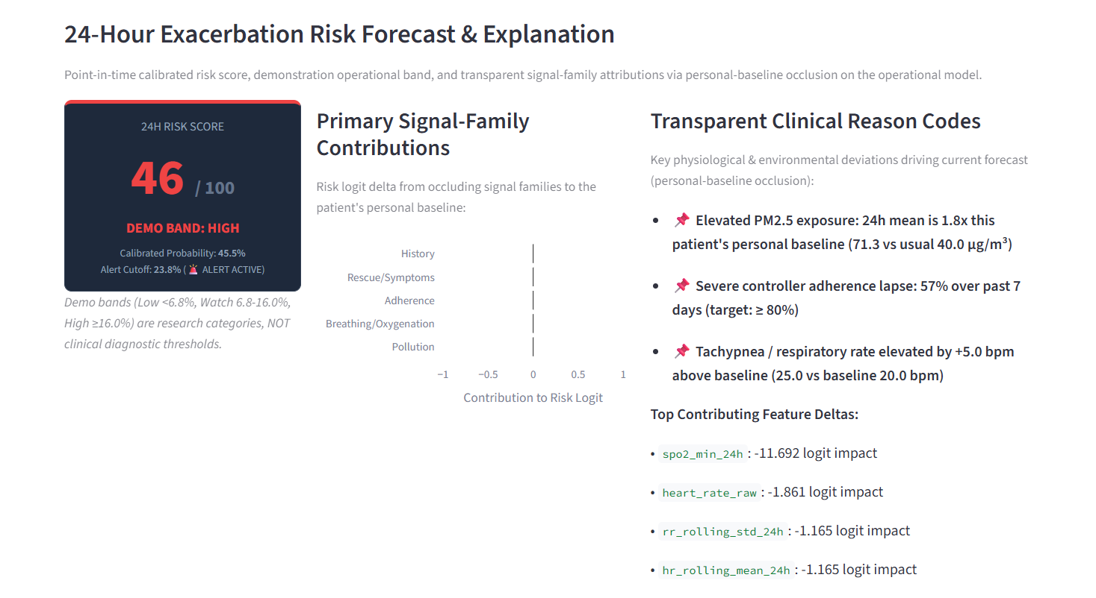
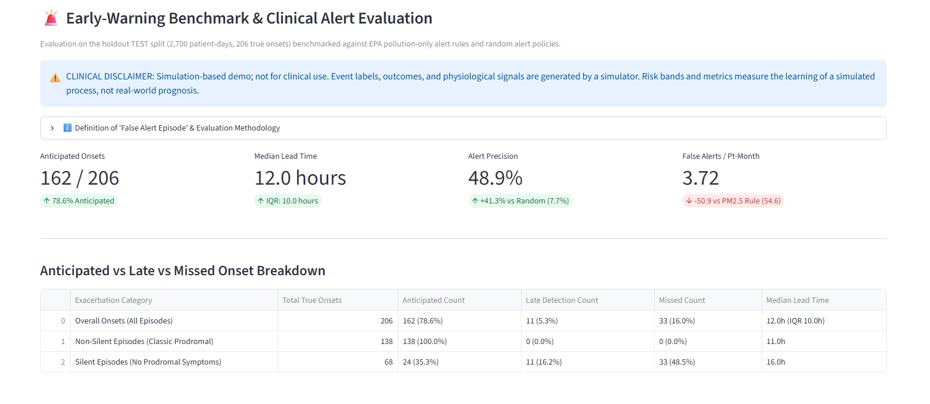
DOCTOR DASHBOARD
What a reviewer should see in the working app
Interface views for risk forecasting, early warning, and episode replay.
Synthetic-patient banner
Signal charts with provenance badges
0–100 risk score with Low / Watch / High demo bands
Reason codes and twin-history timeline
Replay of held-out episodes, including a miss
Interactive virtual patient timeline and episode replay.
Notes:
These two panels illustrate key views from the Streamlit application: the Risk Forecast tab and the Replay or Early-Warning tab. The dashboard makes synthetic provenance visible through a patient banner and provenance badges near the relevant signals. A clinician-facing prototype view includes time-series charts, a risk score from zero to one hundred, demo Low, Watch, and High bands, signal-family reason codes, and a timeline of state updates. Replay makes it possible to step through held-out simulated episodes, including a missed episode, so a reviewer can see what the model did before and after an onset. The dashboard should not imply that an alert diagnoses asthma or directs a medication change. Instead, it shows the internal state of the prototype and why the model output changed. The view presents interactive controls and inspectable state rather than a static design. In the demonstration, reviewers can switch patients, inspect the timeline, and step through episode replay to verify that the interface is directly connected to the prediction pipeline.

Slide 12
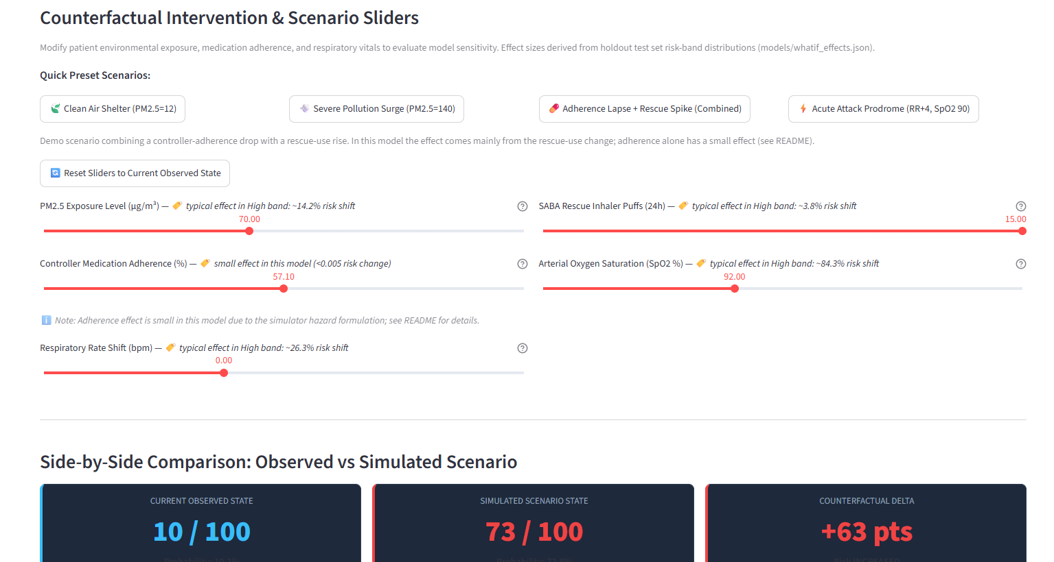
WHAT-IF AND EXPLANATIONS
Explore model response without changing source history
Hypothetical scenarios are not intervention recommendations.
CONSISTENCY CHECK
100%
expected-direction results
5 sweeps · 200 test patient-hours
Scenario presets and sliders
Original data never overwritten
Personal-baseline occlusion by signal family
Caveat: adherence alone has a small effect; about 77% of test-set hours have 100% adherence and the model rarely splits on it.
Notes:
The what-if laboratory is for model exploration, not intervention advice. A user can choose scenario presets or use sliders to alter hypothetical values such as pollution, adherence, respiratory rate, rescue puffs, or oxygen saturation. The stored original observations are not overwritten; the app labels the result as the model response to a hypothetical input. The documented test includes five sweeps across those input families. The relationships were monotone in the expected direction for one hundred percent of two hundred test patient-hours. This is a consistency check against the model's constraints, not a statement that the model has learned clinical causal effects. The explanation view uses personal-baseline occlusion grouped into pollution, breathing and oxygenation, rescue use and symptoms, adherence, and history. One caveat is especially important: adherence alone has a small effect in this model. About seventy-seven percent of test-set hours have one hundred percent adherence, and the model rarely splits on adherence. The slide makes that limitation visible rather than presenting the what-if tool as more powerful than the training data supports. A future model could explore different adherence distributions, but its scenario behavior would need to be tested again before making stronger statements.

Slide 13
LIMITATIONS AND ETHICS
A transparent proof of concept—not a clinical tool
Limits define what the results can and cannot support.
All patient, wearable, pollution and event data are simulated.
Precision–recall trade-off changes the alert burden.
Metrics reflect the simulator’s assumptions.
No external or clinical validation.
Silent episodes are mostly missed or caught late.
Not for clinical use; no diagnosis or treatment advice.
Synthetic data only in this prototype. Real-data use would need consent, governance, security, and applicable privacy review.
Notes:
The limitations are part of the result, not a footnote. Every patient profile, wearable signal, pollution value, event label, and outcome in the prototype is simulated. The model learns the process encoded in the event generator, so its results reflect simulator assumptions. Silent episodes are mostly missed or caught late, showing a clear weak point in early warning. There is also a precision-recall operating-point trade-off: an alert threshold changes how many events are anticipated and how many false alerts are produced. The project has no external clinical validation. It is not for clinical use and must not be used to diagnose, recommend treatment, or change medication. No real patient data is used in the current prototype. If the project moves beyond simulation, data access, consent, de-identification, security, and lawful processing would need a formal plan aligned with applicable DPDP and HIPAA considerations where relevant. The prototype uses synthetic data only; it does not certify compliance for future real-data processing. The correct conclusion is that this is an engineering proof of concept with clearly stated boundaries, not a finished clinical product.

Slide 14
NEXT STEPS
Move from simulation to responsible evaluation
The next milestone is validation, not a stronger claim.
Validate on real, consented, de-identified data with clinicians
PROJECT REPOSITORY
GitHub
Replace synthetic pollution with sourced CPCB / OpenAQ data
github.com/dhruvishah-crypto/
digital-twin-challenge
Integrate real wearable data with provenance and quality checks
TEAM CONTACT
Plan prospective evaluation with appropriate governance
GitHub: github.com/dhruvishah-crypto
Re-test what-if consistency on larger cohorts and real data
Thank you
RespiraTwin · Research prototype
Notes:
The next stage is validation, not a stronger claim. First, the project would need appropriately consented and de-identified data reviewed with clinicians, along with a defined protocol and appropriate governance. The synthetic pollution sequence should then be replaced with properly sourced CPCB or OpenAQ data, with source and timestamp provenance preserved. A future implementation could integrate real wearable streams, subject to device reliability, permission, security, and consent. Prospective evaluation would be required to understand performance and usefulness outside the simulator. A relaxed-constraint variant scored higher on validation but failed our what-if consistency check (respiratory rate shift was consistent in only 57.5% of hours—a 42.5% failure rate—and SpO2 desaturation was consistent in only 7.5% of hours—a 92.5% failure rate), so the constrained model was kept, and any future model would need the same check. The project repository and team contact are shown as the submission handoff. The presentation closes with the main contribution: a reproducible multimodal pipeline, a patient-specific state, a defined forecast horizon, explicit evaluation, and a what-if interface, together with transparent limitations. Thank you for reviewing RespiraTwin. We welcome questions about the assumptions, implementation, metrics, and the work required to move from synthetic proof of concept to responsible evaluation with real data.

Slide 15
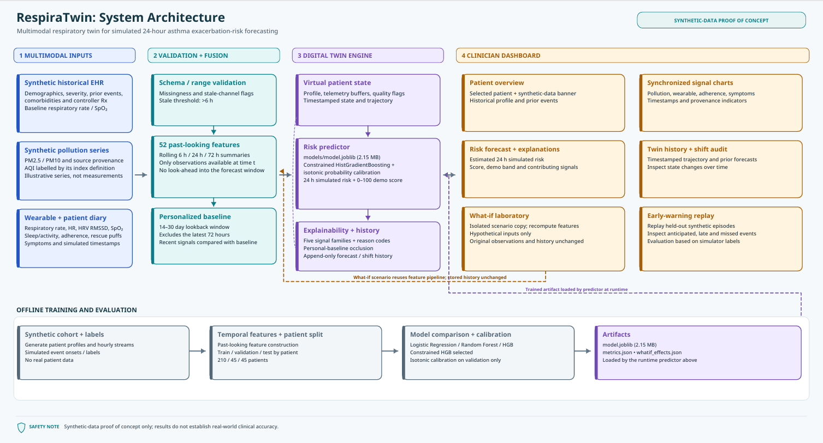
APPENDIX
Appendix: detailed architecture
End-to-end data ingestion, rolling feature engineering, constrained forecasting, and what-if digital twin.
System architecture diagram: four-stage ingestion to what-if pipeline with 25 monotone constraints and offline training.
Notes:
This appendix illustrates the detailed system architecture for RespiraTwin. The pipeline comprises four stages: synthetic data ingestion and range checks, past-only rolling feature engineering, a twenty-five-constraint XGBoost model with isotonic calibration, and an interactive virtual patient digital twin with what-if exploration. All historical states remain immutable during what-if analysis, and every synthetic signal family is tracked with explicit provenance.

