Slide 1

Used Car Price Prediction
A Data Science Project to Estimate Fair Market Price for Used Cars

Slide 2
Business Problem
Our friend Tom wants to sell his used car but doesn't know the right price to ask. He wants to maximize the price without scaring away potential buyers. The goal is to help Tom estimate a fair and competitive price using data analysis and machine learning techniques.

Slide 3
EDA (Exploratory Data Analysis)

Slide 4
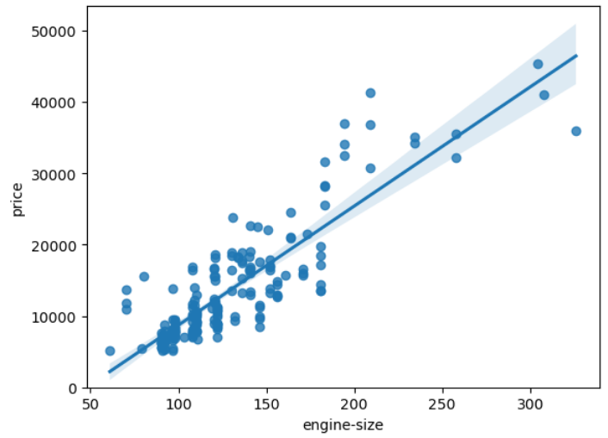
Scatterplot of 'engine-size' and 'price'

Slide 5
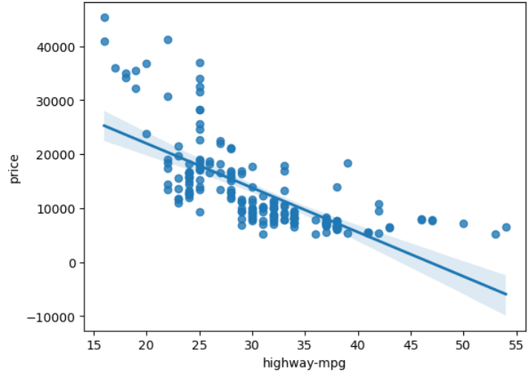
Scatterplot of ‘highway-mpg' and 'price'

Slide 6
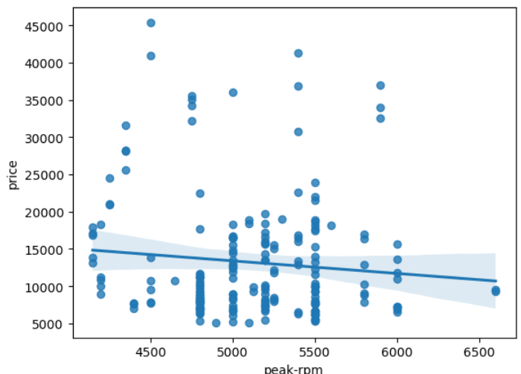
Scatterplot of 'peak-rpm' and 'price'

Slide 7
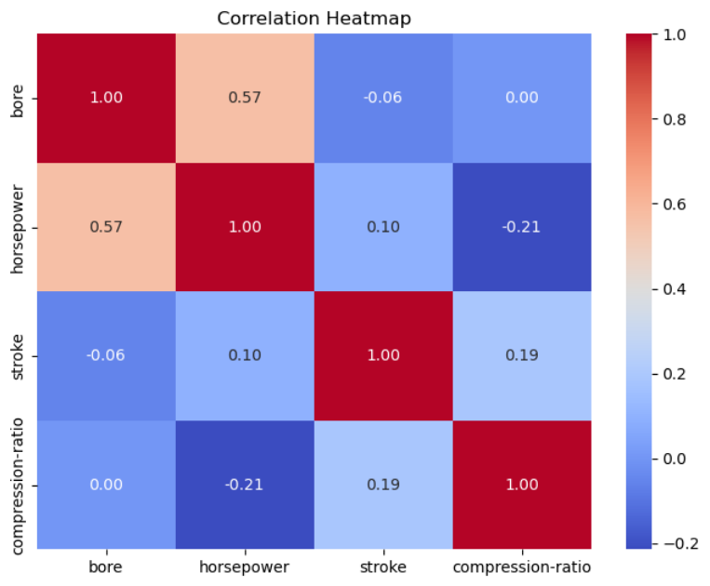
Heatmap Plot

Slide 8
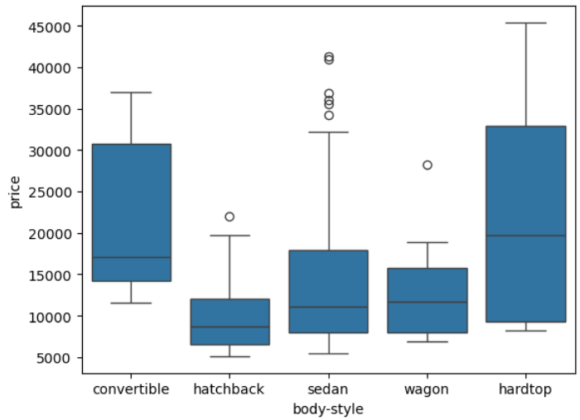
BoxPlot of ‘Body-style’ and ‘Price’

Slide 9
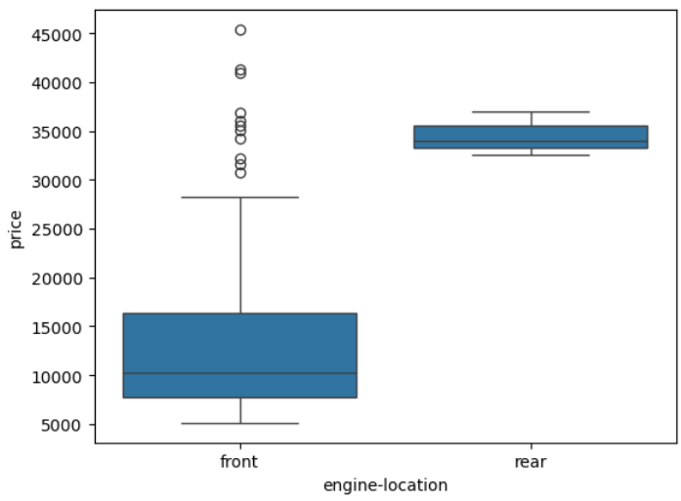
BoxPlot of ‘engine-location’ and ‘Price’

Slide 10
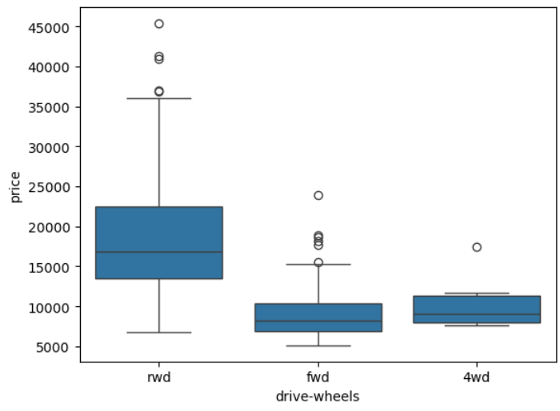
BoxPlot of ‘drive-wheels’ and ‘Price’

Slide 11
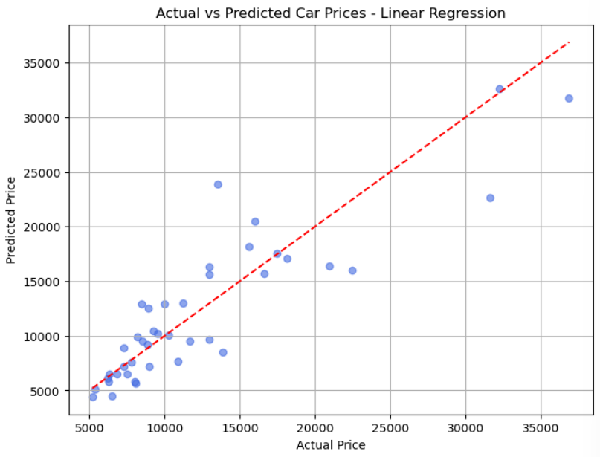

Slide 12
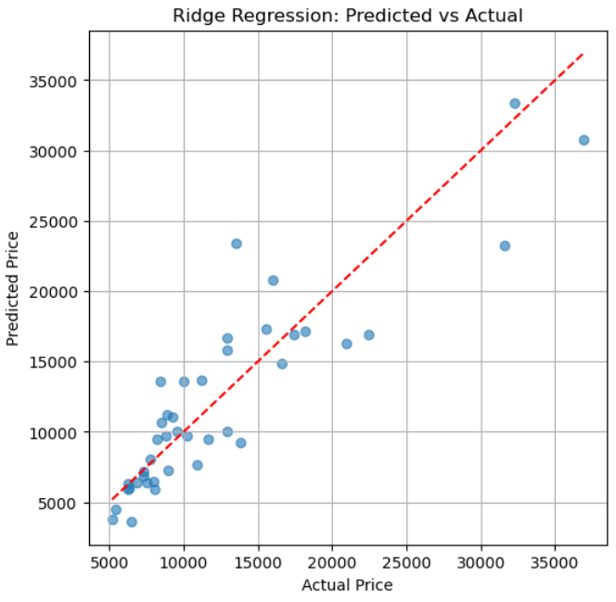

Slide 13
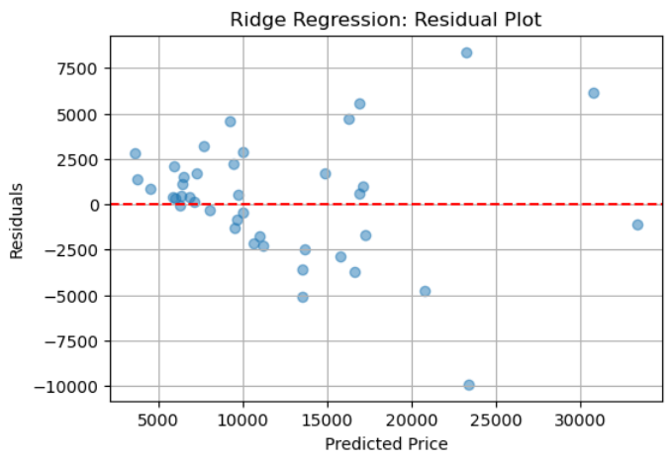

Slide 14
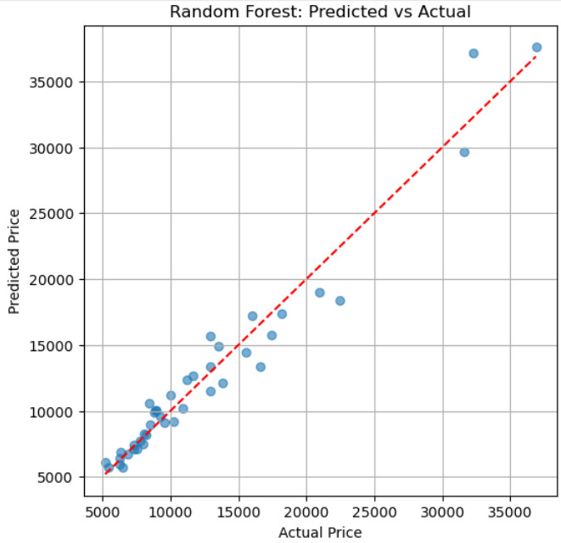

Slide 15
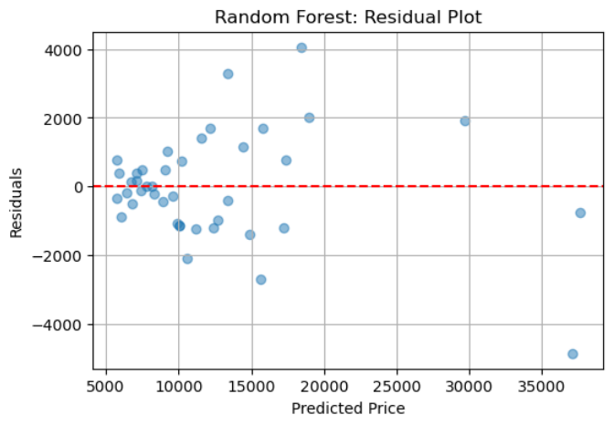

Slide 16
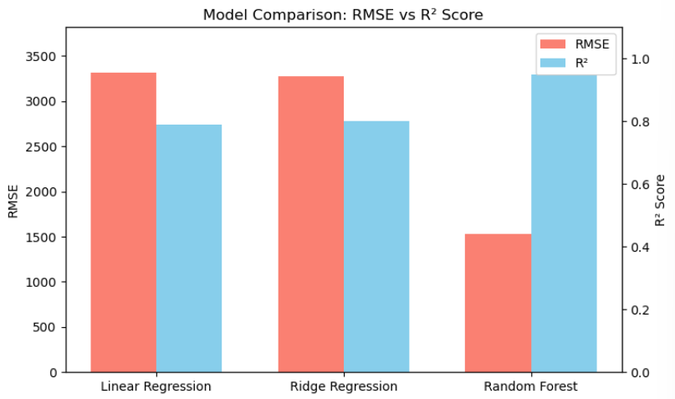

Slide 17
Conclusion
Key Takeaways:
Random Forest Regressor delivered the best performance
Train R²: 0.988
Test R²: 0.956
RMSE: 1533.12
Ridge Regression and Linear Regression performed well, but less accurate than Random Forest.
The model captures key price-driving features such as engine size, horsepower, curb weight, and fuel type.
Cross-validation confirms model reliability:
Random Forest CV Mean R²: 0.907 (lowest std dev = most stable)
Business Insight:
The final model can be reliably used to predict car prices based on car attributes.
This can help sellers like "Tom" set fair and data-driven prices.

