Slide 1

Centaur : Locating Devices in an Office Environment
Rajalakshmi Nandakumar
Krishna Kant Chintalapudi
Venkat Padmanabhan
INDIA

Slide 2


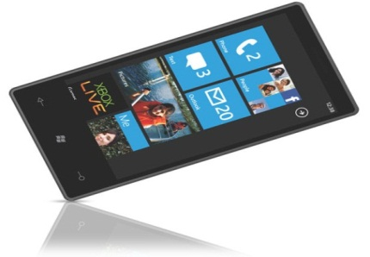
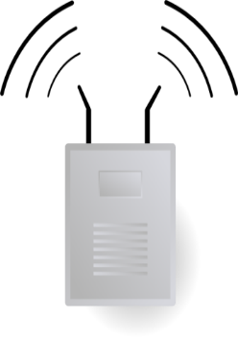

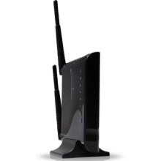


Motivation
Enterprises have a plethora of IT assets.
The physical asset tracking and maintenance is vital for an enterprise
Manual Tracking
IT

Slide 3
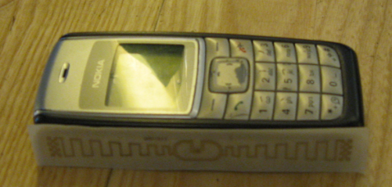
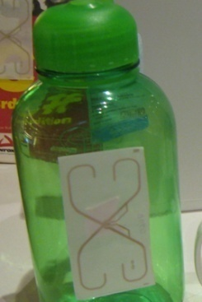
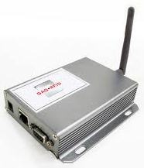
RFID Based Systems
RFID Antennas
+ RFID systems can track all kinds of devices.
- Requires additional infrastructure.

Slide 4
Can We ?
What if we consider only computing assets in an enterprise ?
Can we track these devices without any additional infrastructure by leveraging the sensing capabilities of these devices?

Slide 5

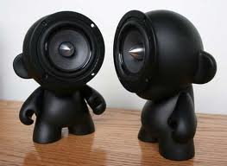
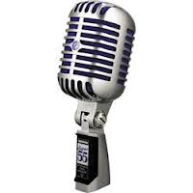

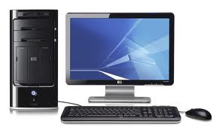
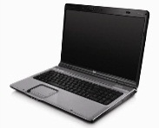

Computing Devices in Office Environment
WiFi, Speaker and mic
Speaker and mic
Only Speaker

Slide 6
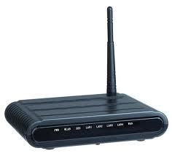


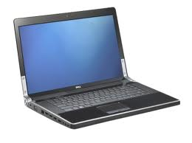
Centaur : Locating IT equipment
Centaur tracks IT assets in an enterprise by leveraging the WiFi and acoustic sensing capabilities of the devices themselves.
Fusion
WiFi-based
Localization
Acoustic
Ranging
Location Distributions
Geometric Constraints

Slide 7
Why
Fusion?

Slide 8
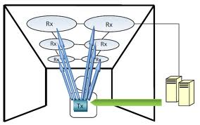
Related Work : Acoustic Localization
Schemes like Active Bat and Cricket have ultrasound devices in ceilings and host devices.
Use time of flight measurement to localize.
Measurement of time of flight requires time synchronization.
BeepBeep was the first scheme to do acoustic ranging without time synchronization.

Slide 9
Acoustic Localization: Issues
Requires deployment of special ultrasound devices.
Large number of beacons because acoustic ranging can be done in the order of few meters.

Slide 10
Related Work : WiFi Localization
Schemes like Radar, Horus constructs RF maps by fingerprinting every location and use it to localize devices.
Requires huge effort to construct database.
Schemes like EZ that use RF propagation model to localize devices.
Accuracy is low compared to the above schemes.

Slide 11
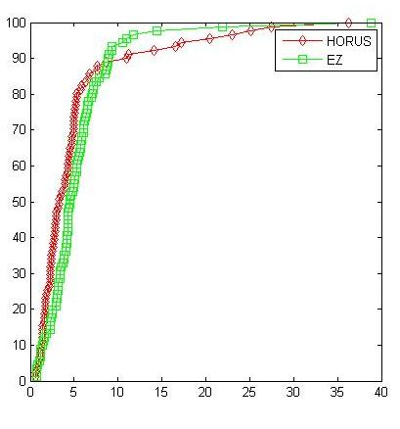
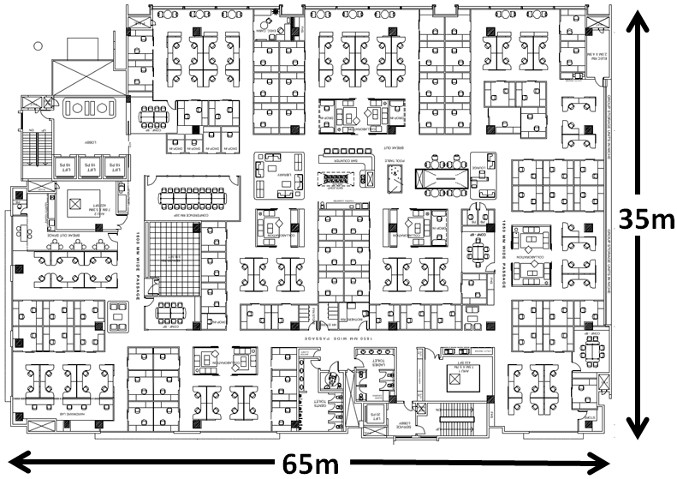
How Well Does WiFi Localization Work?
Tail error is high
CDF in %
Error in m

Slide 12
How does Centaur solve these problems by fusing WiFi and Acoustic Localization ?

Slide 13
Coverage in Centaur
Device with speaker and mic
Device with only speaker

Slide 14


Coverage in Centaur
Devices with WiFi ,speaker and mic.
WiFi-based
localization
Acoustic ranging
Distance
Differences
Devices with only speaker
Secondary localization
of peripherals.
Devices with speaker and mic.

Slide 15

Accuracy in Centaur
P(x_{A} | WiFi_{A} ,WiFi_{B} , d_{AB})
P(x_{B} | WiFi_{A} ,WiFi_{B} , d_{AB})
P(x_{A} | WiFi_{A})
P(x_{B} | WiFi_{B})
d_{AB}
A
B

Slide 16
Challenges
Acoustic ranging in cluttered office environments.
Accommodating speaker-only (“deaf”) devices.
Fusing WiFi and Acoustic Localization using Bayesian Inference.

Slide 17

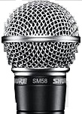
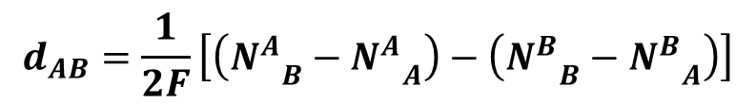
BeepBeep : Acoustic Ranging
Laptop A
d_{AB}
Laptop B
_{B}
_{B}
N
N
_{A}
_{B}
B
$$d_{AB}=\frac{1}{2F}\left[\left({N_{}^{A}}_{B}−{N_{}^{A}}_{A}\right)−\left({N_{}^{B}}_{B}−{N_{}^{B}}_{A}\right)\right]$$
A
BeepBeep [Sensys 2007]
_{A}
_{A}
N
N
_{A}
_{B}

Slide 18
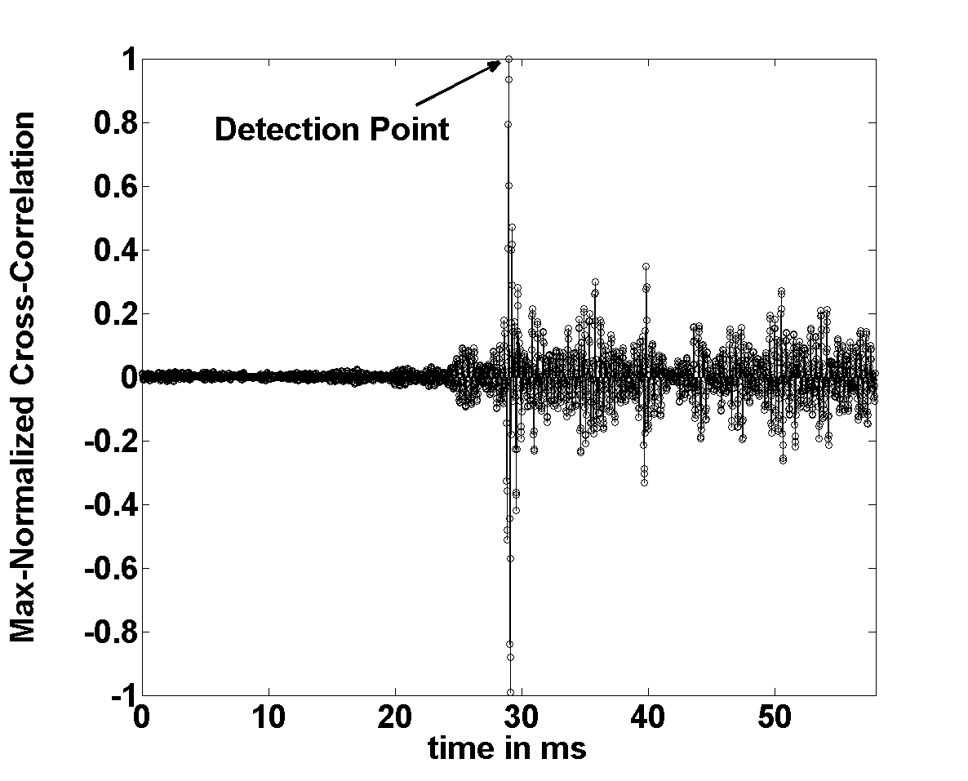
Determining the Onset of Acoustic Signal
Send a known signal – correlate at the receiver, find peak
Chirp/PN sequence have excellent auto correlation properties
6m Line of Sight

Slide 19
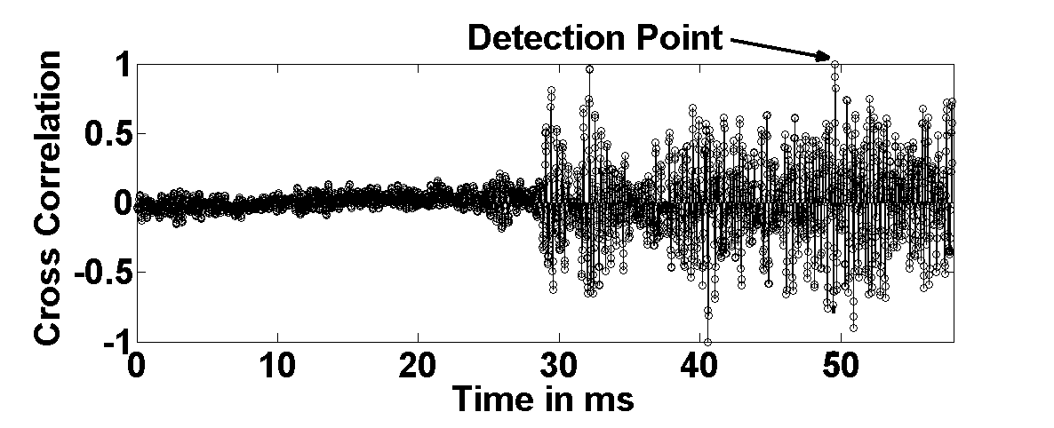
Effect of Multipath in Non-Line of Sight
The shortest path will be weaker than reflected paths

Slide 20
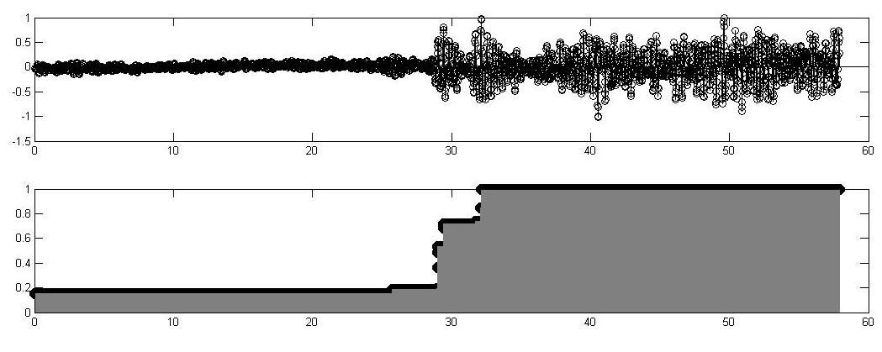
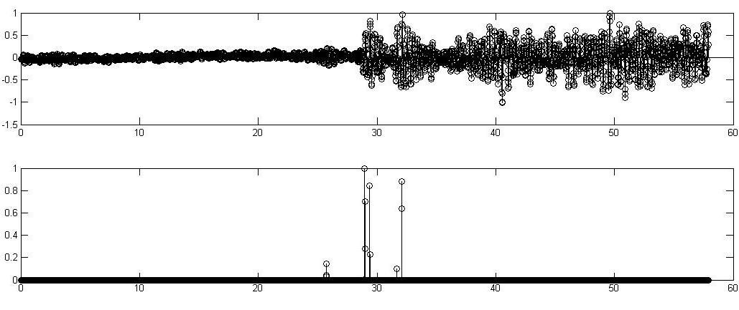
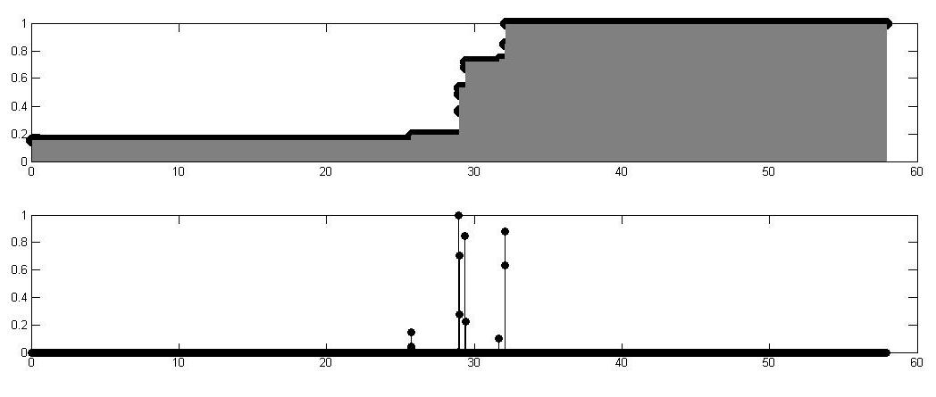
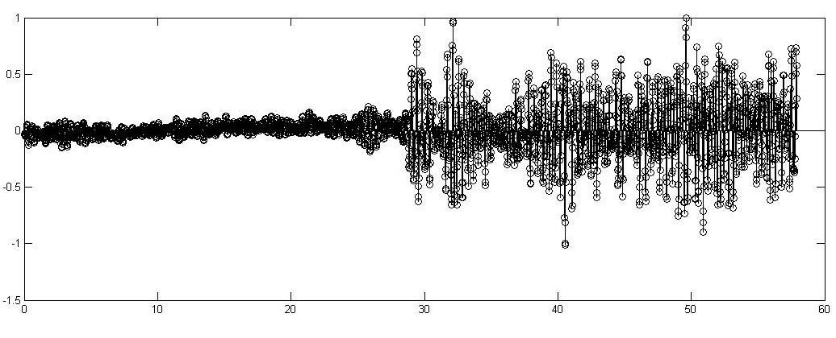

EchoBeep – Acoustic Ranging for NLOS
Correlation
$$O\left(n\right)=\max\left\{C\left(k\right)\right\} n>k>n−W$$
$$∆O\left(n\right)=O\left(n\right)−O(n−1)$$
Time in ms
Time in ms
Time in ms
Time in ms

Slide 21
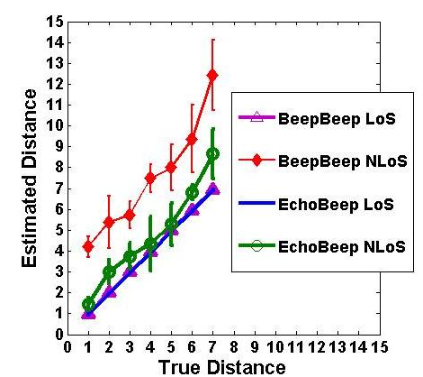
Performance of EchoBeep

Slide 22
Challenges
Acoustic ranging in cluttered office environments.
Accommodating speaker-only (“deaf”) devices.
Fusing WiFi and Acoustic Localization using Bayesian Inference.

Slide 23
Locating Speaker Only Devices
Devices like Desktops may have only Speakers.
EchoBeep can be applied only to devices that have both Speaker and Microphone.
We find Distance Difference between devices and Use them to localize speaker only devices.

Slide 24






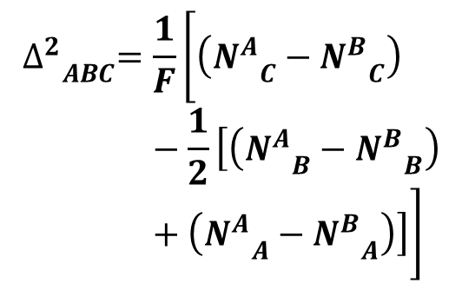
DeafBeep – Measuring Distance Differences
A
B
_{A}
_{A}
_{A}
N
N
_{B}
_{A}
N
C
A
_{C}
$${∆_{}^{2}}_{ABC}=\frac{1}{F}\left[\left({N_{}^{A}}_{C}−{N_{}^{B}}_{C}\right)−\frac{1}{2}\left[\left({N_{}^{A}}_{B}−{N_{}^{B}}_{B}\right)+\left({N_{}^{A}}_{A}−{N_{}^{B}}_{A}\right)\right]\right]$$
C
_{B}
_{B}
_{B}
N
N
N
B
_{B}
_{A}
_{C}

Slide 25
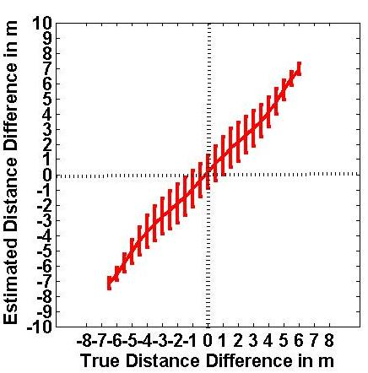
Performance of DeafBeep
The uncertainty is maximum when distance difference is close to 0

Slide 26
Challenges
Acoustic ranging in cluttered office environments.
Accommodating speaker-only (“deaf”) devices.
Fusing WiFi and Acoustic Localization using Bayesian Inference.

Slide 27
Modeling Centaur as a Bayesian Graph
Each measurement is modeled as a Bayesian Sub graph.
All these sub graphs are put together to form a complete Bayesian graph.

Slide 28
Sub Graph for WiFi Measurement
P(R_{A} = r_{A}| X_{A} = x_{A} )
R_{A}
Evidence Node
X_{A}
Node
P(X_{A} = x_{A} )

Slide 29
Bayesian Sub Graphs
EchoBeep
DeafBeep
X_{A}
X_{C}
P(X_{A} = x_{A} )
P(X_{B} = x_{B} )
X_{A}
X_{B}
Δ²_{ABC}
d_{AB}
P(Δ²_{ABC} = δ_{ABC}|
X = x_{A} , X_{B} = x_{B} , X_{C} = x_{C})
P(d_{AB} = d| X_{A} = x_{A} , X_{B} = x_{B})
X_{B}
P(X_{B} = x_{B})
P(X_{A} = x_{A})
P(X_{C} = x_{C})

Slide 30



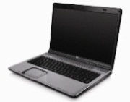
Putting it all Together
Desktop C
(Anchor)
R_{A}
X_{A}
X_{B}
X_{E}
Δ²_{ACE}
X_{A}
Δ²_{BCE}
d_{AB}
R_{A}
Δ²_{ABE}
R_{B}
Exact inference of a Bayesian graph with loops is NP-Hard
X_{E}
X_{B}
X_{A}
Δ²_{ACD}
Desktop E
Δ²_{BCD}
Laptop A
Desktop D
(Anchor)
Δ²_{ABE}
d_{AC}
Δ²_{ABC}
d_{BC}
Laptop B
X_{A}
X_{B}
d_{AB}

Slide 31
Approximate Bayesian Inference
Approximate Bayesian Techniques
Loopy Belief Propagation
Sampling techniques like Gibbs Sampling
Maximum Likelihood approach
These well known techniques don’t converge easily for our problem.

Slide 32
Bayesian inference in Centaur

Slide 33
Two Step Process
Partition the entire graph into loop free sub graphs and perform exact inference on the sub graphs.
Maximize the joint distribution by searching over the narrowed distribution obtained in the 1st step.

Slide 34
First Partition The Graph Into Trees
X_{A}
X_{B}
X_{E}
X_{E}
X_{E}
Δ²_{ACE}
Δ²_{ACE}
Δ²_{BCE}
R_{A}
Δ²_{ABC}
R_{A}
Δ²_{BCE}
Δ²_{ABE}
Δ²_{ABE}
R_{B}
R_{B}
X_{A}
X_{B}
G3
X_{A}
X_{B}
X_{A}
Δ²_{ACD}
Δ²_{ACD}
X_{B}
Δ²_{BCD}
Δ²_{BCD}
X_{A}
X_{B}
Now form the complement graph of G1 and again remove all loop causing evidence nodes – G2
d_{AC}
Δ²_{ABC}
d_{BC}
d_{AC}
d_{BC}
Remove all evidence that causes loops – G1
d_{AB}
d_{AB}
G4

Slide 35
Use Pearl’s Exact Inference In Cascade
X_{A}
X_{B}
X_{E}
X_{E}
Δ²_{ACE}
Δ²_{BCE}
Δ²_{ABC}
R_{A}
R_{B}
Δ²_{ABE}
X_{B}
G3
X_{A}
X_{A}
Δ²_{ACD}
X_{B}
Δ²_{BCD}
Use the inference from G1 as prior for G2 and the run Pearl’s algo
X_{A}
X_{B}
d_{AC}
d_{BC}
Find exact inference on G1 using Pearl’s algo
d_{AB}
G4

Slide 36
Now Find Maximum Likelihood
Search for the solution that maximizes the exact joint distribution P(X | E)
We sample each variable using the results of the posterior from the previous step for searching
We used a GA but found that in most practical scenarios, since the distributions were very narrow the search converged very quickly

Slide 37
Performance of Centaur

Slide 38
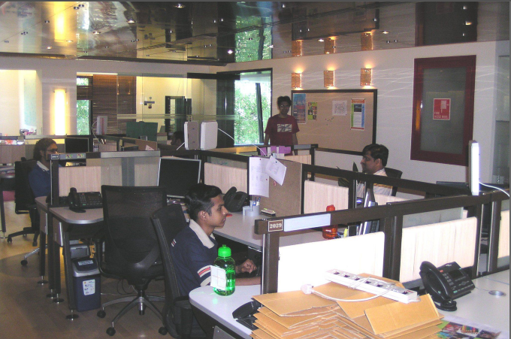
Experiment Setup
Experiments were conducted in office building of area 65m X 35m.
Experiments included all type of devices.
Goal :
To evaluate
Coverage of Centaur
Accuracy of Centaur

Slide 39
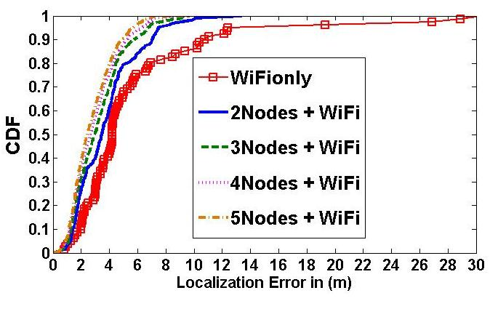
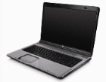
Ranging on Non-Anchor Nodes
Error Decreases even with 2 devices.

Slide 40
Locating Speaker only Devices
40

Slide 41
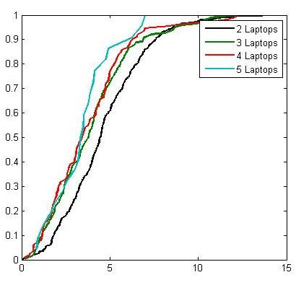
Locating Speaker only Devices
CDF in %
50 % error is less than 5m.
As number of devices increases, the error decreases.
Error in m
Error in m

Slide 42
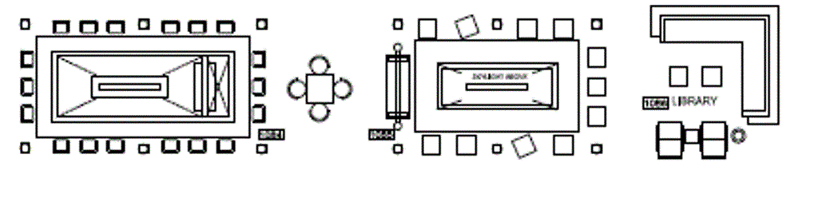
Composite Setup
8
1
8
6
8
6
1
5
8m
By combining acoustic measurements with WiFi, the max error decreased from 13m to 3m.
7
5
7
2
2
4
2
3
4
3
7
27m
True Location
WiFi Only
WiFi + acoustic

Slide 43
Summary
EchoBeep : Performs acoustic ranging accurately in cluttered multipath environments.
DeafBeep : Compute the distance differences between devices to localize speaker only devices.
Centaur fuses the above acquired acoustic measurements with the WiFi measurements to track IT assets accurately without any additional infrastructure

Slide 44

Thank you

