Slide 1
YOLO: You Only Look Once Unified, Real-time Object Detection
Presenter: Dhruv Jain
Date: 12/15/2023
https://arxiv.org/abs/1506.02640
Redmon et al. CVPR 2016.
Notes:
Goal of YOLO algorithm is to do object detection with fast AND high accuracy.

Slide 2
Related Framework
R-CNN or Region Based Convolutional Network:
Used the sliding window approach from earlier, with Selective Search, a smarter way to select candidates (which means there is less computation)
Still feeds a limited part of the image to the classifier
Drawbacks: Large pipeline, slow, too many false positives
Fast and Faster R-CNN:
Optimize parts of the pipeline described earlier
Drawbacks: loses accuracy

Slide 3
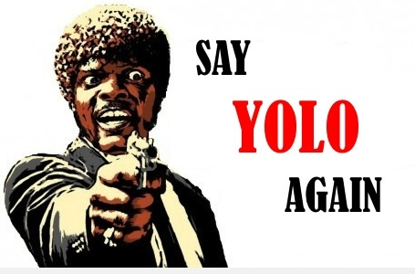
What is YOLO?
Created by Joseph, ali from Washington university, santosh form allen institute and ross from facebook.
In computer vision: YOLO,YOLOv2, YOLOv3, YOLOv4, YOLOv5, YOLOV6, YOLOV7, YOLOv8, and YOLO-NAS.
The YOLO family of models has continued to evolve since the initial release in 2016. Notably, YOLOv2 and YOLOv3 are both by Joseph Redmon. YOLO models after YOLOv3 are written by new authors and – rather than being considered strictly sequential releases to YOLOv3 – have varying goals based on the authors' whom released them.
Notes:
Yolo uses . We apply a single neural network to the full image. This network divides the image into regions and predicts bounding boxes and probabilities for each region. These bounding boxes are weighted by the predicted probabilities.
Won -> the OpenCV People’s Choice Award
Prior detection systems repurpose classifiers or localizers to perform detection. They apply the model to an image at multiple locations and scales. High scoring regions of the image are considered detections.

Slide 4
Context
What is object detection?
How does it work?
Bounding box
IOU
Loss Function
The final architecture
Dataset considered
Evaluation/ Comparison
Final Project
Summary

Slide 5
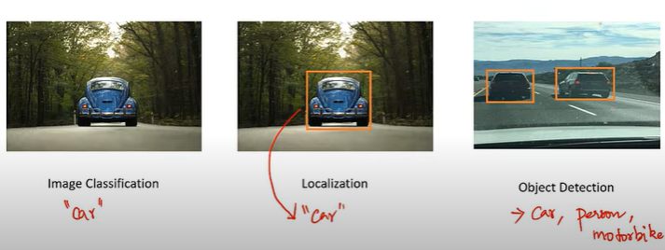
Classification vs Localization vs Detection
Notes:
What is the object? This question seeks to identify the object in a specific image.
Where is this Located ? This question seeks to establish the exact location of the object within the image.
Object Detection It is a phenomenon in computer vision that involves the detection of various objects (eg. people, cars, chairs, stones, buildings, and animals) in digital images or videos.

Slide 6
How does it work ?
Notes:
How does it work, How do I teach a model that this is how we can generate a box.?

Slide 7
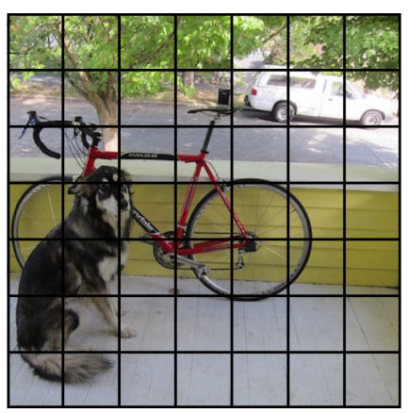
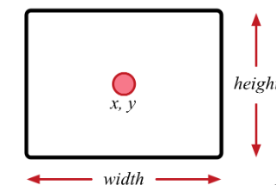



Bounding box
Split the image into 7x7
What is bounding box?
A bounding box is described by four numbers Bx , By, Bw, Bh.
Notes:
Each bounding box also has a class — the type of the object inside the box — and a probability that tells you how confident the model is in its prediction of both the bounding box coordinates and the class.

Slide 8

How does the matrix look like?
Pc
Bx
By
Bh
Bw
C1
C2
C3
Pc - confidence (probability bounding box has object) value will be 1 or 0 based on image found.
Bx, By (coordinates for center of bounding box)
Bw, Bh (width and height)
C1,C2,C3 are class (classification of object in bounding box)

Slide 9
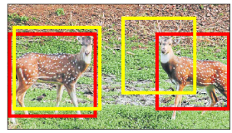
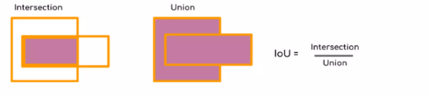
Intersection over Union (IoU)
The number near to 1 is better.
Non-maximal suppression

Slide 10
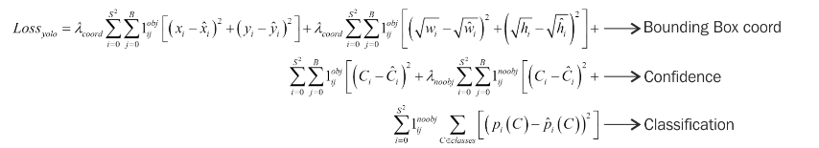
Loss
Three parts: the one responsible for finding the bounding-box coordinates, the bounding-box score prediction, and the class-score prediction.
All of them are Sum of Squared error losses and are modulated by some scalar meta-parameter or IoU score between the prediction and ground truth (Lambda(coord)=5, Lambda(noobj)=0.5 )
Notes:
Sum-squared error also equally weights errors in large boxes and small boxes. Our error metric should reflect that small deviations in large boxes matter less than in small boxes. To partially address this we predict the square root of the bounding box width and height instead of the width and height directly.

Slide 11
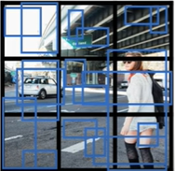
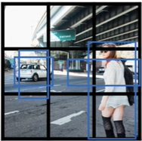
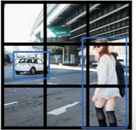
What's happening in actual image ?
Notes:
Step 1: Split the image size here it is 3x3 but in general yolo will split into 19x19.
Step 2: Remove the low probability predictions.
Step3: Find IOU for the similar bxoes.
For each class use non-max suppression to generate a final prediction .

Slide 12
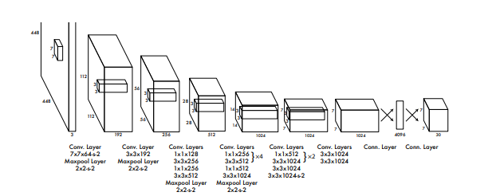
The Architecture
Now that we know the input and output, we can discuss the model
We are given 448 by 448 by 3 as our input.
Implementation uses 7 convolution layers.
Paper parameters:
S = 7, B = 2, C = 20 –
Output S*S*(5B+C) = 7*7*(5*2+20) = 7*7*30
Notes:
The final output of our network is the 7 × 7 × 30 tensor of predictions

Slide 13
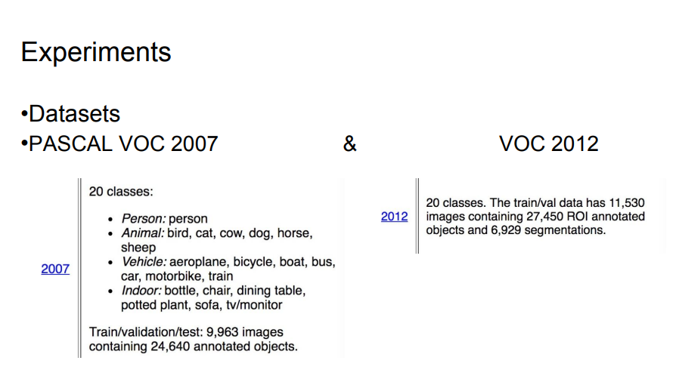
Data set

Slide 14
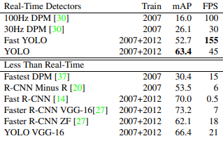
Comparison with pascal voc 2007
Notes:
To evaluate object detection models like R-CNN and YOLO, the mean average precision (mAP) is used. The mAP compares the ground-truth bounding box to the detected box and returns a score. The higher the score, the more accurate the model is in its detections.
Fast YOLO is the fastest detector on record for PASCAL VOC detection and is still twice as accurate as any other real-time detector. YOLO is 10 mAP more accurate than the fast version while still well above real-time in speed.

Slide 15
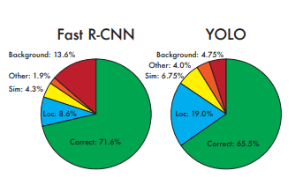
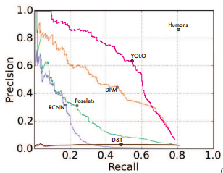
Error Analysis: Fast R-CNN vs. YOLO
Picasso Dataset precision-recall curves.
Notes:
YOLO struggles to localize objects correctly. Localization errors account for more of YOLO’s errors than all other sources combined. Fast R-CNN makes much fewer localization errors but far more background errors. 13.6% of it’s top detections are false positives that don’t contain any objects. Fast R-CNN is almost 3x more likely to predict background detections than YOLO.

Slide 16
Strength
Weaknesses
Fast: 45fps, smaller version 155fps
End2end training
Background error is low
Performance is lower than state-of-art.
Makes more localization errors
Struggle with Small Object.
Notes:
Limitations: Loss function is an approximation.

Slide 17
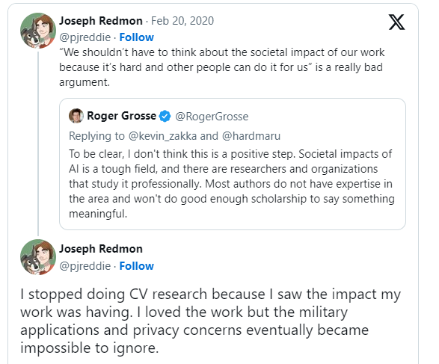
Social impact
Positive impact of Object detection technology can be used in interactive robotics to provide better human-robot interaction capabilities.
Negative social impacts that need to be considered, such as the impact on privacy. Object detection technology can be used to monitor and track individuals, raising concerns about privacy and security.

Slide 18
Any Question ?

Slide 19
Project: Comparison Of 3 Different Model For CIFAR100 Dataset

Slide 20
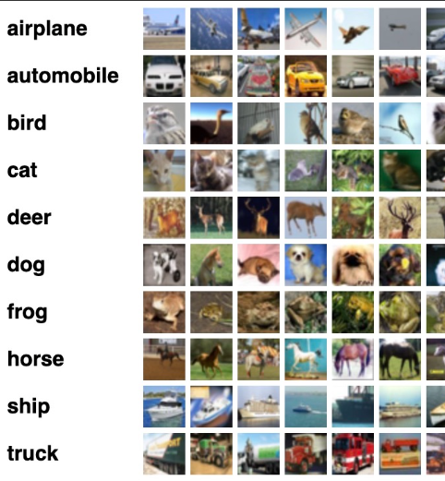
CIFAR-100
The CIFAR-100 dataset (Canadian Institute for Advanced Research, 100 classes) is a subset of the Tiny Images dataset and consists of 60000 32x32 color images.
The 100 classes in the CIFAR-100 are grouped into 20 superclasses. There are 600 images per class. Each image comes with a "fine" label (the class to which it belongs) and a "coarse" label (the superclass to which it belongs). There are 500 training images and 100 testing images per class

Slide 21
Model comparison
ResNet - residual network
VGG16
CNN

Slide 22
Accuracy
CNN Model Evaluation:
Test Accuracy: 42.31%
VGG16 Model Evaluation:
Test Accuracy: 26.30%
ResNet Model Evaluation:
Test Accuracy: 34.5%

Slide 23
Model noise
ResNet50 Robustness Testing:
Noisy Test Accuracy: 10.29%
This suggests that ResNet50 performed very well under noisy conditions, as it maintained a high accuracy level.
VGG16 Robustness Testing:
Noisy Test Accuracy: 1.80%
CNN Robustness Testing:
Noisy Test Accuracy: 43.13%
CNN model is less robust under noisy conditions.

Slide 24
Novel image
Vgg16 Model Prediction:
Top Predicted Classes for Vgg16 Model:
1. clock: 100.00%
2. telephone: 0.00%
3. can: 0.00%
4. couch: 0.00%
5. crocodile: 0.00%
Cnn Model Prediction:
Predicted Class: apple
Top Predicted Classes for Cnn Model:
1. apple: 82.93%
2. pear: 6.26%
3. wardrobe: 2.96%
4. plate: 1.97%
5. bowl: 1.47%
Saving APPLE.png to APPLE.png
Resnet Model Prediction:
Predicted Class: butterfly
Top Predicted Classes for Resnet Model:
1. poppy: 1.46%
2. rose: 1.31%
3. tulip: 1.30%
4. sweet_pepper: 1.15%
5. aquarium_fish: 1.15%

Slide 25
Novel input is coffee
Saving coffee.png to coffee.png
Resnet Model Prediction:
Top Predicted Classes for Resnet Model:
1. cockroach: 1.10%
2. dinosaur: 1.09%
3. couch: 1.09%
4. lawn mower: 1.09%
5. chair: 1.08%
Vgg16 Model Prediction:
Top Predicted Classes for Vgg16 Model:
1. plate: 1.02%
2. aquarium_fish: 1.02%
3. bottle: 1.02%
4. man: 1.01%
5. shrew: 1.01%
Cnn Model Prediction:
Top Predicted Classes for Cnn Model:
1. crab: 36.84%
2. table: 15.47%
3. bowl: 6.83%
4. motorcycle: 6.79%
5. bicycle: 5.61%

Slide 26
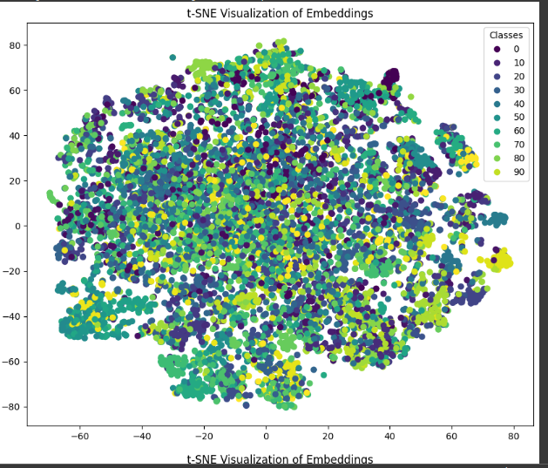
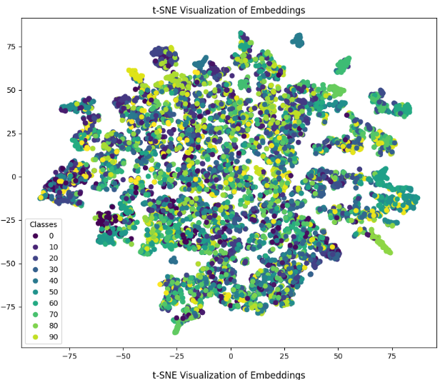
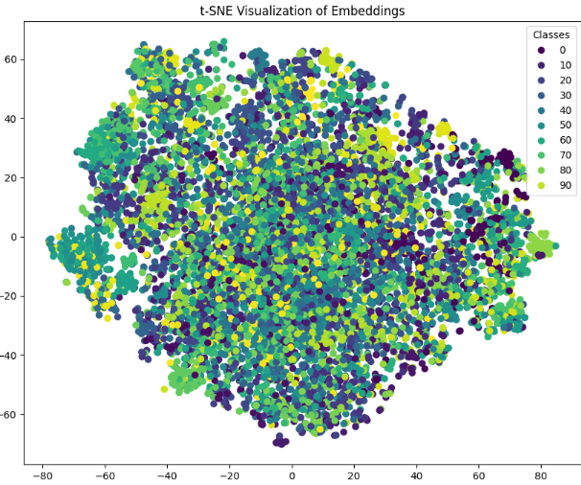
Resnet vs VGG16 vs CNN t-SNE Plot

Slide 27
Future Work
I will work on the pre-trained model.
Adding more layers in CNN model.
Hyperparameter tuning is required to achieve the max goal.

Slide 28
Thank you

