Slide 1
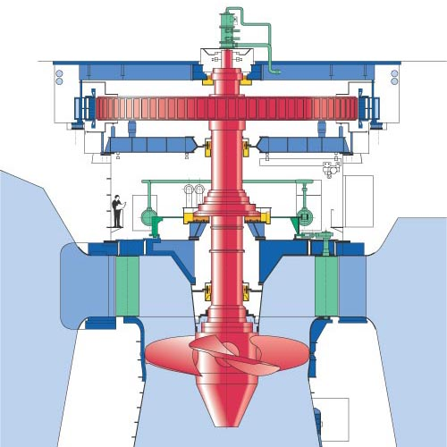
Design of Kaplan Turbine
P M V Subbarao
Professor
Mechanical Engineering Department
Pure Axial Flow with Aerofoil Theory….

Slide 2
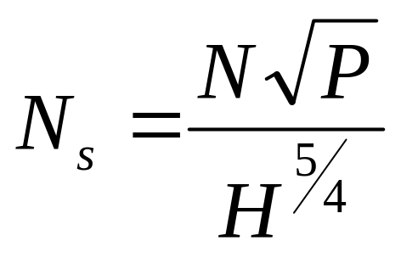
Selection of Kaplan Turbine
MORE ADAPTED TYPE OF TURBINA IN FUNCTION OF THE SPECIFIC SPEED.
Specific Speed in r.p.m. | Turbine type | Jump height in m
From 270 to 500 | Slow Kaplan | 50 to 15
From 500 to 800 | Quick Kaplan | 15 to 5
From 800 to 1100 | Extra-quick Kaplan | Less than 5
P in hp and H in meters.

Slide 3
Design of A Kaplan Turbine

Slide 4
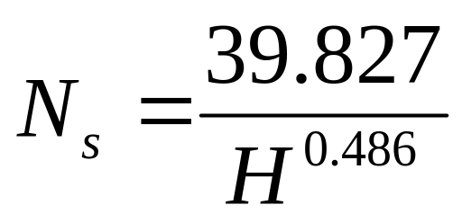
Specific Speed of Kaplan Turbine
Using statistical studies of schemes, F. Schweiger and J. Gregory established the following correlation between the specific speed and the net head for Kaplan turbines:
P in watts.

Slide 5
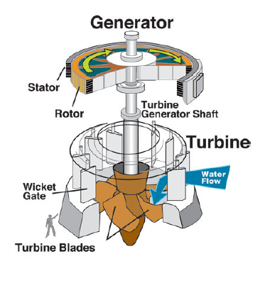
The Schematic of Kaplan Turbine

Slide 6
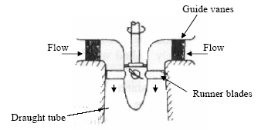

Major Parts of A Kaplan Turbine
P, in hp and H in meters.

Slide 7
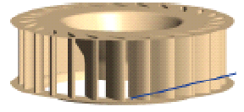
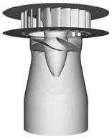
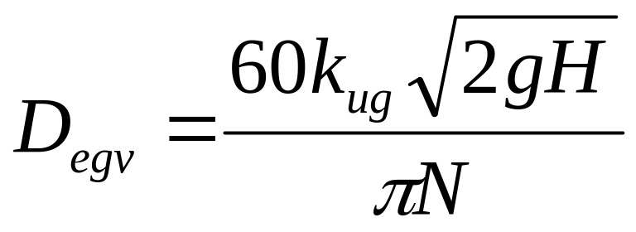
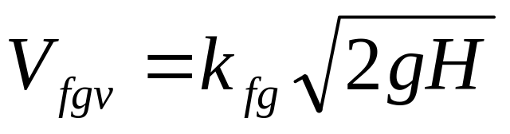
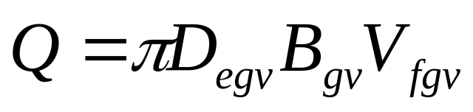
Design of Guide Wheel
D_{egv}

Slide 8
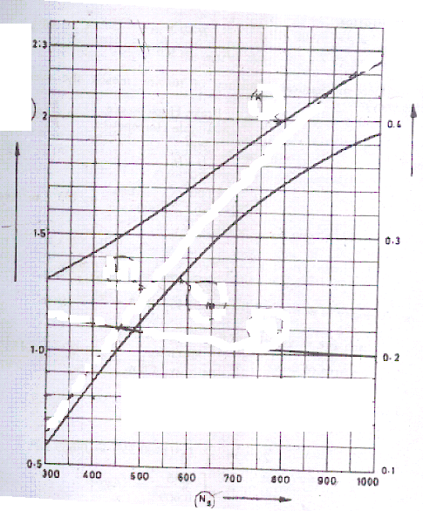
K_{ug}
K_{fg}
K_{ug}
K_{fg}

Slide 9
Flow & Geometric Details of Guid Wheel Exit

Slide 11
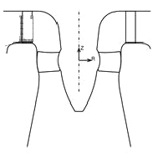
Outlines of Kaplan Runner
a
b
Guide Vanes
Whirl Chamber
The space between guide wheel outlet and kaplan runner is known as Whirl Chamber.
a=0.13 D_{runner} & b=0.16 to 0.2 D_{runner}.

Slide 12
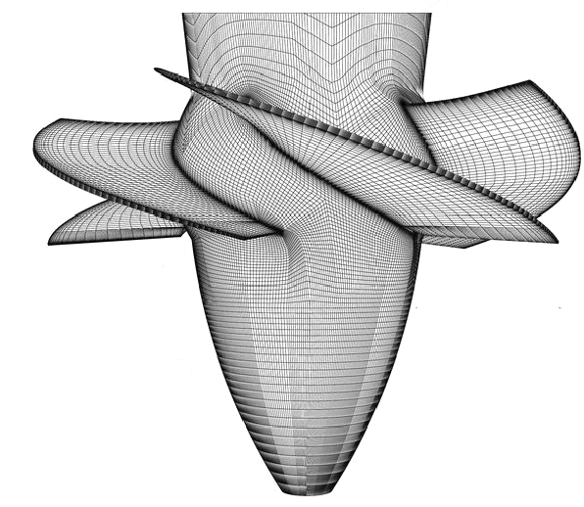
Design of Kaplan Runner
D_{runner}
D_{hub}

Slide 13
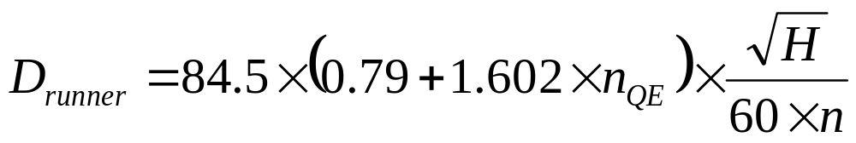
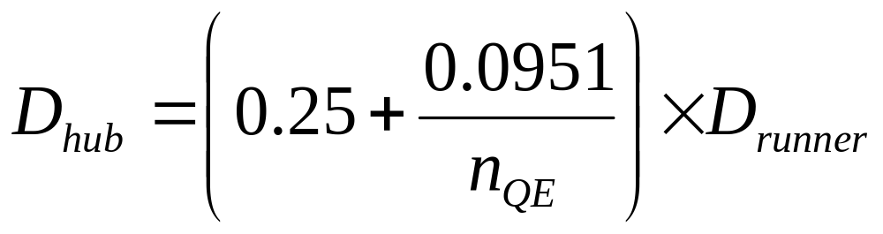
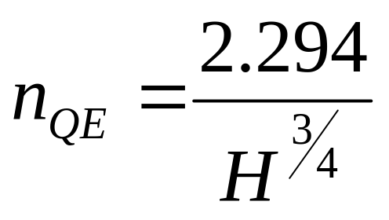
Testing of Runner diameter selection
The runner diameter De can be calculated by the following equation:
n in rps

Slide 14
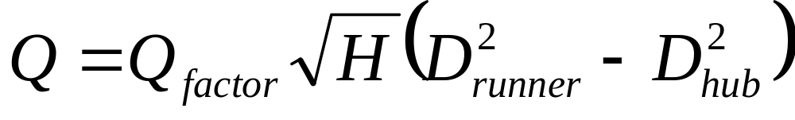
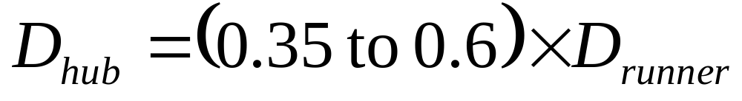
Runner diameter section
The hub diameter D_{hub} can be calculated with the following equation:

Slide 15
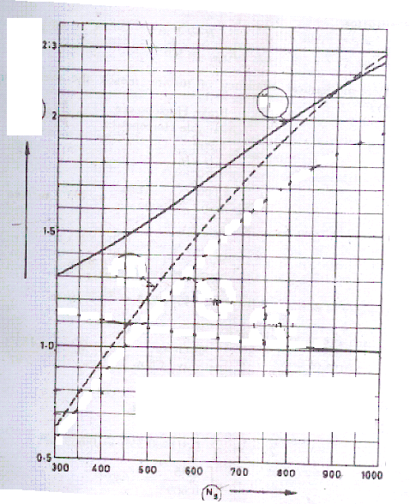
K_{ug}
Q_{factor}

Slide 16
Number of runner Vanes Vs Guide Wheel Diameter
Z | 8 | 10 | 12 | 14 | 16 | 18 | 20 | 24
D_{ge},mm | <300 | 300 – 450 | 450 – 750 | 750 – 1200 | 1200 – 1600 | 1600 - 2200 | 2200 4000 | >4000

Slide 17
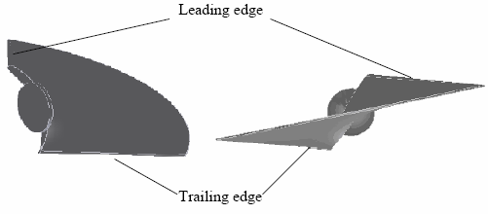
DESIGN OF THE BLADE
Two different views of a blade

Slide 18
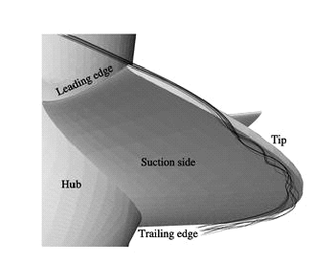
Hydrodynamics of Kaplan Blade

Slide 19
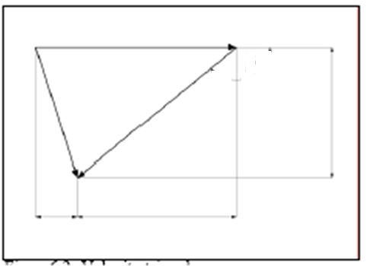
Distortion of the blade under ideal circumstances
The velocity triangles, which occur on the blade, play a significant role in determining its distortion.
α₁ < 90⁰
U_{wheel}
V_{fi}
V_{ai}
V_{ri}

Slide 20
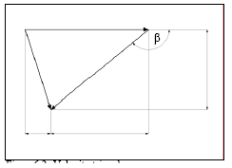
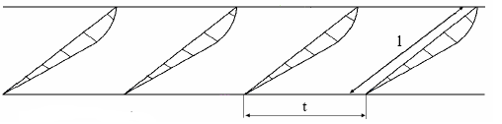
Details of Blade Arrangement
U_{wheel}
V_{ai}
V_{ri}
V_{fi}
U_{wheel}
V_{ae}
V_{re}
V_{fe}
α_{e} = 90⁰

Slide 21
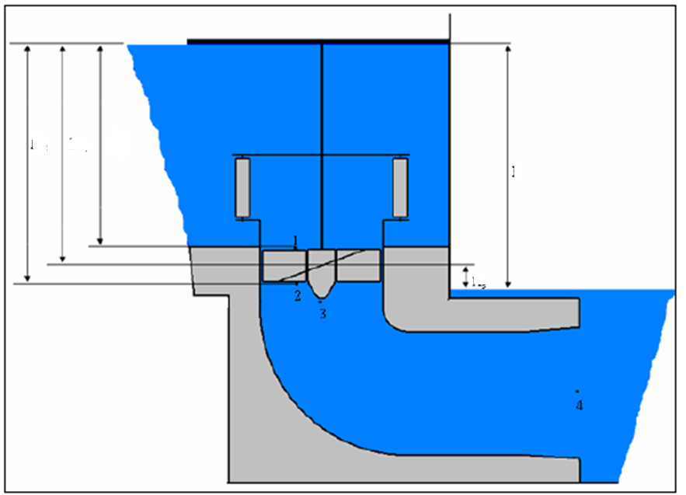
Hydraulic Energy Diagram
H_{m}
H_{ri}
H_{re}
H_{total}
H_{s}

Slide 22
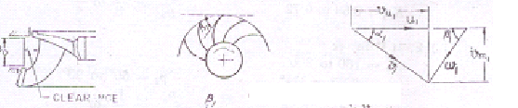
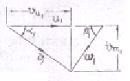
Inlet Velocity Triangles Vs Ns
High Specific Speed : Fast Francis Runner
V_{wi}
V_{fi}
V_{ai}

Slide 23
Specifications of Runner
Slow Runner: N_{s}=60 to 120
  α_{ι} = 15⁰ to 25⁰
  K_{ui} = 0.62 to 0.68
  β_{ι} = 90⁰ to 120⁰
  B_{gv}/D_{mgv}=0.04 – 0.033
Normal Runner: N_{s} = 120 – 180
  α_{ι} = 25⁰ to 32.5⁰
  K_{ui} = 0.68 to 0.72
  β_{ι} = 90⁰
  B_{gv}/D_{mgv}=0.125 to 0.25
Fast Runner: N_{s} = 180 to 300
  α_{ι} = 32.5⁰ to 37.5⁰
  K_{ui} = 0.72 to 0.76
  β_{ι} = 60⁰ to 90⁰
  B_{gv}/D_{mgv}=0.25to 0.5

Slide 24
Design for Maximum Power Retrieval
Inlet Velocity Triangle
U_{wheel}
V_{ai}
V_{ri}
V_{fi}

Slide 25
Specifications of the Runner

Slide 26
Velocity Triangles at Mean Runner Diameter

Slide 28
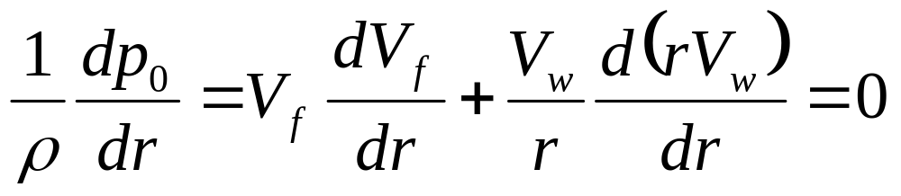
Radial Equilibrium
Radial Equilibrium Equation for Incompressible Fluid Machine

Slide 29
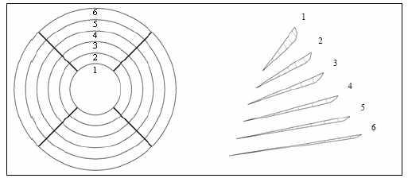
To define the distortion of the blade, the velocity triangles of at least six different radiuses of the blade are to be determined.
The angle β of each radius gives conclusions on the distortion of the blade.
The angles should be corrected for real hydraulics.

Slide 30
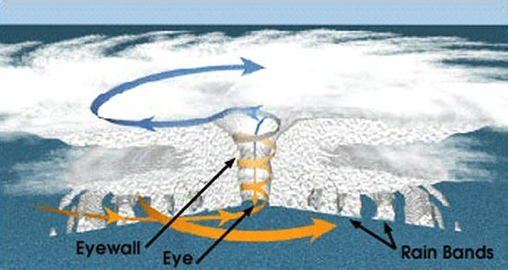
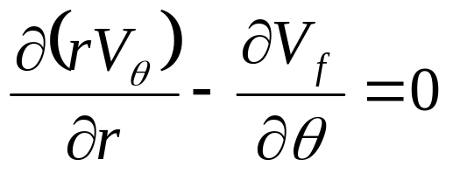
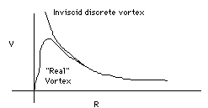
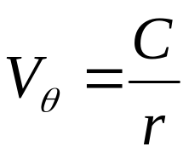
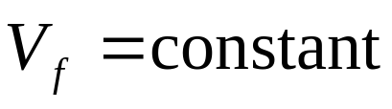
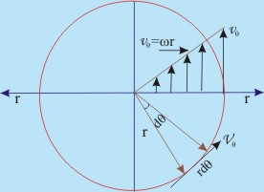
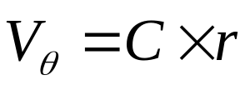
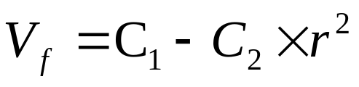
General Rules for Selection of Whirl Component
Free Vortex Whirl:
Forced Vortex Whirl :

Slide 32
Inlet Blade Distortion

Slide 33
Inlet Blade Distortion

Slide 34
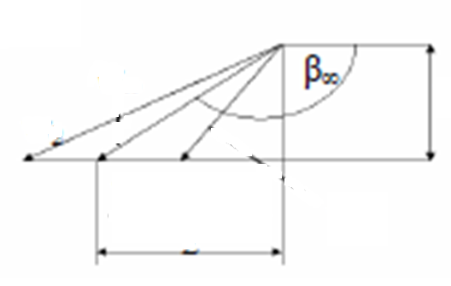
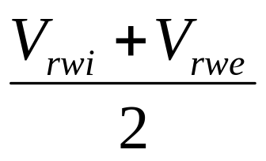
Method for Real Kaplan
Define Half Travel Point of a fluid particle as
V_{fi}=V_{fe}
V_{re}
V∞
V_{ri}

Slide 36
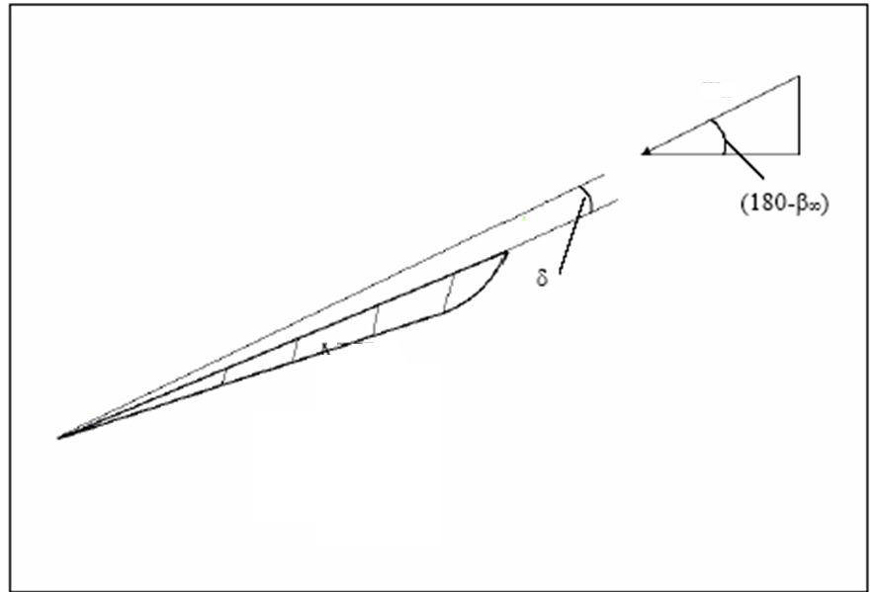
The “Tragflügeltheorie”
V∞
F_{ideal lift}
F_{actual lift}

Slide 37
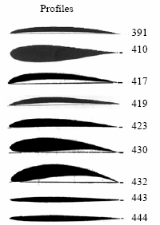
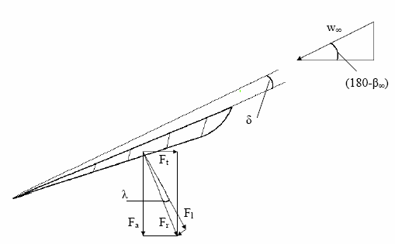
V_{ri}

Slide 38
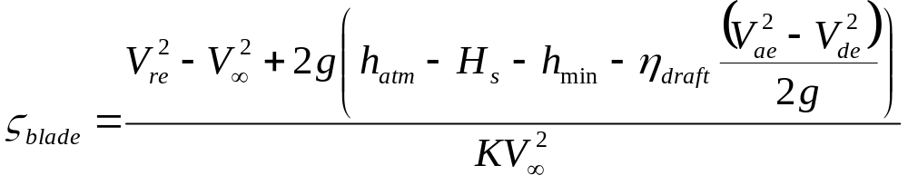
Characteristics of A Single Blade
Ideal Blade lift coefficient:
η_{draft}: Efficiency of draft tube: 0.88 to 0.91
K : Profile characteristic number: 2.6 to 3.0
h_{min}=Head equivalent to minimum allowable pressure at
Runner exit.

Slide 39
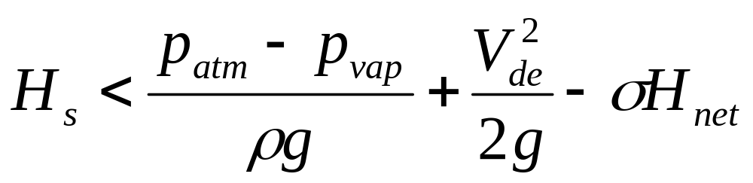
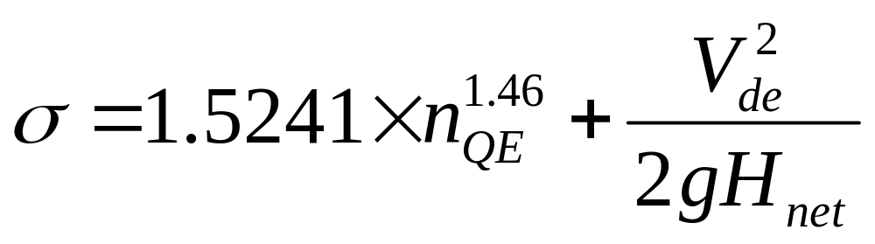
The suction head
The suction head H_{s} is the head where the turbine is installed;
if the suction head is positive, the turbine is located above the trail water;
if it is negative, the turbine is located under the trail water.
To avoid cavitation, the range of the suction head is limited.
The maximum allowed suction head can be calculated using the following equation:

Slide 40
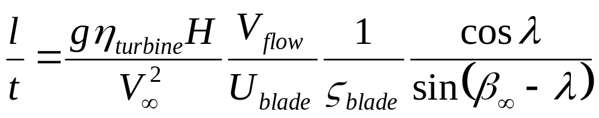
When the lifting coefficient is known, the sufficiency of ratio l/t can be established as follows:
Allowable values of angle of slip λ
2.5°-- 3°

Slide 41
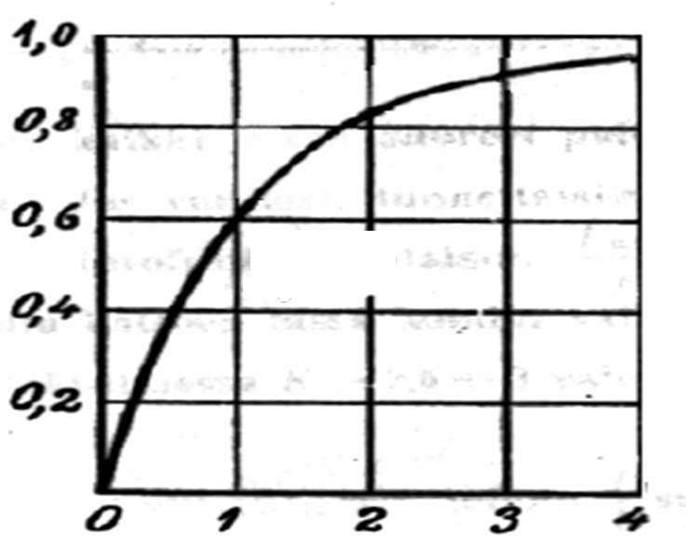
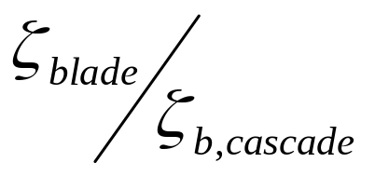
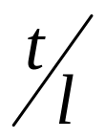
The actual Lifting Coefficient

Slide 42
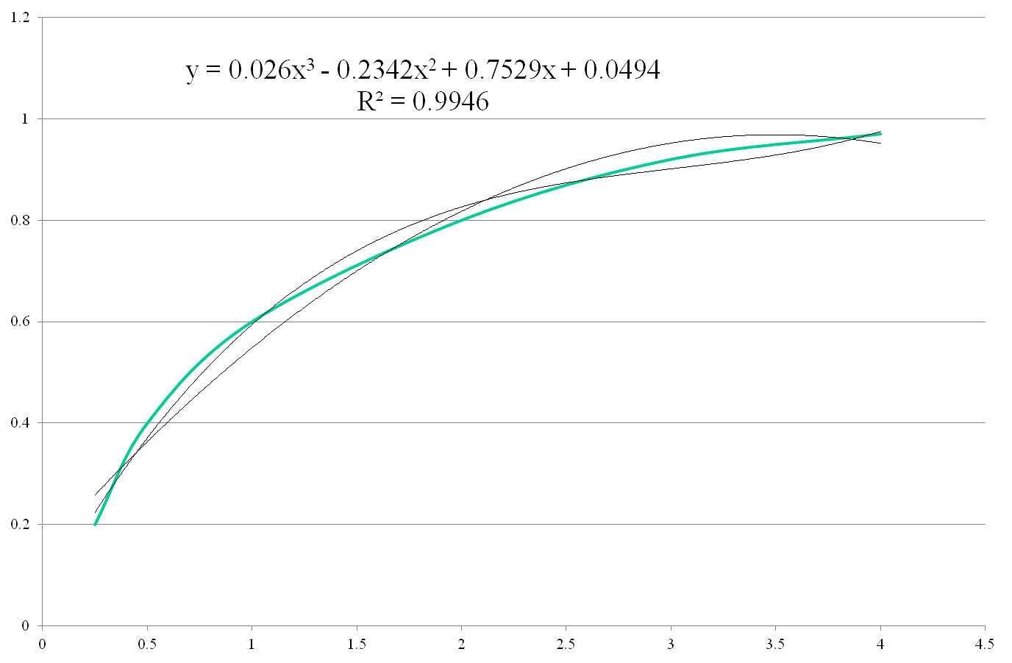

Slide 43



Drag Coefficient

Slide 44


Actual Angle of Attack

Slide 45

Calculation of Actual Angle of Slip

Slide 46

Details of Blade Arrangement
U_{wheel}
V_{ai}
V_{ri}
V_{fi}
U_{wheel}
V_{ae}
V_{re}
V_{fe}
α_{e} = 90⁰

Slide 48


Power Developed by the Runner
Power developed by a differential blade surface

